Slide 1
Databases
Computer Technology
Created by Cathy Tom at Mountain Ridge Junior High
NOTICE: This may not be used, altered, shared, sold, etc. without permission from the creator. This notice must remain on this slide show.

Slide 3
First Record
Last Record
New Record
Previous Record
Current Record
Next Record
Working with Microsoft Access (Database)
Continue

Slide 4
TABLE – Set up and display information
Field (column)
Record (row)
Continue

Slide 5
QUERY – Search or ask questions of the database
Just Girls
Continue

Slide 6
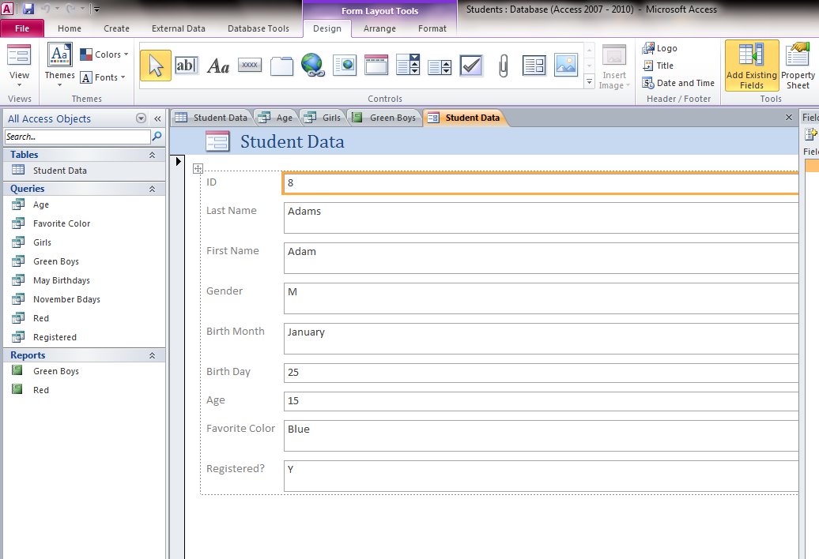
FORM– A simple way to enter information
Field – one piece of information
Record – all of the information for one item (in this case, one person)
Continue

Slide 7
REPORT – Displays final information in a nice format
Report – Boys whose favorite color is green
Continue

Slide 8
Get ready to practice

Slide 10
Practice
Where would you click to go to the next record (click the blue arrow)?
Incorrect – try again
Correct – click to go on
Incorrect – try again

Slide 12
Practice
Where would you click to go to the first record (click the blue arrow)?
Correct – click to go on
Incorrect – try again
Incorrect – try again

Slide 14
Practice
Where would you click to create a new record (click the blue arrow)?
Correct – click to go on
Incorrect – try again
Incorrect – try again

Slide 16
Practice
Which one would you use to set up information for the database?
Form
Report
Table
Query
Incorrect – try again
Incorrect – try again
Correct – click to go on
Incorrect – try again

Slide 18
Practice
Which one would you use to search the database?
Form
Report
Table
Query
Incorrect – try again
Incorrect – try again
Incorrect – try again
Correct – click to go on

Slide 20
Practice
Which one would you use to easily enter information for the database?
Form
Report
Table
Query
Correct – click to go on
Incorrect – try again
Incorrect – try again
Incorrect – try again

Slide 22
Practice
Which one would you use to display your final results?
Form
Report
Table
Query
Incorrect – try again
Correct – click to go on
Incorrect – try again
Incorrect – try again

Slide 23
The End
Practice Again

