Slide 1
Chapter 1 Section 1 Review
The Study of Geography & Basic Map Skills

Slide 2
Fill in the key words to the definition of Geography:
Geography is concerned with how
_____ uses ______ through ______ to ______ the earth.

Slide 3
Answer
Fill in the key words to the definition of Geography:
Geography is concerned with how mankind uses nature through culture to organize the earth.

Slide 4
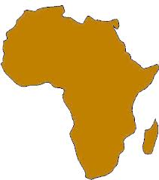
Name the following:

Slide 5
Africa
Name the following:

Slide 6
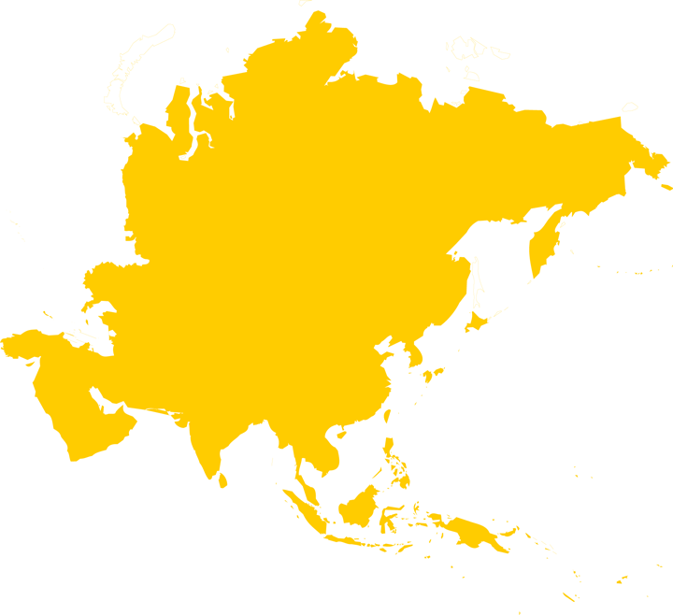
Name the following:

Slide 7
Asia
Name the following:

Slide 8
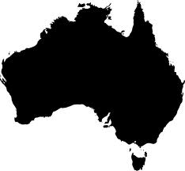
Name the following:

Slide 9
Australia
Name the following:

Slide 10
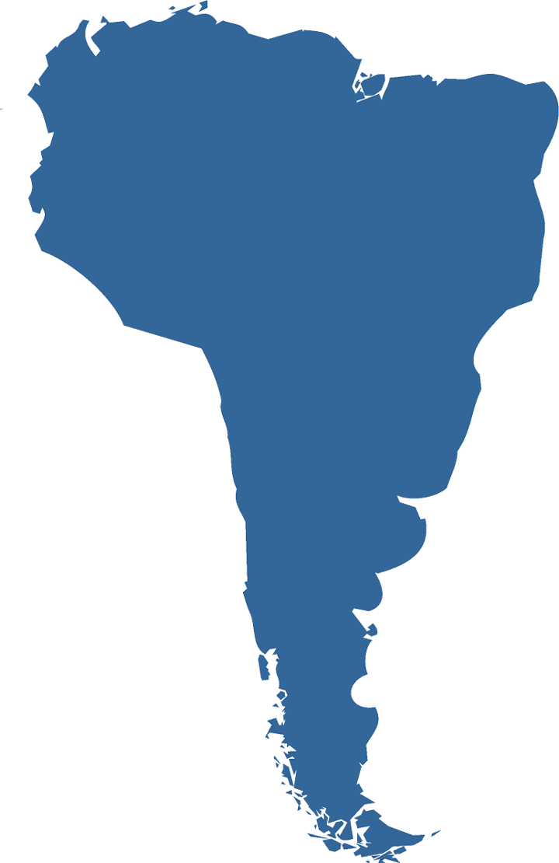
Name the following:

Slide 11
South America
Name the following:

Slide 12
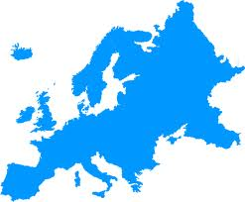
Name the following:

Slide 13
Europe
Name the following:

Slide 14
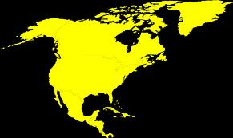
Name the following:

Slide 15
North America
Name the following:

Slide 16
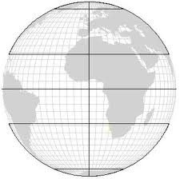
What is the name of letter “B”
A
B
F
C
D
E

Slide 17
What is the name of letter “B”
A
B
Tropic of Cancer
F
C
D
E

Slide 18
What is the name of letter “E”
A
B
F
C
D
E

Slide 19
What is the name of letter “E”
A
B
F
C
D
E
Antarctic Circle

Slide 20
What is the name of letter “F”
A
B
F
C
D
E

Slide 21
What is the name of letter “F”
A
B
F
Prime Meridian
C
D
E

Slide 22
What is the name of letter “C”
A
B
F
C
D
E

Slide 23
What is the name of letter “C”
A
B
F
Equator
C
D
E

Slide 24
Turn to page 16-17 in the World Geography Book
Calculate the latitude & longitude of Atlanta, Georgia

Slide 25
Turn to page 16-17 in the World Geography Book
Calculate the latitude & longitude of Atlanta, Georgia
33° N 84° W

Slide 26
Turn to page 16-17 in the World Geography Book
What is located at 42° N 117° W?

Slide 27
Turn to page 16-17 in the World Geography Book
What is located at 42° N 118° W?
Winnemucca, Nevada

Slide 28
Turn to page 16-17 in the World Geography Book
Calculate the latitude & longitude of Tampa, Florida

Slide 29
Turn to page 16-17 in the World Geography Book
Calculate the latitude & longitude of Tampa, Florida
27° N 83° W

Slide 30
Turn to page 16-17 in the World Geography Book
What is located at 44° N 72° W?

Slide 31
Turn to page 16-17 in the World Geography Book
What is located at 44° N 72° W?
Concord, New Hampshire

Slide 32
Turn to page 26 in the World Geography Book
Calculate the latitude & longitude of Perth, Australia

Slide 33
Turn to page 26 in the World Geography Book
Calculate the latitude & longitude of Perth, Australia
32° S 117° E

Slide 34
Turn to page 26 in the World Geography Book
What is located at 7° N 159° E

Slide 35
Turn to page 26 in the World Geography Book
What is located at 7° N 159° E
Palikir

Slide 36
Vocabulary
What word describes
Imaginary lines that measure north-south distance

Slide 37
Vocabulary
What word describes
Imaginary lines that measure north-south distance
Latitude

Slide 38
Vocabulary
What word means
How things are spread out on the surface of the earth

Slide 39
Vocabulary
What word means
How things are spread out on the surface of the earth
distribution

Slide 40
Vocabulary
What word describes
A method of gathering data from far distances

Slide 41
Vocabulary
What word describes
A method of gathering data from far distances
Remote sensing

Slide 42
Vocabulary
What word describes
the traditions, buildings, food and language that make places unique

Slide 43
Vocabulary
What word describes
the traditions, buildings, food and language that make places unique
Cultural characteristics

Slide 44
Vocabulary
What word describes
A place’s exact or specific position on the globe

Slide 45
Vocabulary
What word describes
A place’s exact or specific position on the globe
Absolute location

Slide 46
Vocabulary
What word describes
The shrinking or stretching that changes the original size or shape when making a map

Slide 47
Vocabulary
What word describes
The shrinking or stretching that changes the original size or shape when making a map
distortion

Slide 48
Vocabulary
What word describes
A person who makes or designs maps

Slide 49
Vocabulary
What word describes
A person who makes or designs maps
cartographer

Slide 50
Vocabulary
What word describes
An imaginary line that circles the globe halfway between the North and South Poles

Slide 51
Vocabulary
What word describes
An imaginary line that circles the globe halfway between the North and South Poles
Equator

Slide 52
Vocabulary
What word describes
A navigation system that uses satellites and receivers to pinpoint locations

Slide 53
Vocabulary
What word describes
A navigation system that uses satellites and receivers to pinpoint locations
GPS (Global Positioning System)

Slide 54
Vocabulary
What word is used to
Compare the distance on a map to the distance on the earth?

Slide 55
Vocabulary
What word is used to
Compare the distance on a map to the distance on the earth?
Scale

Slide 56
Vocabulary
What word describes
A group of places with one or more common characteristics

Slide 57
Vocabulary
What word describes
A group of places with one or more common characteristics
Region

Slide 58
What does it mean to organize something geographically?

Slide 59
What does it mean to organize something geographically?
To organize things according to WHERE they are
Or Spatially

Slide 60
What are the 4 basic parts to a map? (You need all 4)

Slide 61
What are the 4 basic parts to a map? (You need all 4)
Title, scale, key or legend, directional indicator (compass rose, or lat/long)

Slide 62
Fields of Geography
What field or specialty of Geography would most likely study the weather, ocean currents, vegetation zones, etc.?

Slide 63
Fields of Geography
What field or specialty of Geography would most likely study the weather, ocean currents, vegetation zones, etc.?
Physical Geography

Slide 64
Fields of Geography
What field or specialty of Geography would most likely study languages, religion, and values?

Slide 65
Fields of Geography
What field or specialty of Geography would most likely study languages, religion, and values?
Cultural Geography

Slide 66
Fields of Geography
What is Geospatial Technology?

Slide 67
Fields of Geography
What is Geospatial Technology?
Computers, satellites, and aerial photography used to gather, process, and analyze information about the earth. It is also used to produce maps.
Google earth is a common application of geospatial technology, but it is also used in many jobs in business, military, government, education and agriculture.

Slide 68
What is the major distortion on the Mercator Projection?

Slide 69
What is the major distortion on the Mercator Projection?
The SIZE of places away from the equator.

Slide 70
Geographers are concerned with the movement of what three things?

Slide 71
Geographers are concerned with the movement of what three things?
People, goods, and ideas

Slide 72
Geographic Questions
Write a geographic question on the following topic:
The Presidential Election

Slide 73
Geographic Questions
Write a geographic question on the following topic:
The Presidential Election
Answers vary.
Should include a spatial aspect (not who will win).

Slide 74
Homework
Review your study guide!
Review your vocabulary (about 40% of test)
You will be writing an essay during the test (see study guide for topics)

