Slide 1
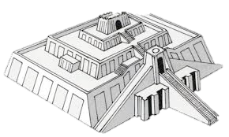
Mesopotamia

Slide 2
Timeline of Mesopotamian People
Mesopotamians

Slide 3
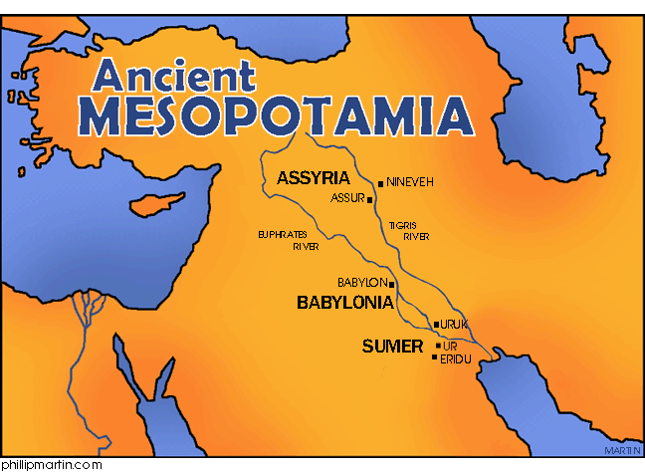

Slide 4
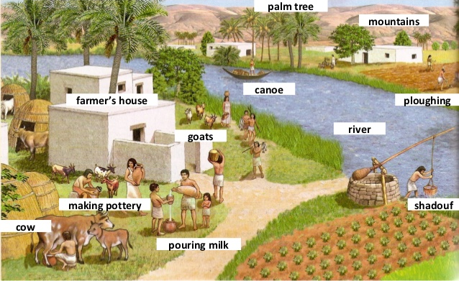
Farming in Mesopotamia

Slide 5
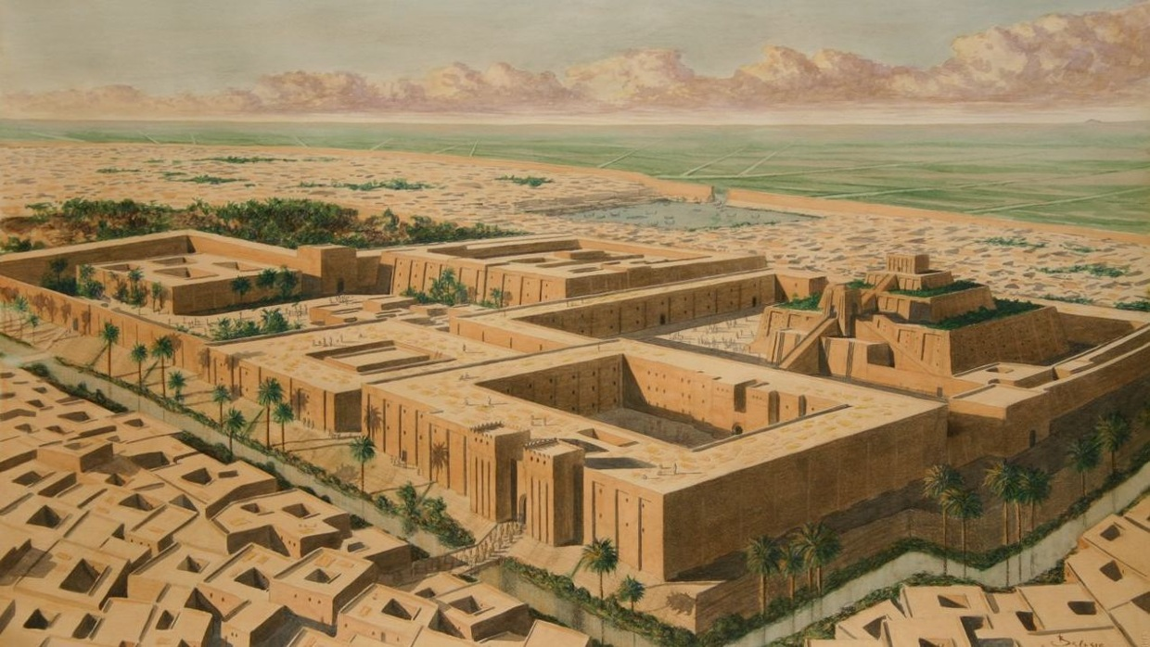
1. Mesopotamian Religion

Slide 6
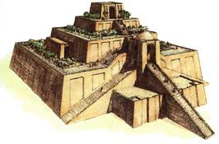
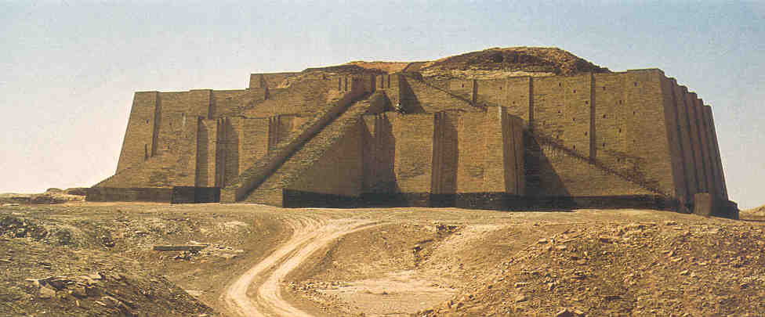
Sumerian Religion
Polytheistic
Built temples called Ziggurats
Worshiped Gods at the Ziggurats

Slide 7
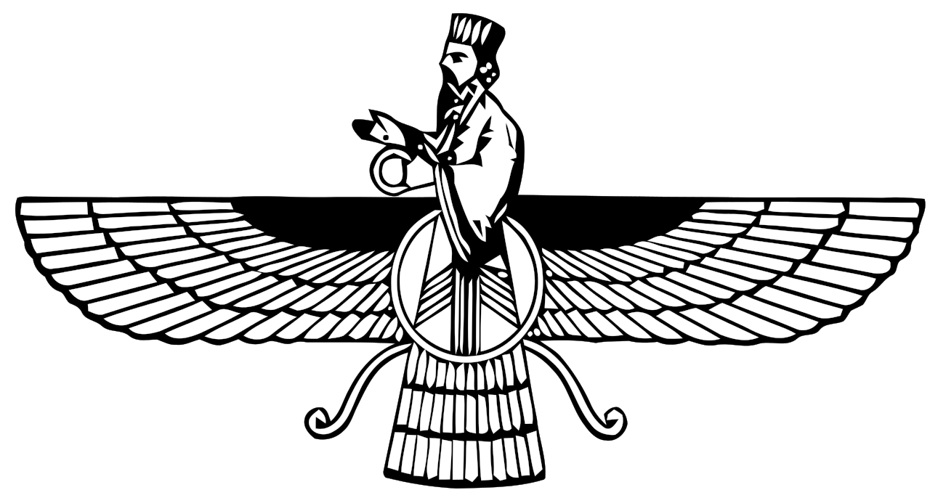
Examine: Persian Religion
Monotheistic
Zoroastrianism

Slide 8
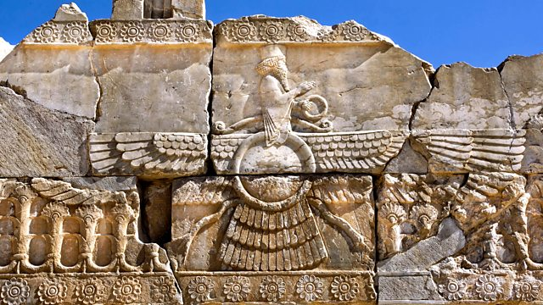
Examine Artifact
Observe + Infer: Whole Class

Slide 9
Examine Artifact
Observe + Infer: Whole Class

Slide 10
II. Mesopotamian Writing

Slide 11
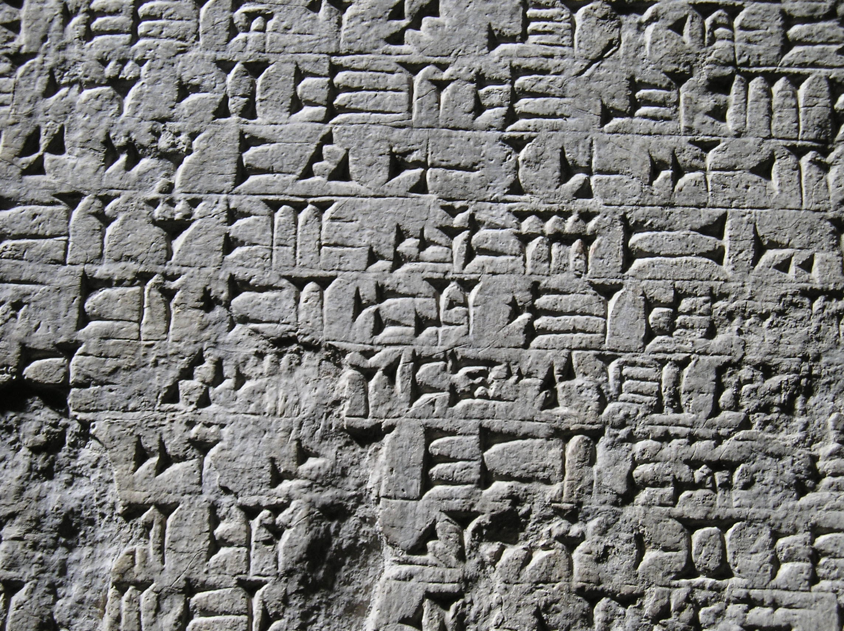
Sumerian Cuneiform
First written language
Pressed into clay tablets
Symbols that represent ideas

Slide 13
Examine: Phoenician's Phonetic Alphabet
Sailors and traders across Mediterranean Sea
Created Phonetic Alphabet
Letters that represent sounds
Group letters together to make a word (sound familiar?!)
Spread alphabet to new civilizations by trade

Slide 15
Examine Artifact
Observe + Infer: Partnerships

Slide 16
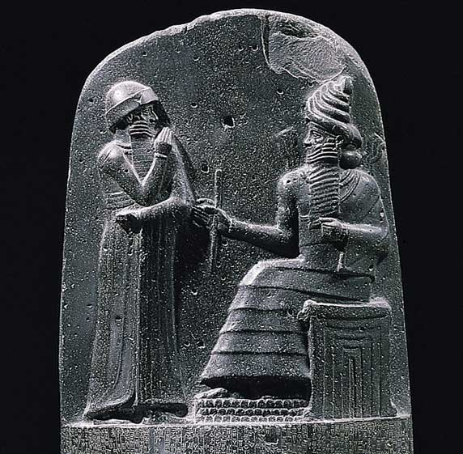
III. Mesopotamian Government

Slide 17
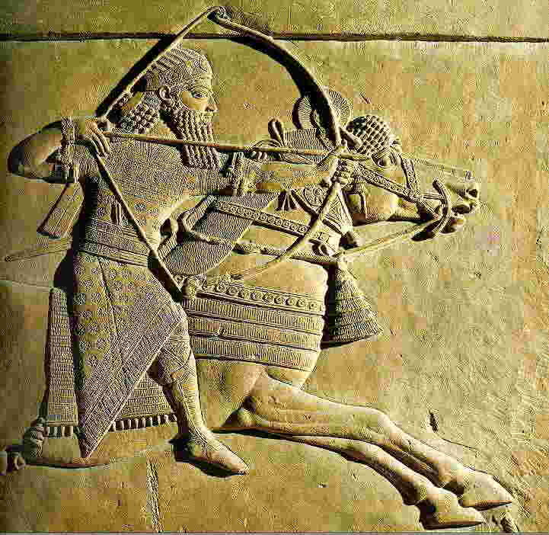
Assyrian Army
Strongest Mesopotamian army
1st army to ever use iron tools and weapons
Empire only lasted 200 years

Slide 18
Examine: Sumerian Code of Hammurabi
First written laws EVER!
Written by King Hammurabi in 1792 BC
282 laws and consequences

Slide 19
Examples of Law #1
If a builder builds a house and the house collapses and kills the owner of the house, the builder shall be put to death. If the house collapses and kills the owner’s son, then the son of the builder shall be put to death.

Slide 20
Examples of Law #2
If a fire breaks out in a house and a person who helps to put out the fire steals something from the house, that person shall be thrown into the fire.

Slide 21
Examine Artifact
Observe + Infer: On your own
1. If a physician kills a patient or cuts out a patient’s eye when trying to remove a tumor, the physicians’ hands will be cut off.
2. If a person steals from a temple or takes goods stolen from the temple, he shall be put to death.
3. If a son hits his father, his hands shall be cut off.
4. If a man’s wife becomes sick, the husband may take a second wife but must continue to care for the sick wife as long as she lives.

