Slide 1
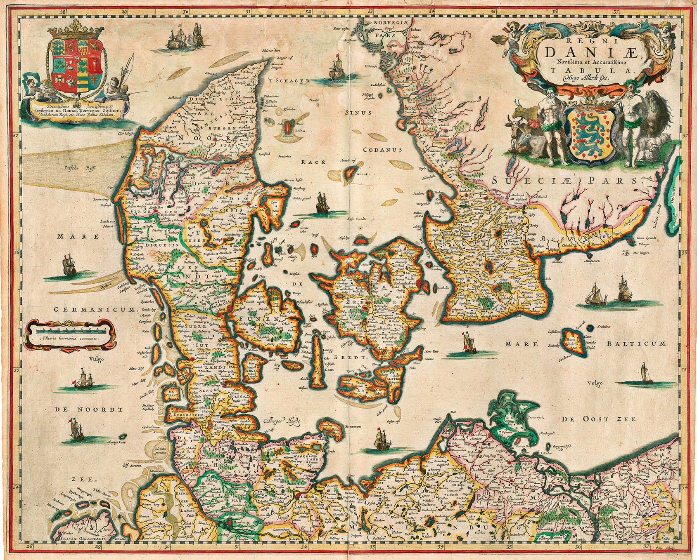
Mapping

Slide 2
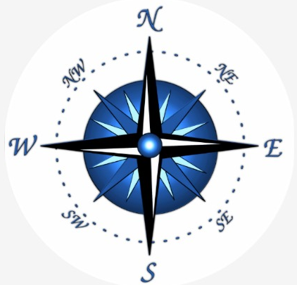
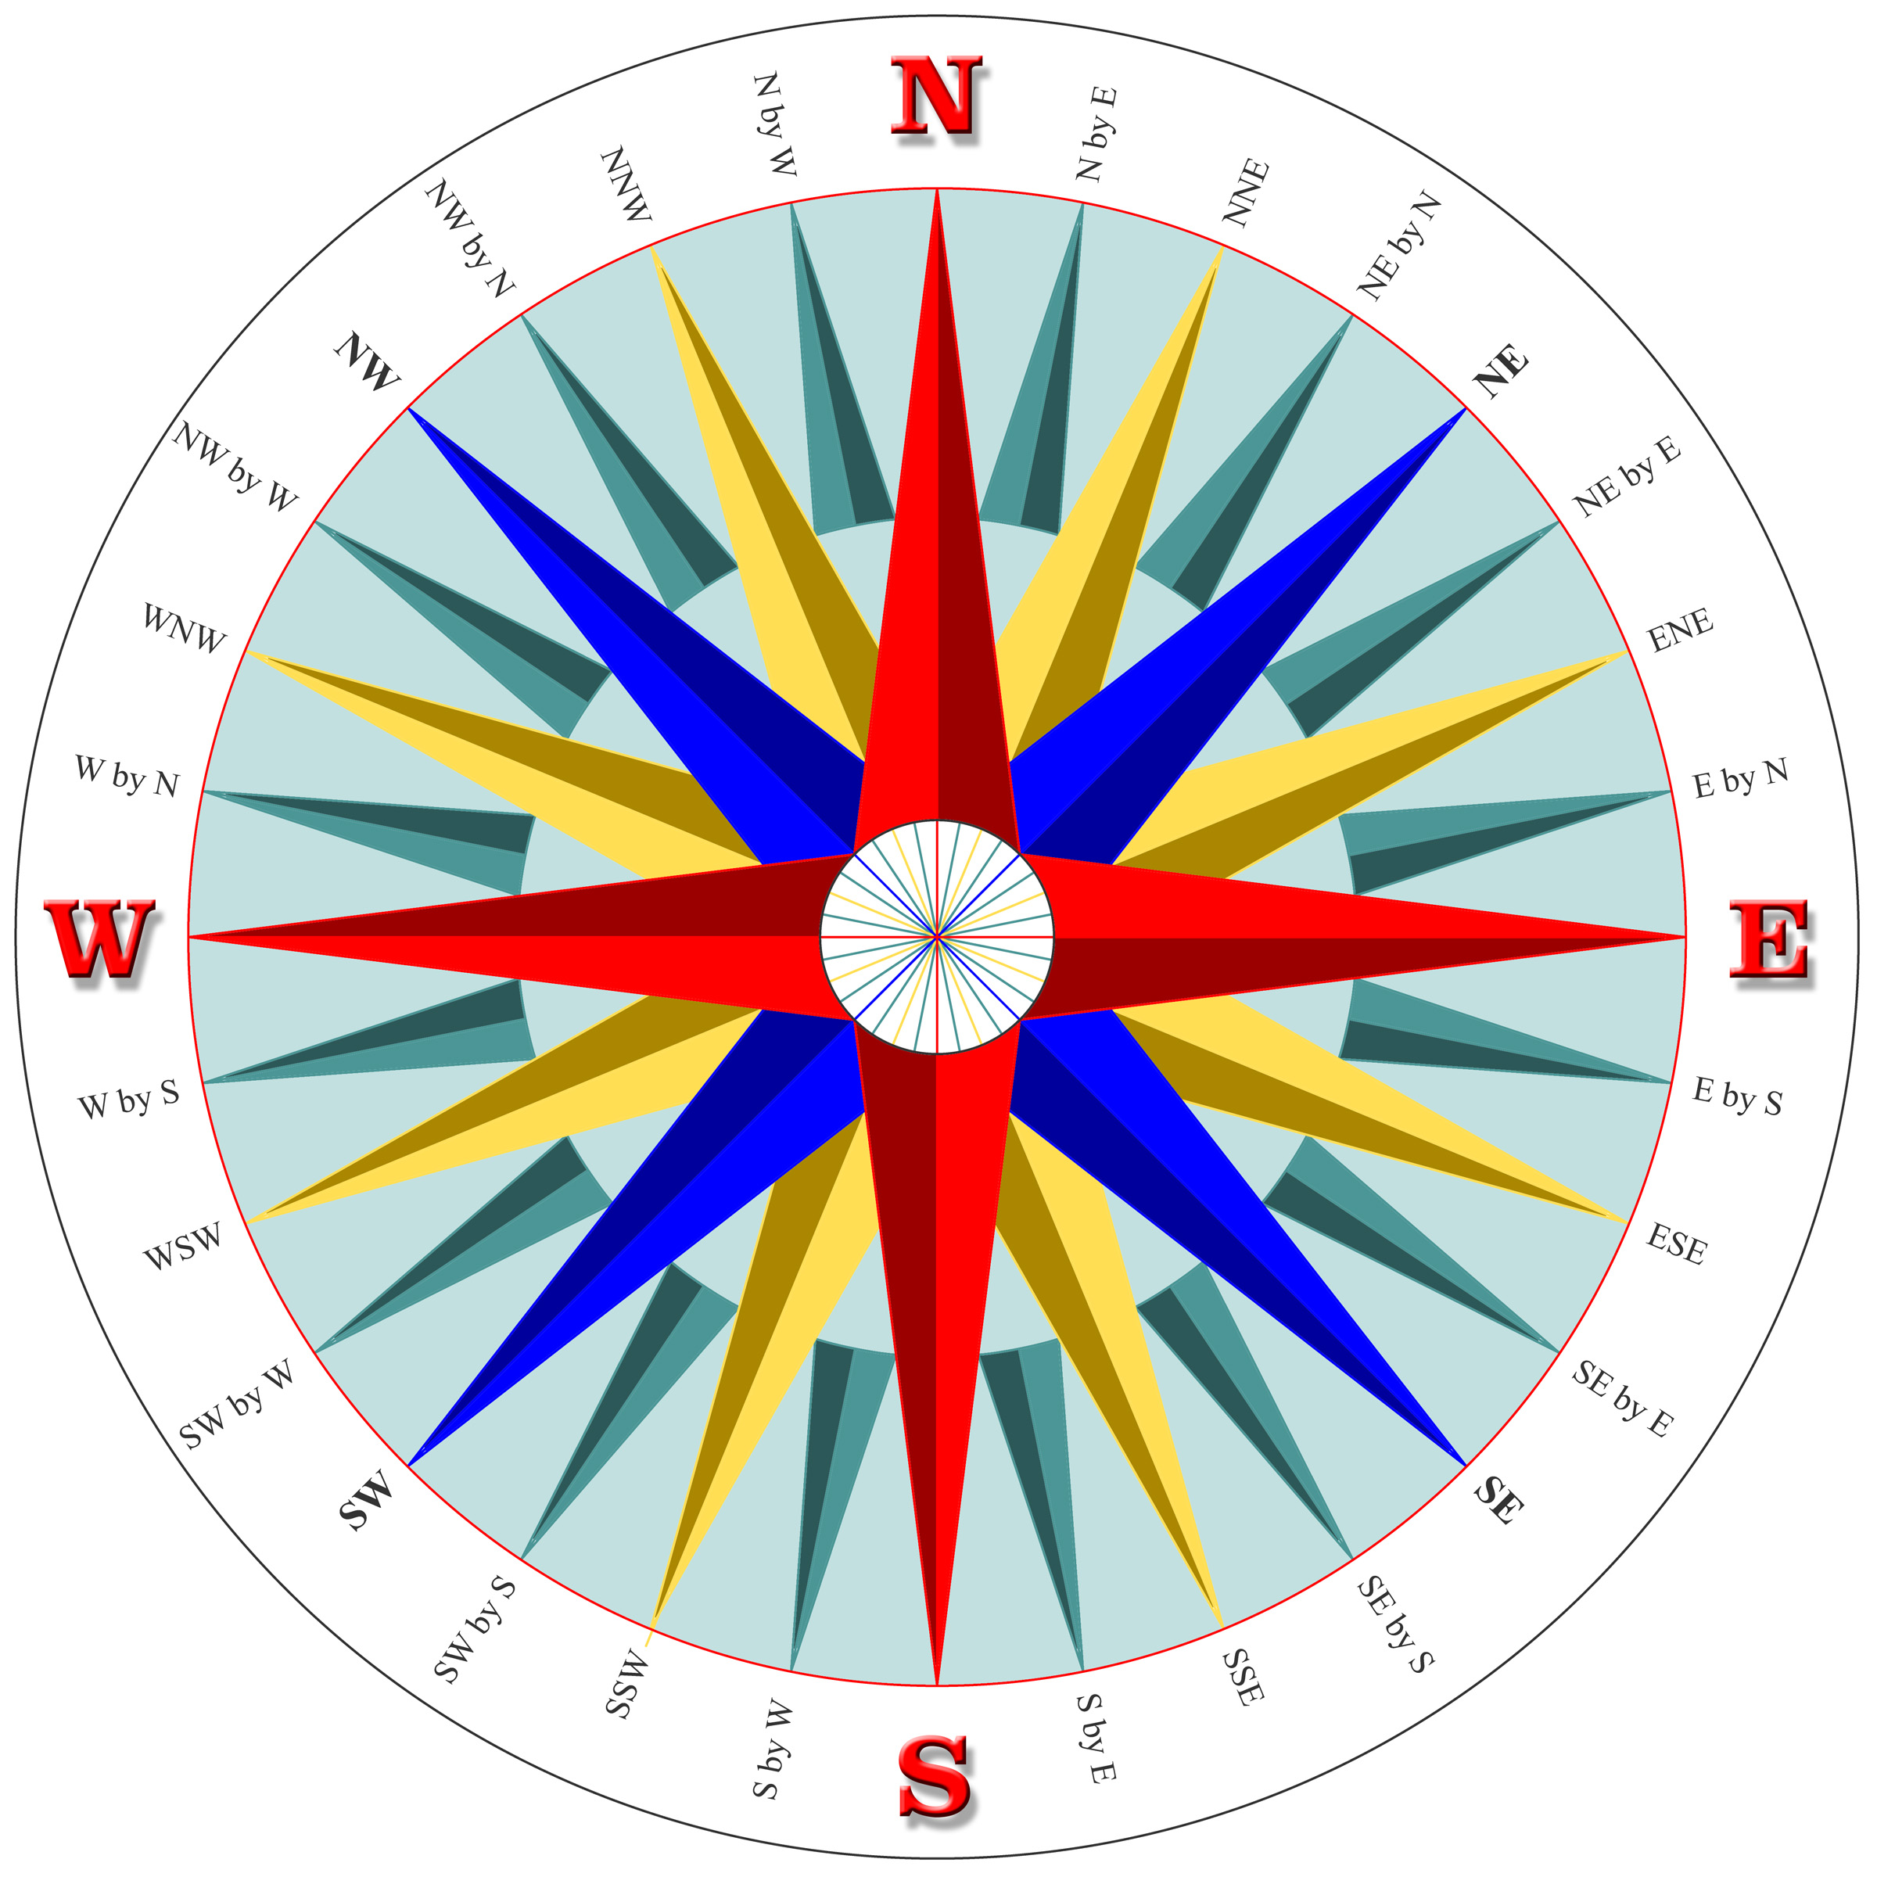
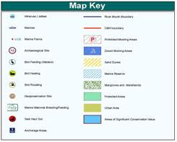
I. 5 Parts of a Map
Key: Explains what symbols mean
Scale: Distance on the ground compared to distance on a map
Compass: Directions on a map
Title: Explains what the map is about
Grid: Latitude and Longitude

Slide 3
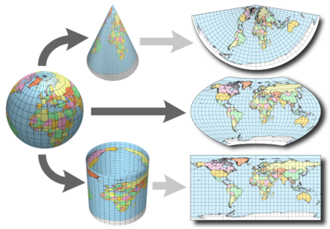
II. Map Projections and Distortions

Slide 4
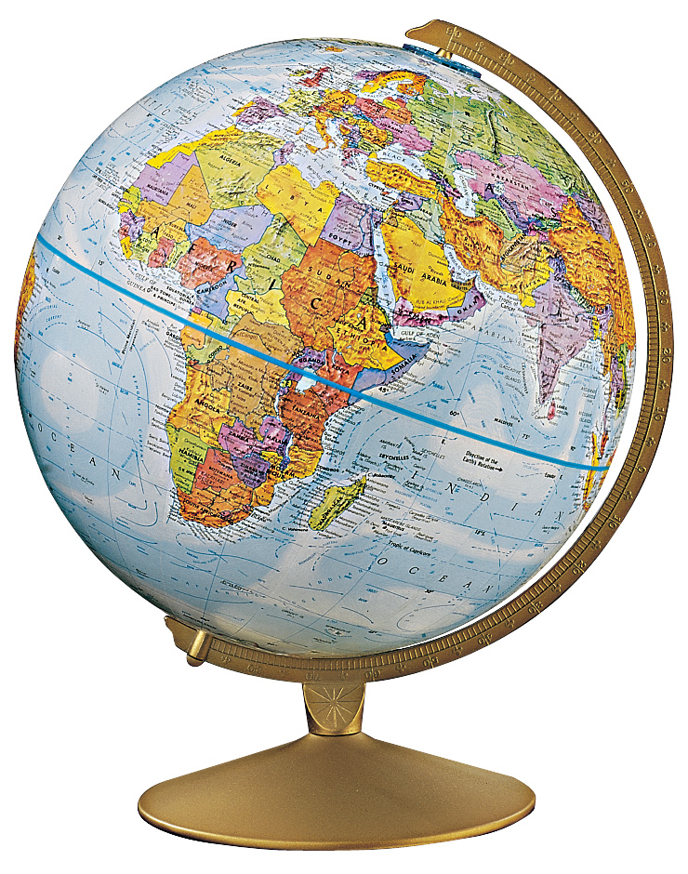
Map vs. Globe
DISTORTIONS!!!

Slide 5
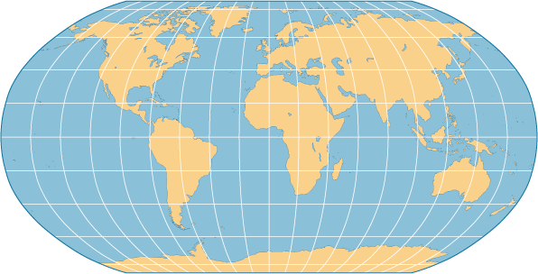
Robinson Projection

Slide 6
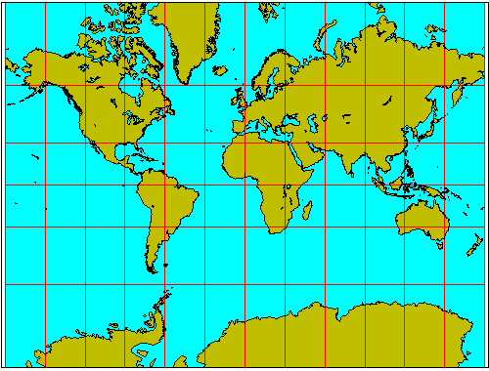
Mercator Projection

Slide 7
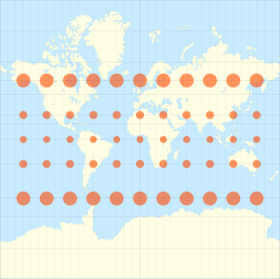
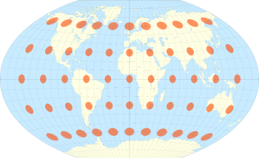
Distortions
Robinson
Mercator

Slide 8
Distortions Video

Slide 9
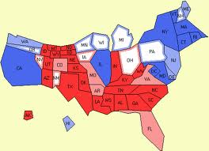
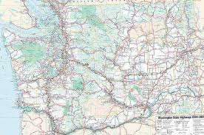
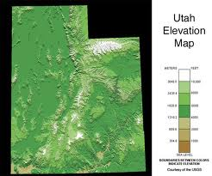
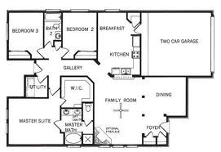
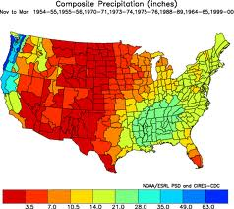
III. Types of Maps:

Slide 10
Cartogram: shows data by changing size
http://www.worldmapper.org/

Slide 11
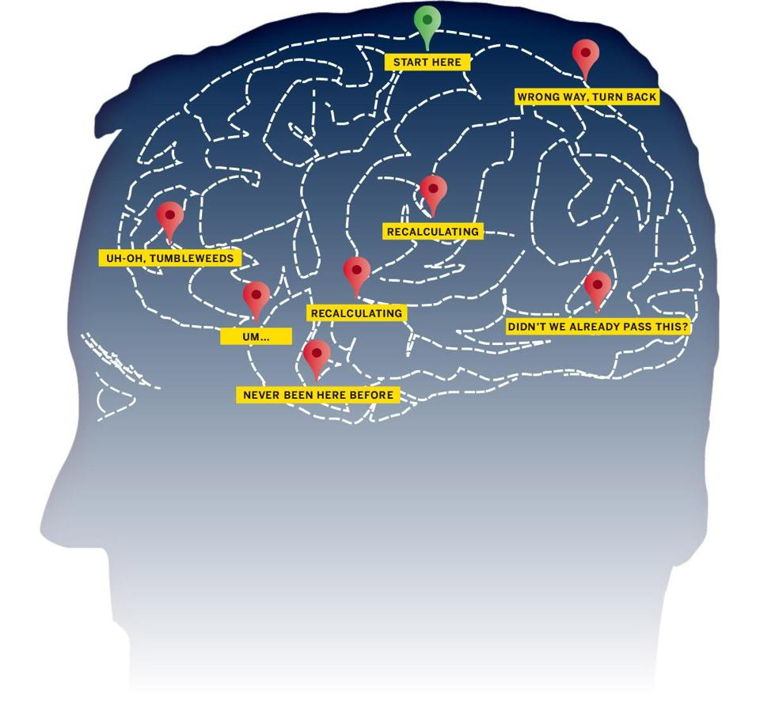
Mental Mapping
Do you need a map to get from your locker to to the library?
Do you need a map to get from your house to your best friends house?
Could you give directions to someone on how to get to the Mall?
If the power goes at your house, could you get to your kitchen in the dark?

