Slide 1
Latitude and Longitude

Slide 2
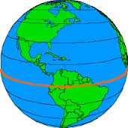
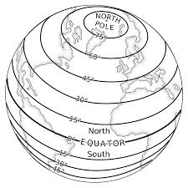
L A T I T U D E
0 degrees Latitude = Equator
Splits earth into N and S Hemispheres
Latitude lines measure the distance N or S of the Equator

Slide 3
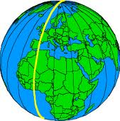
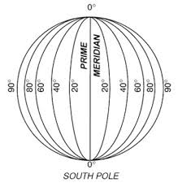
L O N G I T U D E
0 degrees Long. = Prime Meridian
Splits earth into E and W Hemispheres
Longitude measures distance E or W of Prime Meridian

Slide 4
Now lets practice!

