Slide 1

I. Development of Middle Eastern Civilization

Slide 2
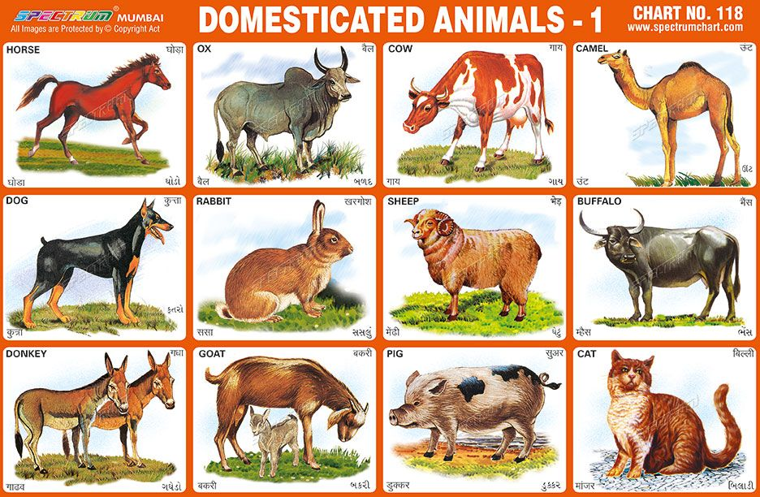
This means the taming of wild plants and animals???????
DOMESTICATION
One around plants
The other around animals

Slide 3
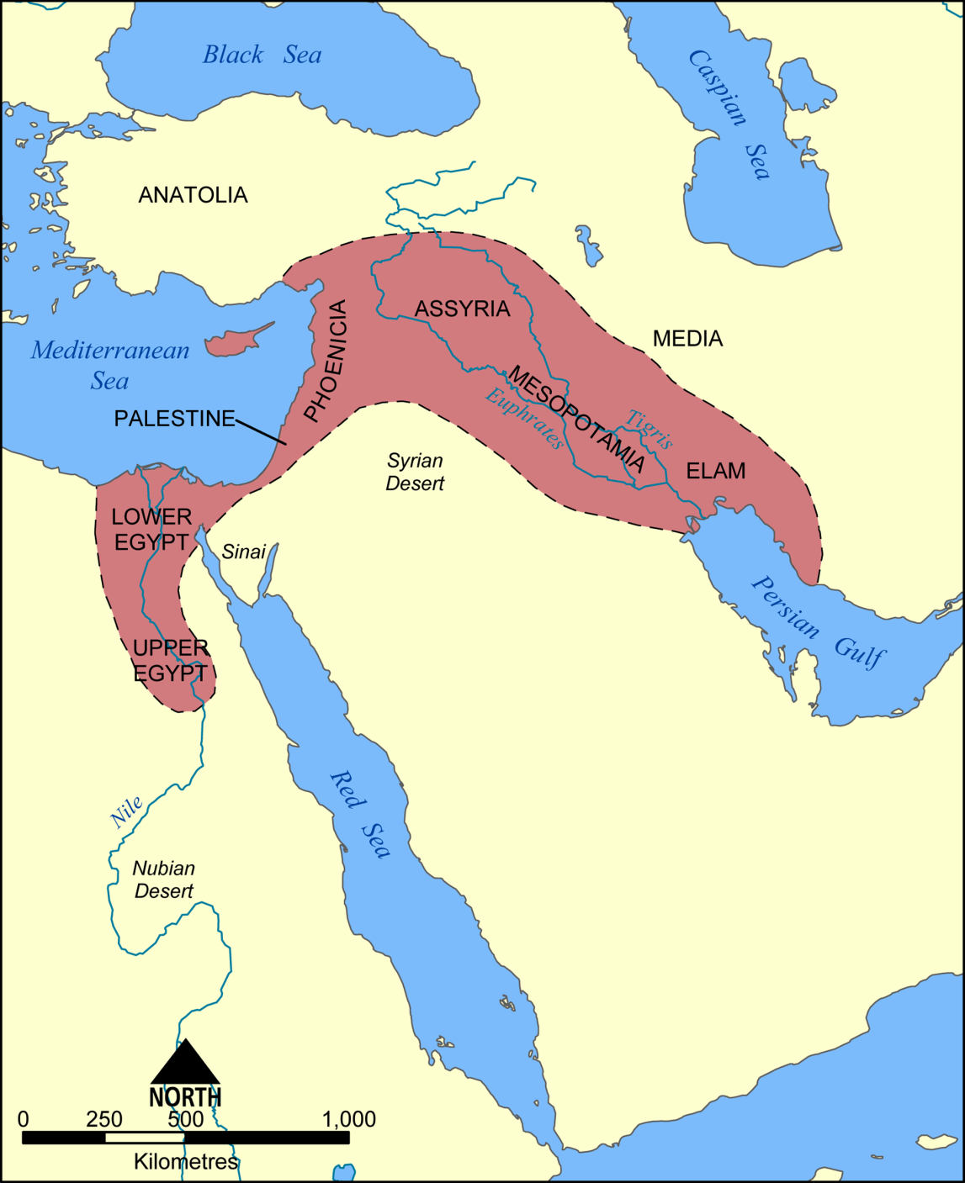
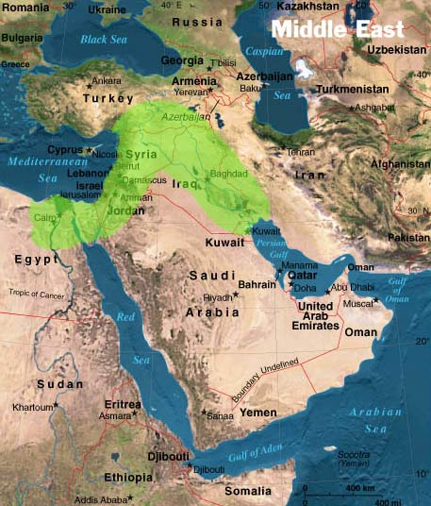
Location: Fertile Crescent
Rich farmland
between the
Persian Gulf
and the
Mediterranean Sea

Slide 4
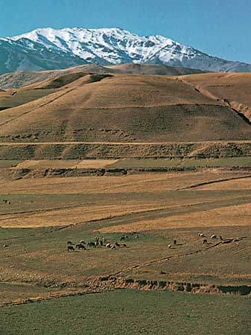
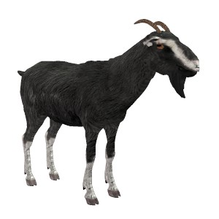

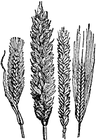
Why did domestication first occur in the mountains????
Rainfall
2. Animals
3. Natural Grasses

Slide 5
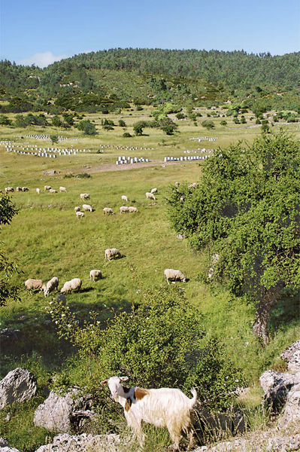
Land with vegetation used for grazing livestock . . .
Pasture

Slide 6
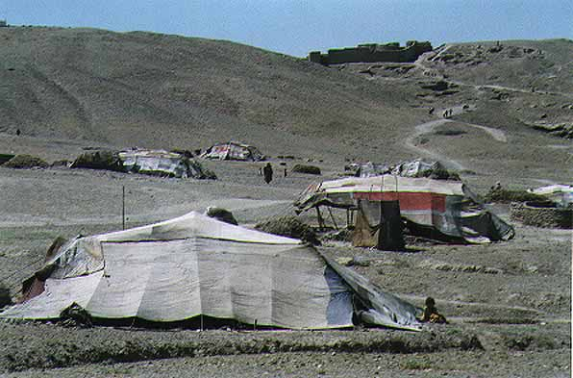
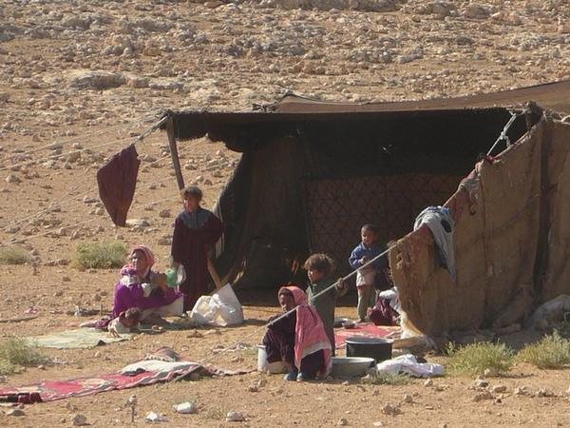
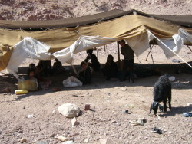
Nomads

Slide 7
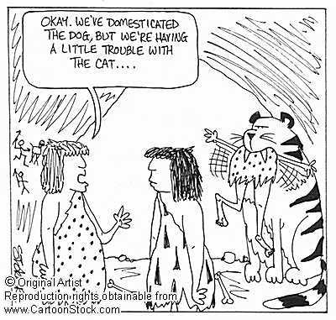

Slide 8
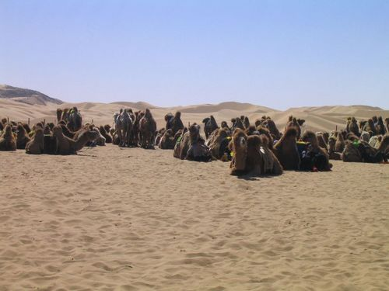
Later, camel domestication began in the Arabian Peninsula and spread throughout the Middle East.

Slide 9
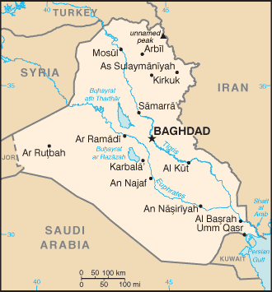
Baghdad
Why is this ancient city located here?

Slide 10
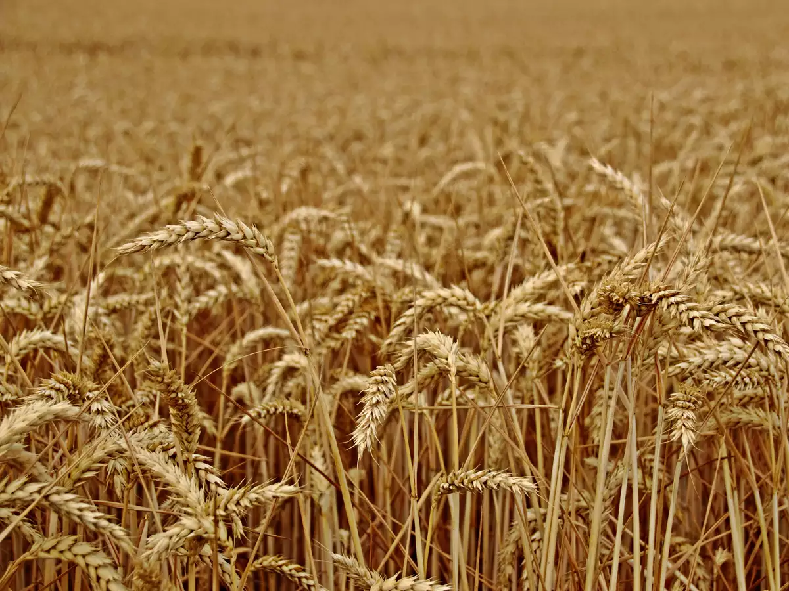
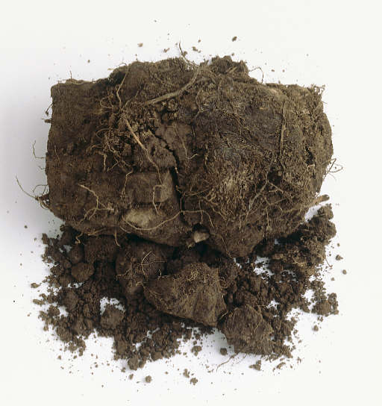
Mesopotamia
“between two rivers”
Wheat and Barley =
plants
The 2 rivers??
The Tigris and Euphrates
The land is fertilized by
silt

Slide 11
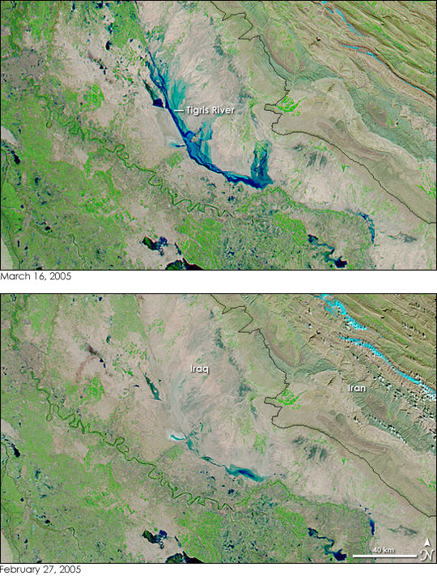
Silt deposits through flooding

Slide 12
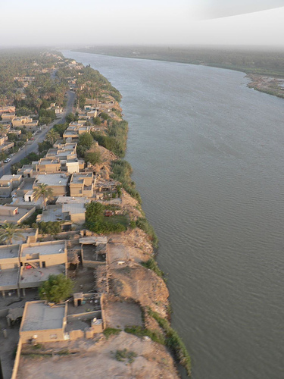
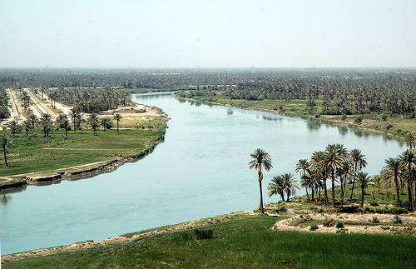
Tigris
Euphrates

Slide 13
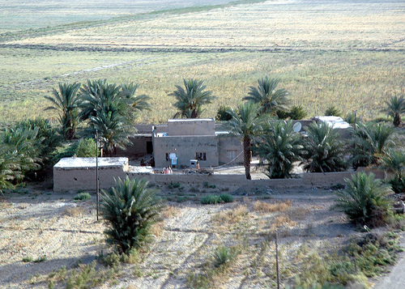
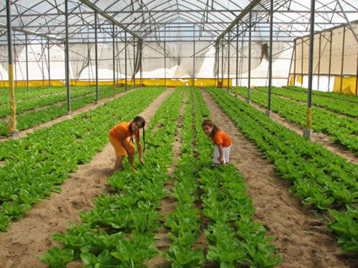
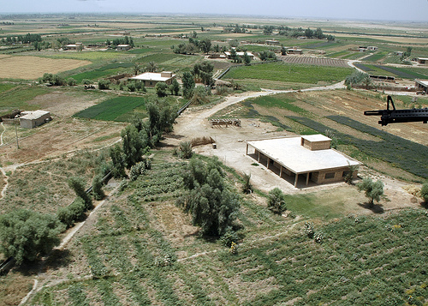

Slide 14
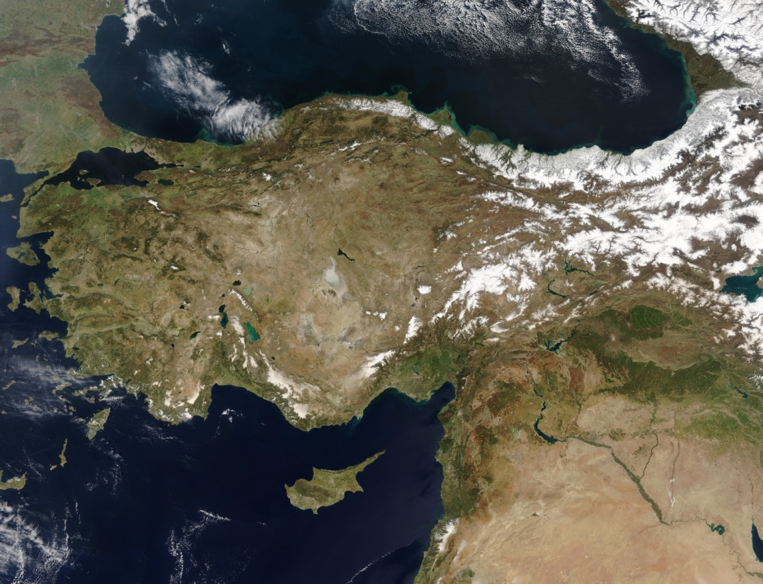
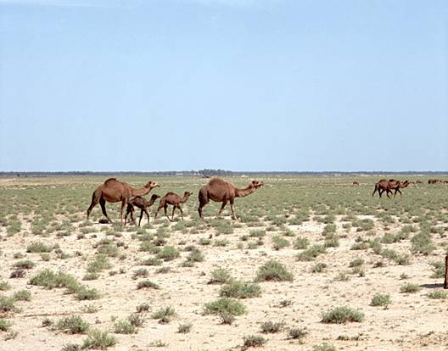
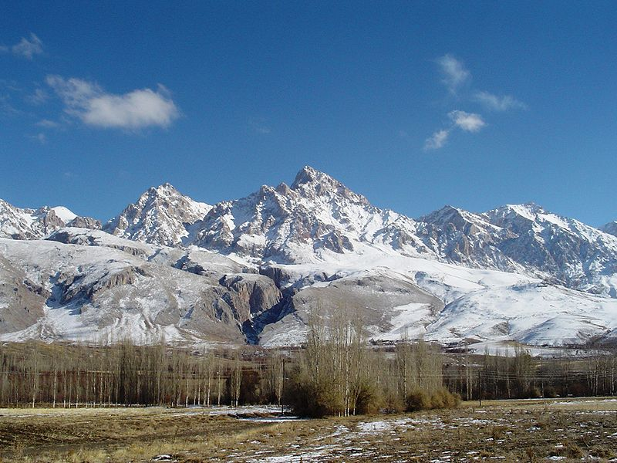
Mesopotamia is naturally dry, so the level of the rivers depended on rainfall or snowfall in Asia Minor (Turkey)

Slide 15
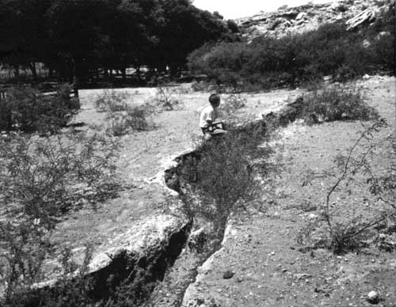
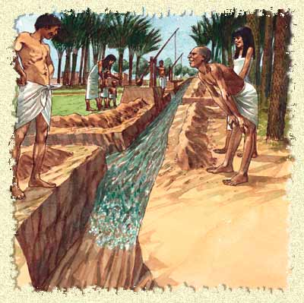
Irrigation by canals

Slide 16
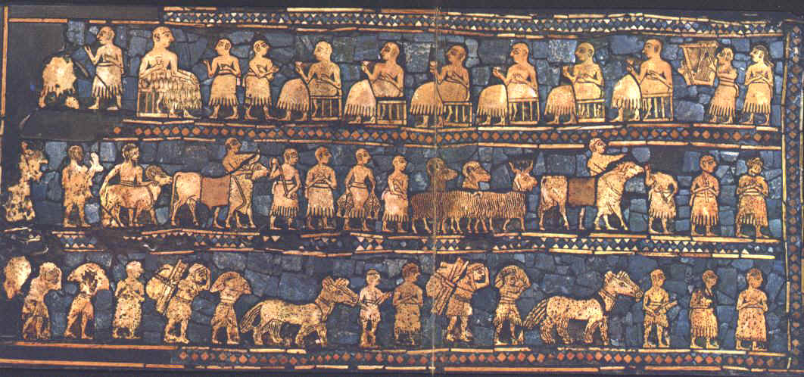
Specialization
A division of labor that leads to more food, crafts and technology

Slide 17
Specialization
A division of labor that leads to more food, crafts and technology

Slide 18
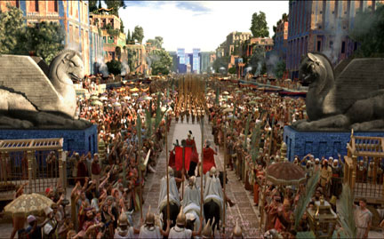
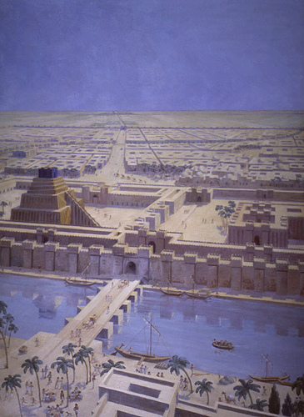
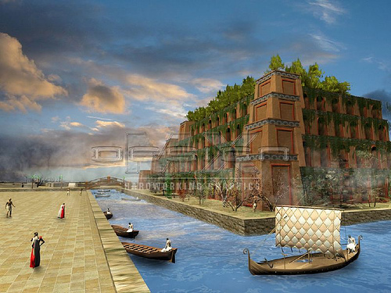
Urbanization

Slide 19
II. The Civilizations of the
Middle East

Slide 20
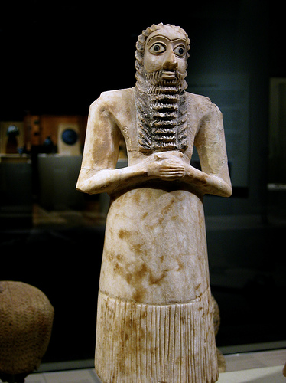
~4000 B.C.
Sumerians
Polytheistic??
Pg. 34-35

Slide 21
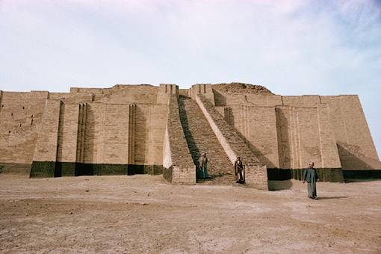
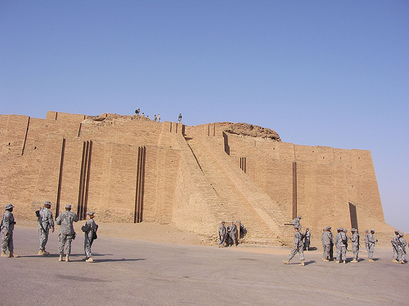
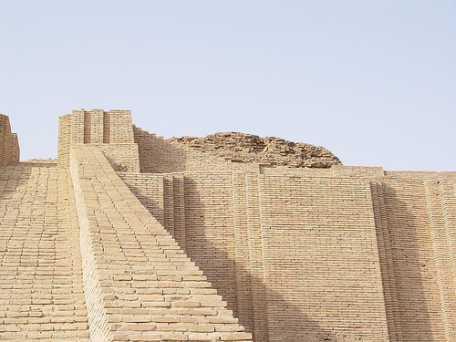
Place of worship
Stairway to Heaven
ziggurat

Slide 22
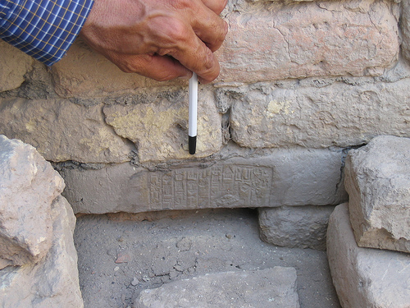
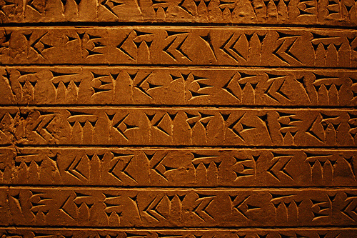
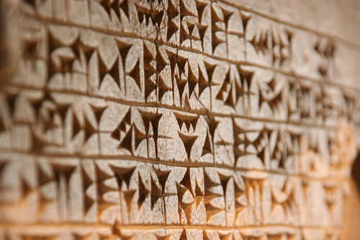
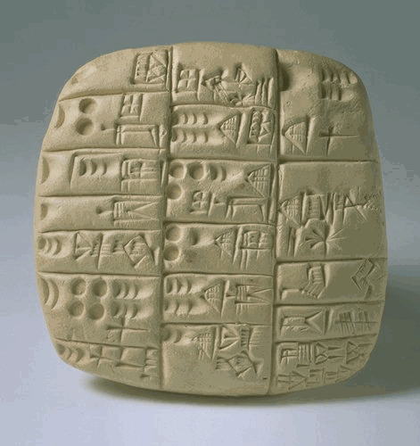
Ancient writing system . . .
Cuneiform

Slide 23
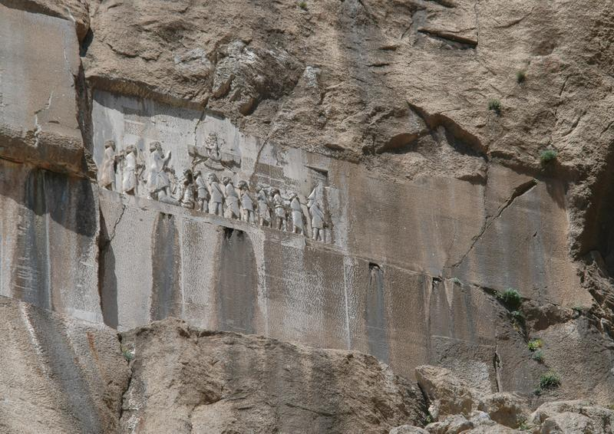
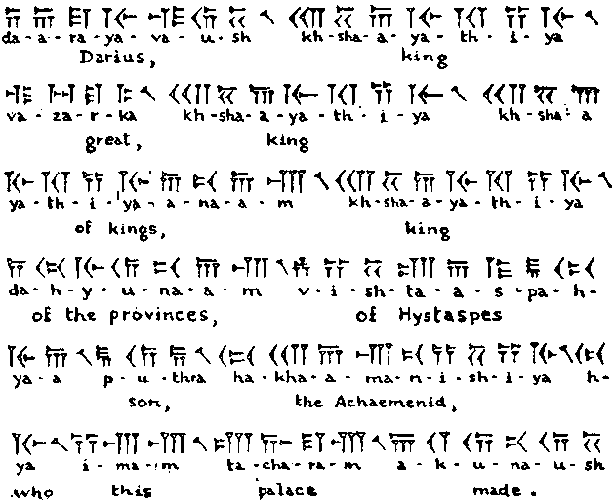
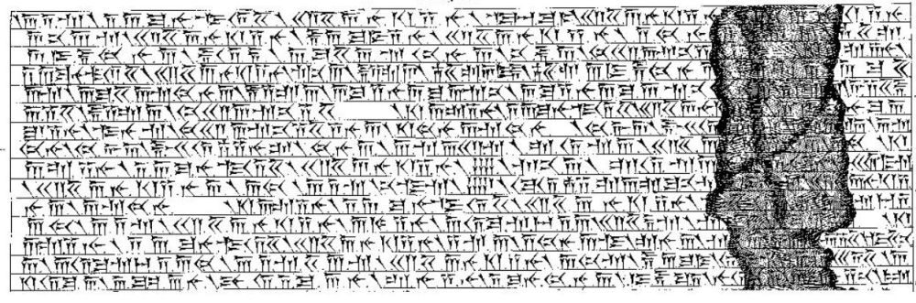
Behistun Rock
Henry Rawlinson spent years translating to understand cuneiform writing

Slide 24
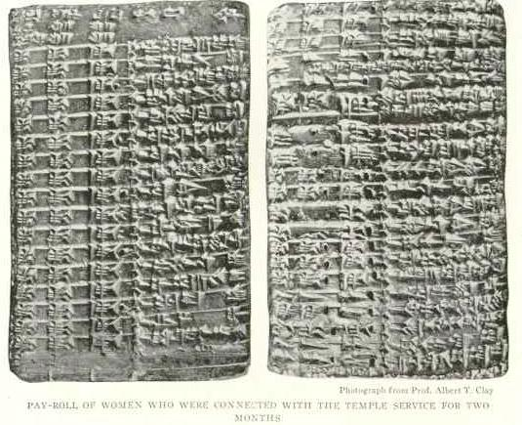
payroll

Slide 25
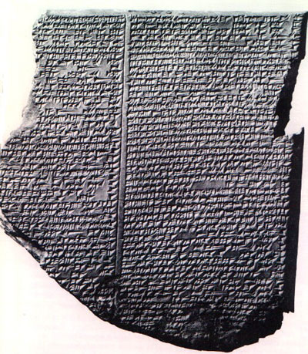
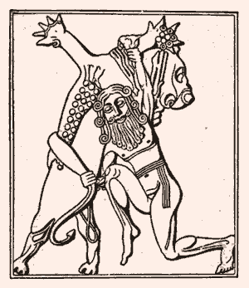
Epic of Gilgamesh
The Epic of Gilgamesh is an ancient poem written in Mesopotamia more than four thousand years ago. The poem tells of a great flood that covers the earth many years earlier, making it similar to the story of Noah in the Old Testament of the Jewish and Christian holy books.

Slide 26
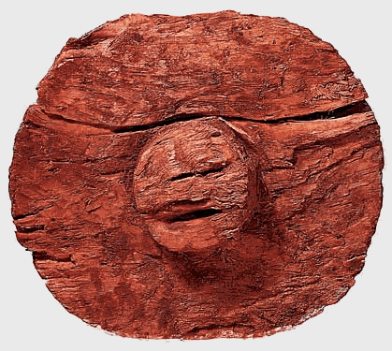

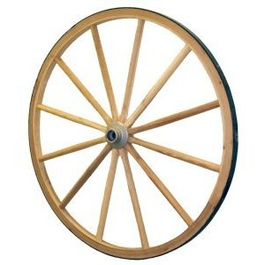
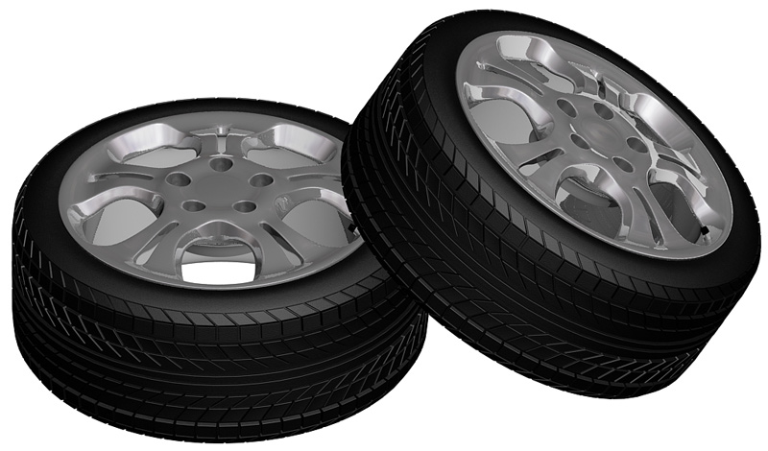
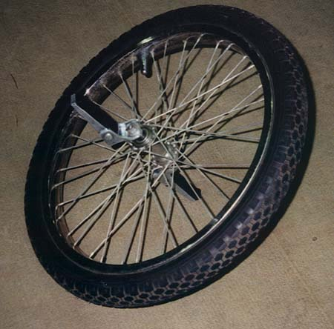
Other achievements
Wheel

Slide 27
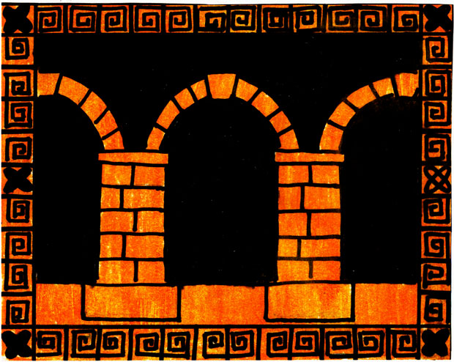
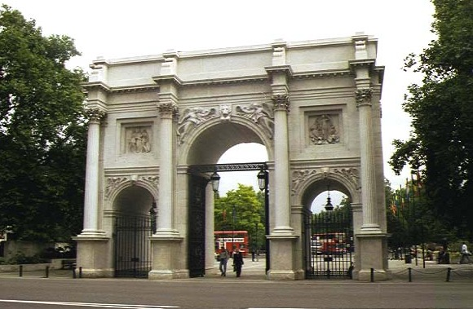



Arch

Slide 28
Although there was trade, there was no large governing body.
Thus, city-states were:
INDEPENDENT

Slide 29

~ 1900 B.C. Babylonians

Slide 30

Babylon

Slide 31

Babylonian Contributions
Mathematics
  Base 60 math (60 seconds in a minute, 60 minutes in an hour, 360 degrees in a circle)
  Did algebra, square root, doubling time, quadratic formula, and Pythagorean theorem
Science
  “Archimedes” screw to lift water

Slide 32


Written legal code
Hammarabi
This made the government responsible for justice and punishment.

