Slide 1
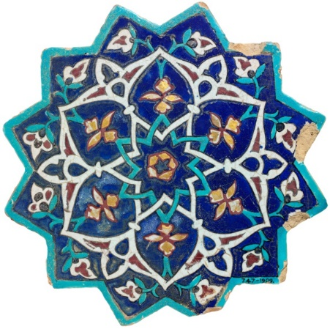
Middle East-North Africa Gallery
Directions:
Part 1
1) View all of the images in the gallery (slide show).
2) After viewing the Gallery once, go back and select 4 images that caught your attention or peaked your curiosity that you want to examine more closely
3) Carefully examine 4 images. Fill out the Middle East-North Africa Gallery Sheet as you describe each photo (observation), make an inference about what the picture tells you about the region, and write one question you have about each image.
Part 2 (See last slide)
1) Once you have completed the process for each of the 4 images you chose, Pick two of the topics listed in bold. Type the topics you chose in the space provided on the Middle East Gallery Sheet.
2) Comment on how you think the Middle East has contributed to that aspect of human activity. (This can be based on inferences you made from the pictures you examined, or knowledge you already have about this region.) You must write at least one complete sentence for each topic.
Reminder: When viewing photos, you make better inferences when you ask yourself questions like:
“Would I see this everyday or just on special occasions?” (Think of the US on Halloween).
“Does this represent something common in the region or did the person take the photo because it is unusual?”

Slide 2
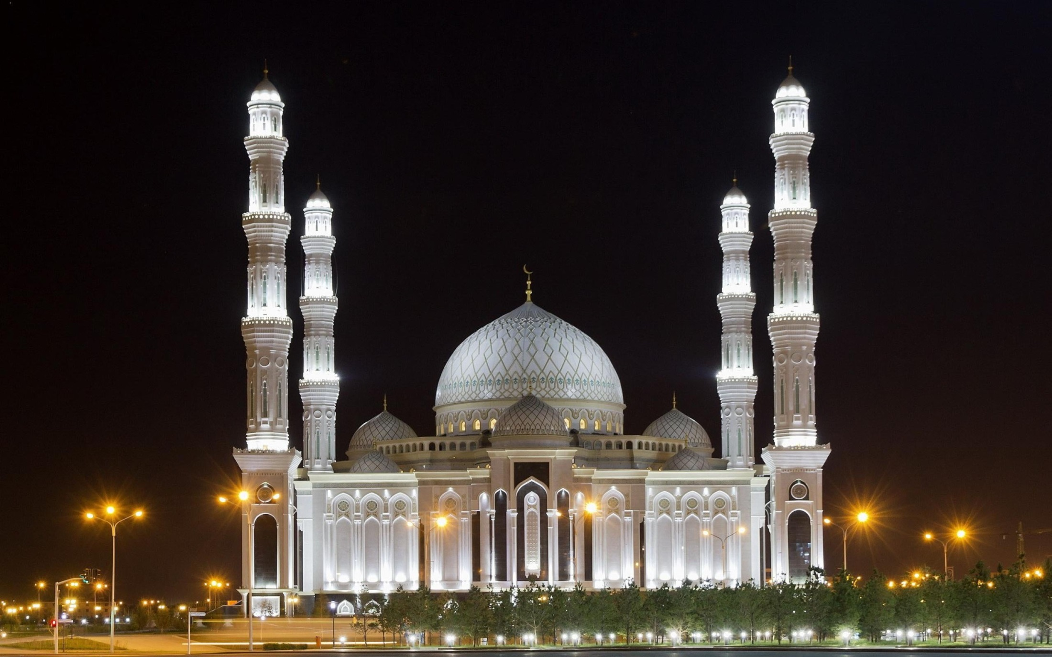
Part 1

Slide 3
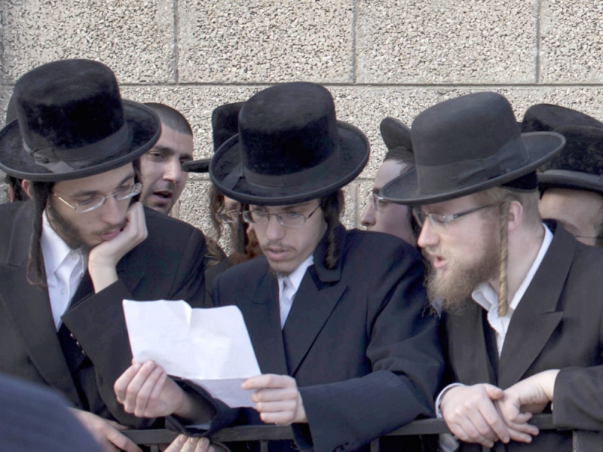

Slide 4
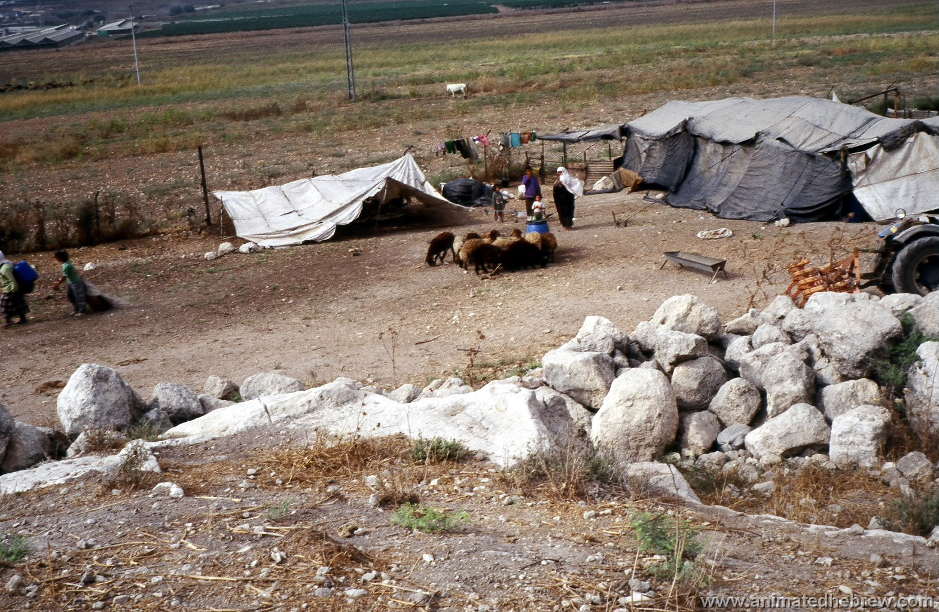

Slide 5
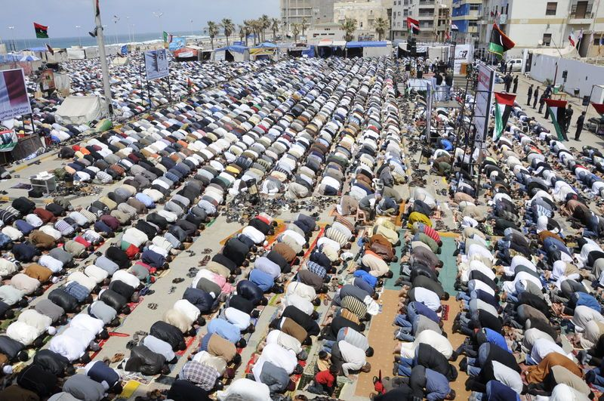

Slide 6
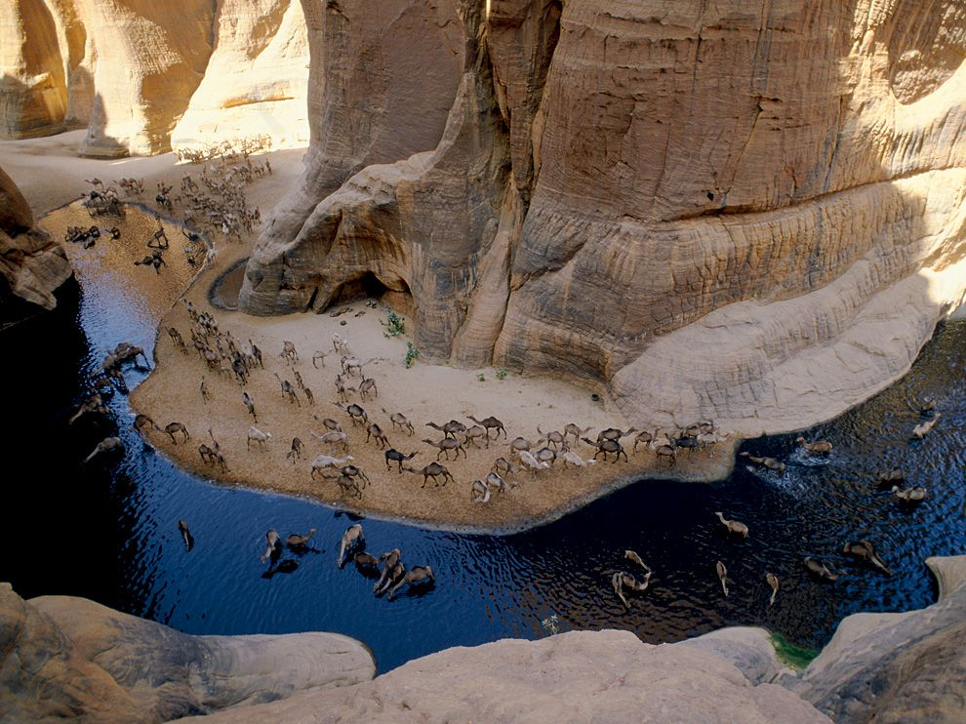

Slide 7
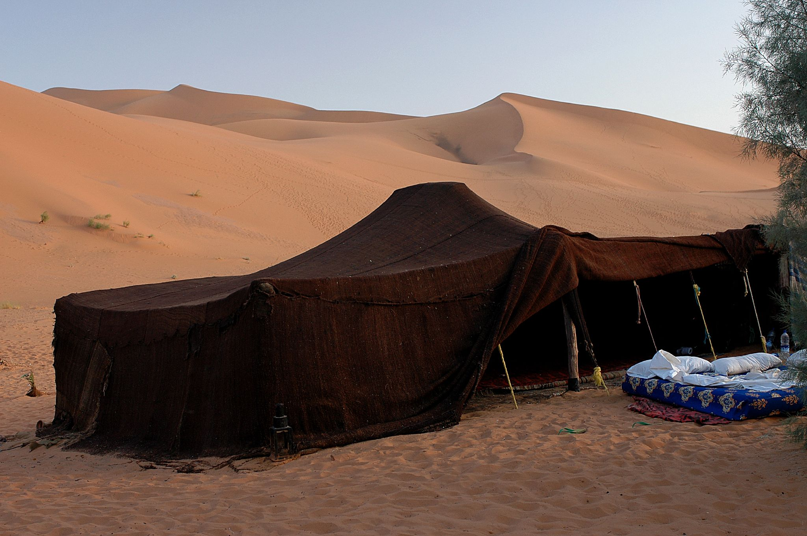

Slide 8
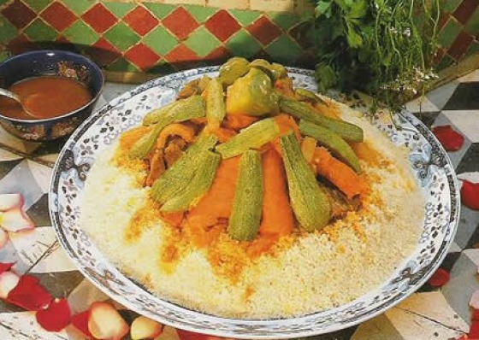

Slide 9
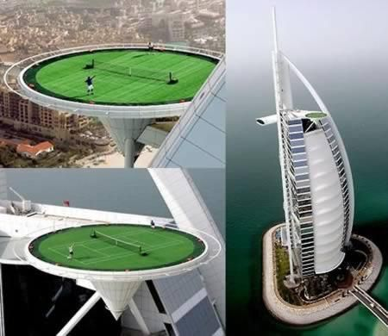
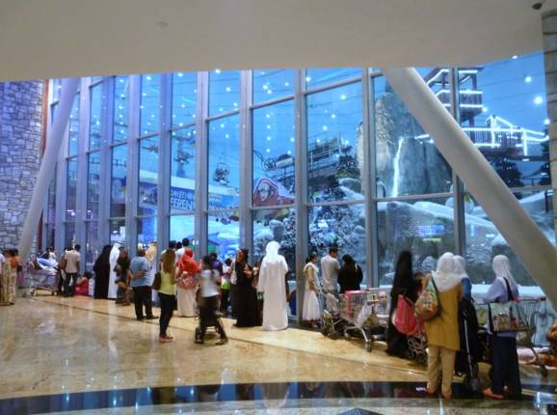
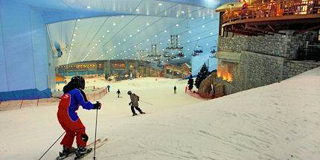
Dubai

Slide 10
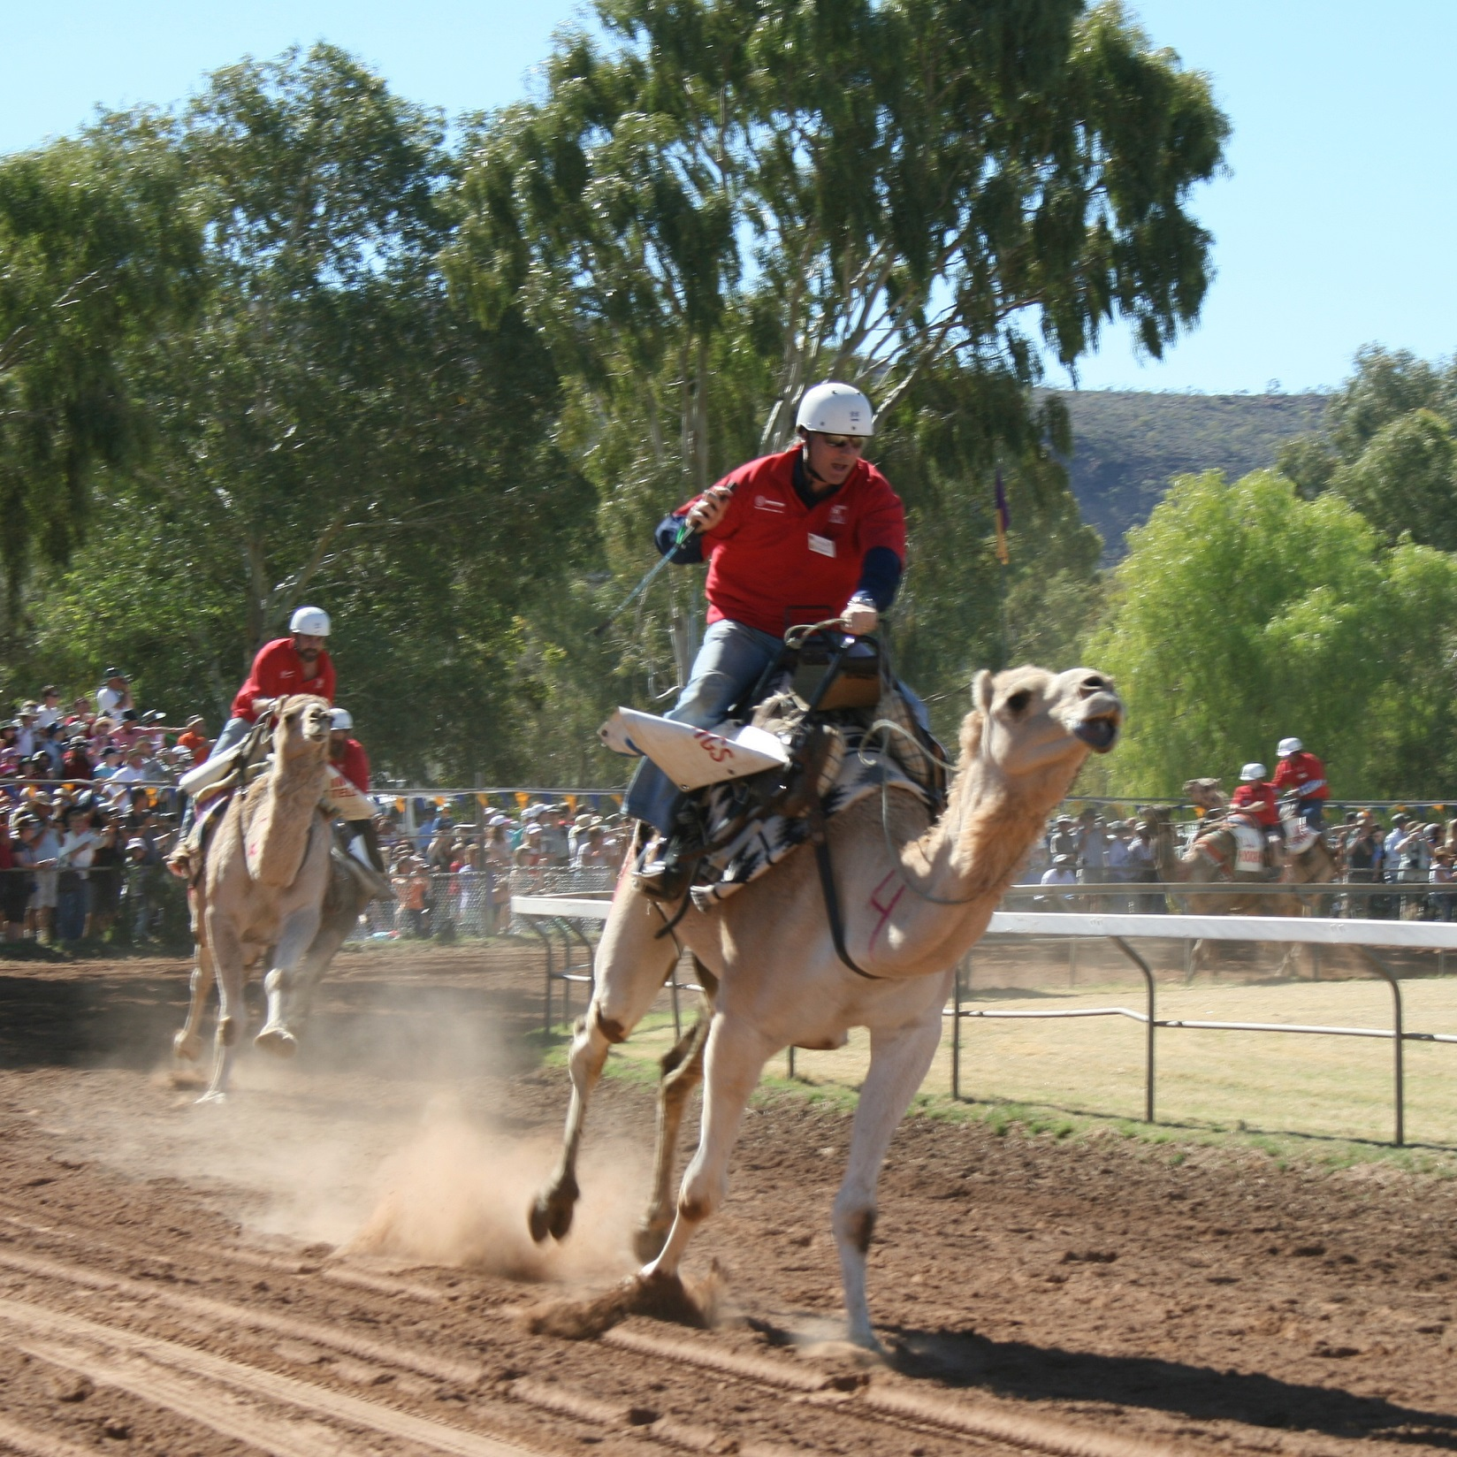

Slide 11
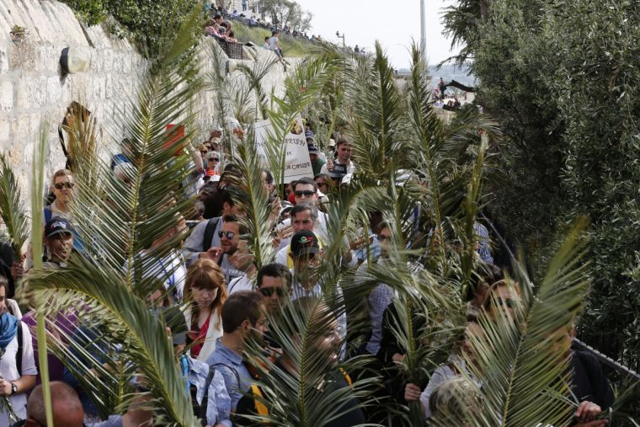

Slide 12
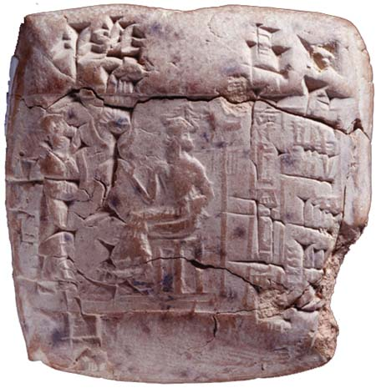

Slide 13
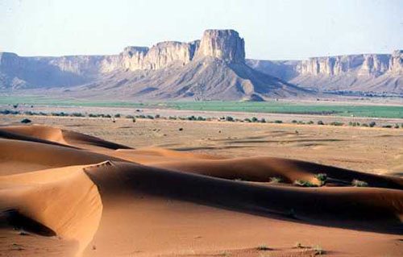

Slide 14
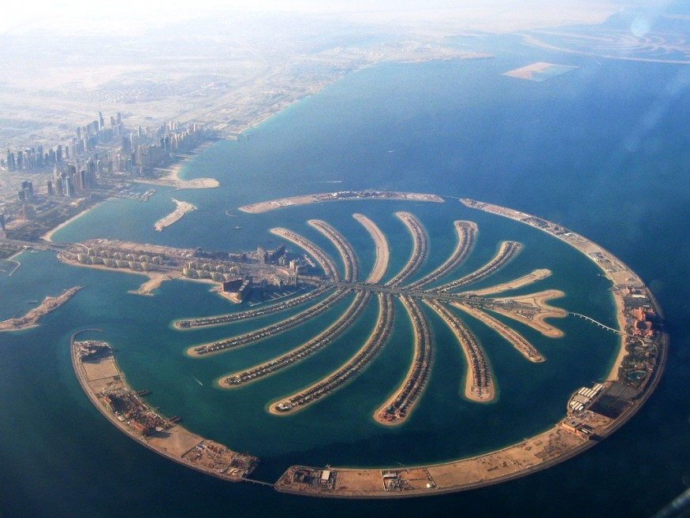

Slide 15
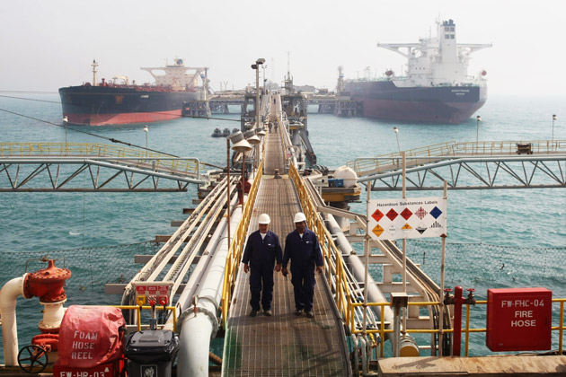

Slide 16
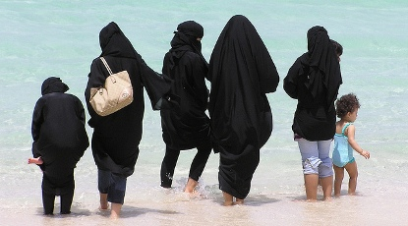

Slide 17
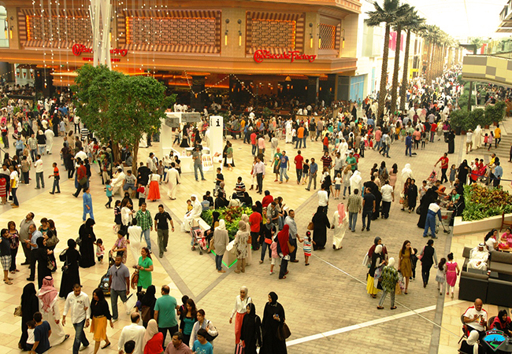

Slide 18
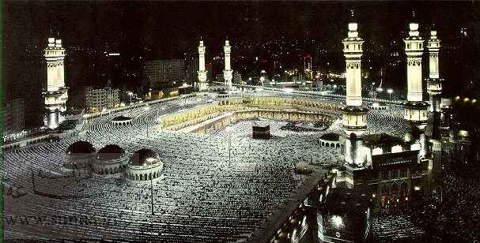

Slide 19
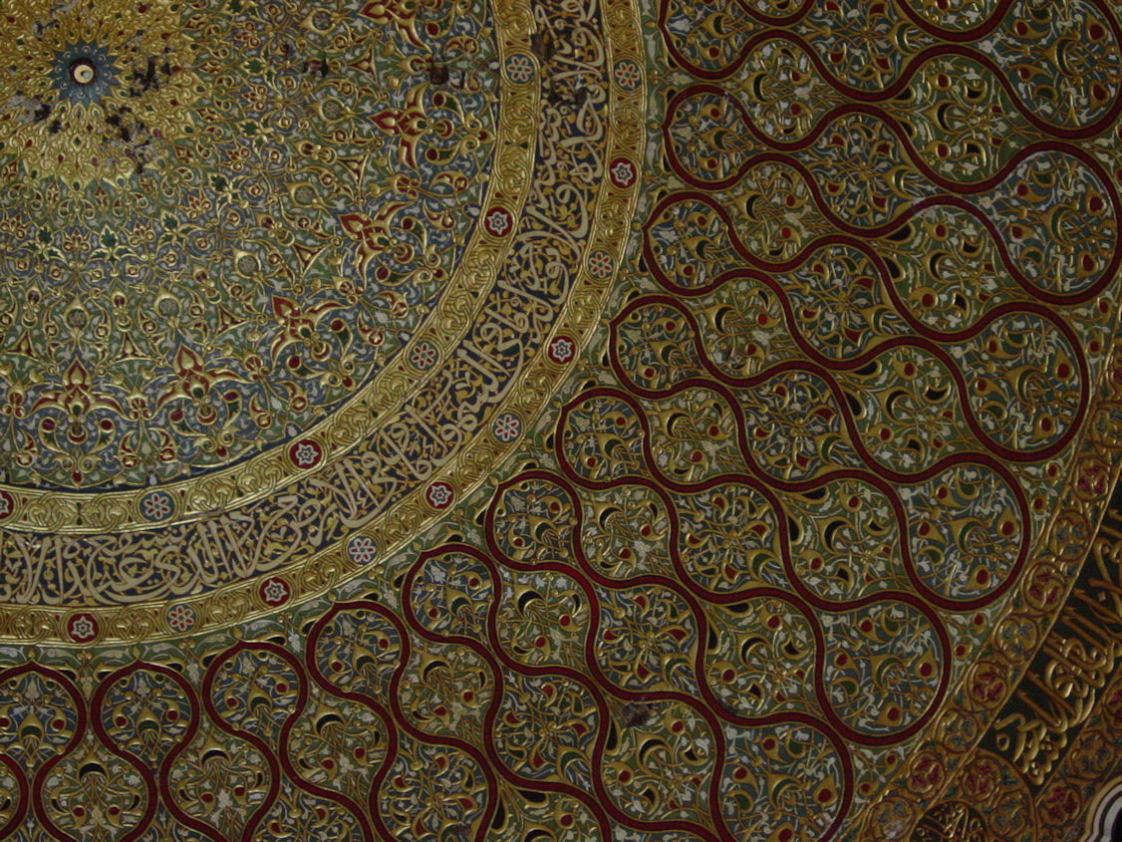

Slide 20
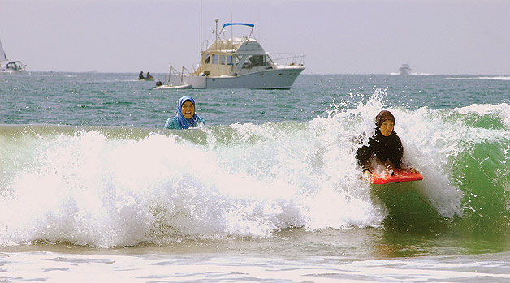

Slide 21
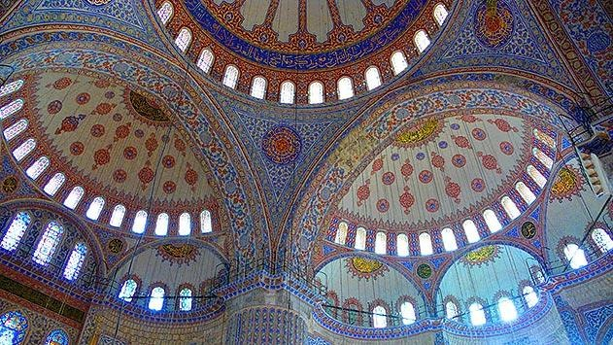

Slide 22
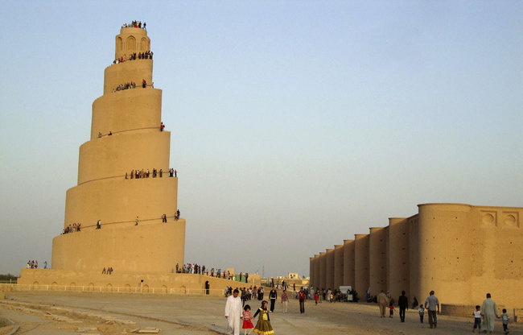

Slide 23
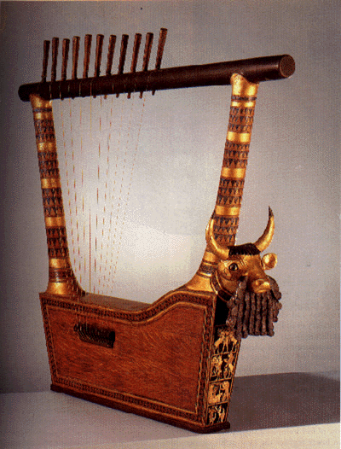

Slide 24
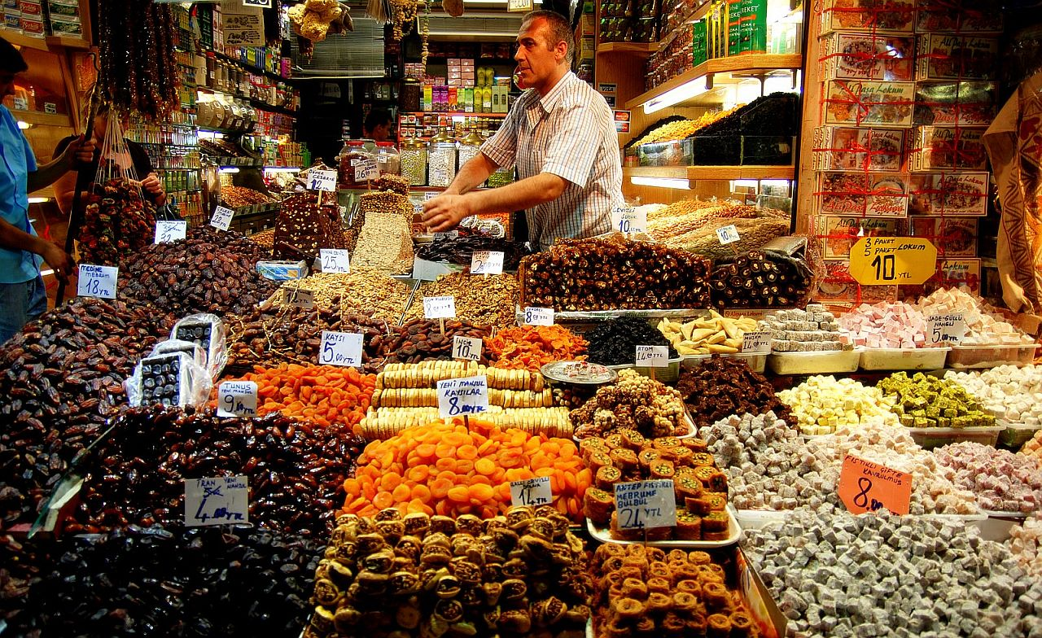

Slide 25
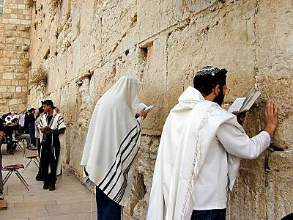

Slide 26
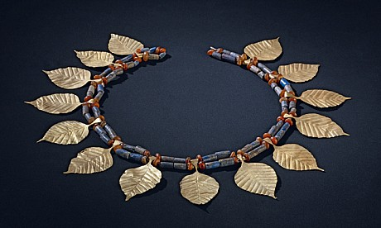

Slide 27
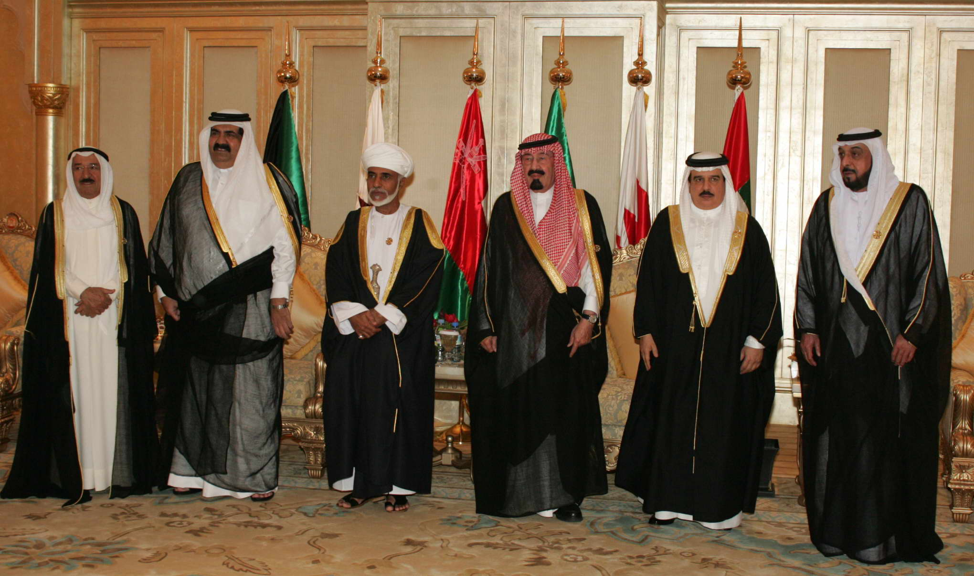

Slide 28
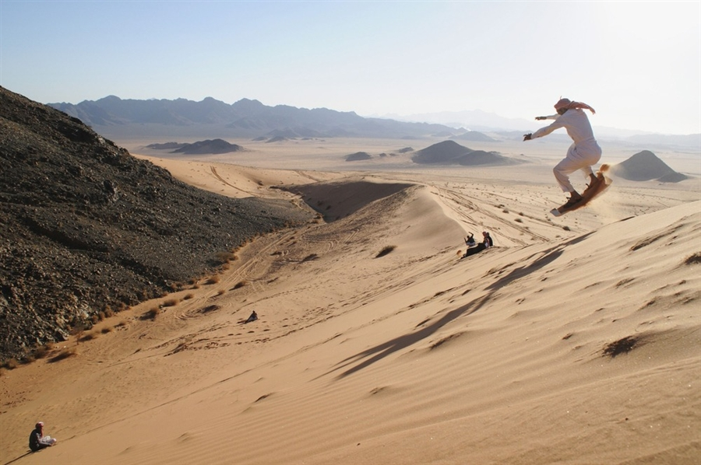

Slide 29
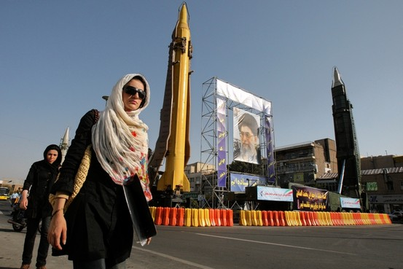

Slide 30
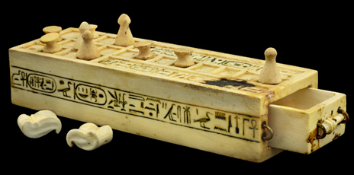

Slide 31
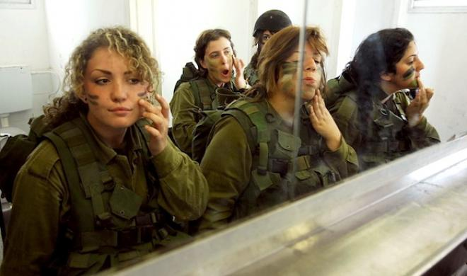

Slide 32
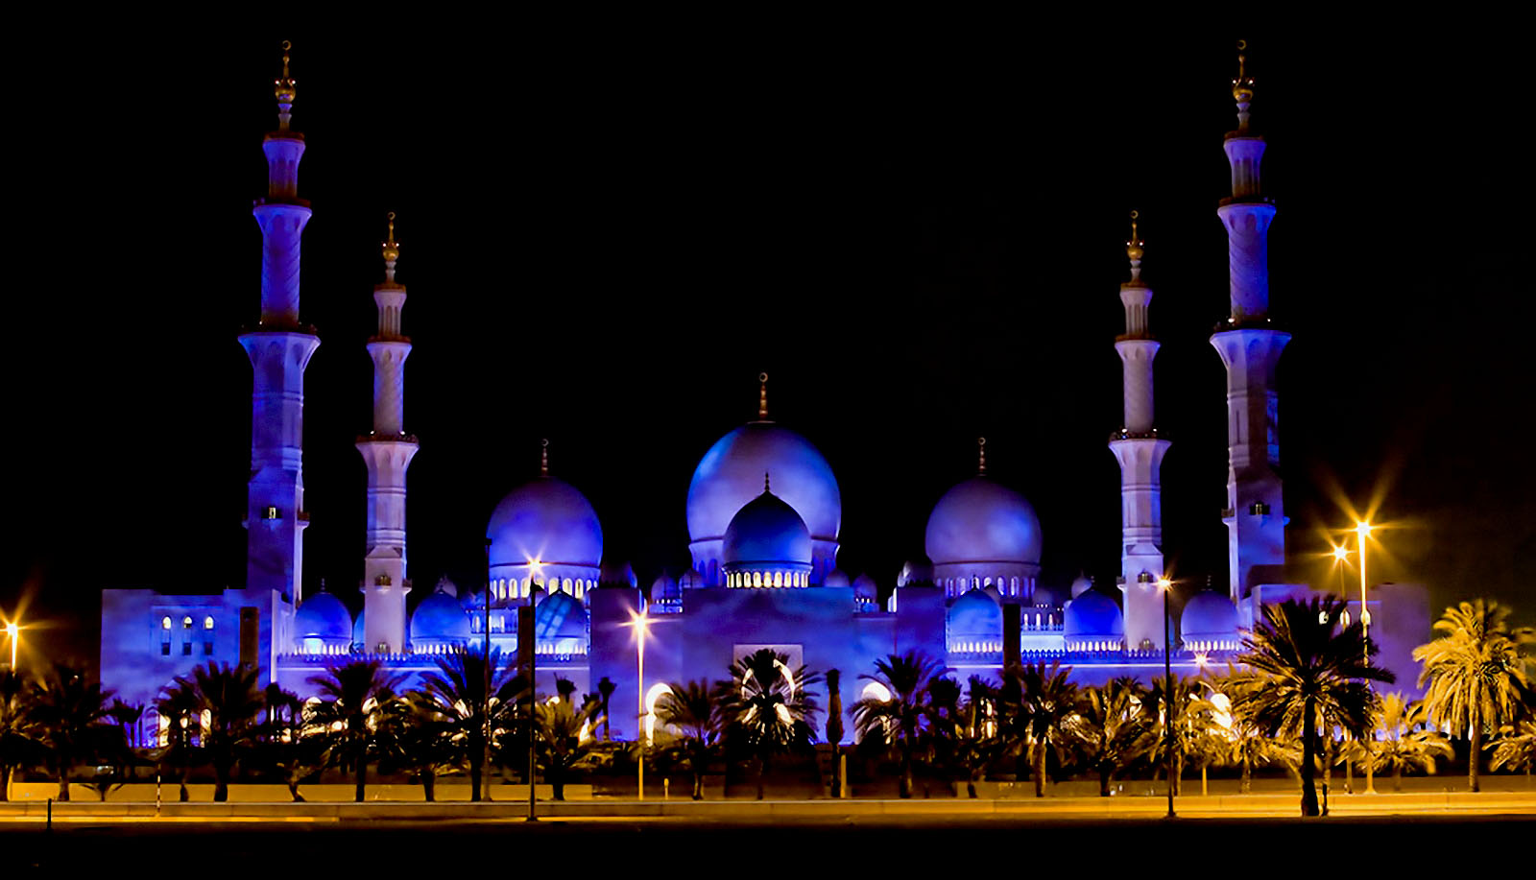

Slide 33
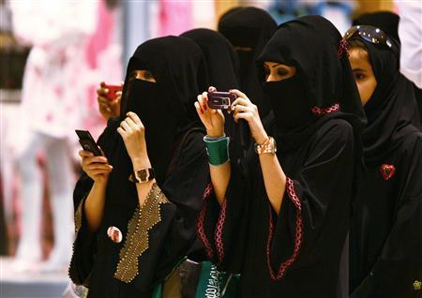

Slide 34
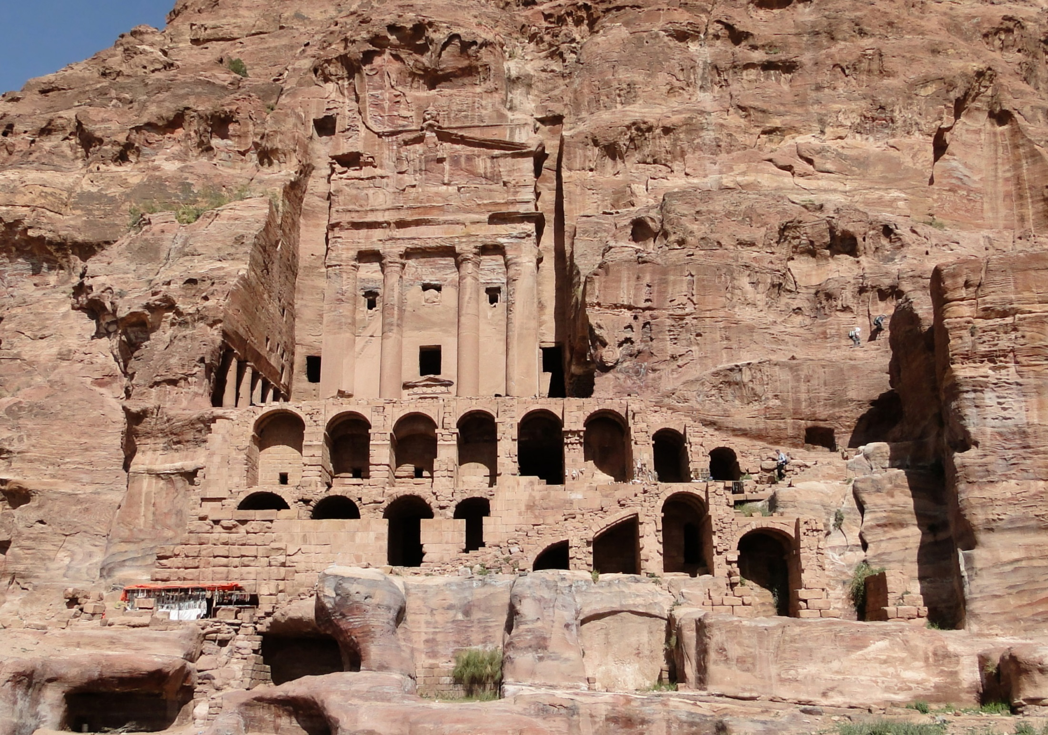

Slide 35
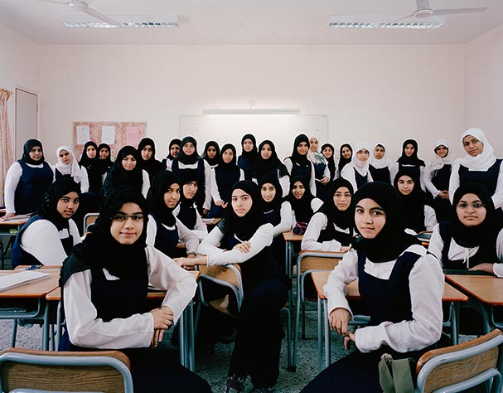

Slide 36
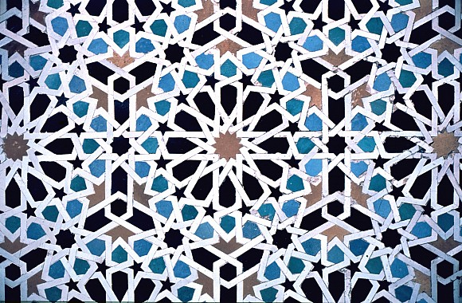

Slide 37
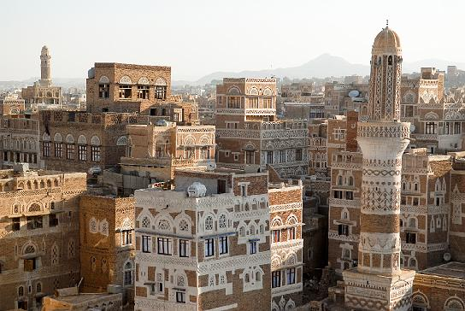

Slide 39
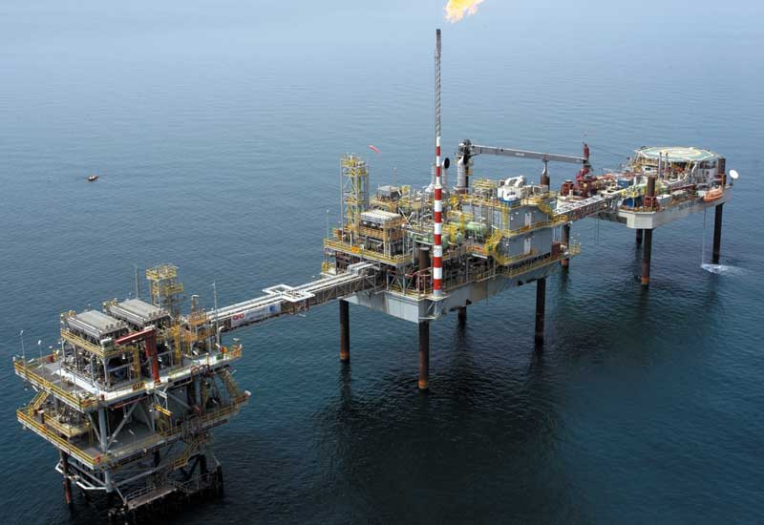

Slide 40
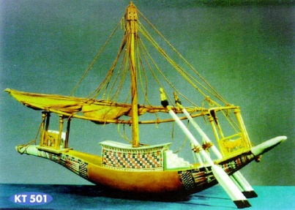

Slide 41
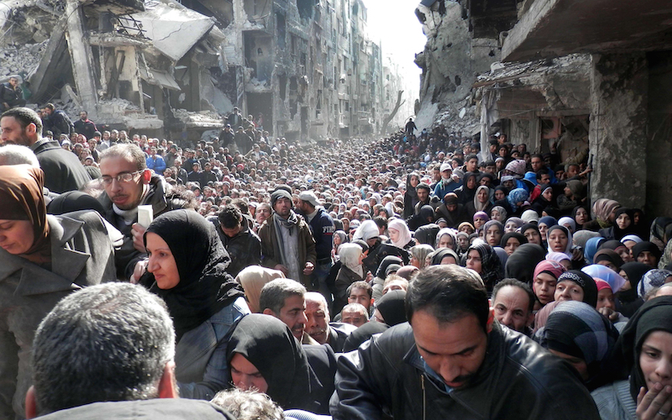

Slide 42
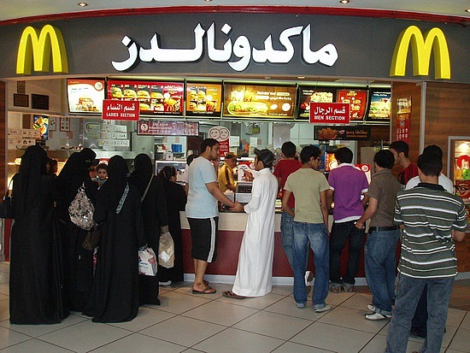
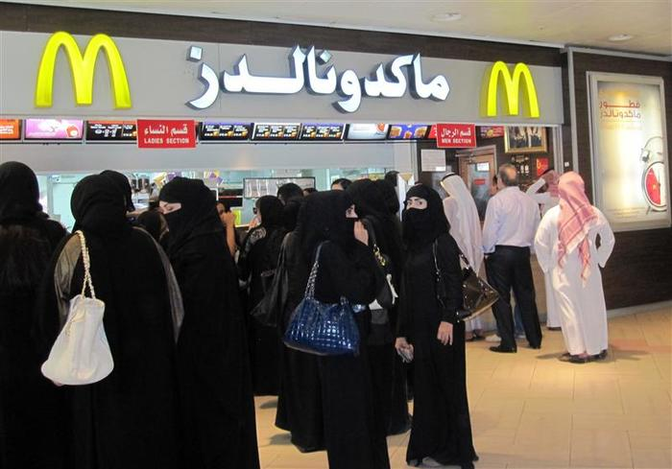
Note: In December 2019, Saudi Arabia lifted the ban on restaurant segregation by gender.

Slide 43
Part 2
1) Once you have completed the process for each of the 4 images you chose, Pick two of the topics listed in bold. Type the topics you chose in the space provided on the Middle East Gallery Sheet.
Here are the topics: political, economic, social, philosophical/religious, scientific/technological, and artistic.
2) For each of the 2 topics you selected, comment on how you think the Middle East has contributed to that aspect of human activity. (This can be based on inferences you made from the pictures you examined, or knowledge you already have about this region.) You must write at least one complete sentence for each.
For example, if I chose philosophical/religious as one of my topics, I might ask myself, “How did the Middle East contribute to the religious aspect of civilization?” If I chose economic as another of my topics, I could ask “How has the Middle East had an impact on the economics of civilization?” I would then type my response in the space provided.

