Slide 1
Do you Speak American? Regions of the United States

Slide 2
What is a region?
“A region is a group of places with at least one common characteristic.”

Slide 3
Regions of the U.S.
What are some common characteristics in the U.S. that might define a region?

Slide 4
How can you determine what region a person comes from?
ACCENT?
Word Choice?
Speed?

Slide 5
What is a dialect?
A regional variation of a language distinguished by vocabulary (word choice), spelling and pronunciation (accent)

Slide 6
Accent
Do you have an accent?
If so, what words do you think you say differently?
What are some words you notice others pronounce differently than you?
How do you pronounce “fork?”
How do you pronounce “creek?”
How about “sherbet?”
How do you feel about others who pronounce things differently?

Slide 7
Speed
Name a state where you think people speak more slowly or faster than you.
What do you think about someone who speaks slowly?

Slide 8
Word Choice
What might someone mean if they are “fixin” to do their homework?
What do you call something with a handle used to carry water?
What do you call a road that has limited access so people can drive without stoplights, etc?
What do you call a fizzy non-alcoholic beverage that comes in cans or bottles?

Slide 9
Carbonated Beverage

Slide 10
Discussion Questions
Why do you think regions have different accents?
How does language change over time?
In what ways can accents be helpful or harmful to us?

Slide 11
Common Accents in the U.S.

Slide 12
New England
Words that end in "er" are pronounced with "ah" far = "fah," etc.
Words that end in "a" are often pronounced with "er" at the end; i.e., California becomes "Californier," idea becomes "idear," etc.
All "a" and "e" sounds broaden; i.e., calf becomes "cahf," bath becomes "bahth," etc.
Most one-syllable words drag out into two syllables; i.e., there becomes "they-uh," here becomes "hee-ah," etc.
Words that end in "y" or "ie" are pronounced with "ay" at the end; i.e., Kathy="Kath-ay," quickly="quick-lay," etc.

Slide 13
Southern Accent
"I've got y'all's assignments here."
I “done” told you before.
I “seen” her first.
Practice the southern dra-wl
Bill → beehill Foot → foo-at Calm → cah-alm Bed → be-od Short → showat Glass → glayus laugh → layuf
Face → fuh-ace Nation → nuh-ation Great → gu-reat Meat → muheat

Slide 14
Northern Accent
“About” pronounced “aboat”
“Minnesota” becomes “Minnes-ohhhhh-tah”
“Doancha know”
“Root beer” is “rutt beer”
Sometimes “ay” is added like in Canadian accent
Practice the Northern Accent
Bag--- bayg
Sorry--- sourry
Wednesday--- Weensdee
“How’s by ya?” (How are you doing)

Slide 15
Western Accent
Pronounce the following pair: cot - caught
Do they sound the same?
What do you use to write with that has ink?
What do you use to hold two pieces of cloth
together? (safety ___)
Do they sound the same?
Pronounce “Egg” and “leg”
pronounced “ayg” and “layg”

Slide 16
Utah Accent
Drop the t in “mountain” and “fountain”
Add the “t” to “Chelsey,” “Cheltsee”
Creek might be pronounced “crick”
Say “acrossed” instead of “across”
Say “fur” instead of “for”
How do you pronounce this word: pillow?
How do you pronounce this word: milk?
What do you say when someone didn’t come to school when they should have?

Slide 17
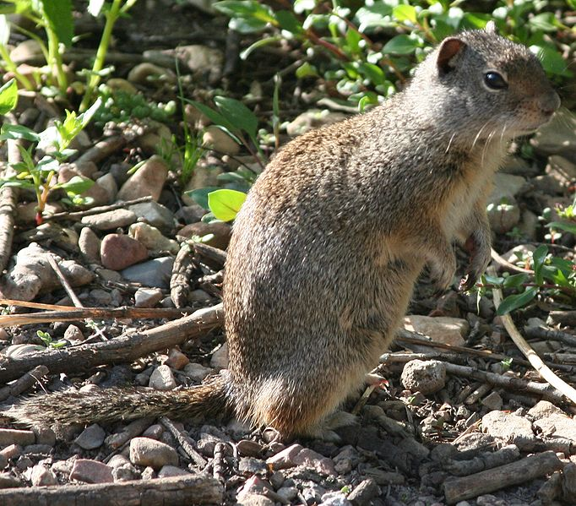
Utah Accent
You know you’re a Utahn when you call this animal . . .
a potgut

Slide 18
Let’s listen to some examples
Try to match the following sound clips to their region.
Northeast
Southern
Upper Midwest (Northern)
Western

Slide 19
Clip 1
Where are these people from?

Slide 20
Clip 2
Try to identify this accent?

Slide 21
Clip 3
Alright, how about this one?

Slide 22
Clip 4
Last try . . . Hmm.

Slide 23
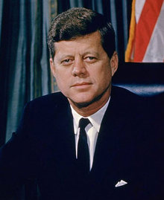
Some Famous Voices

Slide 24
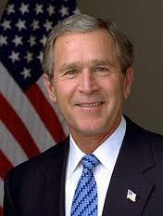
Some Famous Voices

Slide 25
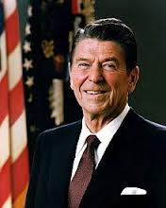
Some Famous Voices

Slide 26
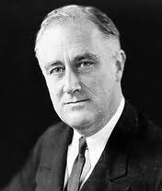
Some Famous Voices

Slide 27
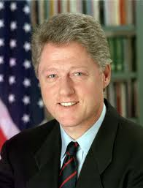
Some Famous Voices

Slide 28
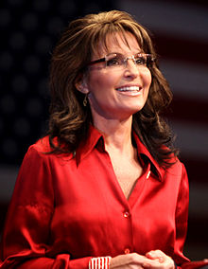
Some Famous Voices

Slide 29
What accent do you have?
We are going to determine what accent you speak with.
Go to the following link to take the quiz:
http://www.youthink.com/quiz.cfm?obj_id=9827
Or
Google “accent quiz.” Click on the link (youthink.com)
This one works at school: http://www.nytimes.com/interactive/2013/12/20/sunday-review/dialect-quiz-map.html?r=8204488j080008200j000080002001050j1200404002090200&_r=0

Slide 30
What accent do you have?

Slide 31
Or . . .

Slide 32
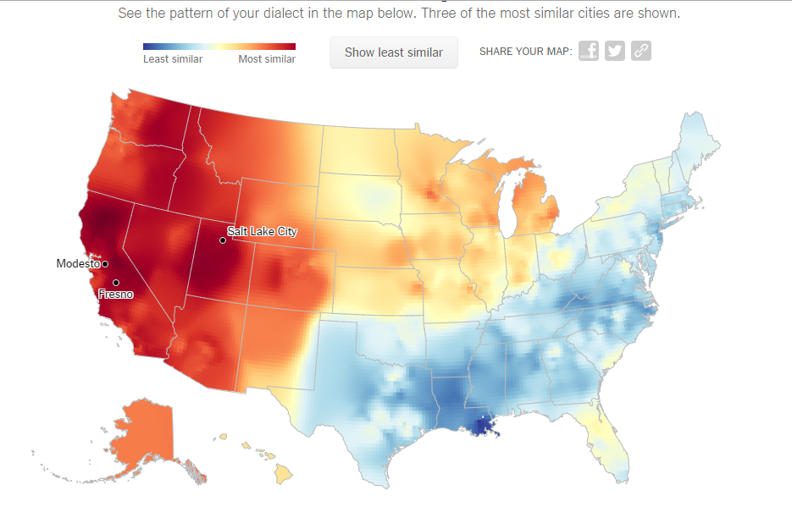
Composite Dialect Map from NYT Survey

Slide 34
A dialect is best classified as which of the following?
A. cultural complex
B. cultural trait
C. language branch
D. language group
E. language family

Slide 35
B. cultural trait
By process of elimination, a dialect cannot be a language branch, group or family because these terms describe collections of multiple languages, and a dialect is a trait of only one language. A cultural complex is a collection of many different cultural traits, so the best answer is (b) cultural trait. A cultural trait is a characteristic of a group of people passed on from one generation to another.

