Slide 1
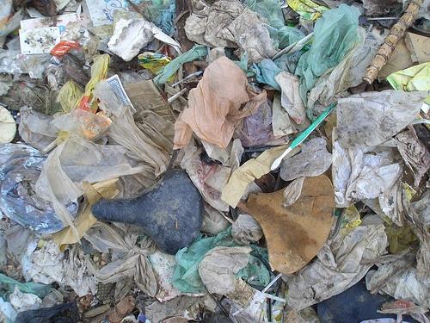
Trash Talk

Slide 2
Types of Trash
Renewable Resources: Naturally replaced
Ex: Food, paper
Nonrenewable Resources: Limited supply that can not be easily replaced
− Ex: Oil, Metal
Recyclable: Can be reused
− Ex: Paper, Plastics, aluminium
Biodegradable: Naturally breaks down
−Ex: Food, grass clippings

Slide 3
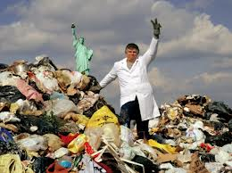
What waste fills most of the landfills?
Until the 1990s most people didn’t know much about solid waste
“Garbologists” Rathje and Murphy (they were really archaeologists) did a study on modern trash by digging through a landfill (20 years of trash)
The results were surprising
(and disgusting)

Slide 4
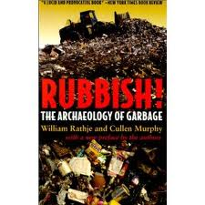
Thy Myths about garbage
When garbologists surveyed the public about solid waste people thought the main things filling up the landfills were:
Fast food packaging
Diapers
Styrofoam
They thought that most biodegrable items (like food and grass clippings) would just decompose at the landfill.

Slide 5
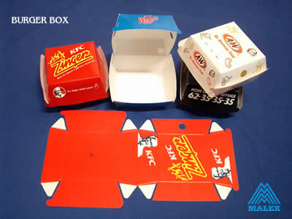
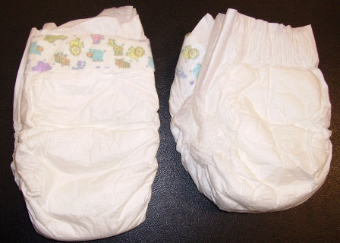
x

Slide 6
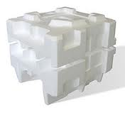
The facts:
fast food packaging (.5%)
polystyrene foam- (.9%)
diapers- (.8%)
Many biodegradable items did not decompose

Slide 7
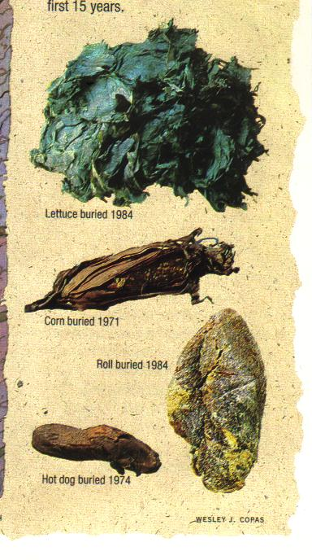

Slide 8
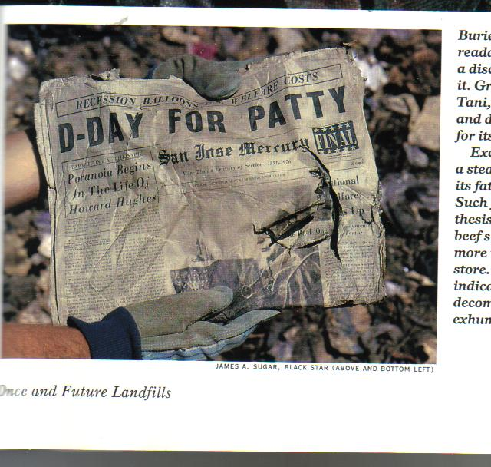

Slide 9
 | Recyclable | Nonrecyclable
Renewable
Nonrenewable
Biodegradable?

Slide 10
Municipal Solid Waste

Slide 11
What are the main types of trash?
Paper—27%
Yard/Kitchen Waste—28%
Plastic—13%
Americans produce more trash per person than other countries:
Over 4 pounds per person per day
Europeans produce about 2 pounds per person per day.

Slide 12
Total and Per capita Waste

Slide 13
What ends up in the landfill

Slide 14
Why should we reduce solid waste? What can we do to reduce solid waste
Three R’s
Reduce
Recycle
Reuse
Compost
Place biodegradable items in a pile or container, mix with dirt, water, air to create good soil
Incinerate
Burn trash to create electricity

Slide 15
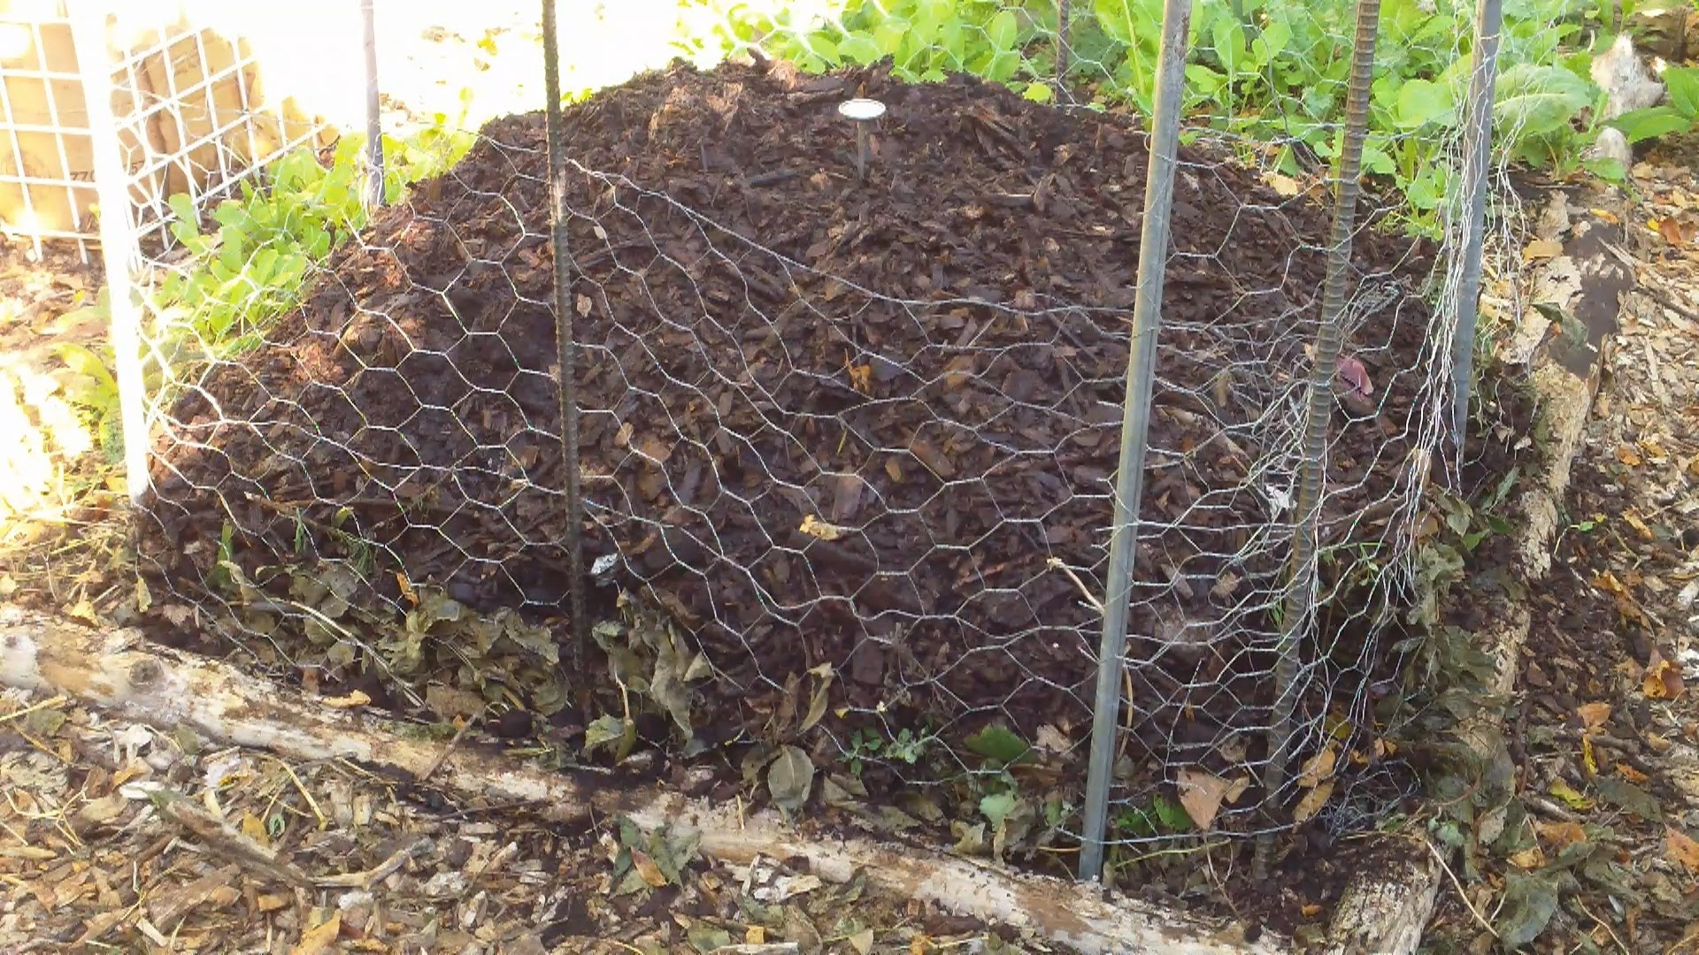
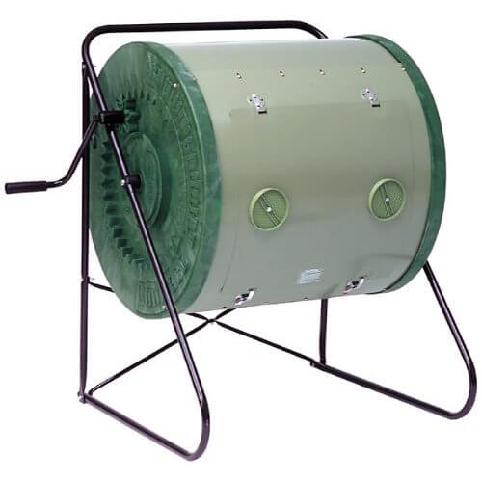
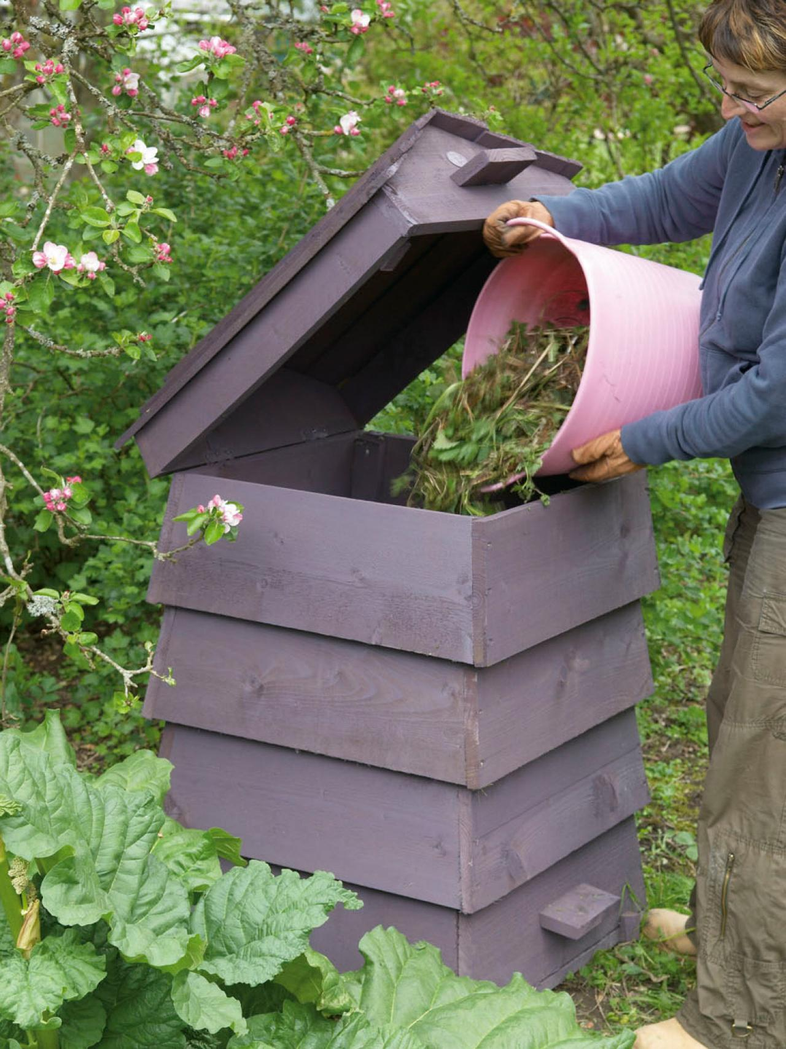
Compost

Slide 16
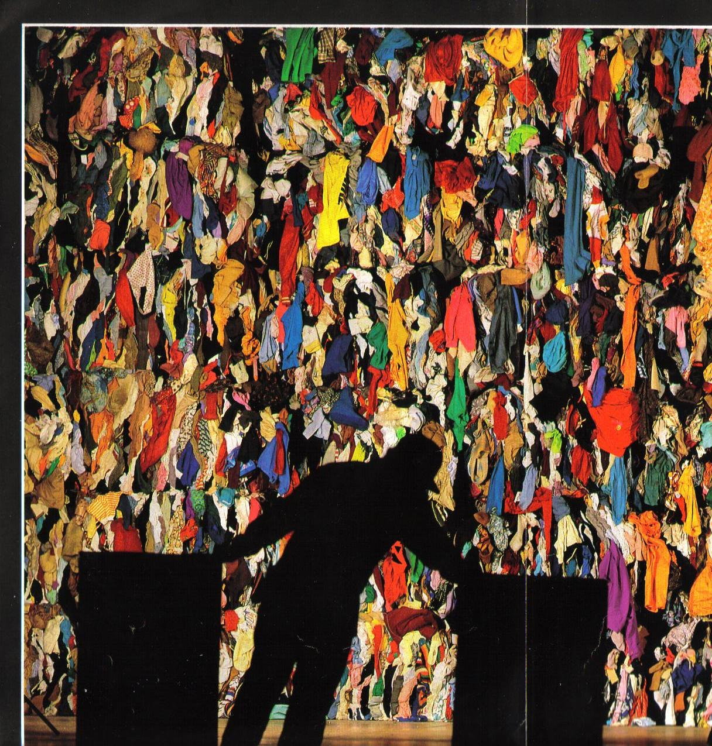

Slide 17
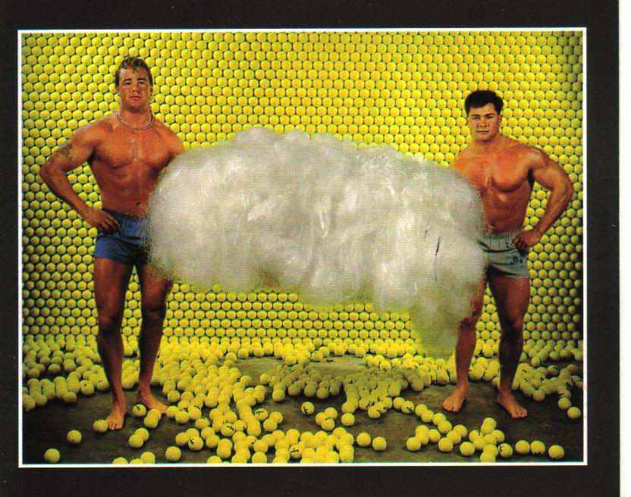

Slide 18
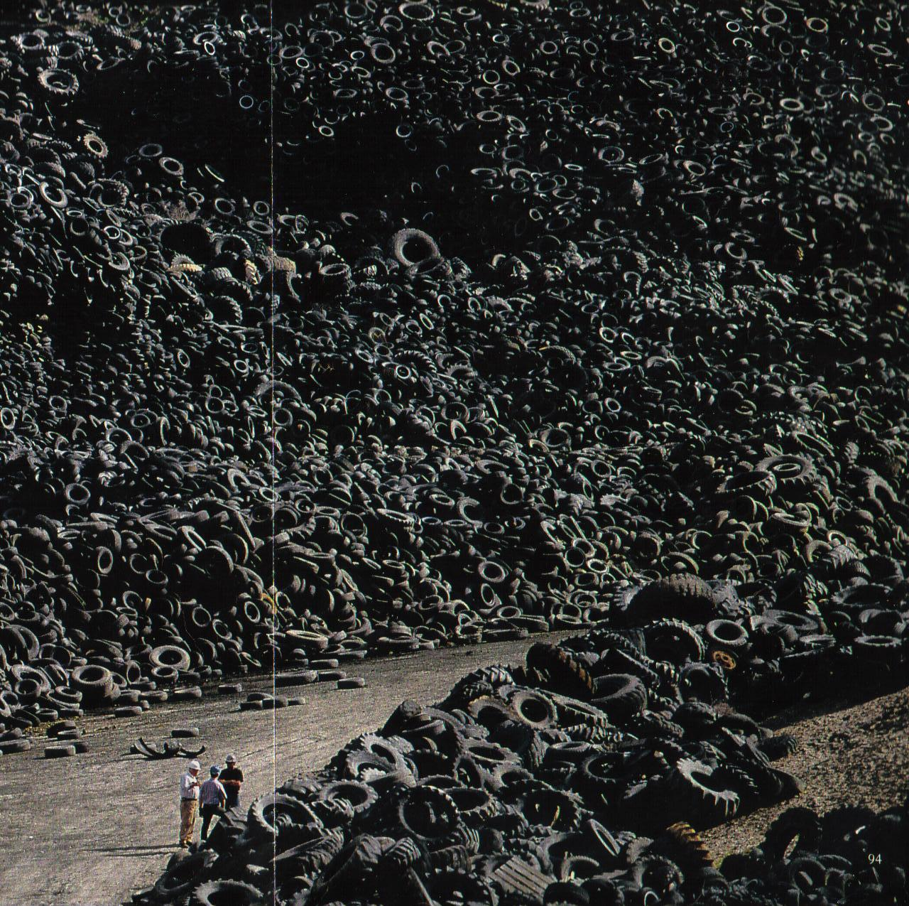

Slide 19
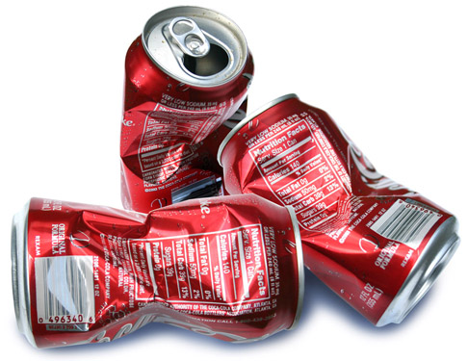

Slide 20
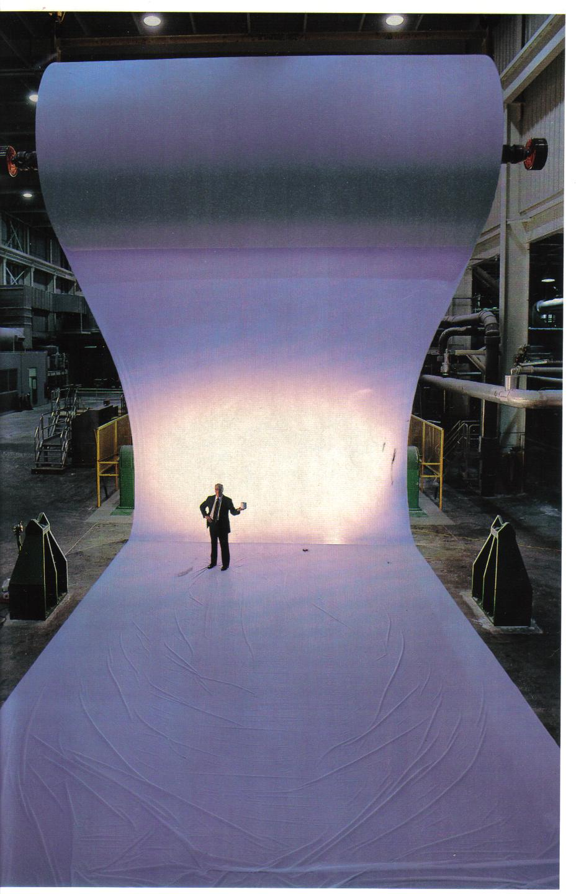

Slide 21
In 2005, Americans
Generated 245.7 million tons of trash
Recycled 58.4 million tons (24%)
Composted 20.6 million tons (8%)
Incinerated (for energy) 33.4 million tons (13%)
Can we do better?

Slide 22
When future archeologists look at our trash piles, what will they think of us?

Slide 23
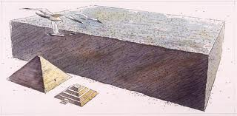
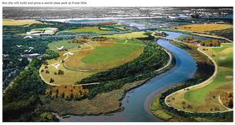
Fresh Kills Landfill, Staten Island, New York
Over 2,200 Acres of Trash from New York City
Was the largest man-made object in the world (2.4 Billion cubic Feet– more than 25x the volume of the Great Pyramid at Giza
Now is being converted into public park/open space

Slide 24
Some things to think about . . .
American produce about 4 pounds of trash per person, per day.
Americans use 2.5 million plastic bottles every hour.
A typical family consumes 182 gallons of soda, 29 gallons of juice, 104 gallons of milk, and 26 gallons of bottled water a year. That's a lot of containers that can all be recycled!
The average American uses 650 pounds of paper each year – 100 million tons of wood could be saved each year if all that paper was recycled.
About 75% of what Americans throw away is recyclable, yet our recycling rate is only 30%.
Recycling one ton (about 2,000 pounds) of paper saves 17 trees, two barrels of oil (enough to run the average car for 1,260 miles), 4,100 kilowatts of energy (enough power for the average home for six months), 3.2 cubic yards of landfill space, and 60 pounds of pollution.
Recycling one aluminum can saves enough energy to run a TV for three hours. In spite of this, Americans throw away enough aluminum to rebuild our entire commercial fleet of airplanes every three months!
Source: www.dosomething.org

Slide 25
Take Action
Why should individuals take action to reduce the amount of solid waste produced and sent to the landfill?
Save Resources
Save energy
Save land
What is something you can do as an individual to reduce the amount of solid waste sent to the landfill?
What is something your family can do?

Slide 26
Even Garbage Men Have a Sense of Humor

Slide 27
Take Action!

