Slide 1
Chapter 2 Test Review
Climate and Vegetation

Slide 2
Could you explain how the earth works?
Yes, in my sleep—easy!
Maybe after this review I could
I need a week to study this stuff
What is the earth?

Slide 3
The earth’s movement around the sun is called .
Rotation
Revolution

Slide 4
On these 2 days each year at noon, the sun appears overhead at the Equator
December 21st, June 21st
June 21st, March 21st
September 22nd, December 21st
March 21st, September 22nd

Slide 5
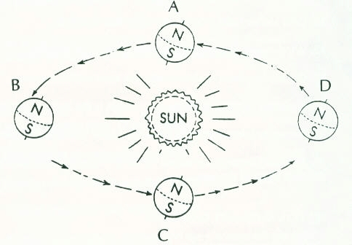
As the earth moves from position A to B, what happens to the hours of sunlight in the northern hemisphere?
They get longer
They get shorter
They stay the same

Slide 6
The Spring ________ is on ________ when the direct rays are over the ________.
Solstice, March 21st, Equator
Equinox, March 21st, Equator
Equinox, June 21st, Tropic of Cancer
Solstice, September 22nd, Tropic of Capricorn

Slide 7
Which position shows winter in the northern hemisphere?
A
B
C
D

Slide 8
How many hours of sunlight would you expect at the South Pole at position D?
0 (zero)
24
12
18

Slide 9
Which positions are solstices?
A & B
C & D
A & C
B & D

Slide 10
The main factor that influences seasons is how close the earth is to the sun during that season.
True
False

Slide 11
What is the difference between weather and climate?
Climate is long-term, weather is the condition of the bottom layer of the earth’s atmosphere in a short period of time.
Climate is based mainly on temperature and weather is based mainly on precipitation
Climate tells you what the conditions will be outside today; weather will tell you what this month’s conditions will be outside.

Slide 12
Which is NOT an example of a factor of climate?
Elevation
Latitude (angle of sunlight)
Humidity
Distance from bodies of water
Prevailing Winds

Slide 13
Temperate zones usually have a wider range of temperatures than the Tropical zones.
True
False

Slide 14
Generally, places of similar latitudes have similar climates.
True
False

Slide 15
A rain shadow is part of which type of precipitation?
Convectional Precipitation
Frontal Precipitation
Orographic Precipitation
Monsoonal Precipitation

Slide 16
Winds move from Low to High pressure.
True
False

Slide 17
What force distributes heat or cold over the surface of the earth?
Ocean Currents
Coriolis Effect
Prevailing Winds
Convection

Slide 18
The Coriolis Effect is caused by wind deflection from the earth’s rotation.
True
False

Slide 19
WHAT are the elements of weather?
Wind, Humidity, Atmospheric Pressure, Temperature
Wind, Currents, Fronts, Convection
Humidity, Latitude, Distance from water, Elevation

Slide 20
Convectional Precipitation:
Is caused by the meeting of two different masses of air
Happens when there is a large landform
Is caused by hot air rising as it is heated near the earth’s surface, cooling, and falling
Both 1 & 3
All of the above

Slide 21
Which is a TRUE statement concerning humidity and precipitation?
Precipitation is all forms of water that fall (rain, snow, hail)
Humidity is the water vapor still contained in the atmosphere
Humidity and Precipitation are the same thing
Both 1 & 2 are true

Slide 22
This type of precipitation occurs when two air masses meet
Convectional
Orographic
Frontal

Slide 23
What is not one of the 6 broad types of climate regions?
Continental
Polar
Tropical
Savanna
Highlands
Moderate
Arid

Slide 24
Convectional precipitation is common in areas near the Equator.
True
False

Slide 25
Orographic Precipitation is common on seacoasts where moist, ocean winds blow toward coastal mountains.
True
False

Slide 26
Large bodies of water affect the surrounding climates because:
Their waves destroy the beaches
Water heats up faster than air
Winds take on the water’s temperature as they blow over
None of the above

Slide 27
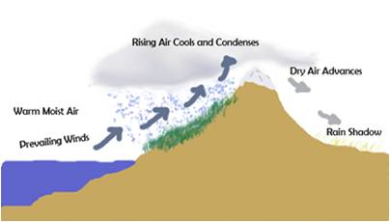
This picture is an example of which type of precipitation?
Orographic
Frontal
Convectional

Slide 28
Continental climates have:
Warm summers, cool winters
Cold summers, cold winters
Hot summers, cold winters
None of the above

Slide 29
A Mediterranean Climate has hot, dry summers and cool, wet winters.
True
False

Slide 30
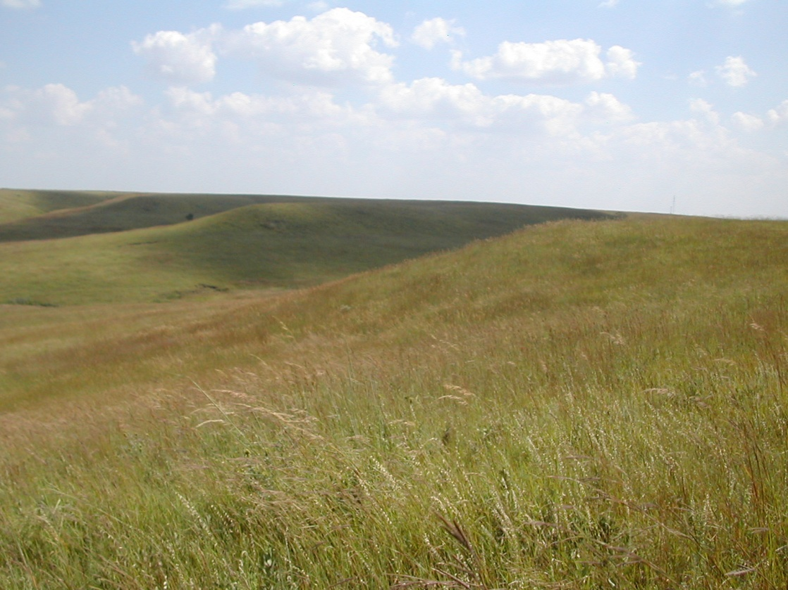
This is an example of which Biome?
Tropical Grassland
Temperate Grassland
Mid-latitude deciduous forest
Mid-latitude coniferous forest

Slide 31
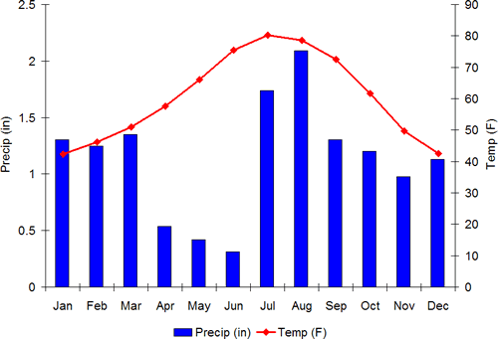
According to the climate graph, how many inches of precipitation does the location average in April?
.5 inches
1.6 inches
20 inches
60 inches

Slide 32
According to the climate graph, what is the warmest month and what is the average temperature?
July, 63 degrees
August, 75 degrees
July, 80 degrees

Slide 33
Tundra is know for this type of vegetation:
Tall, dense evergreens
Tall grasses and wildflowers
Mosses, lichens
Cactus, sage brush

Slide 34
The countries of Western Europe have a more mild climate compared to other areas of the same latitude because:
Western Europe is located in the low-latitudes
Western Europe is at a higher elevation
Western Europe is in a rain shadow
Western Europe is influenced by the Gulf Stream and North Atlantic warm currents

Slide 35
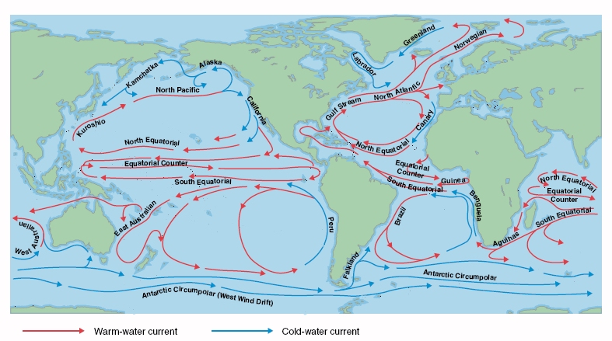

Slide 36
A biome:
Is filled with major types of ecosystems
Is found in various regions of the world
Has communities of plants and animals suited to each other
All of the above

Slide 37
Trees of a deciduous forests are:
Bare in the winter, lush and green in the summer
Found in the mid-latitudes
Common in Utah
All of the above

Slide 38
An example of a coniferous tree is:
Pine tree
Coconut tree
Olive tree
Maple tree

Slide 39
Mixed Forests are often found:
In cool parts of the middle-latitudes
In high elevations
In places with cold winters
1, 2, but not 3
1, 2, and 3

Slide 40
_______ grow in a tropical grassland, or savanna.
Tall grasses with scattered trees
Broadleaf evergreens with thick canopy of leaves
Wildflowers and scattered grasses
Pine trees

Slide 41
Wildfire season in the Savanna:
Doesn’t exist
Kills everything in sight, leaving a destitute terrain
Discourages new grasses to grow
Encourages new grasses to grow

Slide 42
Permafrost:
Is a layer of soil just below the surface
Stays permanently frozen
Is located in the Tundra biome AND climate
Is common in Northern Russia
All of the above

Slide 43
The Chaparral biome is primarily which climate?
Tropical wet/dry
Mediterranean
Tundra
Humid subtropical

Slide 44
Plains/Prairies/Steppes/Velds/Pampas are all part of the Temperate Grassland climate.
True
False

Slide 45
The main factor that influences seasons is the earths tilt compared to the sun.
True
False

Slide 46
A summer thunderstorm in Utah is usually which type of precipitation?
Convectional
Frontal
Orographic

Slide 47
Warm air can hold more water vapor than cold air.
True
False

Slide 48
How well prepared do you feel for the Chapter 2 Test?
I am ready to take it now!
I need to review my notes, worksheets and reading.
I am way behind and need to catch up.
Is there a test coming up?

Slide 49
Which topic do you need to review the most?
Seasons
Elements of Weather
Factors of Climate
Types of precipitation
Biomes
Reading Climate Graphs
Vocabulary

Slide 50
When is the Chapter 2 Test
Next class period
Next week
Next semester

Slide 51
Places by the ocean (marine climates) tend to have more mild climate than places farther inland (continental climates).
True
False
Response Counter

Slide 52
The polar zones are in the ____ latitudes, from ___ degrees to the poles.
High, 23 ½
High, 66 ½
Low, 66 ½
Response Counter

Slide 53
The effect of elevation on climate is that the temperature drops an average of ____ degrees every ______ feet:
3.5 degrees/1000 feet
20 degrees/10 feet
100 degrees/1000 feet
None of the above
Response Counter

Slide 54
What climate is usually found between 25-30 degrees north and south of the equator?
Tropical wet
Tundra
Subarctic
Desert
Highland

