Slide 1
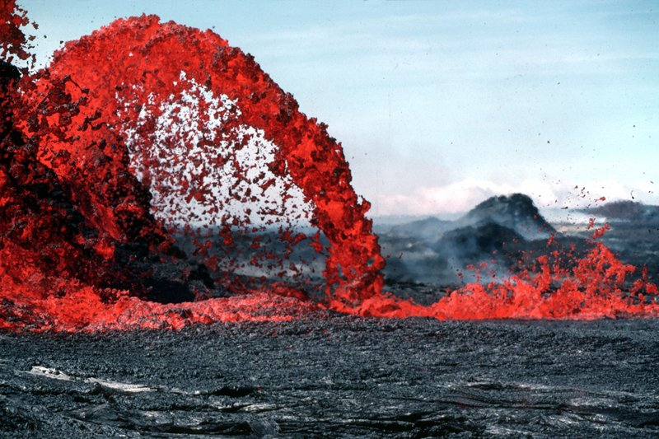
Internal and External Forces that shape the Earth
Chapter 1 Sections 2-3

Slide 2
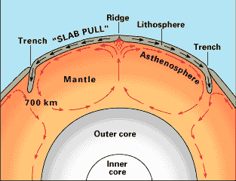
A circular motion created by heating and cooling is called ___.
Magma
Convection
Slab pull
Converging

Slide 3
A circular motion created by heating and cooling is called ___.
Magma
Convection
Slab pull
Converging

Slide 4
Which force would most likely create a “U” shaped canyon?
Water erosion
Subduction
Glacial erosion
Wind deposition

Slide 5
Which force would most likely create a “U” shaped canyon?
Water erosion
Subduction
Glacial erosion
Wind deposition

Slide 6
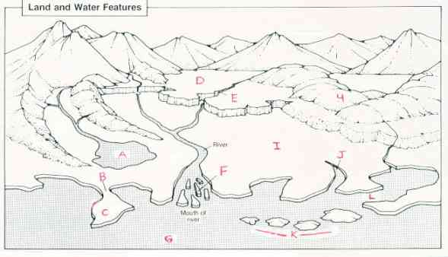
What is the name of feature “J”?
inlet
isthmus
strait
alluvial fan

Slide 7
What is the name of feature “J”?
inlet
isthmus
strait
alluvial fan

Slide 8
The ___ is close to the peninsula on the diagram
Plateau
strait
isthmus
volcano

Slide 9
The ___ is close to the peninsula on the diagram
Plateau
strait
isthmus
volcano

Slide 10
Letter “F” on the diagram was most likely formed by ____.
faulting
Water deposition
Glacial deposition
Mechanical weathering

Slide 11
Letter “F” on the diagram was most likely formed by ____.
faulting
Water deposition
Glacial deposition
Mechanical weathering

Slide 12
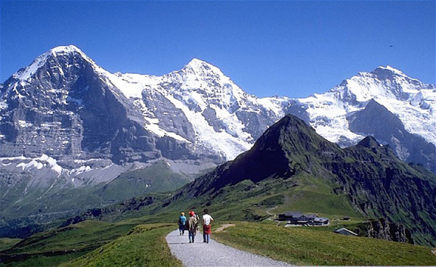
The landform in this picture was created by ____.
Seafloor spreading
Volcanic eruptions
A meteor shower
Converging plates

Slide 13
The landform in this picture was created by ____.
Seafloor spreading
Volcanic eruptions
A meteor shower
Converging plates

Slide 14
What kind of landform would most likely be found where two oceanic plates converge?
A mountain range
A mid-oceanic ridge
A rift valley
A trench

Slide 15
What kind of landform would most likely be found where two oceanic plates converge?
A mountain range
A mid-oceanic ridge
A rift valley
A trench

Slide 16
The earth’s major landforms were first shaped by
The breaking up of Pangaea
Forces within the earth’s interior
Weathering
Glaciers during the ice age

Slide 17
The earth’s major landforms were first shaped by
The breaking up of Pangaea
Forces within the earth’s interior
Weathering
Glaciers during the ice age

Slide 18
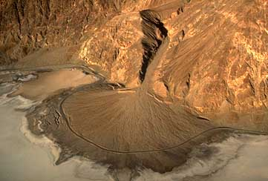
The landform in this picture is a good example of a landform created by __.
Glacial erosion
Wind deposition
Water erosion
Water deposition

Slide 19
The landform in this picture is a good example of a landform created by __.
Glacial erosion
Wind deposition
Water erosion
Water deposition

Slide 20
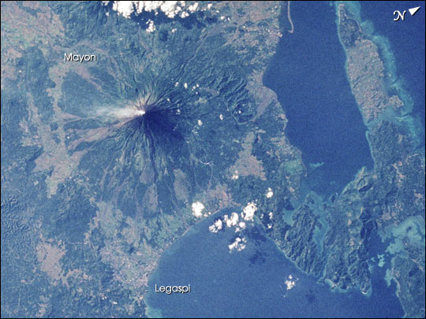
This is a picture of a ____.
butte
volcano
foothill
Fault line

Slide 21
This is a picture of a ____.
butte
volcano
foothill
Fault line

Slide 22
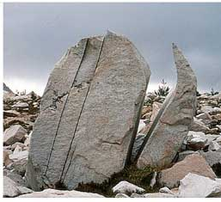
Cracks in this landform were most likely caused by ____.
Mechanical weathering
Sedimentation
Moraines
Glacial erosion

Slide 23
Cracks in this landform were most likely caused by ____.
Mechanical weathering
Sedimentation
Moraines
Glacial erosion

Slide 24
Scientists believe ____ moves the various plates across the earth’s surface.
Subduction
Chemical weathering
Continental drift
Convection

Slide 25
Scientists believe ____ moves the various plates across the earth’s surface.
Subduction
Chemical weathering
Continental drift
Convection

Slide 26
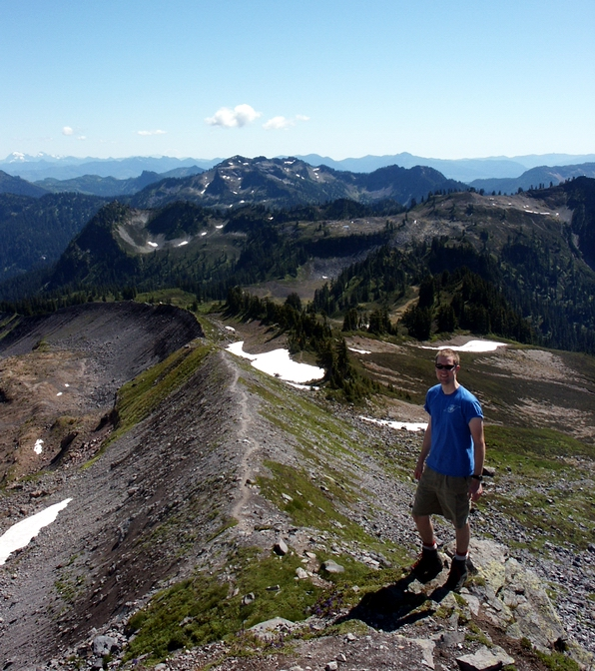
In this picture, we can see all of the following EXCEPT ...
Glacial erosion
Deposition
Magma
Moraines

Slide 27
In this picture, we can see all of the following EXCEPT ...
Glacial erosion
Deposition
Magma
Moraines

Slide 28
Mr. Miyagi explains plate tectonics with the terms ___, ___, & ___.
Crash, push, & pull
Erosion, deposition, & weathering
Collide, slide, & divide
Faulting, convection, & loess

Slide 29
Mr. Miyagi explains plate tectonics with the terms ___, ___, & ___.
Crash, push, & pull
Erosion, deposition, & weathering
Collide, slide, & divide
Faulting, convection, & loess
0 of 42

Slide 30
Timpanogos Cave is an example of ____ in Utah because the water dissolved the limestone.
Rifting
Chemical weathering
subduction
moraines

Slide 31
Timpanogos Cave is an example of ____ in Utah because the water dissolved the limestone.
Rifting
Chemical weathering
subduction
moraines

Slide 32
The vocabulary terms for collide slide and divide are ___, ___, ___, & ___.
Converging, subduction, faulting, & rifting or seafloor spreading
Convection, magma, erosion, & weathering
Collide, slide, deride, & divide
Erosion, weathering, deposition, & faulting

Slide 33
The vocabulary terms for collide side and divide are ___, ___, ___, & ___.
Converging, subduction, faulting, & rifting or seafloor spreading
Convection, magma, erosion, & weathering
Collide, slide, deride, & divide
Erosion, weathering, deposition, & faulting

Slide 34
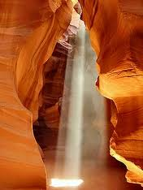
This picture shows which process?
Mechanical weathering
Water erosion
None of the above
Both 1 & 2

Slide 35
This picture shows which process?
Mechanical weathering
Water erosion
None of the above
Both 1 & 2

Slide 36
If the earth’s ____ stopped working, but nothing else changed, in millions of years the earth would be completely smooth and under water.
External forces
Weather and air currents
Internal forces

Slide 37
If the earth’s ____ stopped working, but nothing else changed, in millions of years the earth would be completely smooth and under water.
External forces
Weather and air currents
Internal forces

Slide 38
Almost no plant or animal life would be able to live on the earth if ___ did not turn rock into soil through ___.
External forces, weathering & erosion
Internal forces, weathering & erosion
Earthquakes, smashing rocks together

Slide 39
Almost no plant or animal life would be able to live on the earth if ___ did not turn rock into soil through ___.
External forces, weathering & erosion
Internal forces, weathering & erosion
Earthquakes, smashing rocks together

Slide 40
The three main layers of the earth are . . .
Core, mantle, crust
Lithosphere, hydrosphere, atmosphere, biosphere
Mantle, magma, lava

Slide 41
The three main layers of the earth are . . .
Core, mantle, crust
Lithosphere, hydrosphere, atmosphere, biosphere
Mantle, magma, lava

Slide 42
All of the following are evidence of plate tectonics EXCEPT
Magnetism in rocks
Age of rocks on the sea floor
Migrating birds
Patterns of earthquakes/volcanoes when mapped
Fossils of similar plants & animals on different continents

Slide 43
All of the following are evidence of plate tectonics EXCEPT
Magnetism in rocks
Age of rocks on the sea floor
Migrating birds
Patterns of earthquakes/volcanoes when mapped
Fossils of similar plants & animals on different continents

Slide 44
What kind of landforms would most likely be found where an oceanic and continental plate meet?
Mid-oceanic ridge
Rift valley
Volcanic mountain range

Slide 45
What kind of landforms would most likely be found where an oceanic and continental plate meet?
Mid-oceanic ridge
Rift valley
Volcanic mountain range

Slide 46
The Grand Canyon is located in Utah.
True
False

Slide 47
The Grand Canyon is located in Utah.
True
False

Slide 48
Old tombstones are examples of ___ in Utah because the rock is dissolved over time.
Subduction
Chemical weathering
Mechanical weathering
Erosion
Deposition

Slide 49
Old tombstones are examples of ___ in Utah because the rock is dissolved over time.
Subduction
Chemical weathering
Mechanical weathering
Erosion
Deposition

Slide 50
What are “regions deep within the earth’s mantle that produce plumes of magma” which can lead to the creation of hot springs, volcanoes, or other thermal activity?
Geysers
Lava
Convection
Hot spots

Slide 51
What are “regions deep within the earth’s mantle that produce plumes of magma” which can lead to the creation of hot springs, volcanoes, or other thermal activity?
Geysers
Lava
Convection
Hot spots

Slide 52
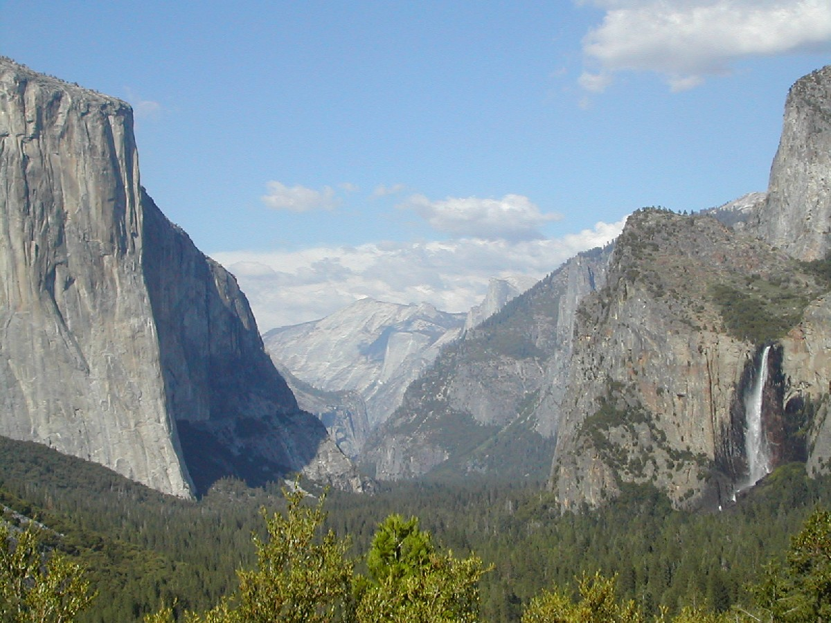
This picture best illustrates ...
Chemical weathering
Glacial erosion
Loess
Faulting

Slide 53
This picture best illustrates ...
Chemical weathering
Glacial erosion
Loess
Faulting

Slide 54
The process of water freezing in cracks of rocks which results in the cracking or splitting of rocks is ____
Frost wedgies
Chemical weathering
Frost wedging
Frost freezing

Slide 55
The process of water freezing in cracks of rocks which results in the cracking or splitting of rocks is ____
Frost wedgies
Chemical weathering
Frost wedging
Frost freezing

Slide 56
Which of the following is not an example of mechanical weathering
Frost wedging
Grass and weeds growing through the sidewalk
Acid rain
Mrs. Ashments driveway

Slide 57
Which of the following is not an example of mechanical weathering
Frost wedging
Grass and weeds growing through the sidewalk
Acid rain
Mrs. Ashments driveway

Slide 58
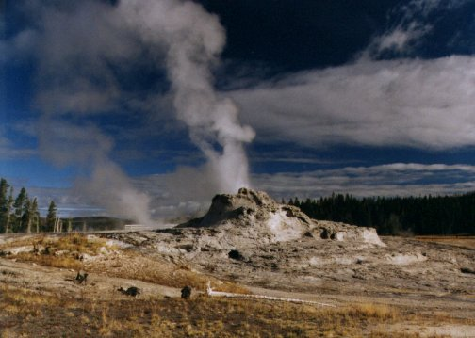
This picture best illustrates...
subduction
converging
hot spots
faulting

Slide 59
This picture best illustrates...
subduction
converging
hot spots
faulting

Slide 60
What kind of landform would most likely be found where two continental plates converge?
A trench
A rift valley
A mountain range
A mid-oceanic ridge

Slide 61
What kind of landform would most likely be found where two continental plates converge?
A trench
A rift valley
A mountain range
A mid-oceanic ridge

Slide 62
Which of the following is NOT an example of deposition?
Loess
Chemical weathering
Alluvial fan
Moraines

Slide 63
Which of the following is NOT an example of deposition?
Loess
Chemical weathering
Alluvial fan
Moraines

Slide 64
There are currently no glaciers in Utah.
True
False

Slide 65
There are currently no glaciers in Utah.
True
False

Slide 66
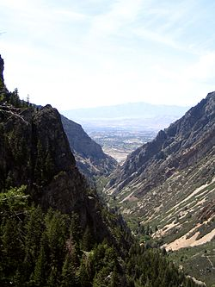
The distinctive shape of this landform is caused by ...
Wind deposition
Glacial erosion
Water deposition
Water erosion

Slide 67
The distinctive shape of this landform is caused by ...
Wind deposition
Glacial erosion
Water deposition
Water erosion

Slide 68
The layer of the earth just under the crust but above the mantle is called the lithosphere ?
True
False

Slide 69
The layer of the earth just under the crust but above the mantle is called the lithosphere ?
True
False

Slide 70
The difference in elevation between the highest and lowest points in an area is known as ___.
Relief
Latitude
Altitude

Slide 71
The difference in elevation between the highest and lowest points in an area is known as ___.
Relief
Latitude
Altitude

Slide 72
The main difference between lava and magma is whether it is found inside or outside of the earth’s surface?
True
False

Slide 73
The main difference between lava and magma is whether it is found inside or outside of the earth’s surface?
True
False

Slide 74
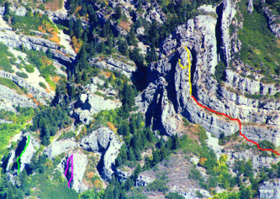
The landform in this picture was creating by ...
Seafloor spreading
Volcanic eruptions
A meteor shower
Converging plates

Slide 75
The landform in this picture was creating by ...
Seafloor spreading
Volcanic eruptions
A meteor shower
Converging plates

Slide 76
The process of changing a rock’s makeup or turning one kind of rock into a completely different kind is called ___.
Mechanical weathering
Chemical weathering

Slide 77
The process of changing a rock’s makeup or turning one kind of rock into a completely different kind is called ___.
Mechanical weathering
Chemical weathering

Slide 78
What kind of landform would most likely be found where two oceanic plates diverge?
A mid-oceanic ridge
A trench
A mountain range
A rift valley

Slide 79
What kind of landform would most likely be found where two oceanic plates diverge?
A mid-oceanic ridge
A trench
A mountain range
A rift valley

Slide 80
This diagram will be on the test. You will need to identify the features.

Slide 81
Match the letters to the names
Archipelago
Canyon
Delta
Hills
Inlet
Isthmus
Lake
Ocean
Peninsula
Plain
Plateau
Strait

Slide 82
Match the letters to the names
Archipelago K
Canyon E
Delta F
Hills H
Inlet J
Isthmus B
Lake A
Ocean G
Peninsula C
Plain I
Plateau D
Strait L

Slide 83
After this review, how well do you think you will do on the test?
ACE
Better than last test
I need to study more.
I really need to study more!

