Slide 1
Let’s Explore Our Earth

Slide 2
Let’s start by trying an experiment…
I am going to show you several words. Without writing anything down try to memorize as many of the words you can.

Slide 3
Hair Lungs Belly Button
Nails Liver Eyelashes Brain Lips Heart
Skin Intestines Bones

Slide 4
Now take out a pencil and paper and write down as many of the words that you can…

Slide 5
How many words did you get right?
Hair Lungs Belly Button
Nails Liver Eyelashes Brain Lips Heart
Skin Intestines Bones

Slide 6
What technique or tricks did you use to memorize the words?

Slide 7
Did you notice that all the words related to the human body?
Hair Lungs Belly Button
Nails Liver Eyelashes Brain Lips Heart Skin Intestines Bones
Is there anyway to break up the words into categories?

Slide 8
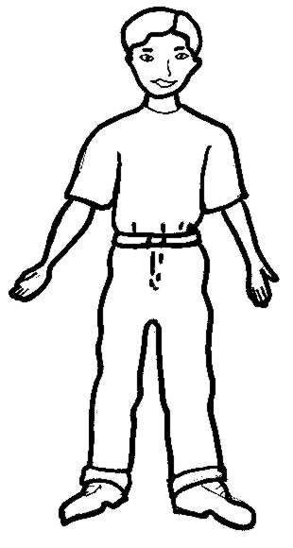
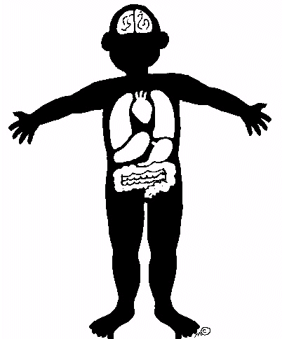
What about the inside (internal) and the outside (external) of the body?
External Hair Belly Button Nails Eyelashes Lips Skin
Internal Lungs Liver Brain Heart Intestines
Bones

Slide 9
Brain Research
Our brain wants to do the least amount of work possible
When our brain encounters new information it wants to categorize it
If we can make one connection to information we can remember it better (compared to random information)
If we can make two connections to information, we can remember it even better!

Slide 10
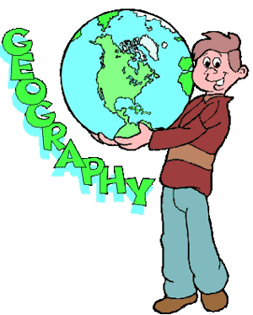
What in the world does all of this have to do with geography?
Let’s open our textbooks to find out.

Slide 11
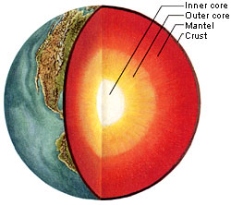
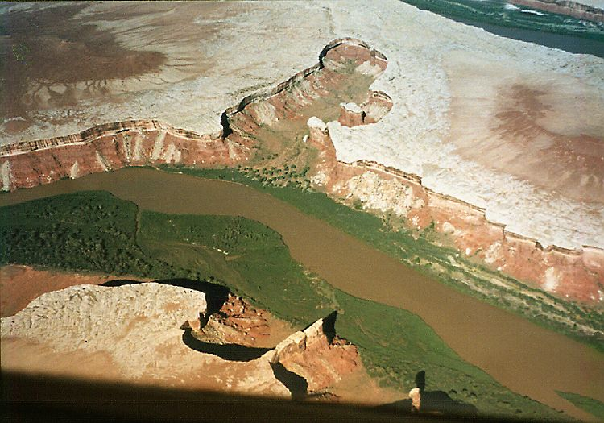
What are Sections 2 and 3 in Chapter 1 about?
Section 2: Changes Within the Earth
Section 3: Changes on the Earth’s Surface
Internal
External

Slide 12
So what kind of changes do you think happen within or inside of the earth?
To fully answer that question we are going to need to take a closer look at the planet we live on.

Slide 13
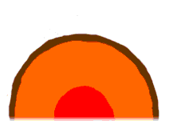
The Earth’s Structure

Slide 14
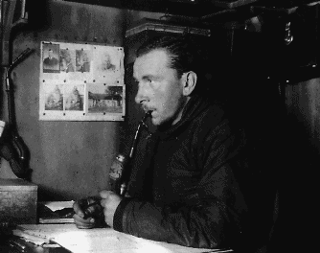
Alfred Wegener questions the earth in the early 1900s

Slide 15
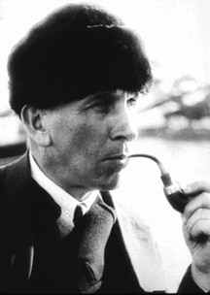
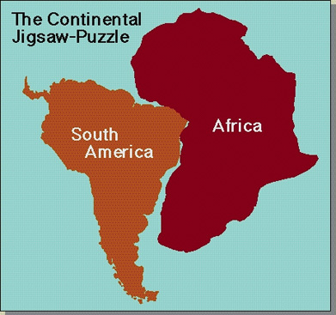
Many wondered if the continents had once been together but drifted apart because many (1) continent coastlines look like pieces of a puzzle.

Slide 16
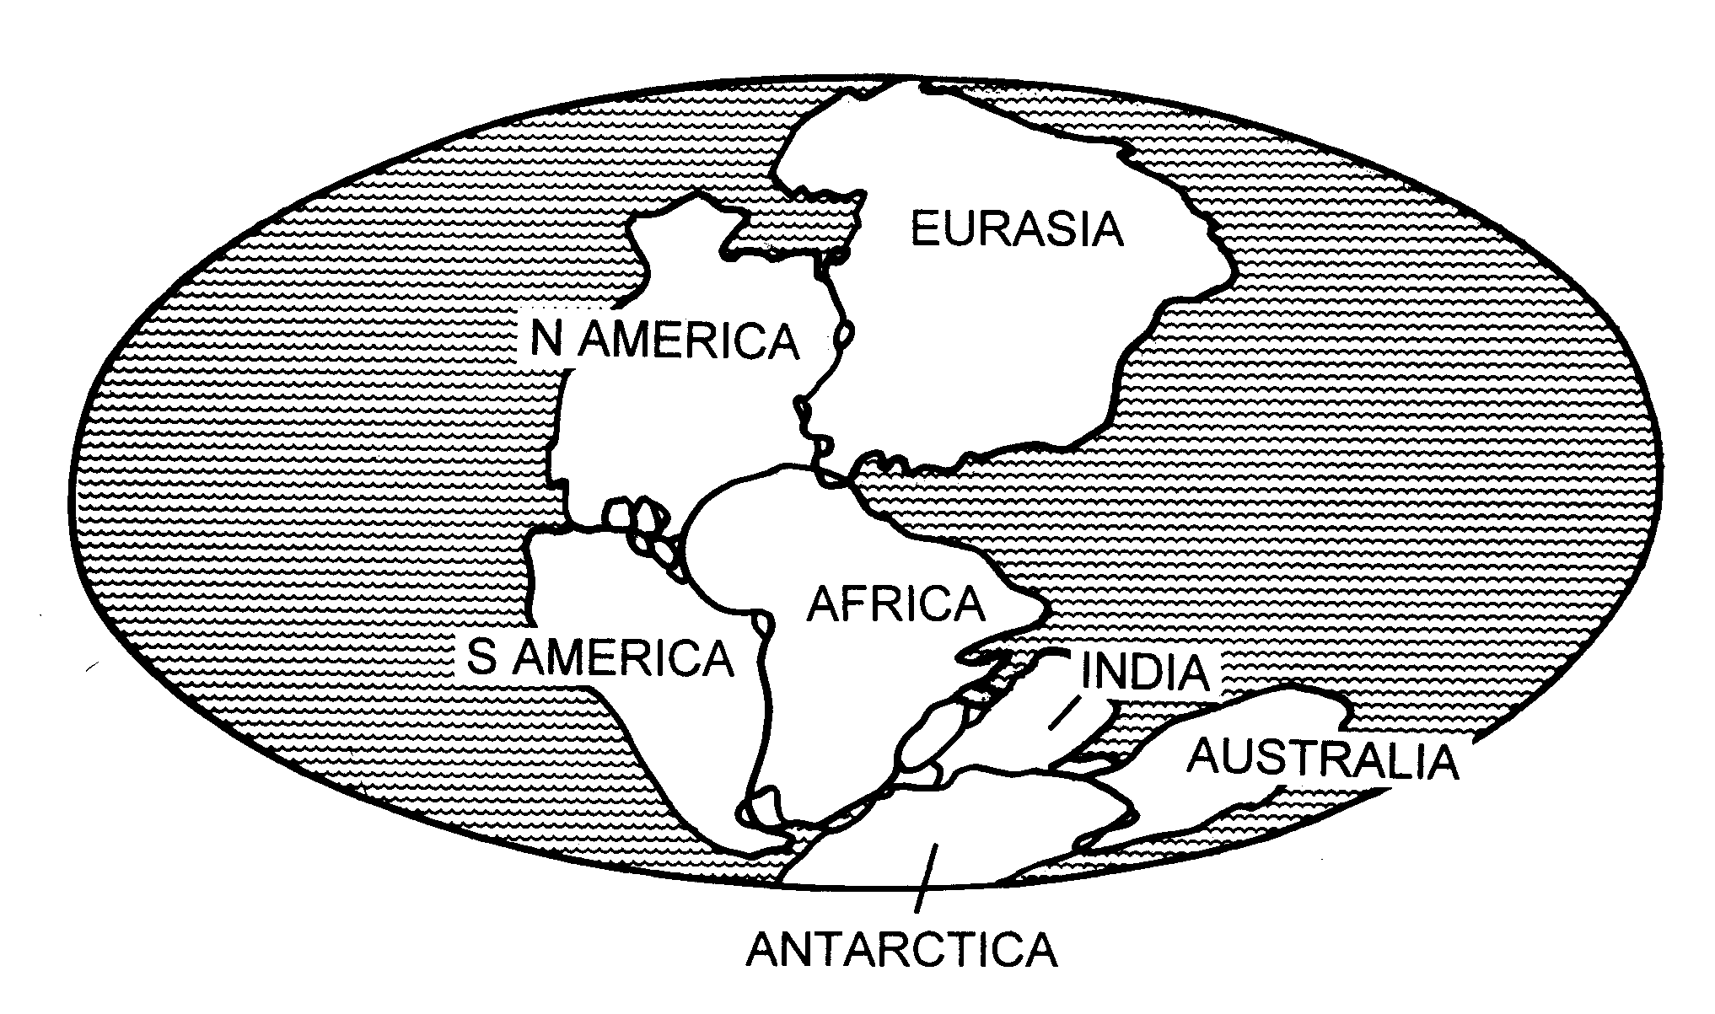
Wegener believed that a long time ago all the land on earth was one huge super-continent called Pangaea

Slide 17
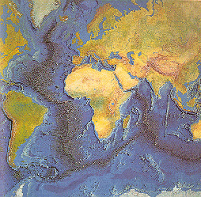
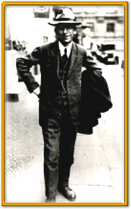
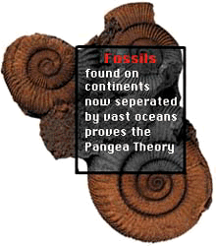
Wegener searches for more proof.

Slide 18
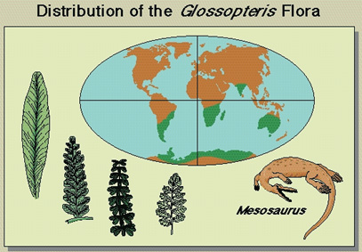
(2) Fossils on different continents match!

Slide 19
(3)Age of rocks on ocean floor Sea Floor Spreading

Slide 20
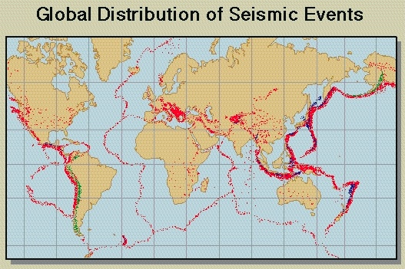
(4)Pattern of Earthquakes and volcanoes at plate boundaries

Slide 21
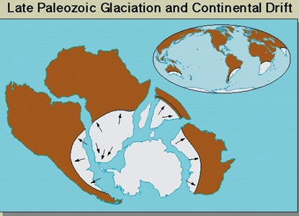
(5)Evidence of Glaciers in what is now tropical areas

Slide 22
(6) Magnetism in Rocks

Slide 23
(7) GPS measurments
http://sideshow.jpl.nasa.gov/post/series.html

Slide 24
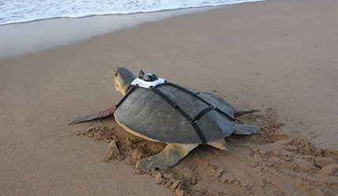
(8) Sea Turtles?
Female sea turtles return to the beach they were born on to lay their eggs.
During the rest of the year, they may travel thousands of miles in the ocean.
Scientists tagged female sea turtles on beaches in Gabon (West Coast of Africa). The same turtles retuned to the same beaches to lay their eggs.
Later the same turtles were identified off the coast of Brazil and Argentia in South America.

Slide 25
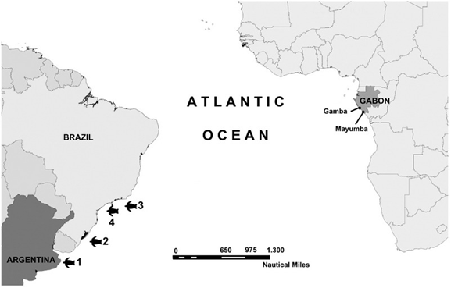
Why do you think the turtles would swim clear across the Atlantic ocean to lay their eggs in Africa if they do most of their feeding in South America?

Slide 26
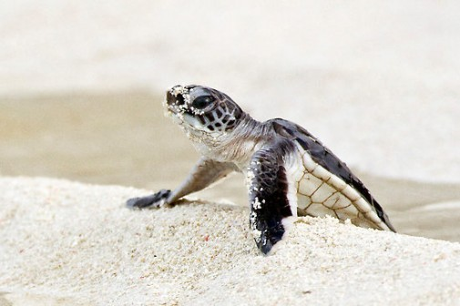
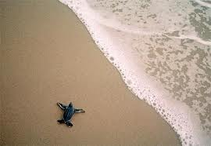
Could it be this migration pattern began when the continents were much CLOSER and continued through time?

Slide 27
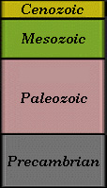
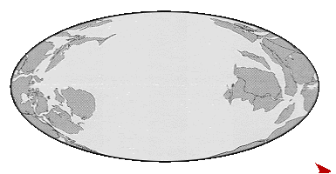
Continental Drift Theory

Slide 28
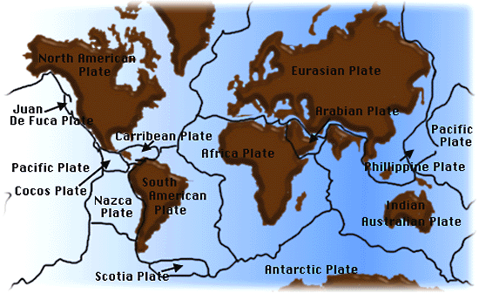

Slide 29
But it is still a… THEORY

Slide 30
Mr. Miyagi’s Method of Plate Tectonics

Slide 31
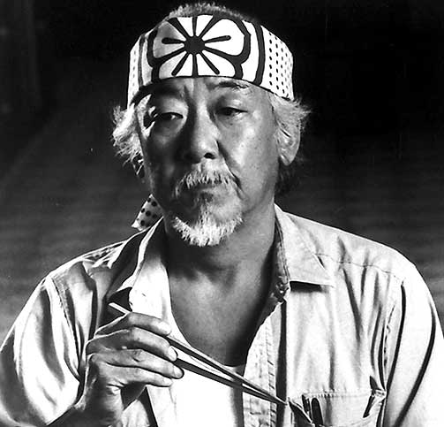
Mr. Miyagi’s Method of Plate Tectonics
“I am a Master of Plate
Tectonics—I’m from Japan.”
Daniel couldn’t understand what force
was powerful enough to move
an entire continent.
But, what can be
that powerful?!?

Slide 33
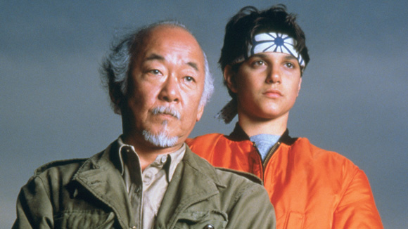
What was Daniel supposed to learn by waxing cars?

Slide 34
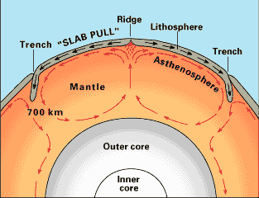
So according to this theory, what drives the plates?

Slide 35
Plate Tectonics : A Continuous Process We live on the Earth's outermost part, the crust. This layer of solid rock is actually divided into several 'pieces', which we term 'plates', as they seem to 'hold‘ and contain the land or sea above them, just as normal plates carry food. These plates lie above the magma and are moved by the convection currents of the mantle. This continuous movement is called the 'plate tectonics'.

Slide 36
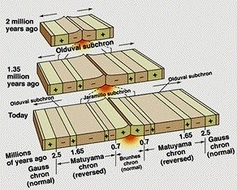
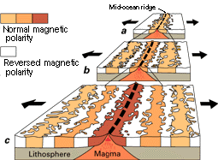

Slide 37
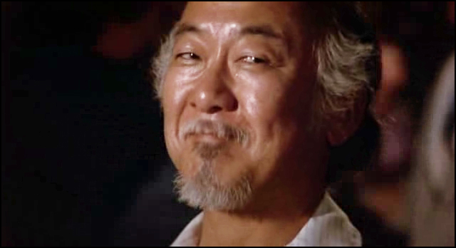
Daniel’s teacher expected him to know what happens where plates meet. Mr. Miyagi performs a miracle to help Daniel to understand plate boundaries. See if you can figure out the 3 major plate movements…

Slide 39
There Are Basically 3 Types Of Plate Movements:
Collide Slide Divide

Slide 40
There are basically 2 types of plates: 1. Oceanic Plates 2. Continental Plates

Slide 41
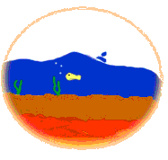
What Are Oceanic Plates? Oceanic plates, as the name goes, are crusts which 'carry' the oceans above it. It is made of lighter but denser materials than the continental crust.

Slide 42
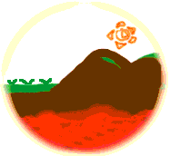
What Are Continental Plates? Continental plates are crust that have continents and some areas of ocean on them. They are usually named after the continents they 'carry'.

Slide 43
Convergent Plate Movement When two plates move towards each other, they collide. This is called a convergent plate movement.

Slide 44
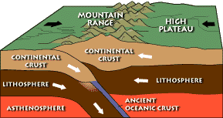
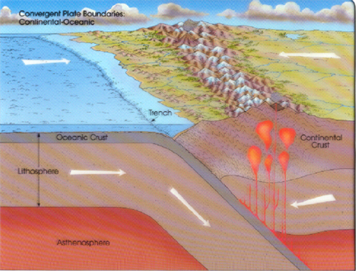
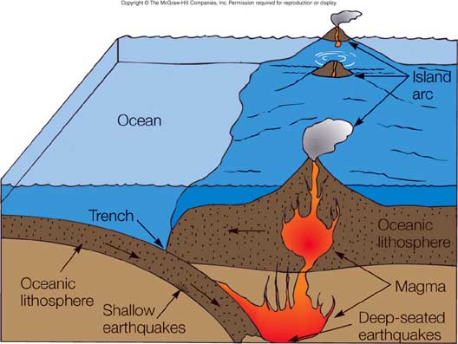
Convergent Boundaries
Continental-Continental
Converging
Oceanic-Continental
Subduction
Oceanic-Oceanic
Subduction

Slide 45
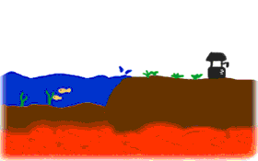
SUBDUCTION: When a continental plate and an oceanic plate collide, subduction occurs. The oceanic plate sinks under the continental plate because it is denser.

Slide 46
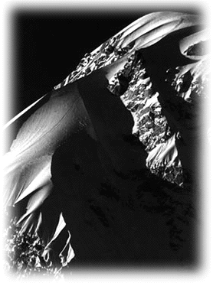
When Two Continental Plates Converge When two continental plates converge, one plate will be forced only slightly under the other, but no subduction will take place. Thus, the pressing together of two plates will fold the crust and forms what we known as fold mountains.
More well-know examples of folded mountains are
the Himalayas in Asia and the Andes in South America.

Slide 47
When Two Oceanic Plates Converge Similarly, when one oceanic plate converge, the other oceanic plate may subduct beneath the other. However, there is no head-on collision for two oceanic plates. Magma will then rise up to form volcanoes.

Slide 48
Divergent Plate Movement A divergent plate movement occurs when two plates move away from each other.

Slide 49
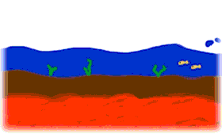
Convection Currents Divergent plate movement can cause magma from the mantle underneath the crust rises up to the surface to cool and solidify at the plate boundary.

Slide 50
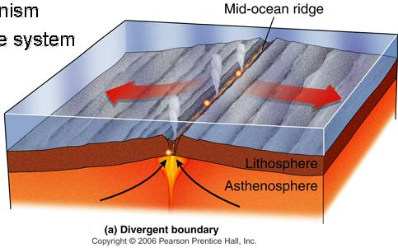
Divergent movement takes place at the boundary of the oceanic plates and forms new sea floor. This process is called sea-floor spreading.

Slide 51
What is an “Oceanic Ridge?”
As magma rises up to the surface, it piles up and solidifies, slowly forming a long chain of mountains on the ocean floor, called an oceanic ridge.

Slide 52
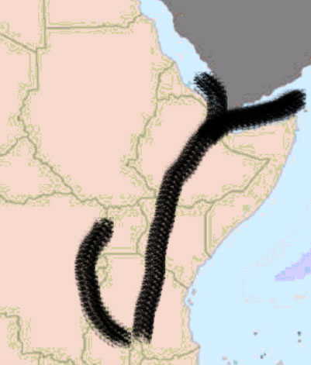
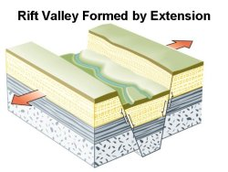
Rifting
On land, divergent boundaries often create “Rift valleys”

Slide 53
Transform Plate Movement A transform plate movement is one where two plates slide laterally past each other. However, movement is not smooth due to friction between the rocks of the two plates

Slide 54
Faulting

Slide 55
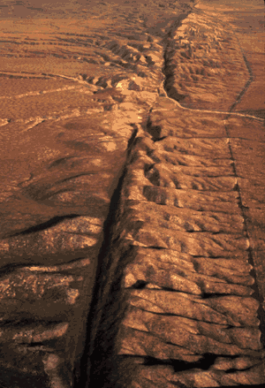
Therefore, sometimes the two plates would get 'stuck’ and lock together. But since the convection currents of the underlying magma are still dragging the plates, much tension and pressure is built up at the transform boundary. When there is sufficient buildup of pressure, rocks in the plates break and get jerked apart. This results in earthquakes.

Slide 56
Earthquakes: registering 1 on the Richter Scale Effect: Unnoticeable

Slide 57
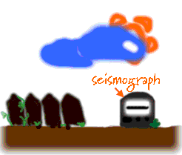
Earthquakes: registering 2 on the Richter Scale Effect: Detected By Instruments Only

Slide 58
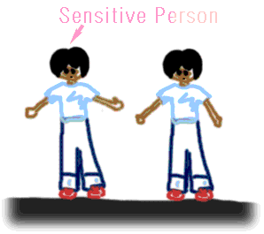
Earthquakes: registering 3 on the Richter Scale Effect: Noticed By Sensitive People Only

Slide 59
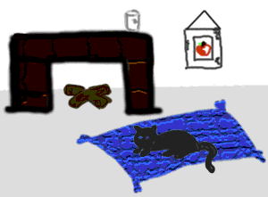
Earthquakes: registering 4 on the Richter Scale Effect: Faint Tremor And Vibration Of Loose Objects (eg. Hanging Lamps, Small Portraits On The Wall)

Slide 60
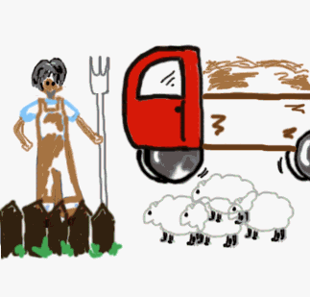
Earthquakes: registering 5 on the Richter Scale Effect: Felt By Almost Everyone And Objects Drop (eg. Cup Fall Of Table)

Slide 61
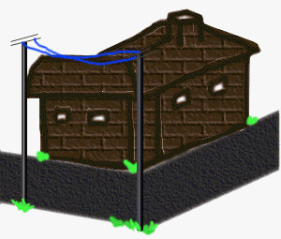
Earthquakes: registering 6 on the Richter Scale Effect: Distinct Violent Vibration Which Makes Chimneys And Badly Constructed Houses Collapse

Slide 62
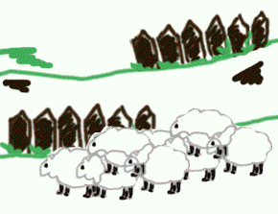
Earthquakes: registering 7 on the Richter Scale Effect: A Major Earthquake Causing Wide Cracks In The Ground. Many Buildings Are Damaged Or Destroyed, Landslides Also Occur

Slide 63
Earthquakes: registering 8 on the Richter Scale Effect: Very Major Earthquake Of Mass Devastation. Even Sturdy Concrete Structures Are Destroyed

Slide 64
Plate boundaries are zones of movement and
instability, therefore a lot of interesting
geographical features occur there.
Let us look at some features that we are familiar with.

Slide 65
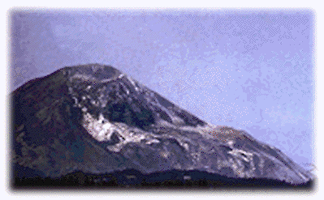
Volcanoes A volcano, by geographical definition, is any conical or dome-shaped structure that is formed as a result of magma escaping to the surface of the Earth through an opening which we call a vent. There are various types of volcanoes, ranging from flat shield-shaped ones to tall and steep ones.

Slide 66
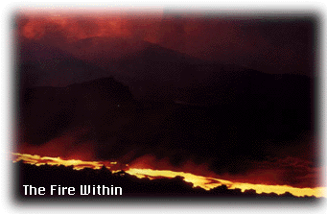
Volcanic Activities Volcanic activities occur frequently at areas of plate boundaries. Plate tectonics causes movement in the plates and crust, resulting in cracks being formed. These cracks allows the pressure underneath the crust to push the magma, or sometimes water and steam, up the crust. Features like volcanoes, geysers and hot springs are formed in these areas.

Slide 67
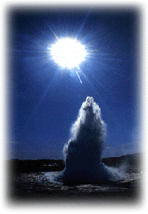
Geysers
A geyser is a very violent ejection
of hot water and steam through
a vent.
This steam is the product of the
water being boiled underground
by the hot magma and gets released through the vent.
This ejection of the hot water
and the steam occurs at intervals as
there must be sufficient water and
steam before the next eruption can occur.

Slide 68
Yellowstone National Park

Slide 69
Evidence of Pangaea
Continental Jigsaw puzzle
Fossils
Age of rocks on sea floor (spreading)
Pattern of Earthquakes and Volcanoes
Evidence of Glaciers in Tropical Areas
Magnetism in Rocks
GPS measurements
Sea Turtles

Slide 70
What an AMAZINGWorld We Live In!

