Slide 1
5 themes of geography

Slide 2
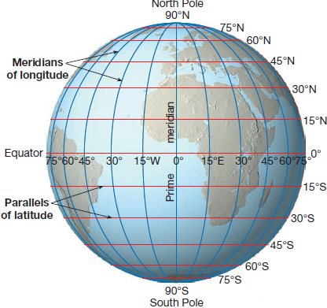
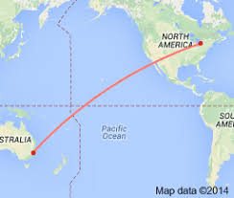
1. LOCATION
Where is it located?
Absolute Location-Specific. Measured using Latitude and Longitude.
Relative Location- Measures where something is in relation to another place. Uses direction, distance or time.

Slide 3
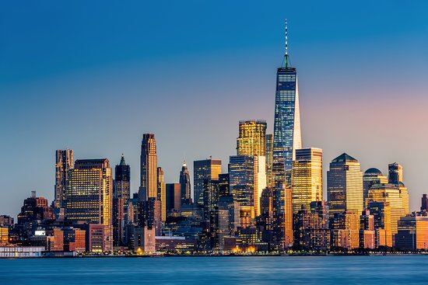
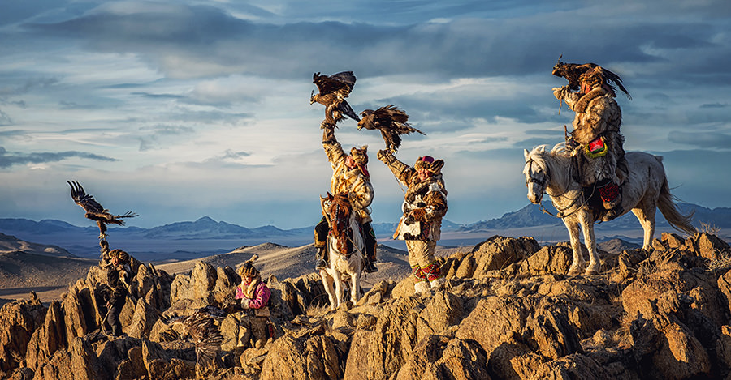
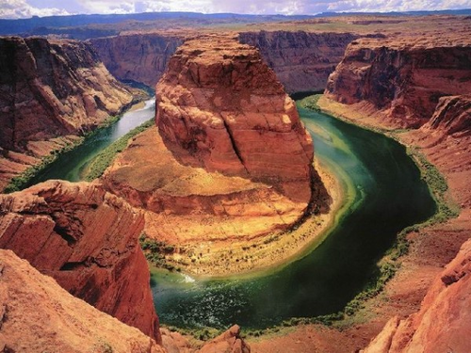
2. Place
What is it like there?
Place tells us the PERSONALITY of a location using HUMAN and PHYSICAL characteristics

Slide 4
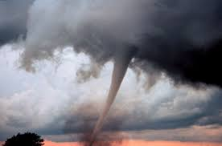
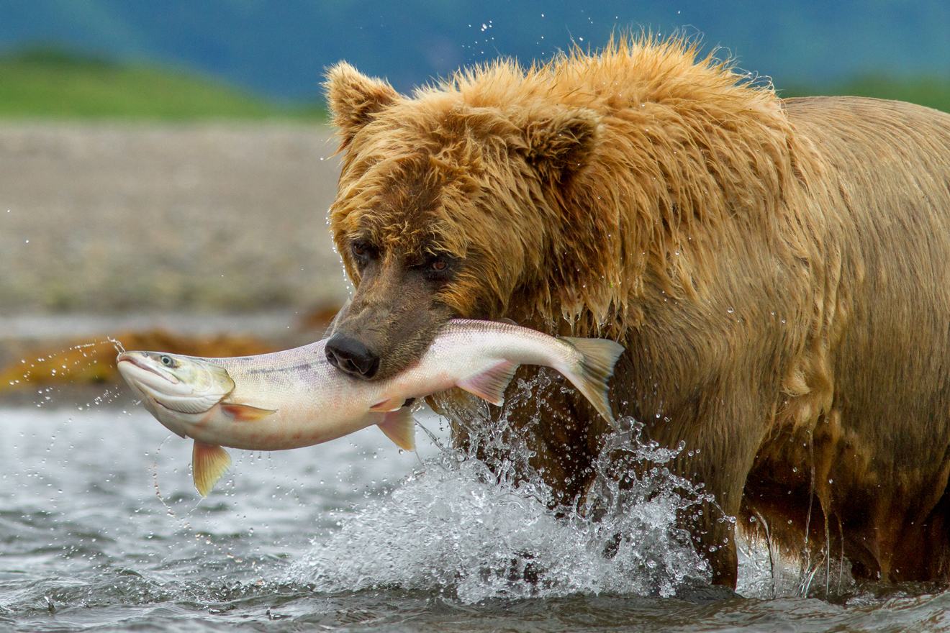
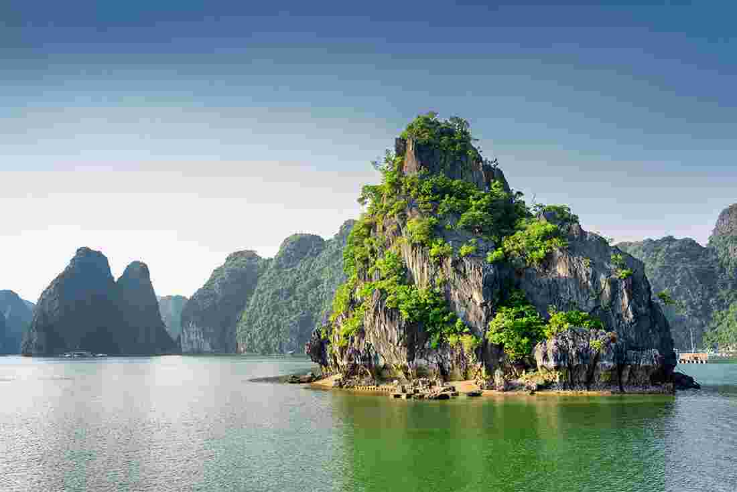
Physical characteristics
Naturally Occurring
Ex. Climate Landforms
Landscape Animals
Vegetation

Slide 5
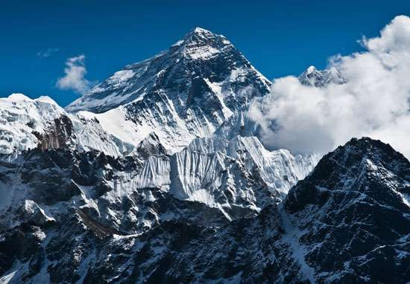

Slide 7
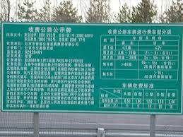
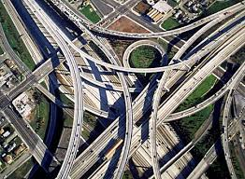
Human Characteristics
“Man-Made”
Not in the natural World
Ex. Language
Culture
Religion
Buildings
Roads
Cities

Slide 9
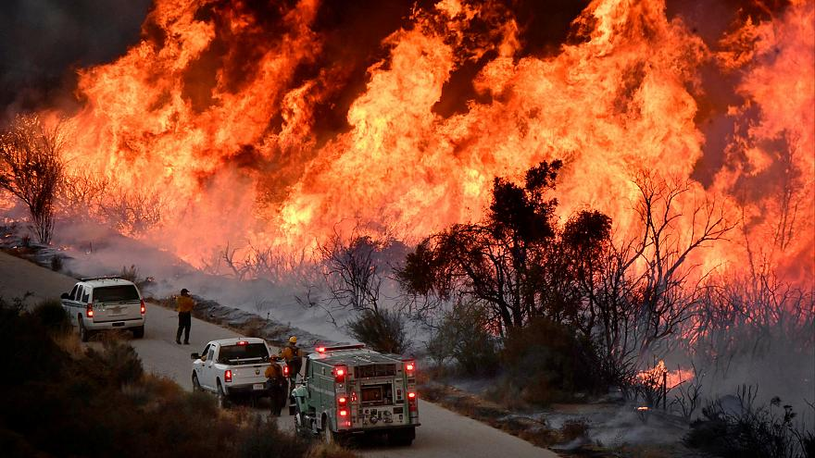
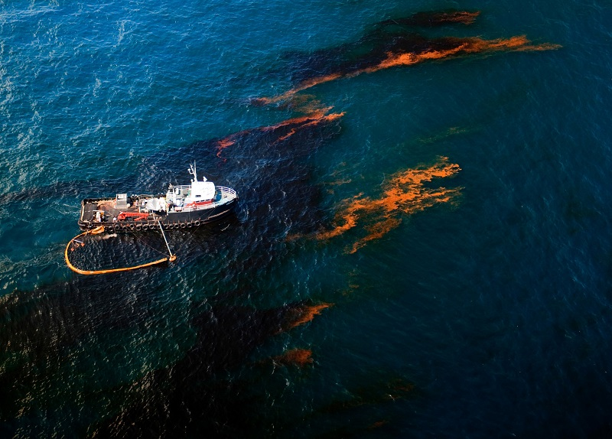
3. Human Environment Interaction
How do people interact with their environment?

Slide 10
In your notes…
List 5 ways humans affect their environment? (positive or negative)

Slide 11
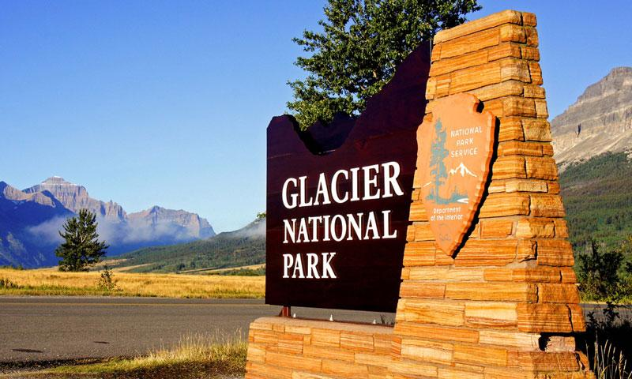
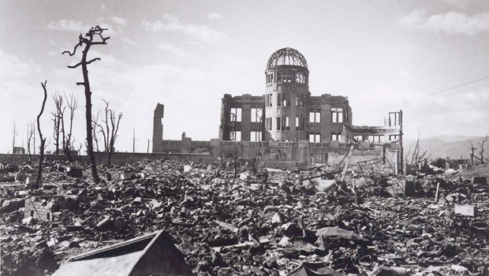
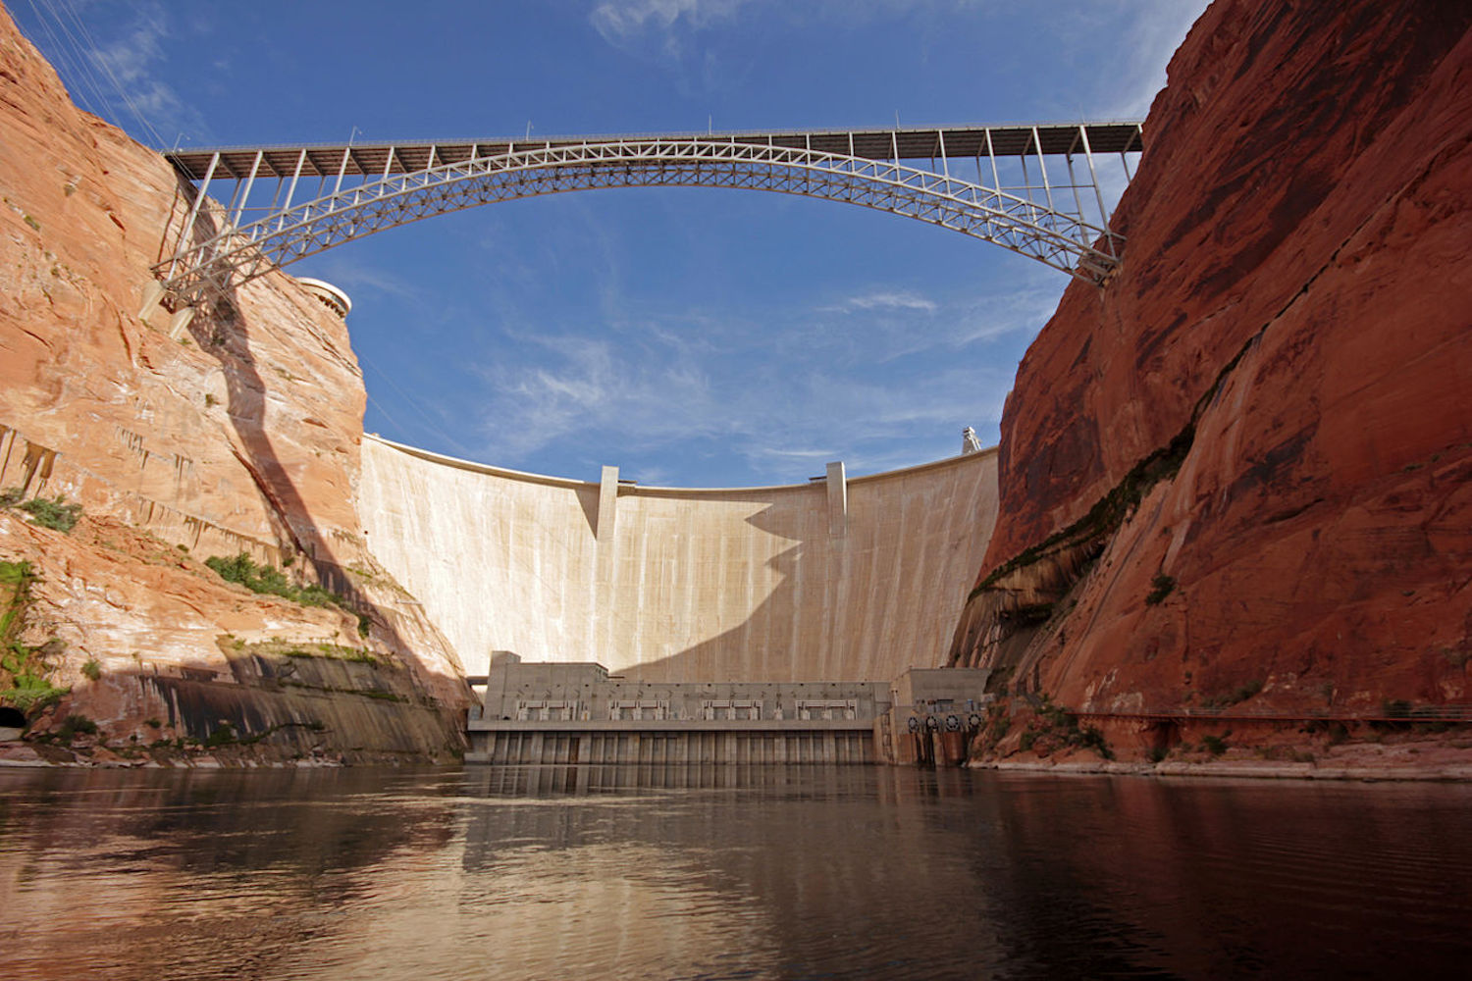

Slide 12
In your notes….
List three ways humans are affected by their environment

Slide 13
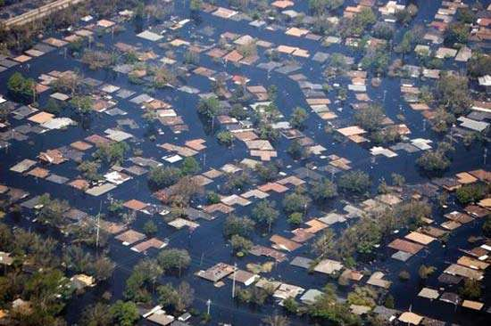
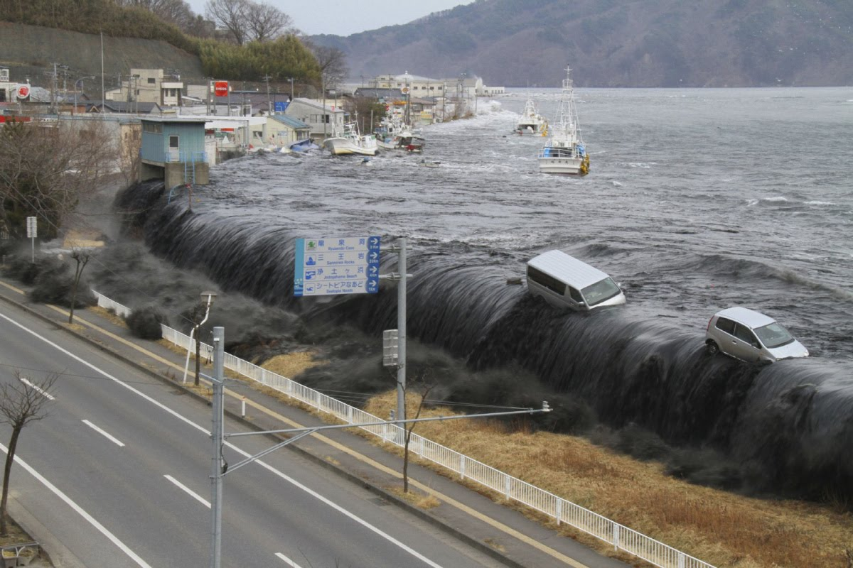
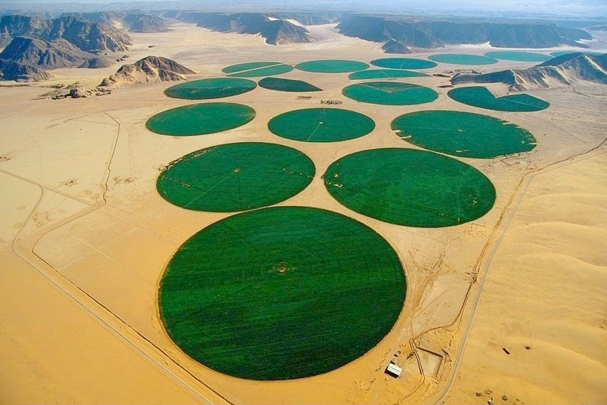

Slide 14
4. Movement
How do things move between places?

Slide 15
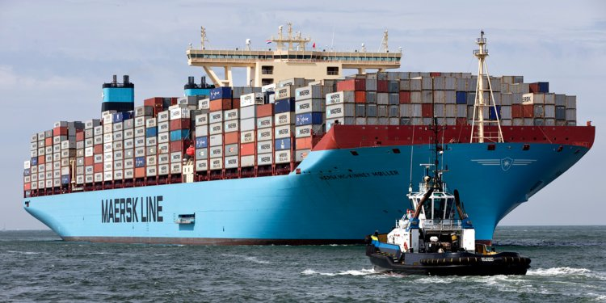
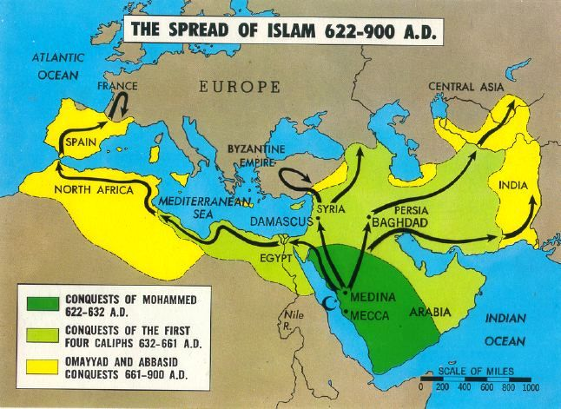

Slide 16
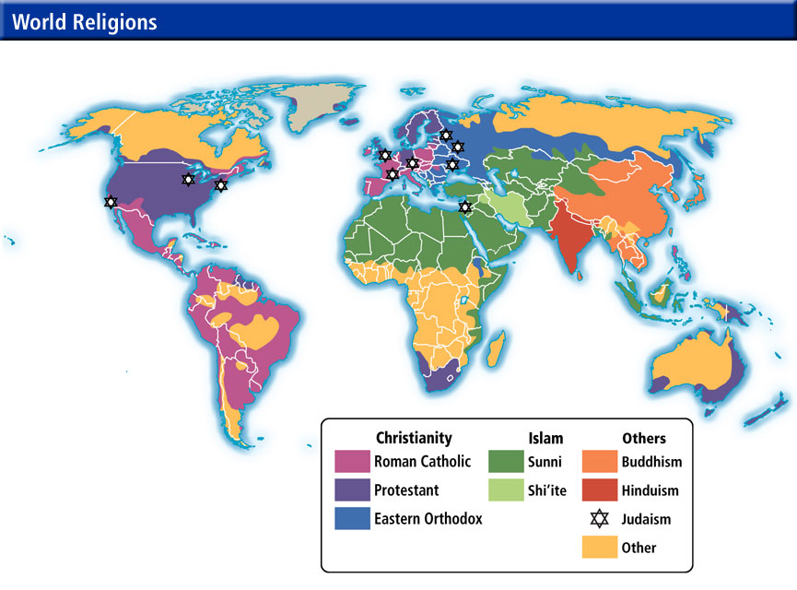
5. Region
How are places similar to other places?
What common characteristics do places share?
Ex. Language Climate
Culture Government
Religion

