Slide 1
WHAT IS GEOGRAPHY?
An Analogy with
“The Blind Men and the Elephant”

Slide 2
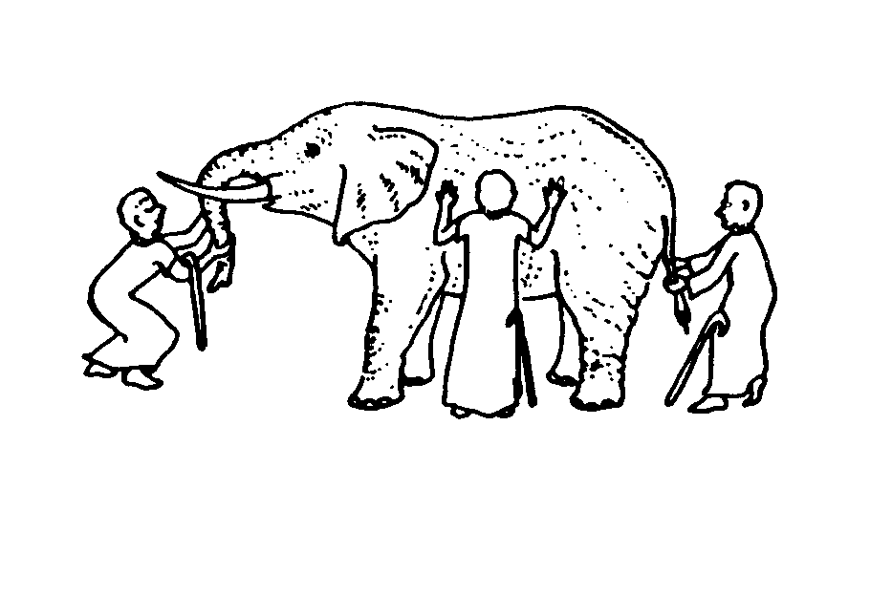
The Blind Men and the Elephant
By John G. Saxe
It was six men of [India]
To learning much inclined
Who went to see an elephant
(though all of them were blind)
That each by observation
Might satisfy his mind.

Slide 3
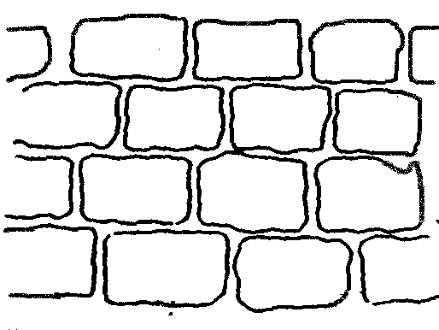
The first approached the elephant,
And happening to fall
Against his broad and sturdy side
At once began to bawl,
“God bless me! But the elephant
Is very like a wall!”

Slide 4
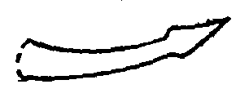
The second feeling of the tusk
Cried, “Oh! What have we here
So very round and smooth and sharp?
To me ‘tis very clear.
This wonder of an elephant
Is very like a spear!”

Slide 5
The third approached the animal,
And happening to take
The squirming trunk within his hands
Thus boldly up and spake:
“I see,” quoth he, “the elephant,
Is very like a snake!”

Slide 6
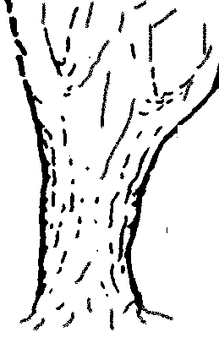
The fourth reached out his eager hand,
And felt about the knee;
“What most this wonderous beast is like
Is might plain,” quoth he;
“’Tis clear enough the elephant is very like a tree.”

Slide 7
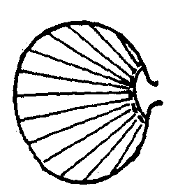
The fifth, who chanced to touch the ear
Said: “E’en the blindest man
Can tell what this resembles most
Deny the fact who can,
The marvel of an elephant
Is very like a fan!”

Slide 8
The sixth no sooner had begun
About the beast to grope,
Then seizing on the swinging tail
That fell within his scope,
“I see, “ quoth he, “the elephant
Is very like a rope!”

Slide 9
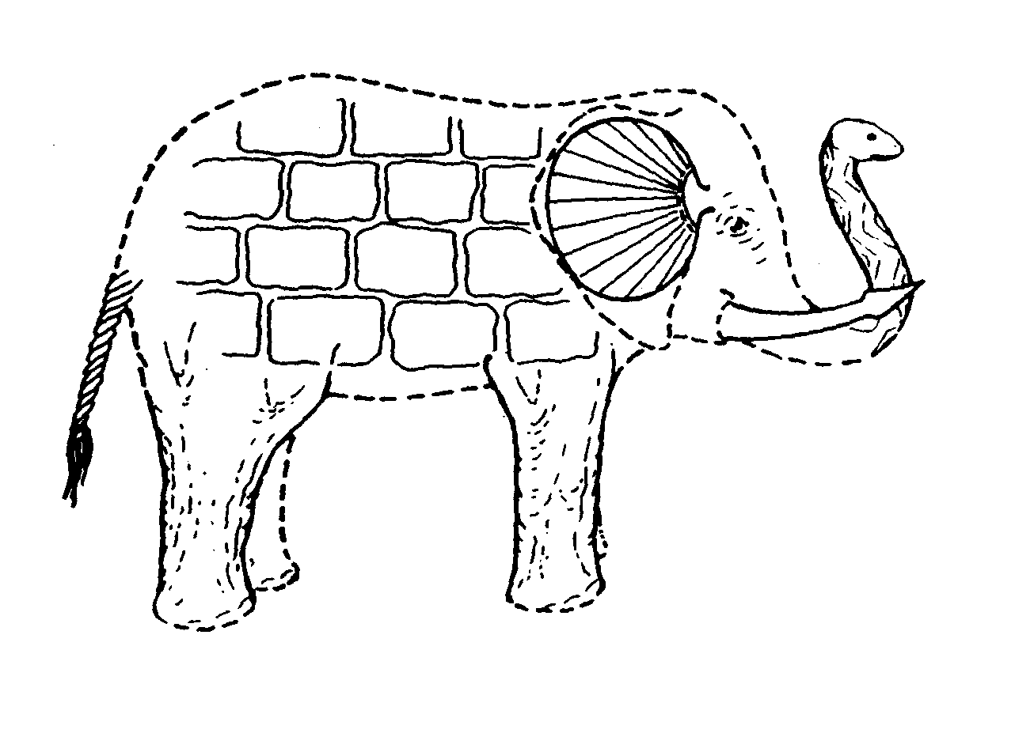
And so these men of [India]
Disputed loud and long,
Each in his own opinion
Exceeding stiff and strong,
Though each was partly in the right,
And all were in the wrong!

Slide 10
What does this story have to do with Geography?

Slide 11
What does this story have to do with Geography?

Slide 12
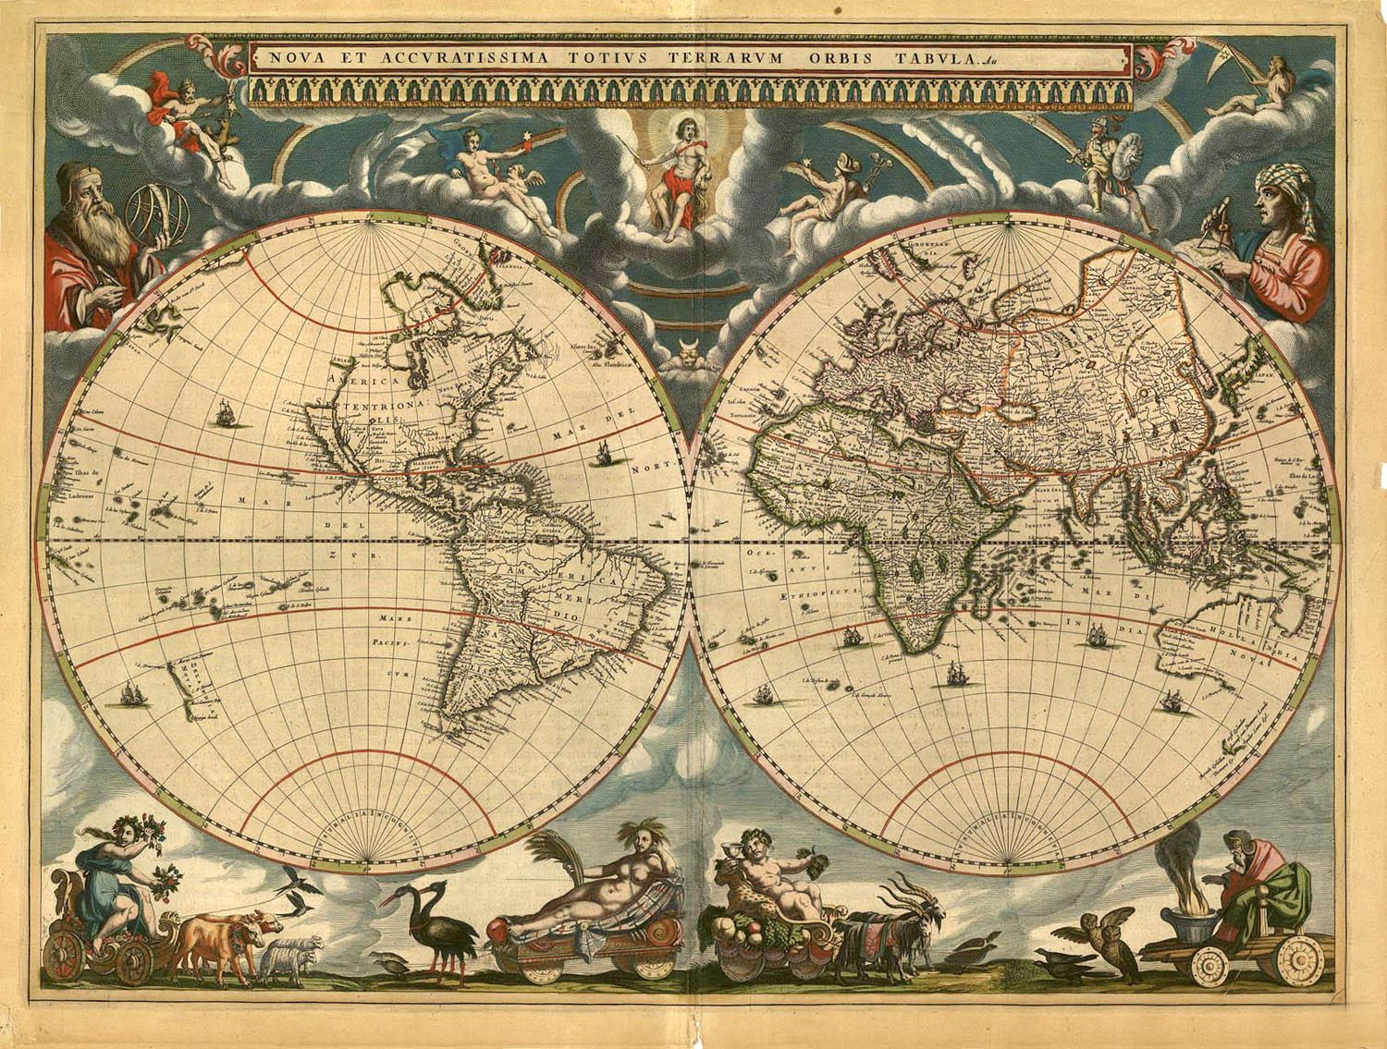
Let’s take a look at what Geography is so that we can see the BIG picture.
Remember: Each part is important to know, but all the parts together will help you understand.
Notes:
Examine the map from the 1600s. What “pieces” are missing? Why?

Slide 13
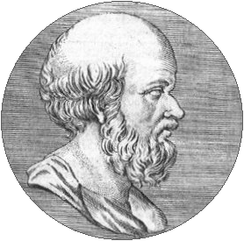
Geography is:
A definition.
The word Geography comes from the Greeks:
Geo = earth
Graphy = to write or describe
The Greeks were some of the first people to scientifically try to describe the earth
The Greek scholar Eratosthenes (276-194 BC) is considered to be the “Father” of Geography. He was the first to use the word “geography.” He also invented a latitude and longitude grid and measured the circumference of the earth to within 1% accuracy.

Slide 14
Geography is:
Another definition.
Your textbook has another definition
Turn to the glossary and copy down the definition on a T-chart with the 3 parts of the definition on the left, and leave the right for examples.
“. . . the study of the Earth’s surface and the processes that shape it;
example
example
and the complex relationship between people and the environment.”
example
example
the connections between places,
example
example
Notes:
List examples of each part of the definition in your notebook.

Slide 15
Geography is:
Yet another definition.
“. . . the study of the relationships between and the distribution of things on the earth.”
What does this definition add to the other two?
DISTRIBUTION
Think about how things are spread out on the surface of the earth. List in your notebook anything you think is distributed on the surface of the Earth.
Notes:
What does distribution mean?
World Geography Today? Sager, Robert J and Helgren, David M (Holt publishing)

Slide 16
Geography is:
Finally!
“. . . Concerned with how mankind
Uses nature
through culture
to organize the earth.
What does this definition add to the other three?
CULTURE- people think about and use the earth differently.
ORGANIZE- Geography is a way to organize things!

Slide 17
How do Geographers organize things?
Let’s try an experiment. List the first names of the members of your family (your immediate family--not cousins, aunts, uncles, grandparents, etc.)
Look over the list of names. How did you organize the list of family members?
Did you do it from oldest to youngest (chronologically)? If not, how did you decide the order of the names?
What are some other ways to organize things?

Slide 18
So another way to organize things is GEOGRAPHICALLY. When we organize things geographically it means that we organize things:
- According to where they are
in relation to SPACE! (Spatially)
- Can you think of an example where you might organize something geographically besides house numbers?
- It is quite normal to organize things geographically, but it is not the best way for everything!

Slide 19
Geographic Fields
Political
Regional
Economic
Physical
Geospatial Technologies
Cultural
Geography

Slide 20
Now that you have a better idea of what Geography is, it is time to think geographically.
Look over your definitions of geography and write at least 5 questions that you think are geographic in nature. Each questions should deal with a different aspect of geography.
Be prepared to explain why you think the questions are geographic in nature.
Here are some generic examples:
- Where is it?
- Why is it located there?
- How close or far away is it from other things?
- Is it found mostly in one area or is it spread out?
Notes:
Hint: A geographer is not so concerned with when the Panama Canal was built but in where it was built and why it was built there.

Slide 21
Now its time for the BIG picture.
You have learned a lot about Geography today. Now try to put all the pieces together by completing the following:
- In your notebook, list 5 reasons why it is important to study geography.
- Give this some real thought. It’s not just, “so we know where things are.”
- Be prepared to discuss your reasoning with Mrs. Ashment.
Notes:
Like the blind men, you have examined parts, but now its time to put the parts together—the big picture.

Slide 22
Quiz:
Write your responses to the following in your notebook:
What does the Greek root of Geography mean?
What does it mean to organize something geographically?
How are most history books organized?
How is geography similar to and different from other social science subjects?
Fill in the key words to this definition of geography:
Geography is concerned with how uses
through to the earth.

Slide 23
Quiz (continued):
Define distribution.
Which geographic field investigates things like earthquakes, volcanoes, weather, etc.?
Define density.
Explain how a geographic perspective could be used in a career.
You are talking to a friend and told her that you are taking a World Geography class. She wonders why you would take a whole class when you could just look things up on a map. Write how you would respond in a way that would help your friend understand that Geography is more than just place location.

