Slide 1
Gandhi India/Pakistan Independence

Slide 2
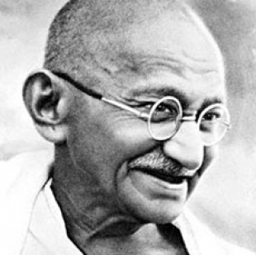
Mohandas K. Gandhi
“Mahatma” meaning great soul or holy one.
Lawyer
Nonviolent protest, collective action, non cooperation “Satyagraha”
“Indianness” transcends caste and religion

Slide 3
Teachings of Gandhi
“There are many causes that I am prepared to die for but no cause that I am prepared to kill for.”
“We must become the change we want to see in the world”
“If we want to reach real peace in this world, we should start educating children.”
“The weak can never forgive. Forgiveness is the attribute of the strong.”
“Live as if you were to die tomorrow. Learn as if you were to live forever.”

Slide 4
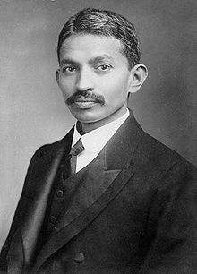
South Africa
Experienced injustices in South Africa
Getting thrown off a train.
In South Africa for 21 years
Fought for Indian rights
These experiences laid a foundation for the rest of his life.
Learned how to speak to rally people together in unity for a cause

Slide 5
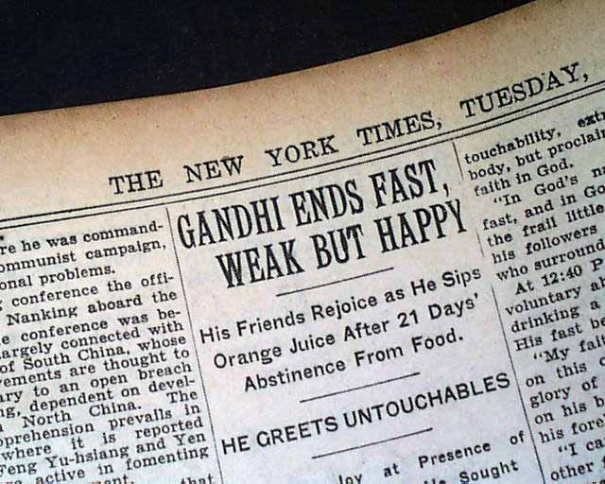
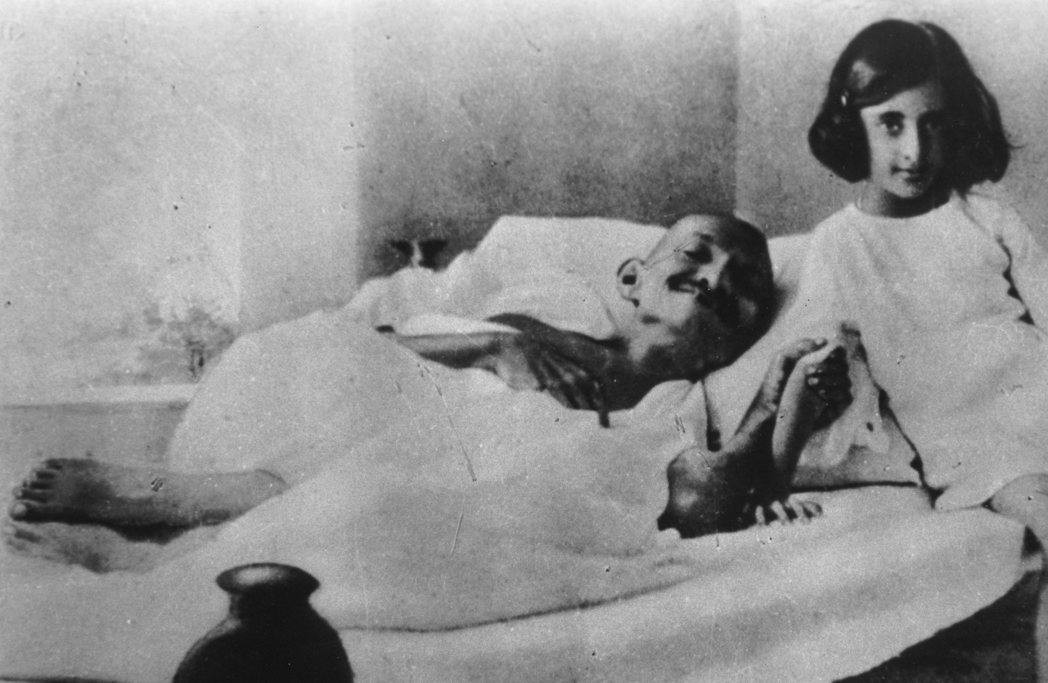
Fasting
Gandhi fasted for political causes but also to show sacrifice.
Fasted many times throughout his life to promote his cause.

Slide 6
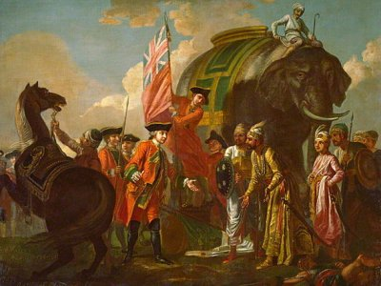
British oppression

Slide 7
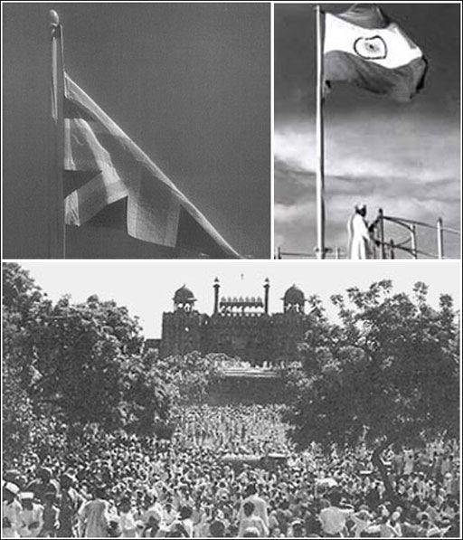
Independence
August 15, 1947
After WW2 Great Britain was weak and couldn’t maintain control. Left India pretty quickly
“The Great Divide” Partitioning of India

Slide 9
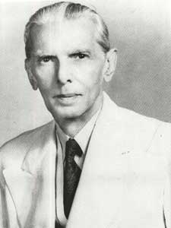
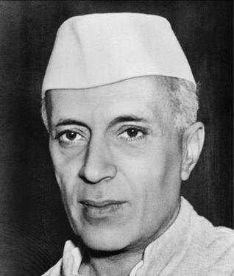
Muhammad Ali Jinnah Jawaharla Nehru
1st Governor/General of Pakistan 1st Prime Minister of India

Slide 10
Muslim Hindu Conflict
They had gotten along of about 30 years with Gandhi there fighting for their independence. But now it came to a boiling point.
This conflict was nothing new it had happened for years and years.
Muslim league – Indian National congress.
Hindu power was rising. Muslims were outnumbered.
Gandhi fasted for 21 days to make the fighting stop.

Slide 11
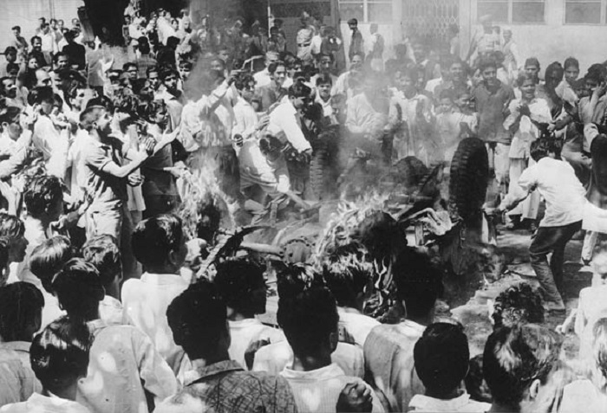

Slide 12
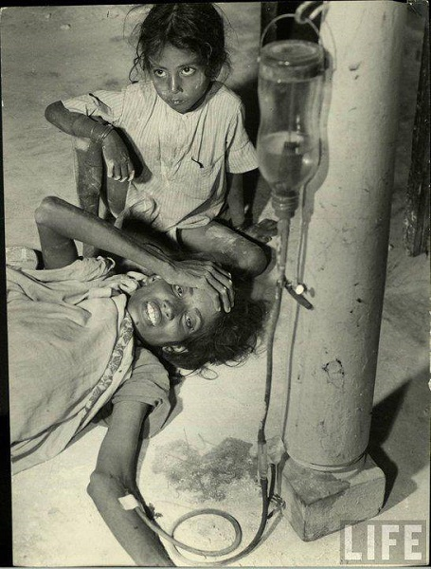
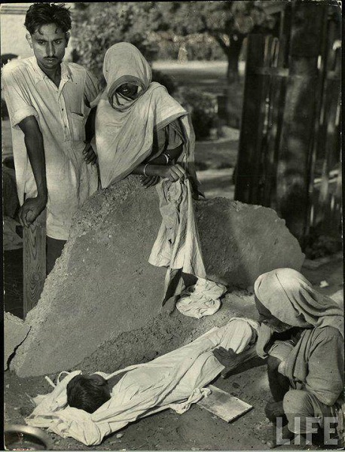
.
.

Slide 13
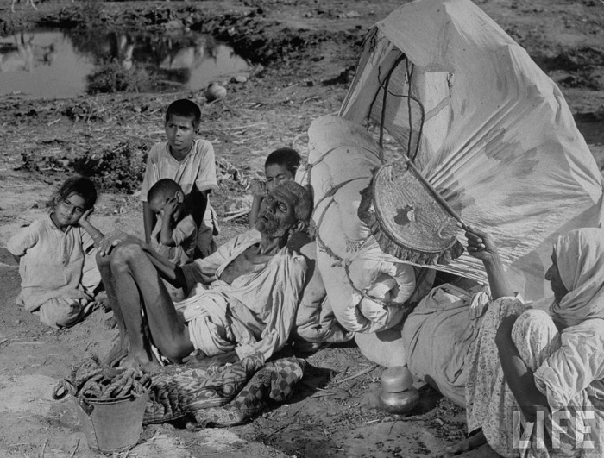

Slide 14
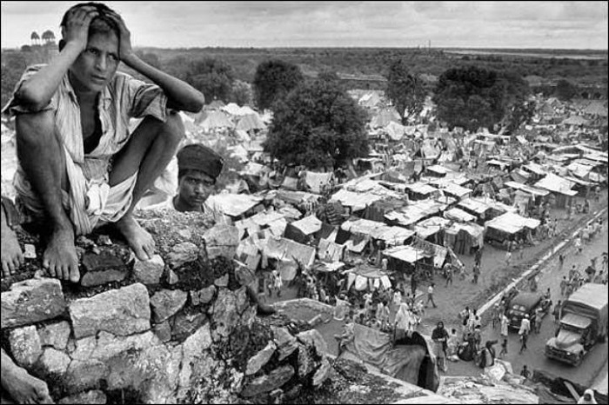

Slide 15
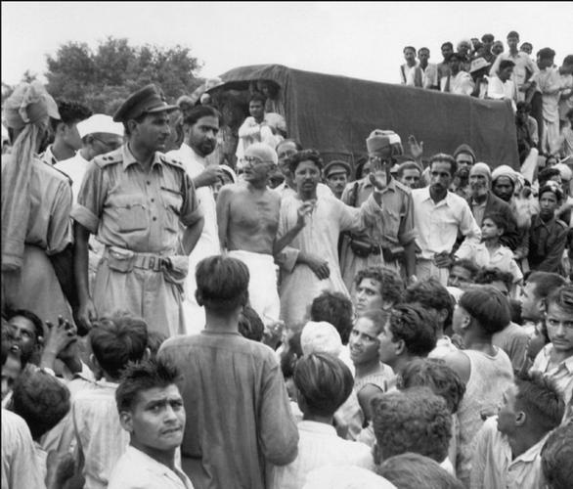
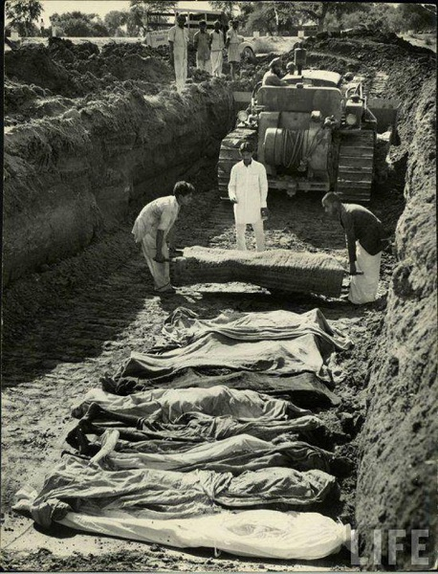

Slide 16
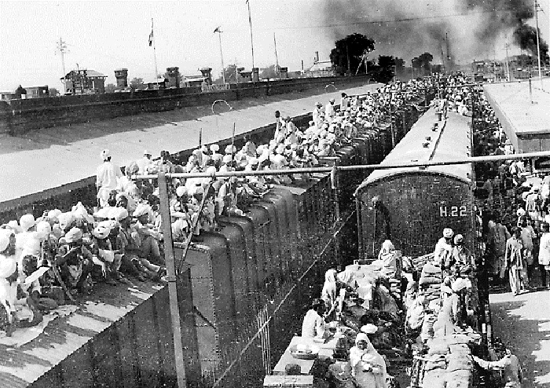

Slide 17
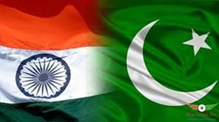
Pakistan and India Today
India’s population, its defense budget, and its economy are seven times as large as Pakistan’s.
Since the Partition, the two countries have fought 3 major wars, one undeclared war, and have been involved in other skirmishes.
Pakistan has the 6th largest army in the world and is declared as a nuclear weapon state.

