Slide 2
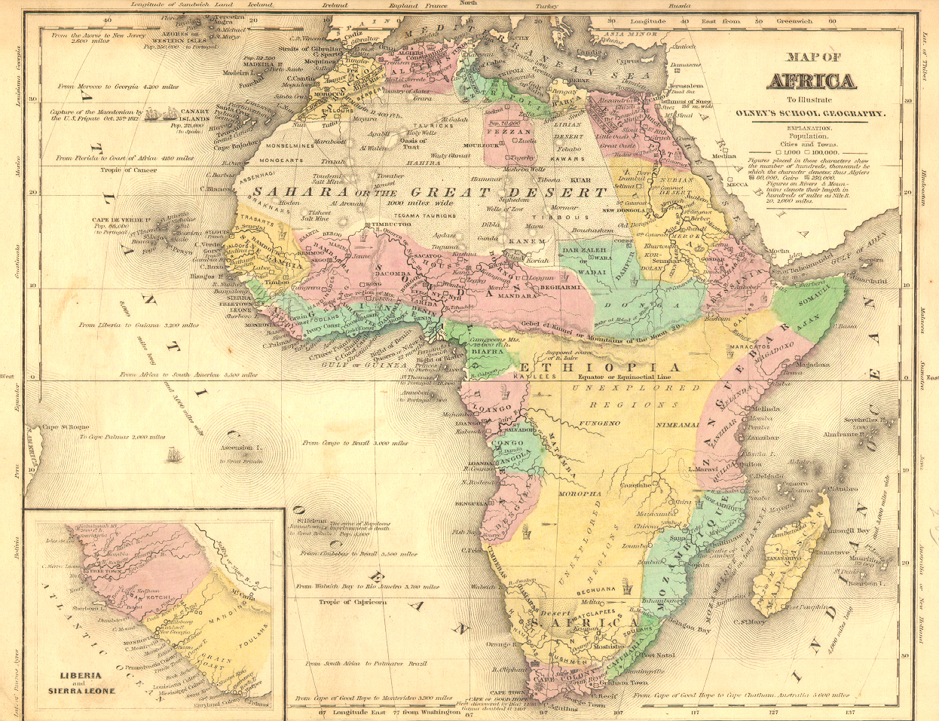
Africa
Geographical and Historical Overview

Slide 3
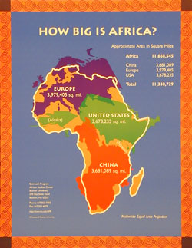

Slide 4
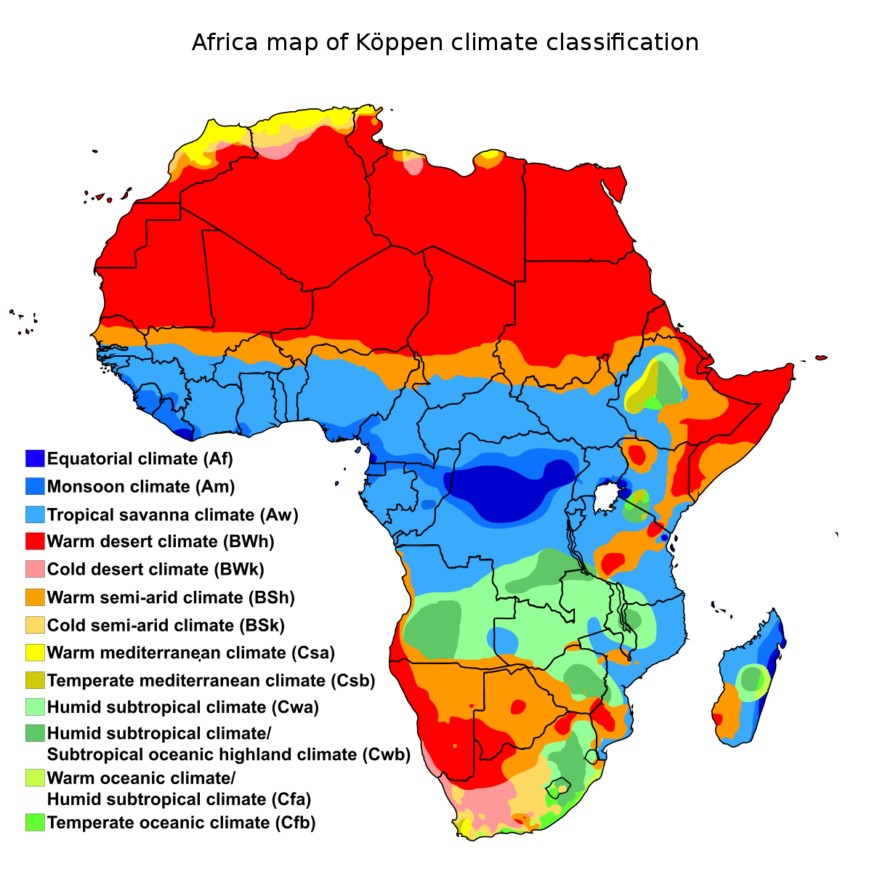
Geography
What is Sub Saharan Africa?
What is the geography like?
How would the climate affect native culture?

Slide 5
What are major physical features in Africa?

Slide 6
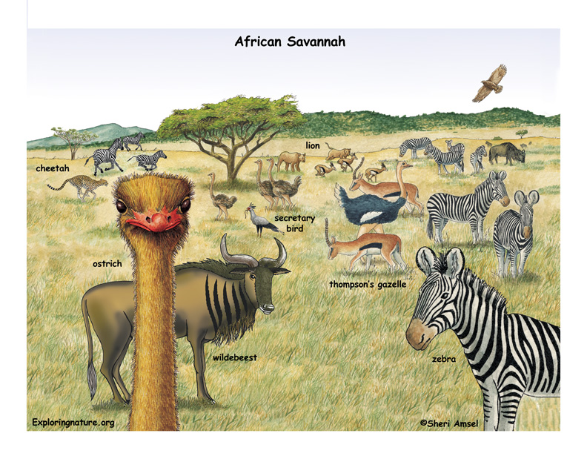
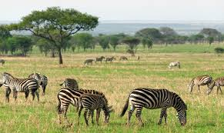
The Savanna
A grassy plain in subtropical Africa with few trees.

Slide 7
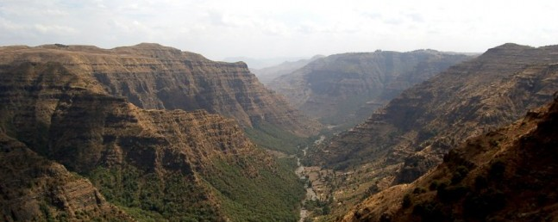
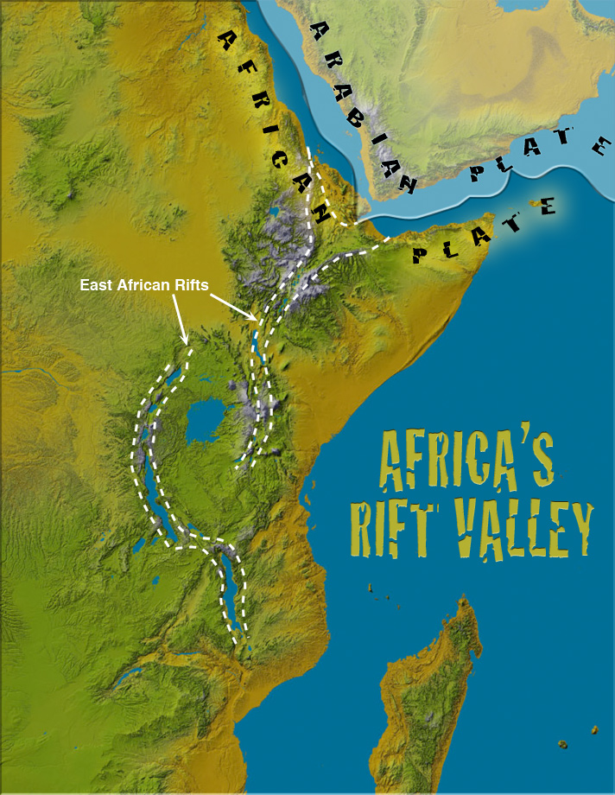
Great Rift Valley

Slide 8
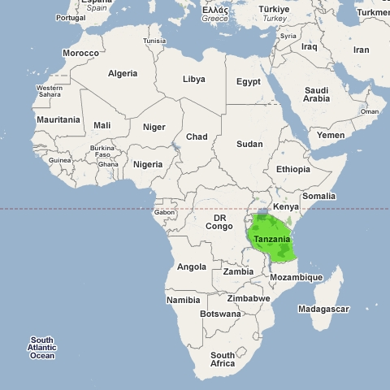
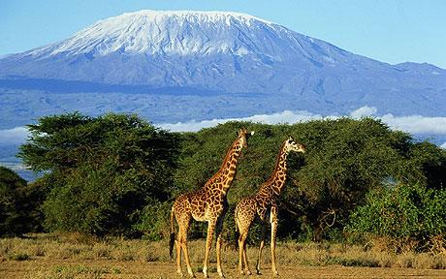
Mt. Kilimanjaro
Highest Mt. in Africa

Slide 9
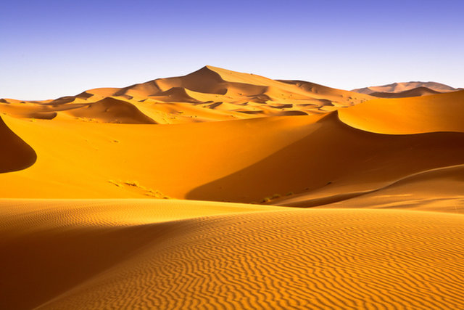
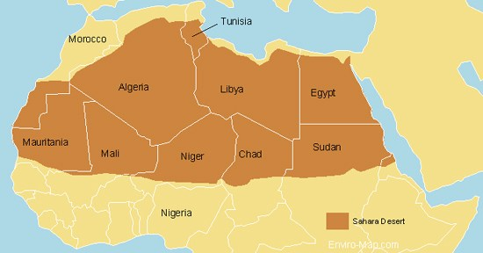
The Sahara Desert
What obstacles did this physical feature bring to ancient civilizations?
How did they adapt? What did they do?
Notes:
Sahara 10,000 it was a savannah. You could not cross it for a long time. (at one point black pharaoh from nubia)
No writing
No connection
Bantu migration
Arabs introduced camel to sub-Saharan Africa. Which made crossing it possible. After 600 AD

Slide 10
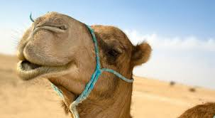
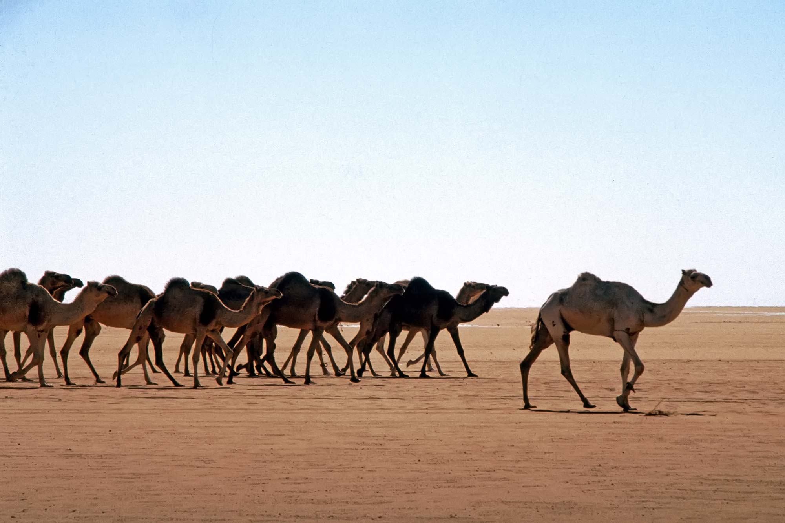
The Camel
The Arabs introduced the camel to Sub-Saharan Africa around 200 AD
Can carry 300 pounds 25 miles a day
Can go days without water.
FUN FACTS
Has two layers of eyelashes
Can close nostrils on will
Can run up to 40 mph
They spit/throw up on you if they feel threatened

Slide 11
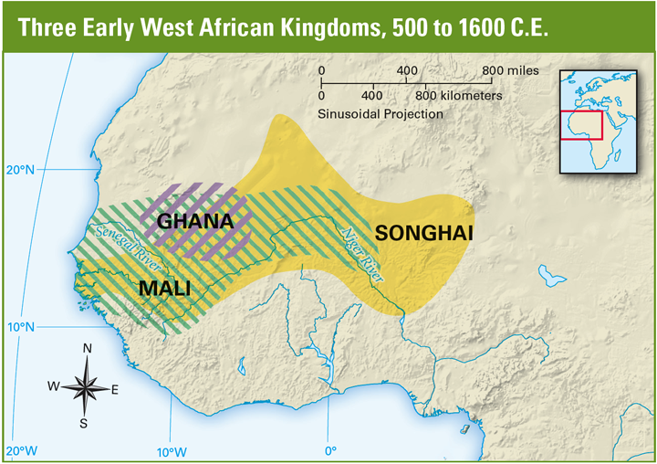
Ancient Africa
Individual Kingdoms
No written language
Oral History
What is the disadvantage of oral histories?

Slide 12
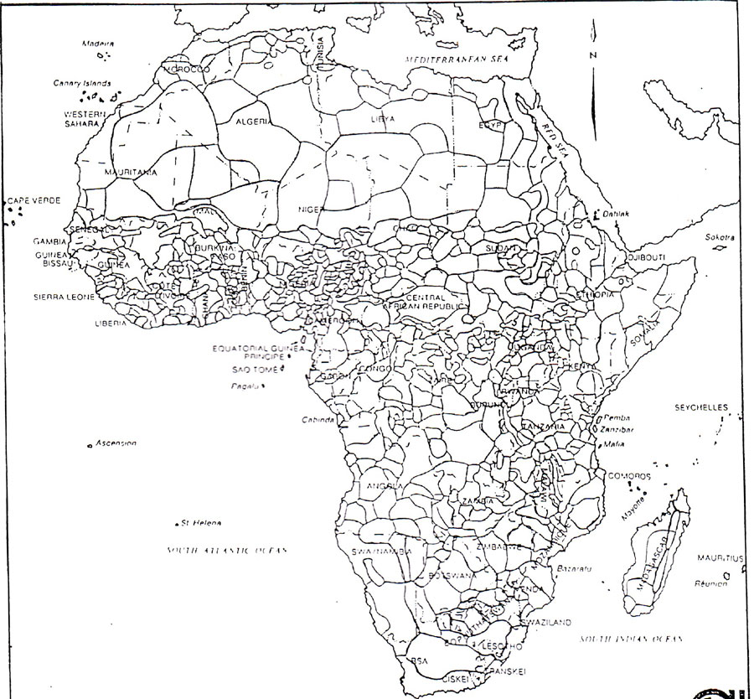
Tribes of Africa

Slide 13
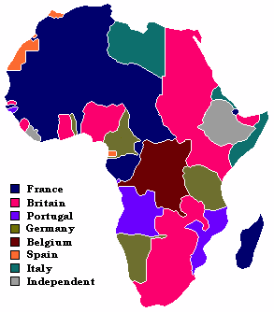
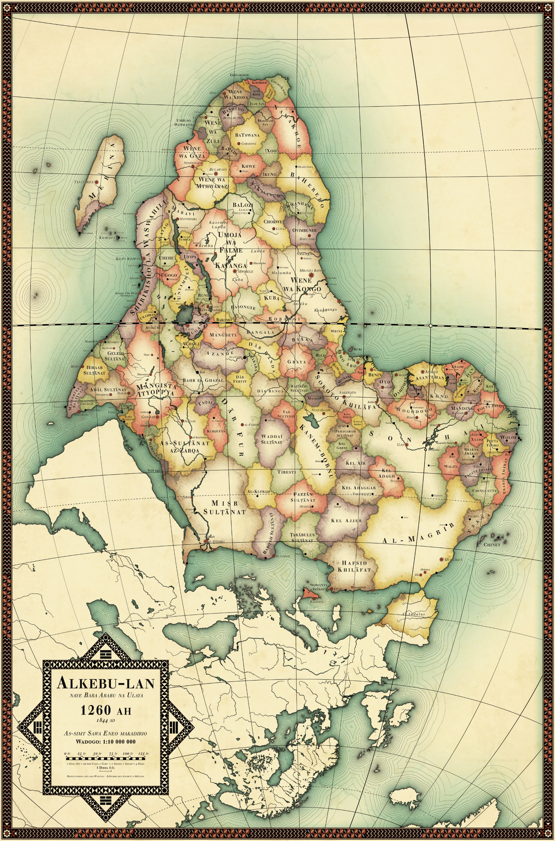
European Control
Without European control?

Slide 14
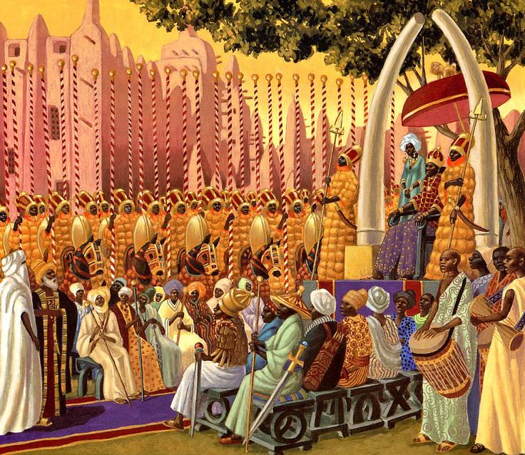
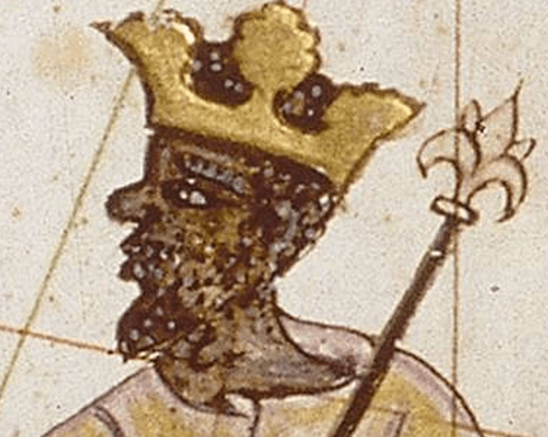
Mansa Musa
Very wealthy
Converts to Islam
Pilgrimage to Mecca

Slide 15
The Spread of Islam in Africa
The spread of Islam and its culture taught sub-Saharan people to write, to form government, and even science.

Slide 16
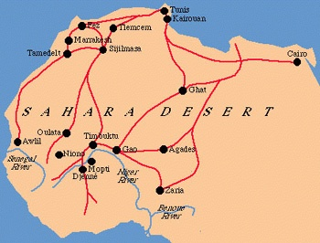
TRADE --- Trans-Sahara Trade
1. Stimulated gold mining and slaves
2. development of urban centers
3. Introduction of Islam to Sub Saharan Africa

Slide 17
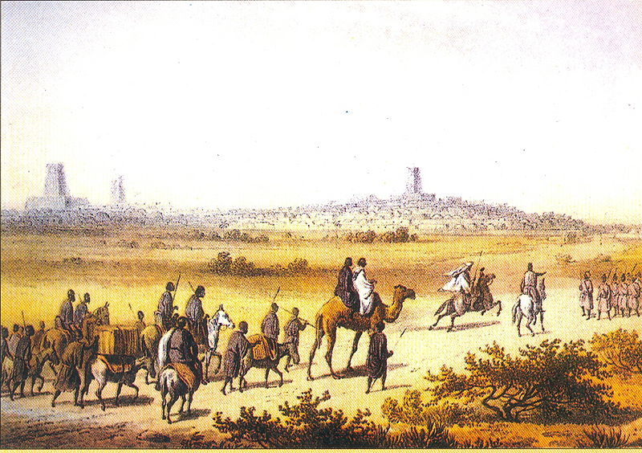
Timbuktu– Yes its real
Trade center for
salt
gold
ivory &
Slaves
Center for learning
12 universities
Books 2nd most valuable resource after salt.

Slide 18
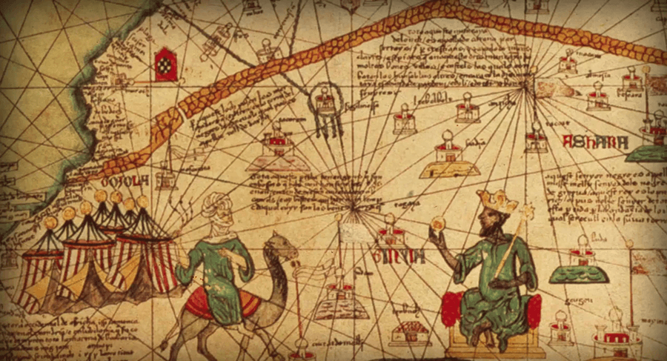

Slide 19
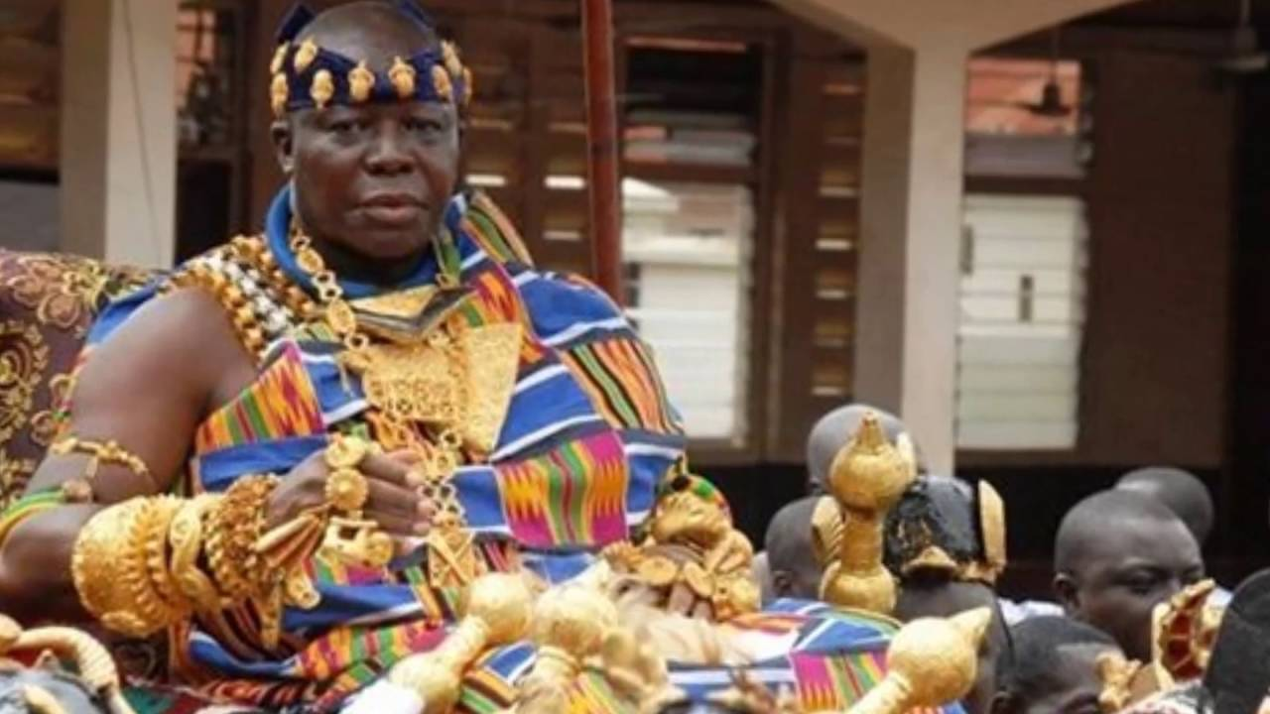
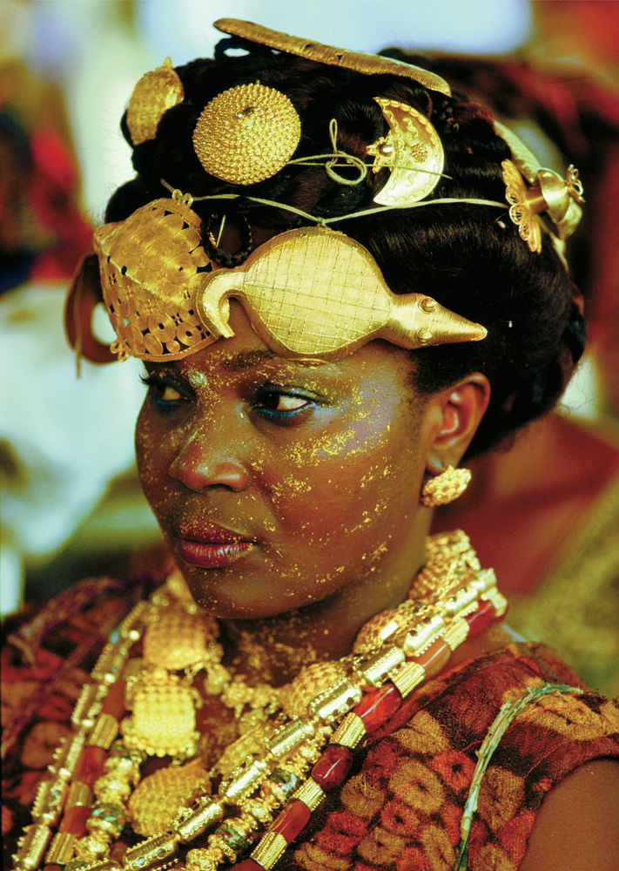
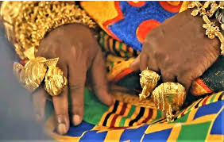
West African Gold

Slide 20
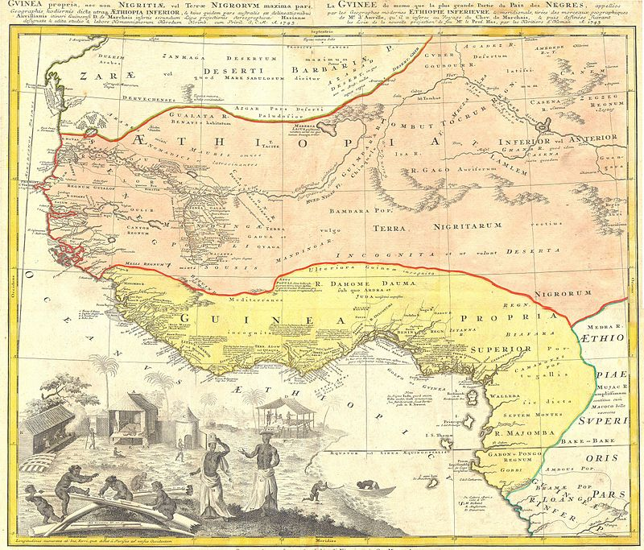
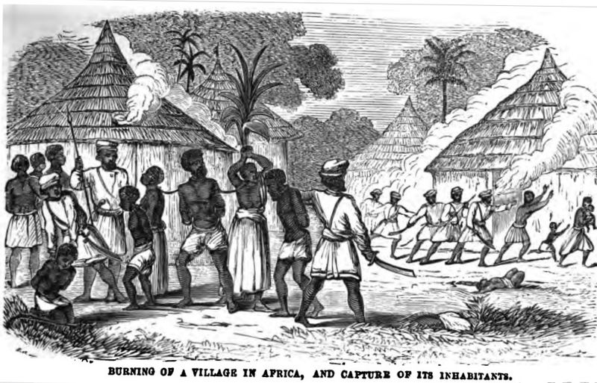
Slavery IN Africa
- Inter tribal slave trade

Slide 21
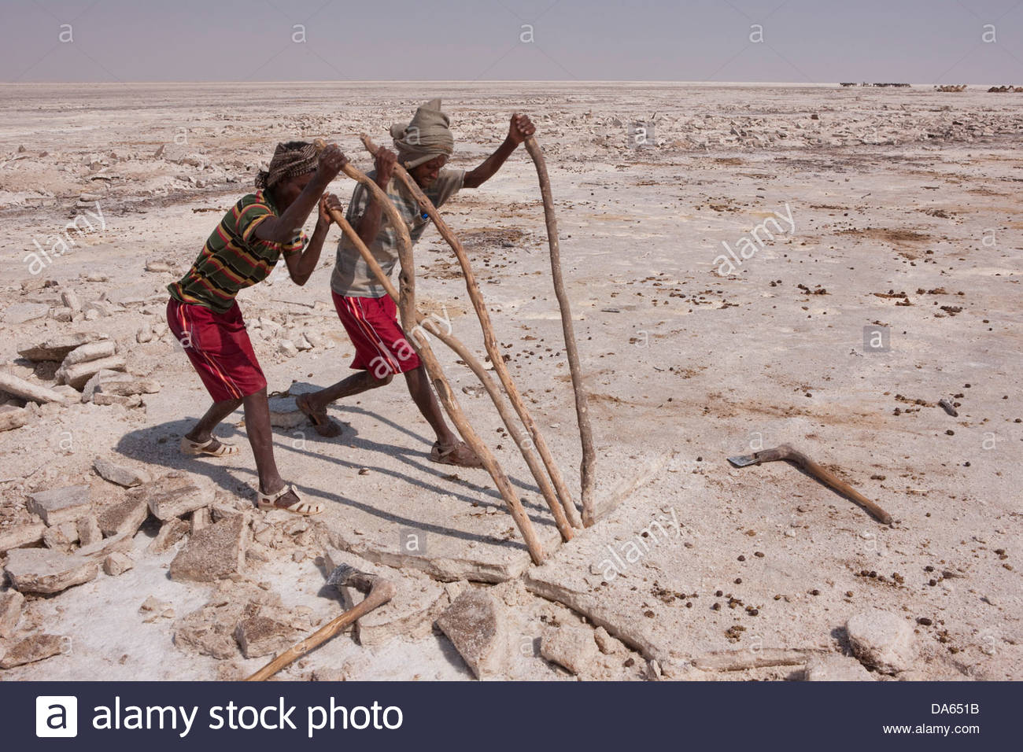
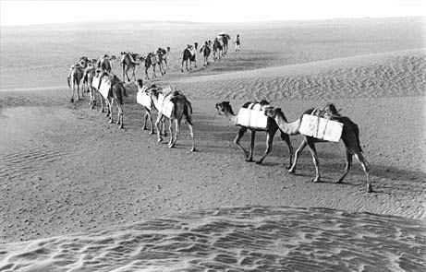
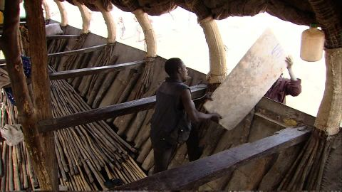
African Salt Trade
1. Salt was mined in the Sahara
2. Salt was transported by came to border kingdoms like Mali
3. Salt is transported further south by boat
4. Although salt is no longer “worth its weight in gold” it is still an important resource traded in open markets in Africa.

Slide 22
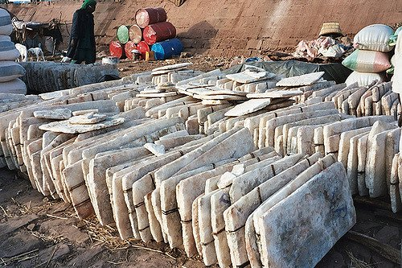
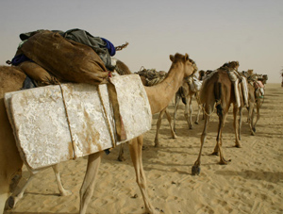

Slide 24
True and false for africa
Snow on the equator
There is a native penguin colony if africa
Black pharaoh in Egypt
Africa is the second largest country in the world
Africans started the slave trade in Africa
The sahara desert was once an savannah with many animals
No known great civilaztion in Africa because they did not have a writing system
The first black president of South Africa was once a prisoner for 30 years.
Africa is a 3rd world country

