Slide 1
Jerusalem
introduction

Slide 2
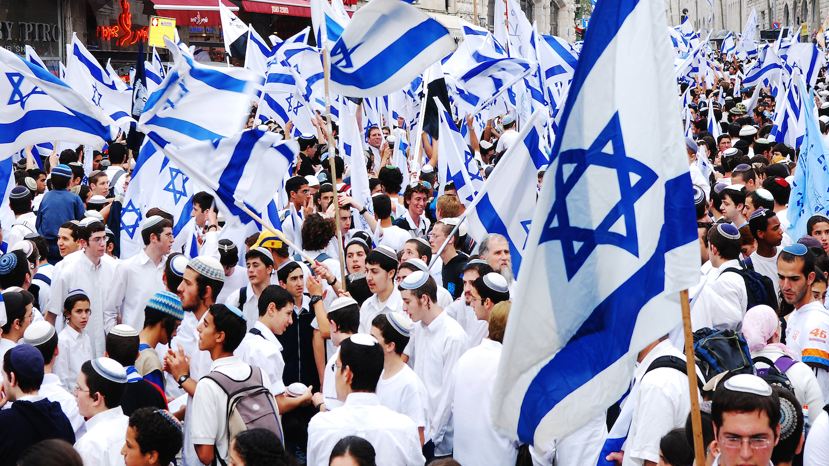
Zionism
A political movement that supports the re-establishment of a Jewish homeland in Israel
Begins in the late 19th century
Notes:
Abraham had been there. Moses took the people back to Israel. They wanted to get Israel back.

Slide 3
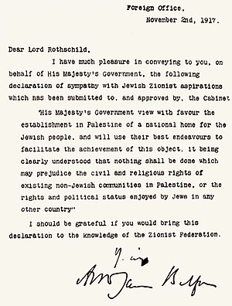
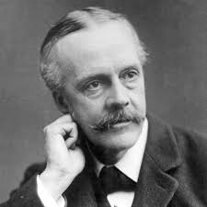
Balfour Declaration
A statement made in 1917 (during World War I) that announced Britain’s support of creating a Jewish homeland in Israel
Notes:
Balfour=foreign secretary
Israel was controlled by Britain after WWI

Slide 4
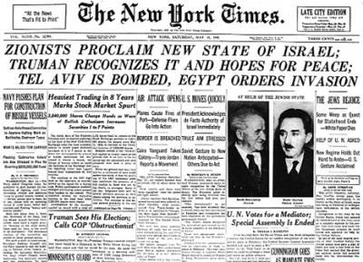
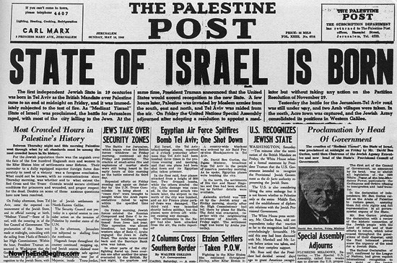
1948 Israeli State declared
After years of fighting, the United Nations agrees to divide Palestine and create a Jewish state.
Britain withdraws from Israel and Egypt, Jordan, Lebanon and Iraq invade immediately
Cease-fire in 1949
Notes:
Made Israel Jewish. All the surrounding area was mad.

Slide 5
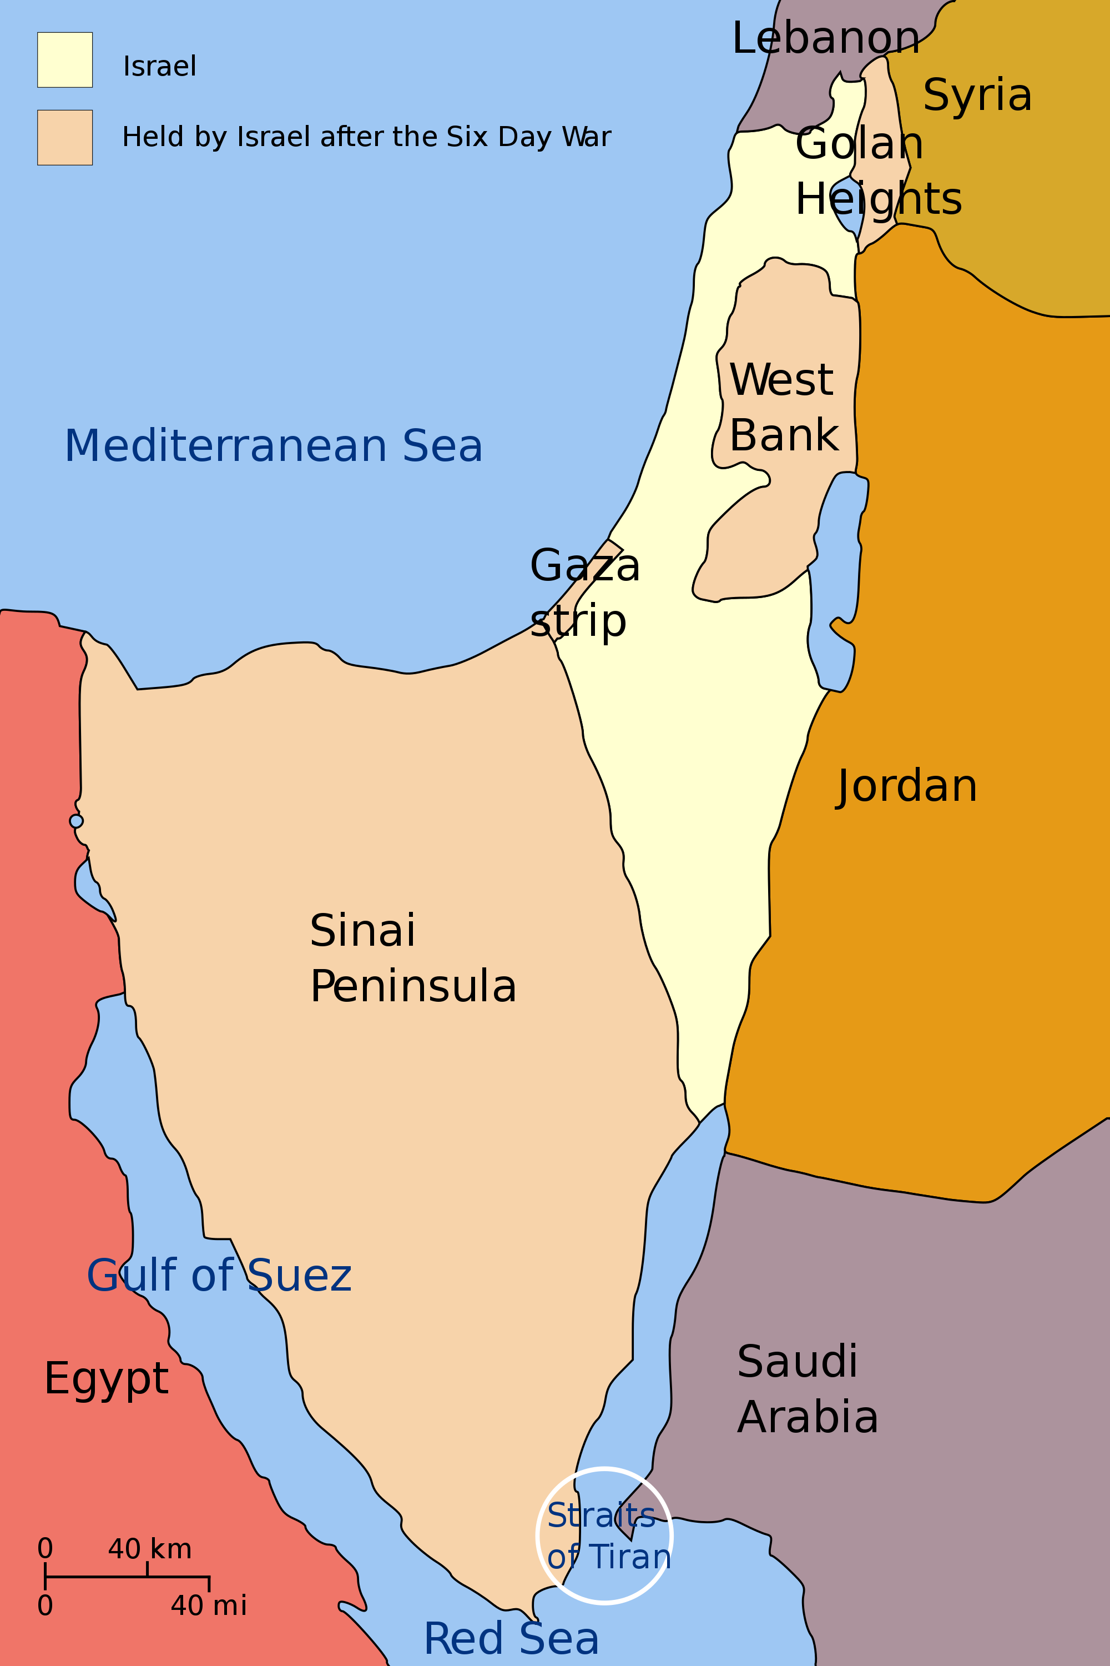
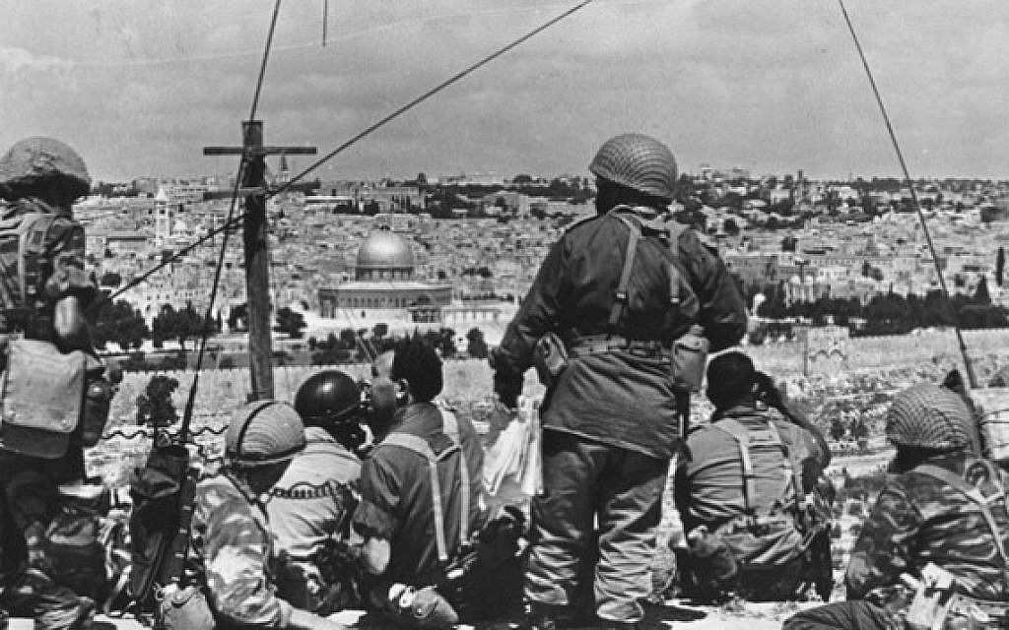
Six day war
1967
Israel increases its boundaries and gains control of the West Bank, Sinai Peninsula, Golan Heights and the Gaza Strip
Sign a ceasefire and Egypt gets Sinai Peninsula back.
Golan Heights, West Bank and Gaza remain under Jewish control but have majority Arab population
Notes:
Conflict continues till today (this fight goes all the way back to Abraham) --- this story doesn’t haven an ending
Israel “hey recognize us a state” and everyone said no. So Israel takes over (Golan Heights, West Bank, Gaza, and Sinia Peninsula)– gave back Sinai peninusal because Egypt was like fine. And backed off. The other areas are mostly muslim

Slide 6
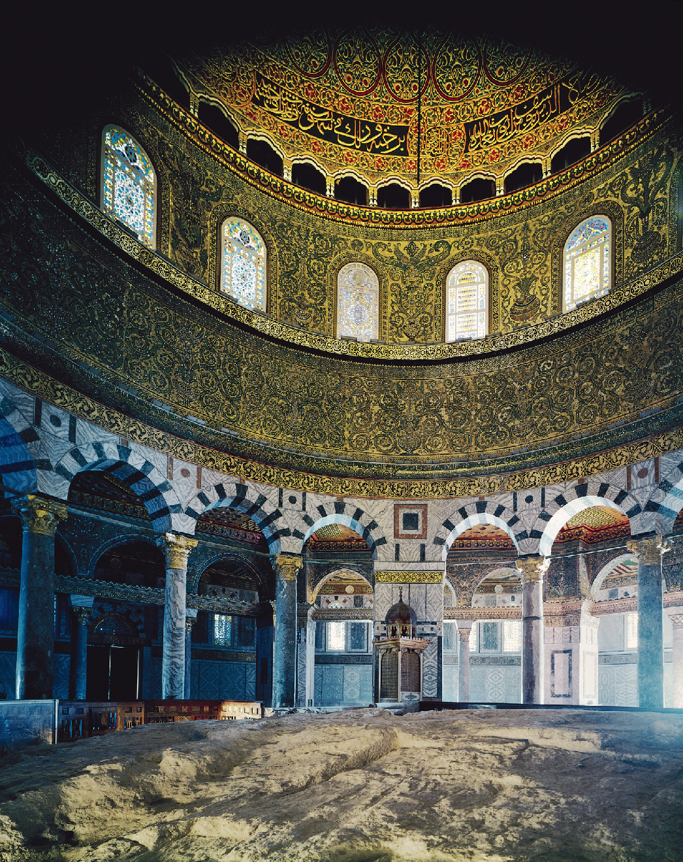
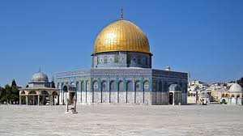
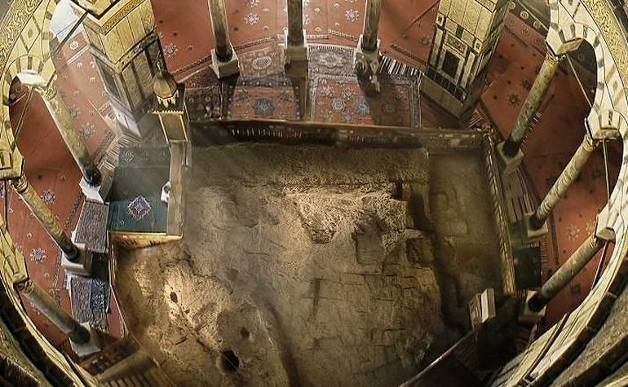
Dome of the rock
Muslims: Where Muhammad ascended into Heaven
Jews: Where Abraham prepared to sacrifice Isaac
Currently under Muslim control

Slide 7
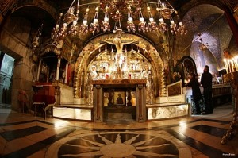
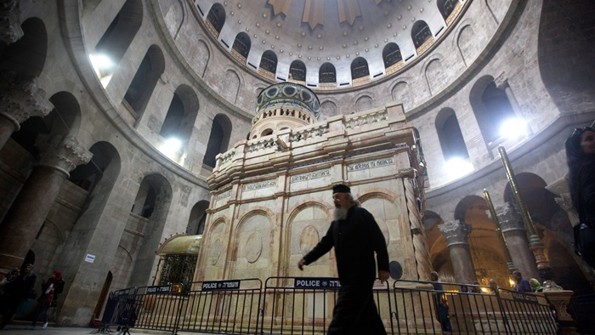
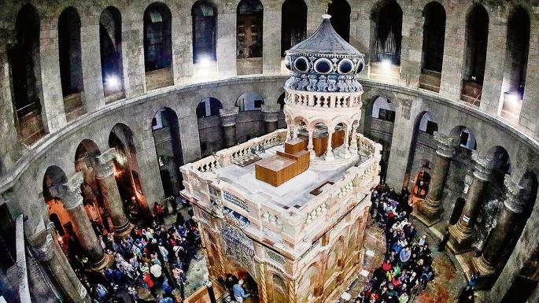
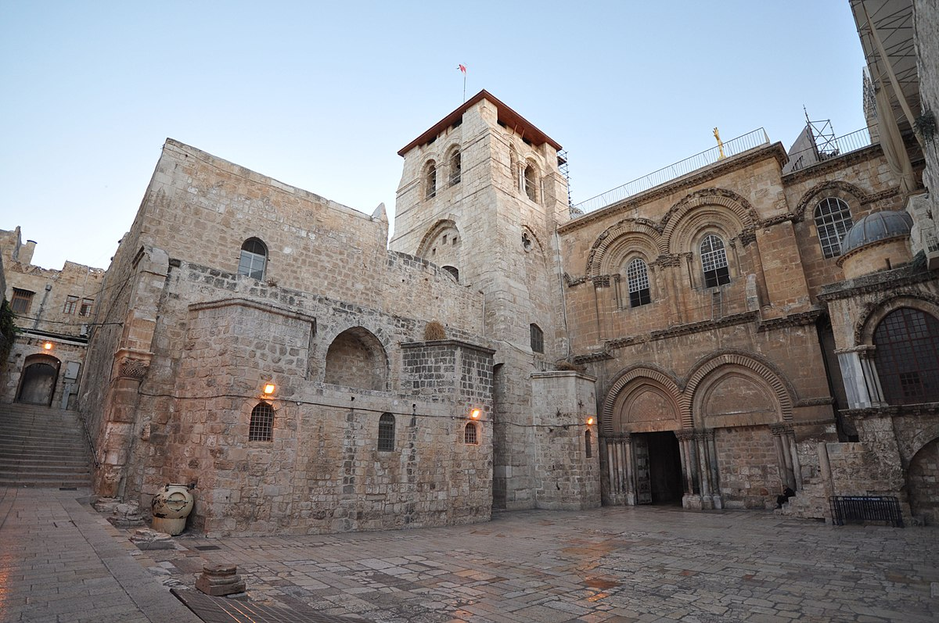
Church of the holy sepulcher
Believed to be the tomb of Jesus Christ

Slide 8
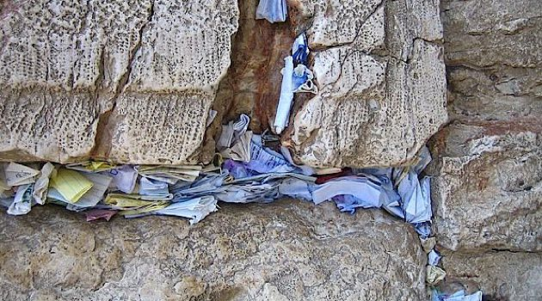
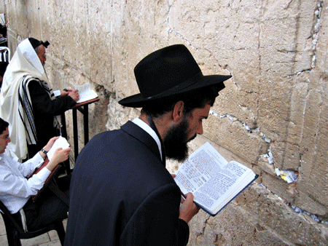
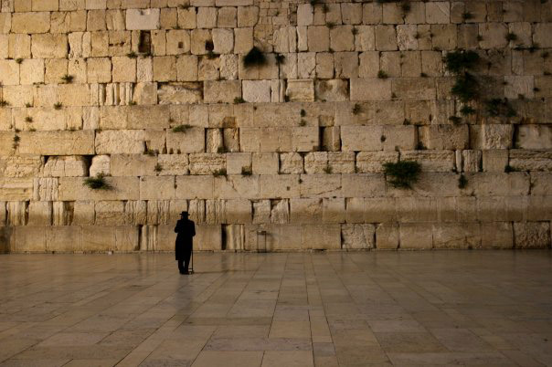
Western Wall
Ruins from the first Jewish Temple
Notes:
Wall closest to the old temple

Slide 9
Western Wall
Notes:
3 major sacred sites within a block of each other. – Christian, jews, muslims fight over this area.

