Slide 1
Monotheistic religions
World history

Slide 2
Monotheism = Belief in One GOd

Slide 3
Religion and history
Why can we talk about religion in school?
Why is it important to understand religions when studying history?

Slide 4
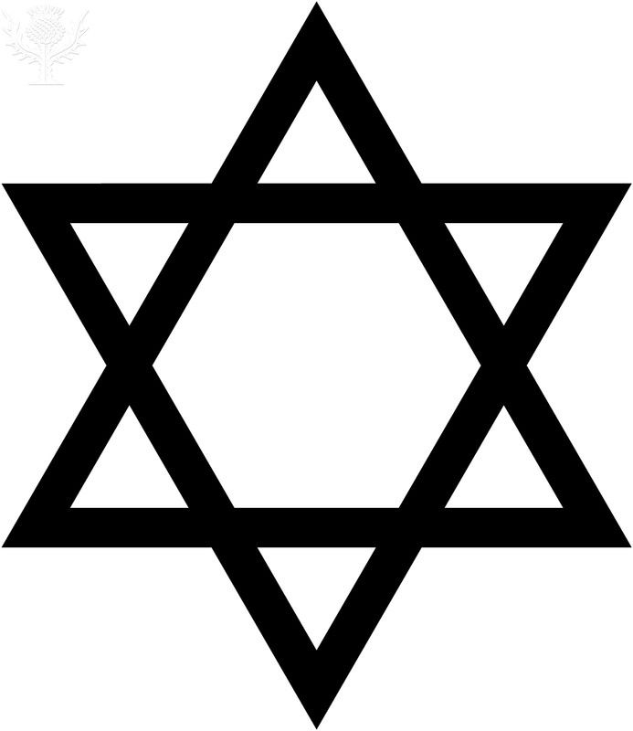
Major Religions in Middle East
Judaism Christianity Islam

Slide 5
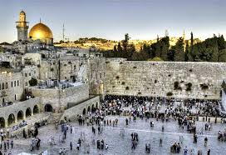
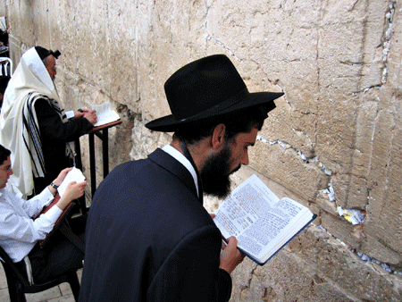
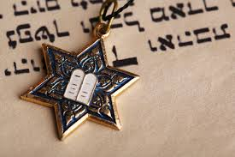
Judaism
Notes:
What do you know about Judaism?

Slide 6
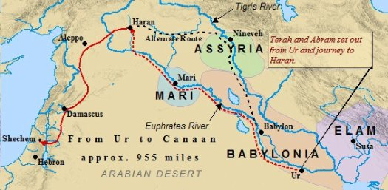
Origins of judaism
Judaism is the oldest monotheistic religion
The religion dates back to 1900BC when Abraham was called of God to leave his city in Ur and travel to Canaan.
Notes:
Canaan=israel and palestine

Slide 7
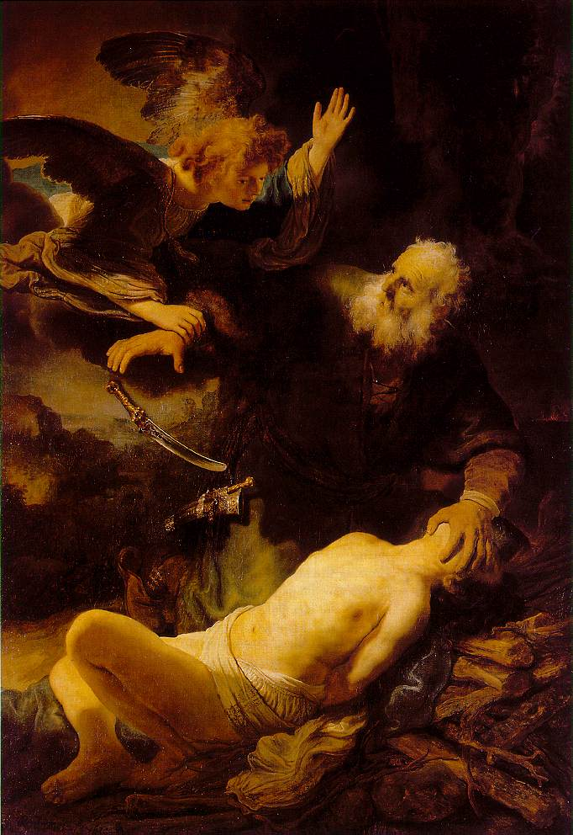
KEY PEOPLE IN JUDAISM
Abraham: The founder of Judaism. Believed in only one God since his birth. Father of Issac (second son but rightful heir).
Moses: Born in Egypt. Leads the Jews out of captivity in Egypt. Receives the 10 commandments.
King Solomon: King of the Jews. Builds a temple in Jerusalem
Issac: Son of Abraham. Abraham was going to sacrifice Issac but God stopped him.

Slide 8
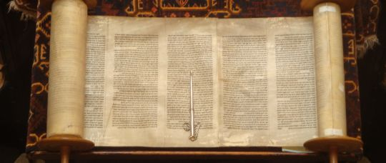
whAT DO THE JEWS BELIEVE?
Jews believe in only ONE God.
The Torah is the sacred text in Judaism.
A Messiah will come to suffer for the sins of the world (not Jesus Christ)
God plays an active role in the world
Life after death
Worship in a synagogue on Saturday

Slide 9
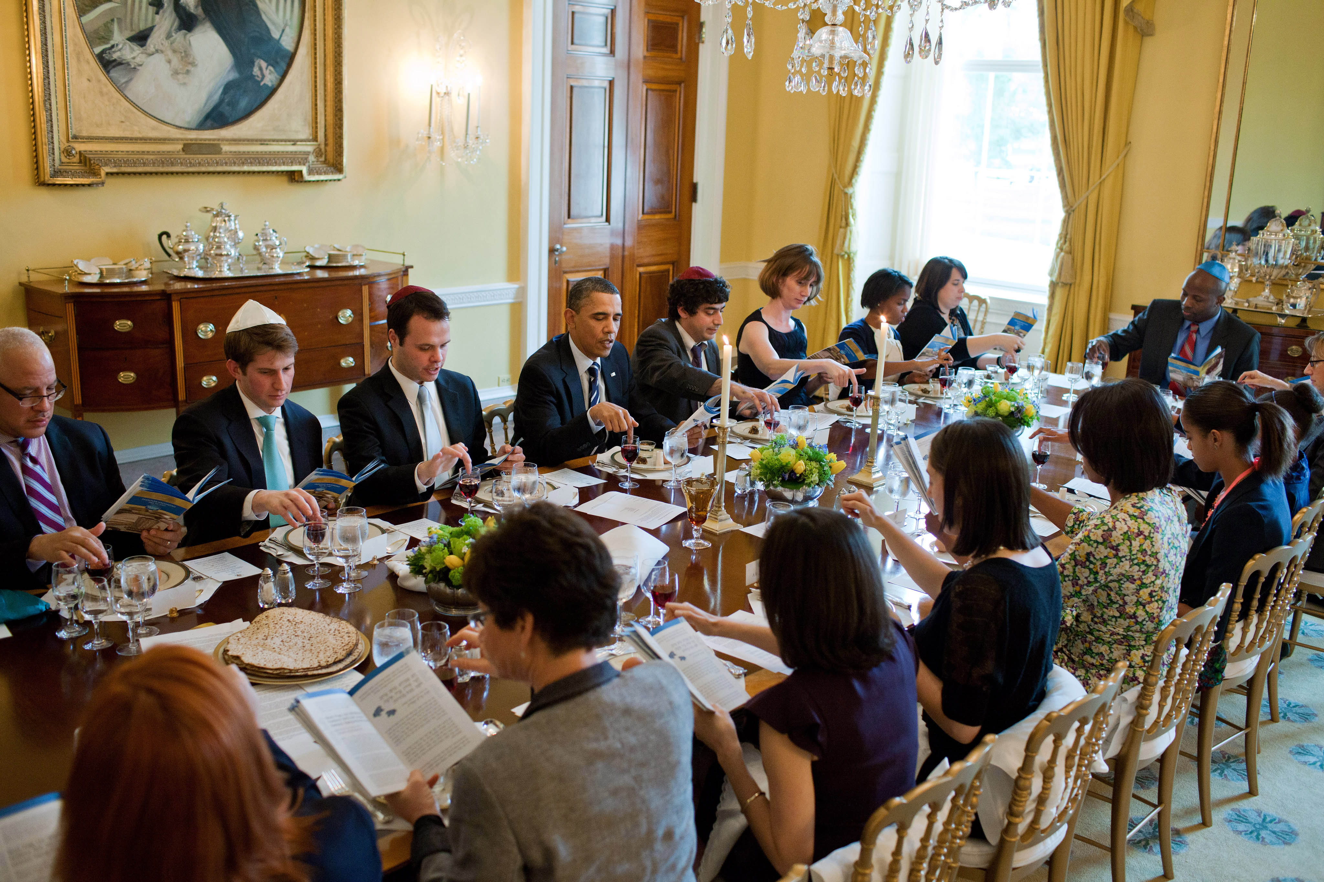
Jewish Holidays
Hanukkah: an 8 day holiday that celebrates the rededication of the temple in Jerusalem
Bar Mitzvah: coming of age party for boys turning 13
Passover: celebrates the Jews release from Egypt
Notes:
Lambs blood on doors to escape the 10 plagues
1:21
https://www.youtube.com/watch?v=fQP9KaPwAgc

Slide 10
Passover
https://www.youtube.com/watch?v=fQP9KaPwAgc

Slide 11
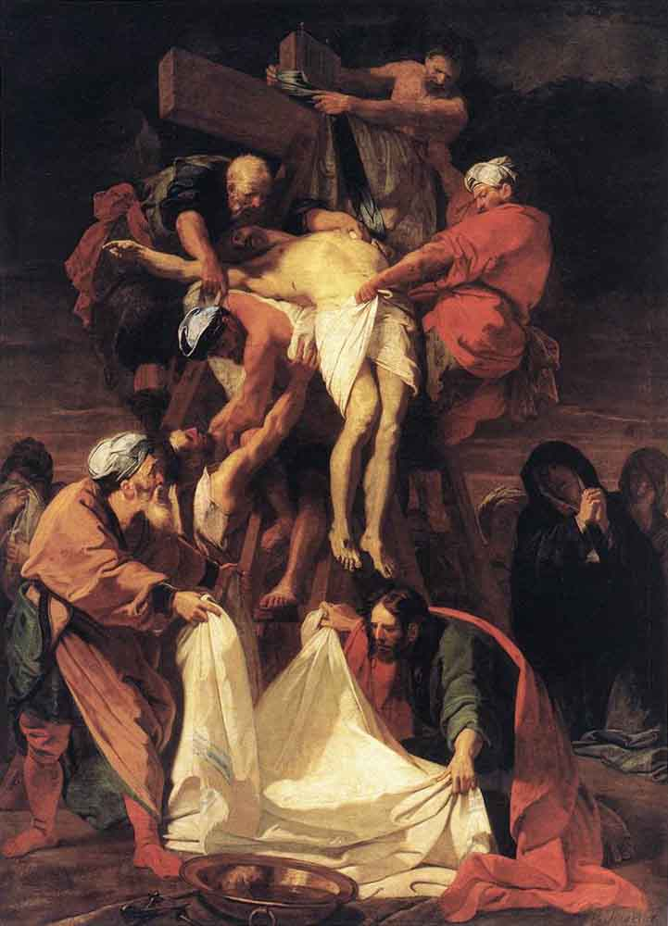
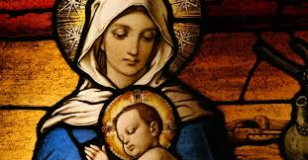
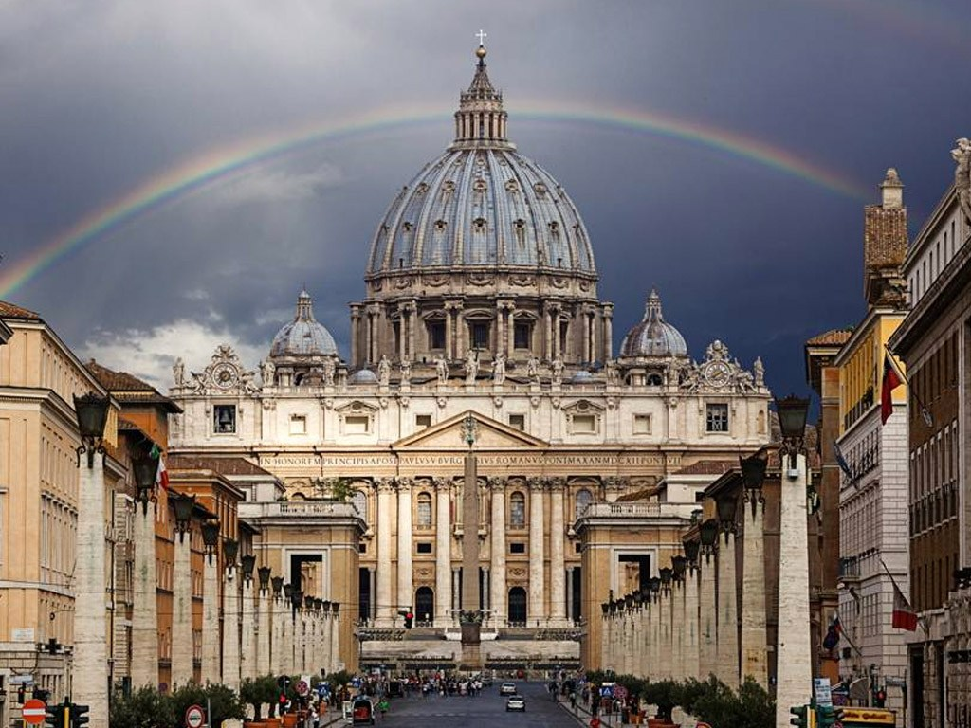
Christianity

Slide 12
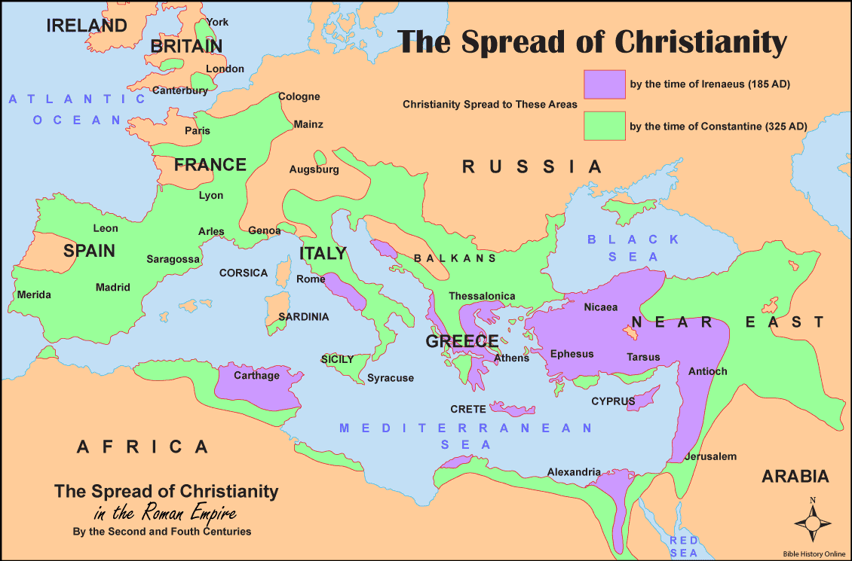
Origins of Christianity
Begins in the 1st century AD with the birth of Jesus Christ
The religion is spread by the 12 Apostles

Slide 13
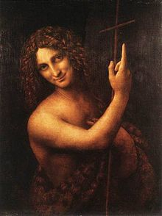
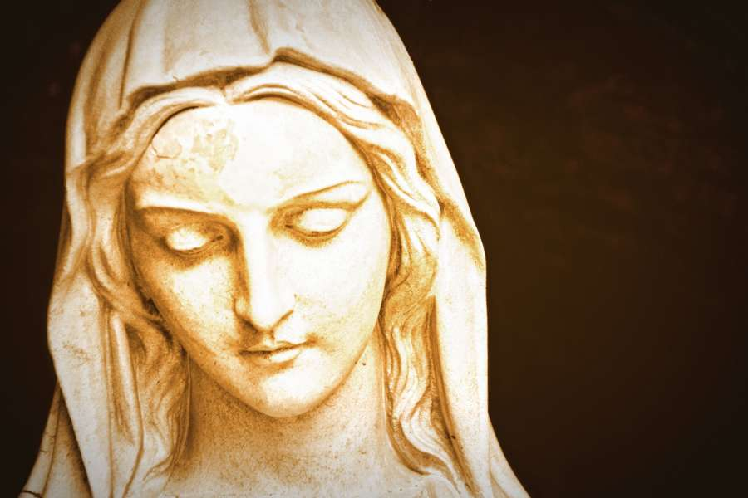
Important figures in Christianity
Jesus Christ: The Bible teaches that Jesus Christ has come from Heaven to save the world from sin. Jesus Christ’s teachings make up the Christian Doctrine. (The Jews also believe in a “Messiah” but they do not believe it is Jesus Christ)
Mary: A Jewish woman who is the mother of Jesus Christ.
John the Baptist: A Jewish man who spreads the doctrine of Jesus Christ. Regarded as a prophet in Christianity and Islam
Paul: An apostle of Jesus Christ who spreads the Christian religion to other parts of the world.

Slide 14
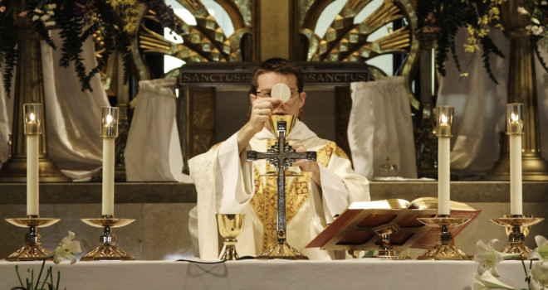
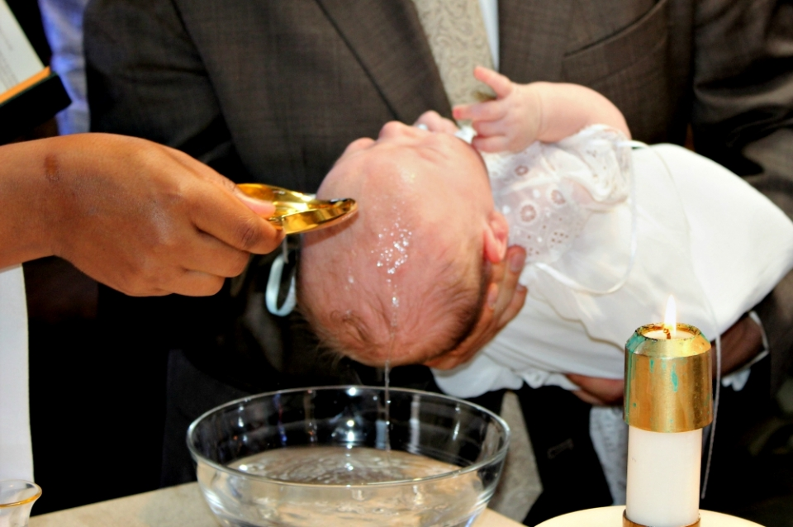
What do Christians believe?
Virgin birth and resurrection of Jesus Christ
The Trinity
Life after death
Prayer as a way to communicate to God
The Eucharist
Notes:
God, Father and Holy Spirit
Eucharist=way to commemorate Jesus’ last meal with the disciples. Making covenants with God

Slide 15
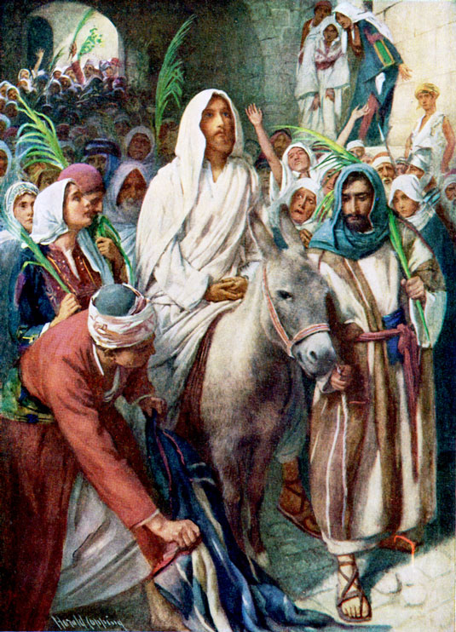
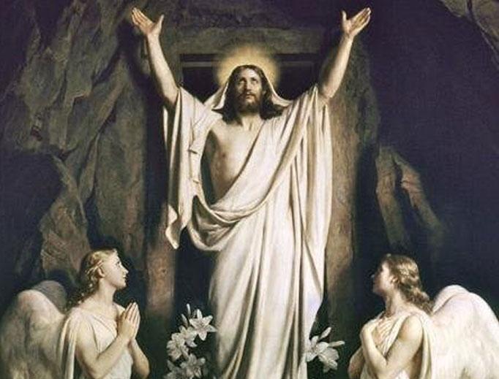
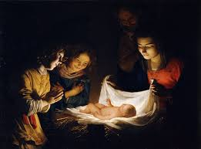
Christian Holidays
Palm Sunday: The Sunday before Easter. Celebrates Jesus’ entry into Jerusalem.
Easter: Resurrection Sunday. Celebrates the resurrection of Jesus Christ
Christmas: Celebrates the birth of Jesus Christ
Pentecost: 40 days after Easter. Celebrates the formation of the Catholic Church when the Holy Spirit descended onto the apostles.
***note: there are many different branches of Christianity who have similar practices but they are not all the same.
Notes:
Jesus claims to be king of the Jews-enters the city to rescue his people
Rides In on a donkey-symbol of peace
Cover ground for people of high honor

Slide 16
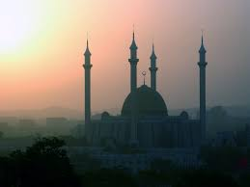
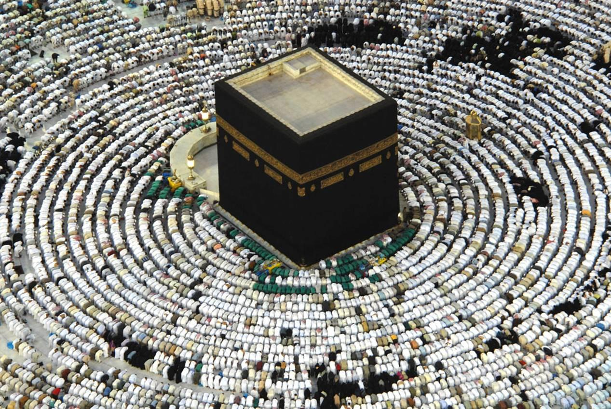
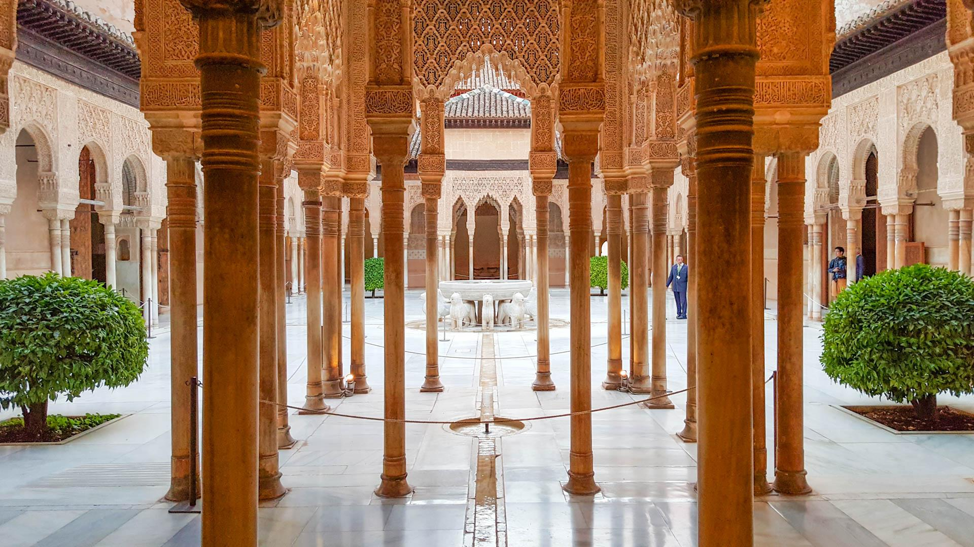
Islam

Slide 17
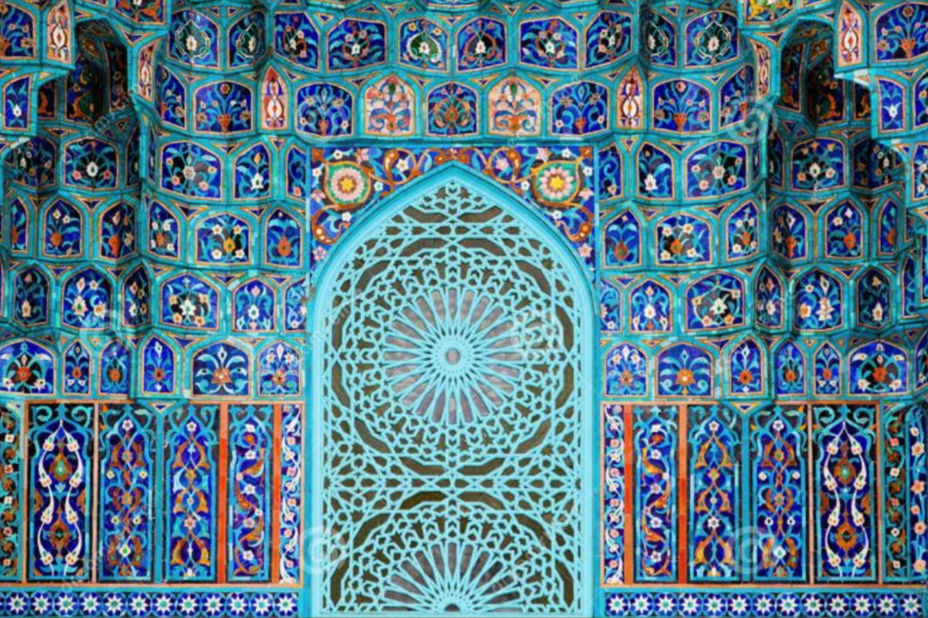
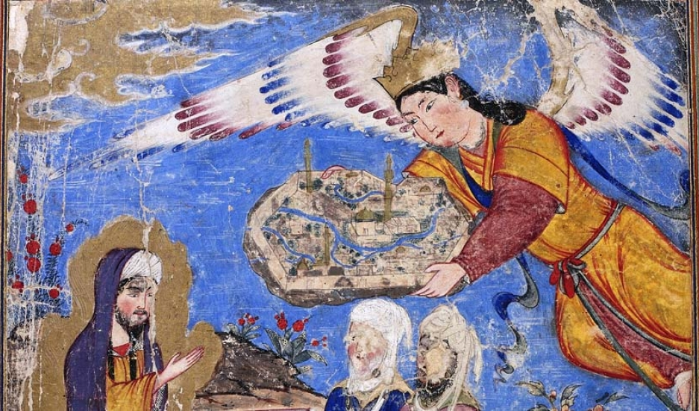
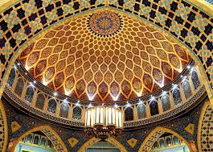
Origins of islam
610 AD -Muhammad has his first revelations in Mecca
618 AD -Muhammad travels with his followers to Medina

Slide 18
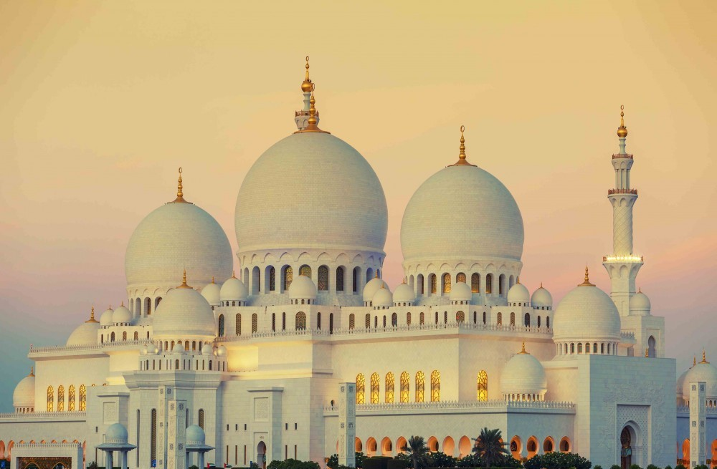
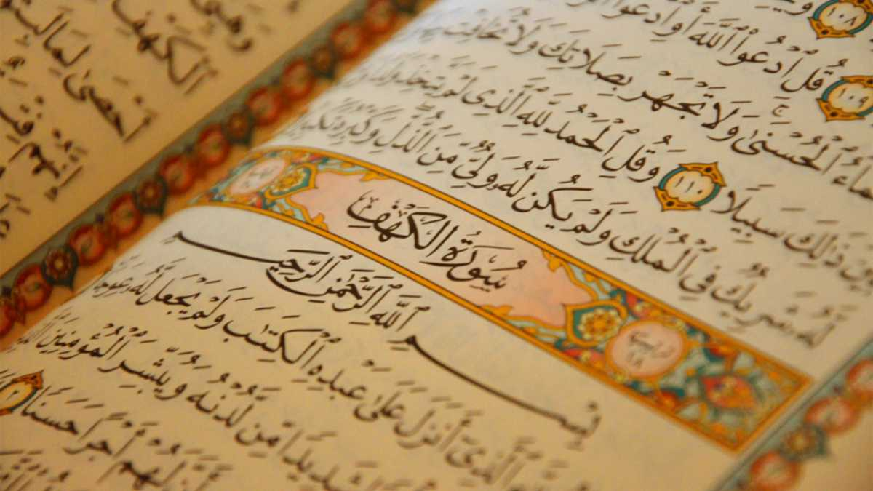
Important figures in islam
Muhammad: Founder of Islam. Viewed as the final prophet sent by God.
Allah: God in arabic
Abu Bakr: Muhammad’s advisor. First Caliph. Succeeds Muhammad as the leader of Islam

Slide 19
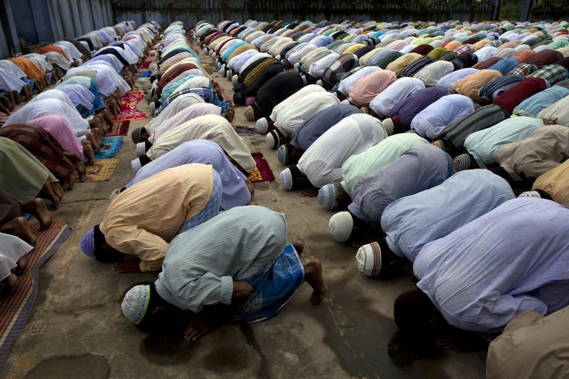
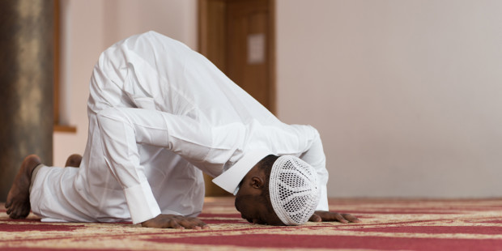
What do Muslims believe?
FIVE PILLARS OF ISLAM:
Faith in Allah (Allah as the only God)
Prayer-pray five times a day
Charity-paying alms to the poor
Fasting
The Hajj
Notes:
Ramadan-9th month of the muslim calendar. Fast from sunrise to sunset to celebrate the first revelations

Slide 20
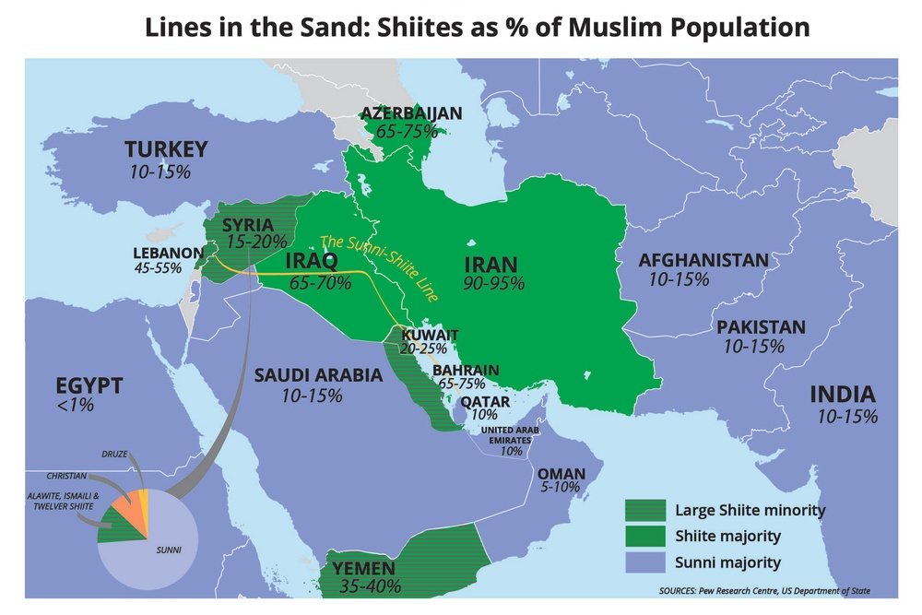
Sunni and ShiA Muslims
Sunni Muslims-favored Abu Bakr (Muhammad’s advisor) as the next Caliph
Shia Muslims-favored Muhammad’s cousin and son-in-law
What is the difference between the two?

Slide 21
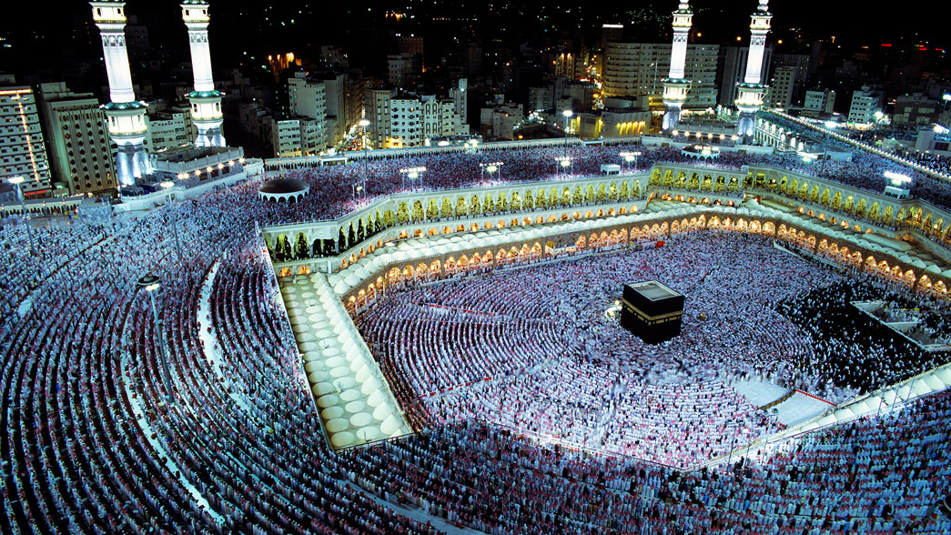
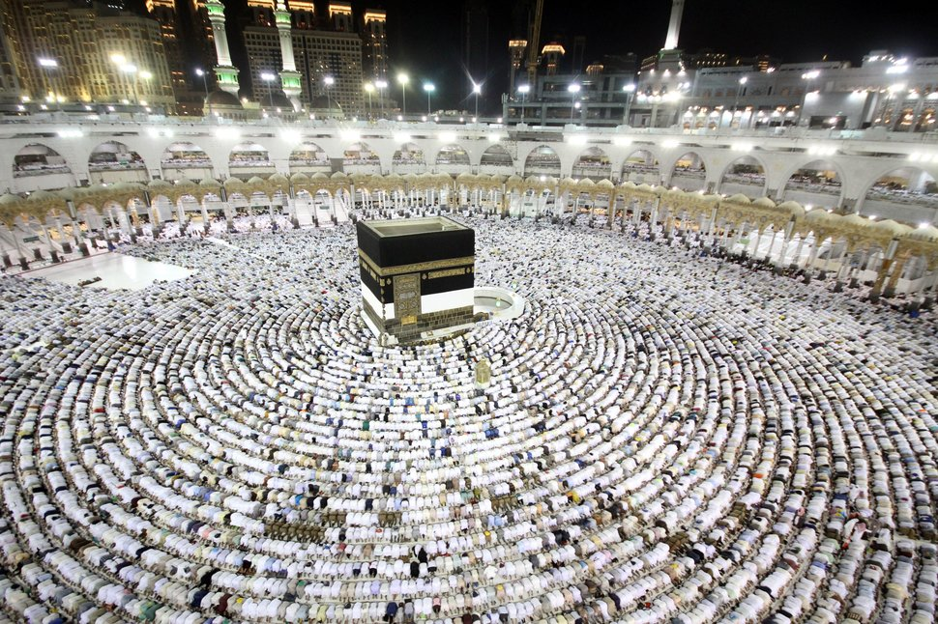
The Hajj
Hajj=Pilgrimage to Mecca and Medina
Required by all able bodied Muslims
Pilgrims follow the footsteps of Muhammad and participate in
a series of rituals

Slide 23
moSES AND THE Burning Bush
https://www.youtube.com/watch?v=6ds9y3lJGig
Notes:
START AT 0:52-5:00

