Slide 1
CODE OF HAMMURABI
.

Slide 2
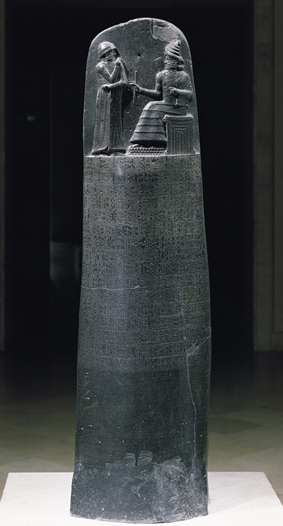
Louvre, Paris

Slide 3
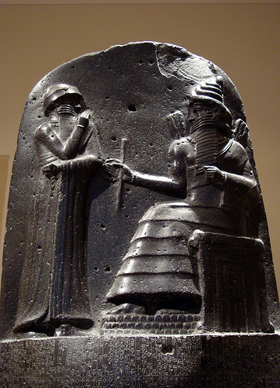

Slide 4
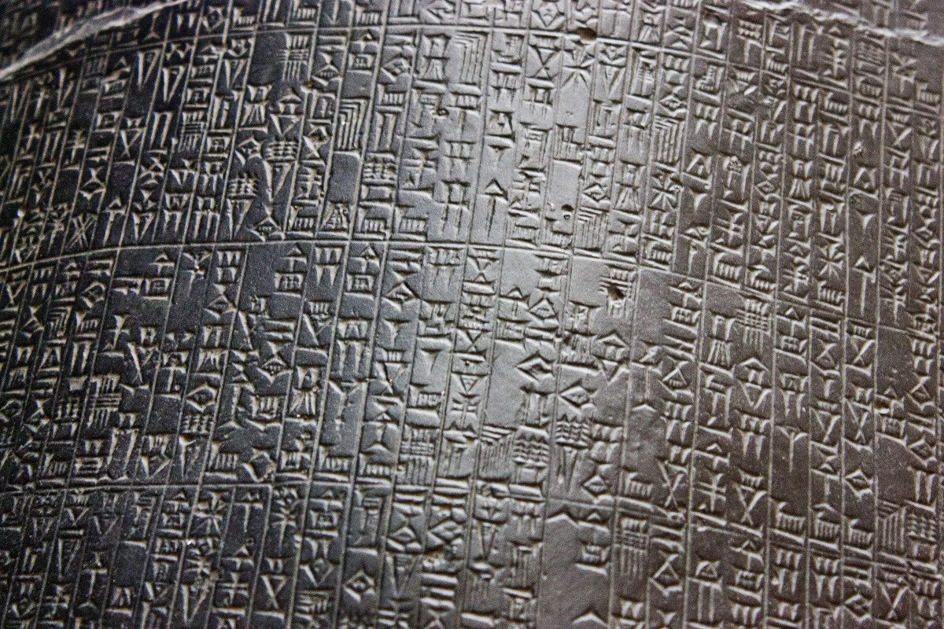

Slide 5
Fill In
The top of the pillar shows a scene with __________ standing before __________, the Babylonian ____ of ________. He is handing __________ a ____ and a _____.
WORD BANK:
God
Hammurabi
Hammurabi
Shamash
Rod
Justice
Ring

Slide 6
The top of the pillar shows a scene with Hammurabi standing before Shamash, the Babylonian God of Justice. He is handing Hammurbi a rod and a ring.
Shamash is also the Babylonian God of the Sun.

Slide 7
Hammurabi’s Code
-
-
-
-
-
US Constitution
-
-
-
-
-
-

Slide 8
Hammurabi’s Code
-
-
-
-
-
US Constitution
Form a more perfect union.
Establish Justice
Ensure domestic tranquility (keep the peace at home)
Provide for the common defense
Promote general welfare
Secure liberty for us and future generations.

Slide 9
Hammurabi’s Code
Establish Justice
Destroy Wicked
Protect Weak
Enlighten the Land
Promote Welfare
US Constitution
Form a more perfect union.
Establish Justice
Ensure domestic tranquility (keep the peace at home)
Provide for the common defense
Promote general welfare
Secure liberty for us and future generations.

Slide 10
If a man bring an accusation against a man, and charge him with a (capital) crime, but cannot prove it, he, the accuser, shall be put to death.
Aspect:
testimony and evidence
“Modern” Translation:
If you accuse someone of murder but can’t prove it, you will be put to death.
Inference:
No frivolous law suits (you will have to be pretty serious about your case before you would go to court.)

Slide 11
Why are written laws better than no laws?

Slide 12
Why is it important for the state (government to be responsible to administer the law rather than people taking the law into their own hands?

Slide 13
What are some conclusions you can make about Babylonian society? What evidence supports your conclusions?

