Slide 1
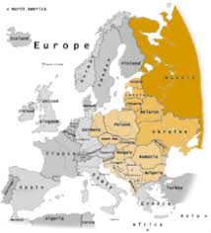
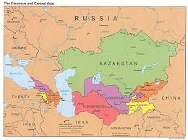
Eastern Europe/Eurasia Review

Slide 2
Add these terms to your study guide AND make surE to use the study guide
Propaganda
Isolationism
Fascism
Berlin Wall
Cold War
D-Day
Anti-Semitism
Hiroshima
Atomic Bomb
Pearl Harbor
Trench Warfare

Slide 3
World War I
Archduke Franz Ferdinand
Entente Alliance
Central Alliance
Trench Warfare
Weaponization
Propaganda
Lusitania
Treaty of Versailles

Slide 4
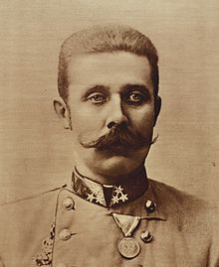
Archduke Franz Ferdinand
Heir to the Austro-Hungarian Throne
Assassinated while on a trip to Bosnia
His death started World War I

Slide 5
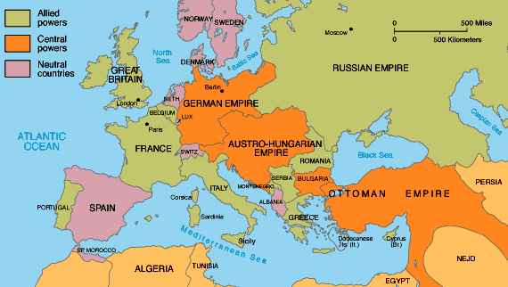
Entente Alliance
Military alliance during World War I
Aka Allied Powers
France
UK
Russia
Italy
US
Serbia
Belgium
Greece

Slide 6
Central Alliance
Military alliance during World War I
Germany
Austria-Hungary
Ottoman Empire
Bulgaria

Slide 7
Trench Warfare
Fighting technique used during World War I
Soldiers dug pits in the ground and fought from these pits
No-mans land existed between two enemy trenches

Slide 8
Weaponization
A lot of new weapons were developed during World War I that had devastating effects and killed people on large scales
These weapons included….
Barbed wire
Machine Gunes
Mustard/Chlorine Gas
Tanks
Blimps
Submarines

Slide 9
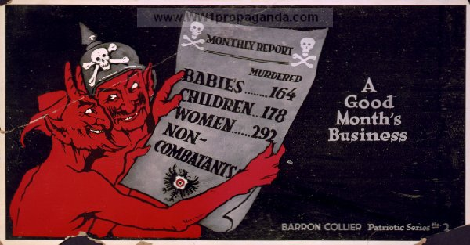
Propaganda
Information used to spread a particular idea, especially political ideas
Can be in the form of posters, books, literature, music etc.

Slide 10
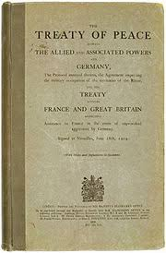
Treaty of Versailles
Treaty that ended World War I
Germany was heavily punished and forced to take blame for World War I
Germany lost their army, territory and was forced to pay back England, the US and France

Slide 11
WW2
Adolf Hitler
Isolationism
Anti-Semetism
Air Raids
Pearl Harbor
Atomic Bomb
Hiroshima
Swastika
Storm Troopers
Swastika
Mein Kampf
Fascism
D-Day
Manhattan Project

Slide 12
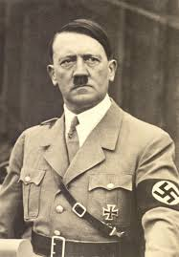
Adolf HItler
Afraid of Cats
Vegetarian
Wanted to be an artist
Helped develop volkswagan
Wrote Mein Kampf
Was facist
Dictator in Germany

Slide 13
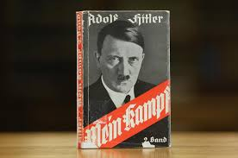
Mein Kampf
Mein Kamp means: “My Struggle” ---- a book writted by Adolf Hitler
Blamed Jews for the defeat in WW1
believed Germans were a master race, Jews, slaves, gypsies were inferior

Slide 14
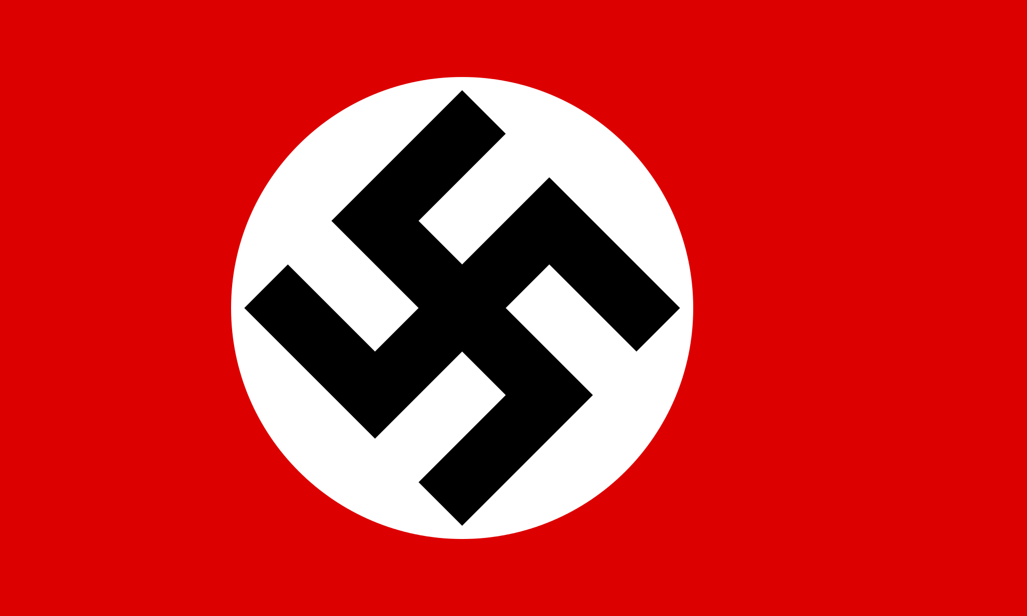
Why the Swastika?
The swastika would become the most recognizable icon of Nazi propaganda.
Hitler didn’t invent the Swastika. It anciently was a symbol of good fortune or well being. Used by the Hindu and Buddhist.

Slide 15
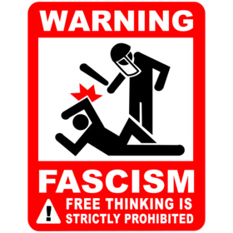
Fascism
Fascism: a system of government characterized by rigid one-party dictatorship, forcible suppression of opposition, private economic enterprise under centralized governmental control, belligerent nationalism, racism, and militarism, etc.

Slide 16
Pearl Harbor
Attack by Japan on Pearl Harbor in Hawaii
Forced the United States out of isolationism to joining the war
Isolationism= staying apart from other countries political affairs/wars

Slide 17
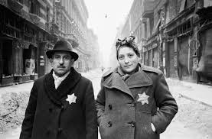
Antisemitism
Antisemitism = Hatred of the Jews

Slide 18
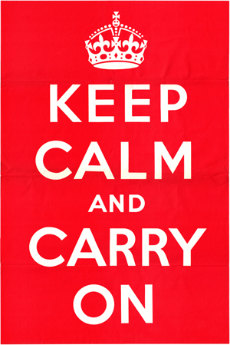
Air Raids in London
Germans bombing London and other British cities brought on this piece of propaganda ----→

Slide 19
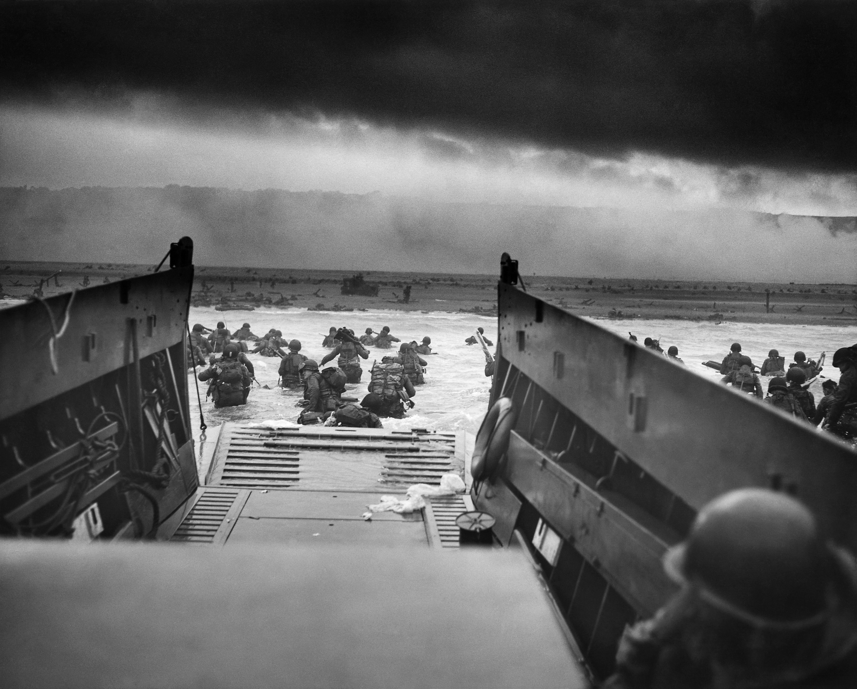
D-Day
Invasion on the beaches of Normandy France. This was a turning point in WWII.

Slide 20
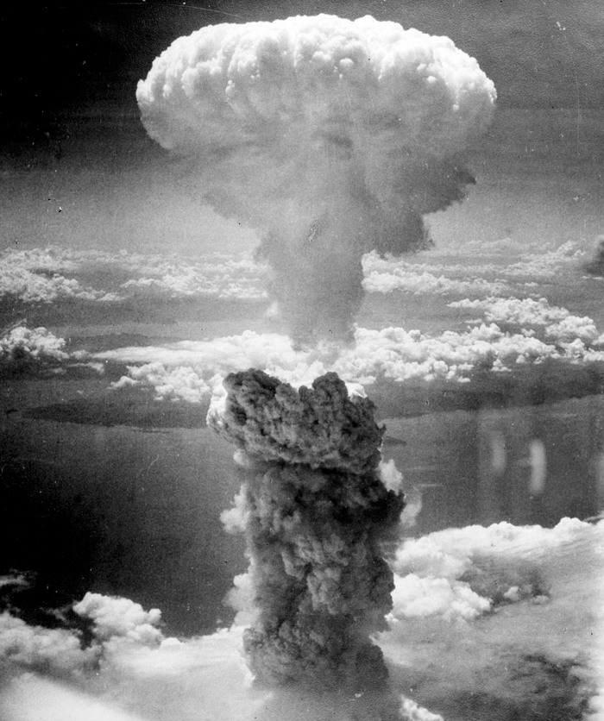
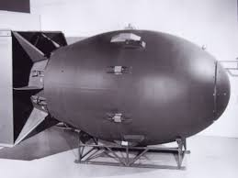
Atomic Bomb
The U.S. bombed Hiroshima (a city in Japan) to help end the war. Also in retaliation of Japan bombing Pearl Harbor
Dropping the bomb also brought about the “arms race” with the Soviet Union and brought the world into the Atomic Age
The Development of the atomic bomb was called the Manhattan Project

Slide 21
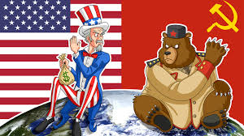
The Cold War
Political tension and military rivalry between the United States and the Soviet Union
“Cold” because no fighting actually breaks out

Slide 22
The Truman Doctine
Pledges to provide American economic and
military assistance to any nation threatened by
Communism

Slide 23
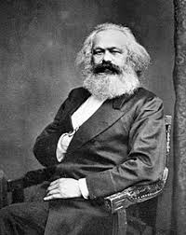
Karl Marx
German philosopher who wrote about communism

Slide 24
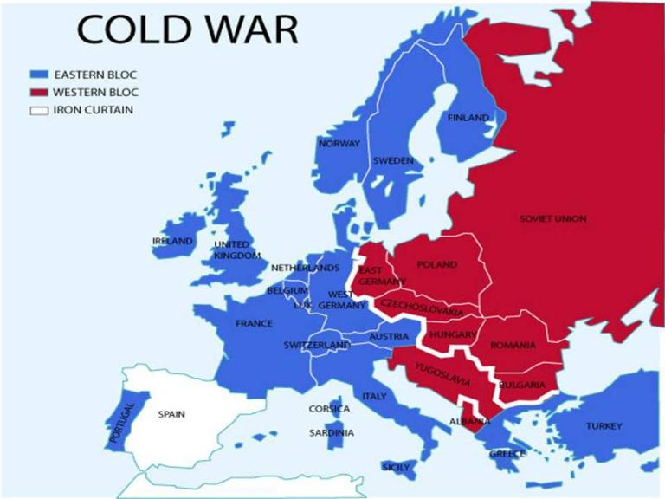
Iron Curtian
An ideological barrier that divides East (communist) and West (capitalist) Europe during the Cold War

Slide 25
Arms Race
Military buildup between the Soviet Union and the United States during the Cold War
The Space Race
A competition between the US and the Soviet Union to see who could get to the moon first

Slide 26
The Berlin Wall
A physical boundary that separated capitalist West Berlin from Communist East Berlin
Torn down in 1989

