Slide 1
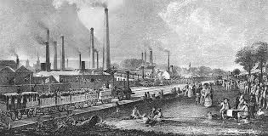
The industrial Revolution
1700-1800’s

Slide 2
What was the industrial Revolution?
A period of major industrialization that took place during the late 1700s and early 1800s.
It began in Great Britain and quickly spread throughout the world.
The mechanization of agriculture and textile manufacturing and revolution in power (steam engine, and railroads)
Had a massive effect on social, cultural, and economic conditions.

Slide 4
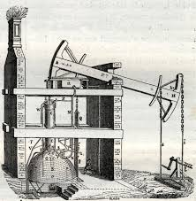
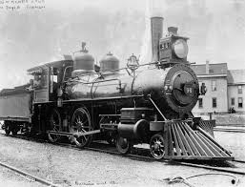
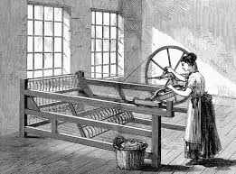
Contributions
Steam Engine
Spinning Jenny
Factories

Slide 5
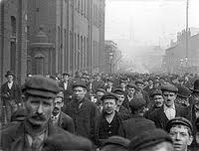
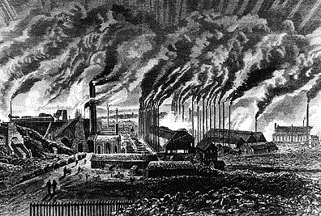
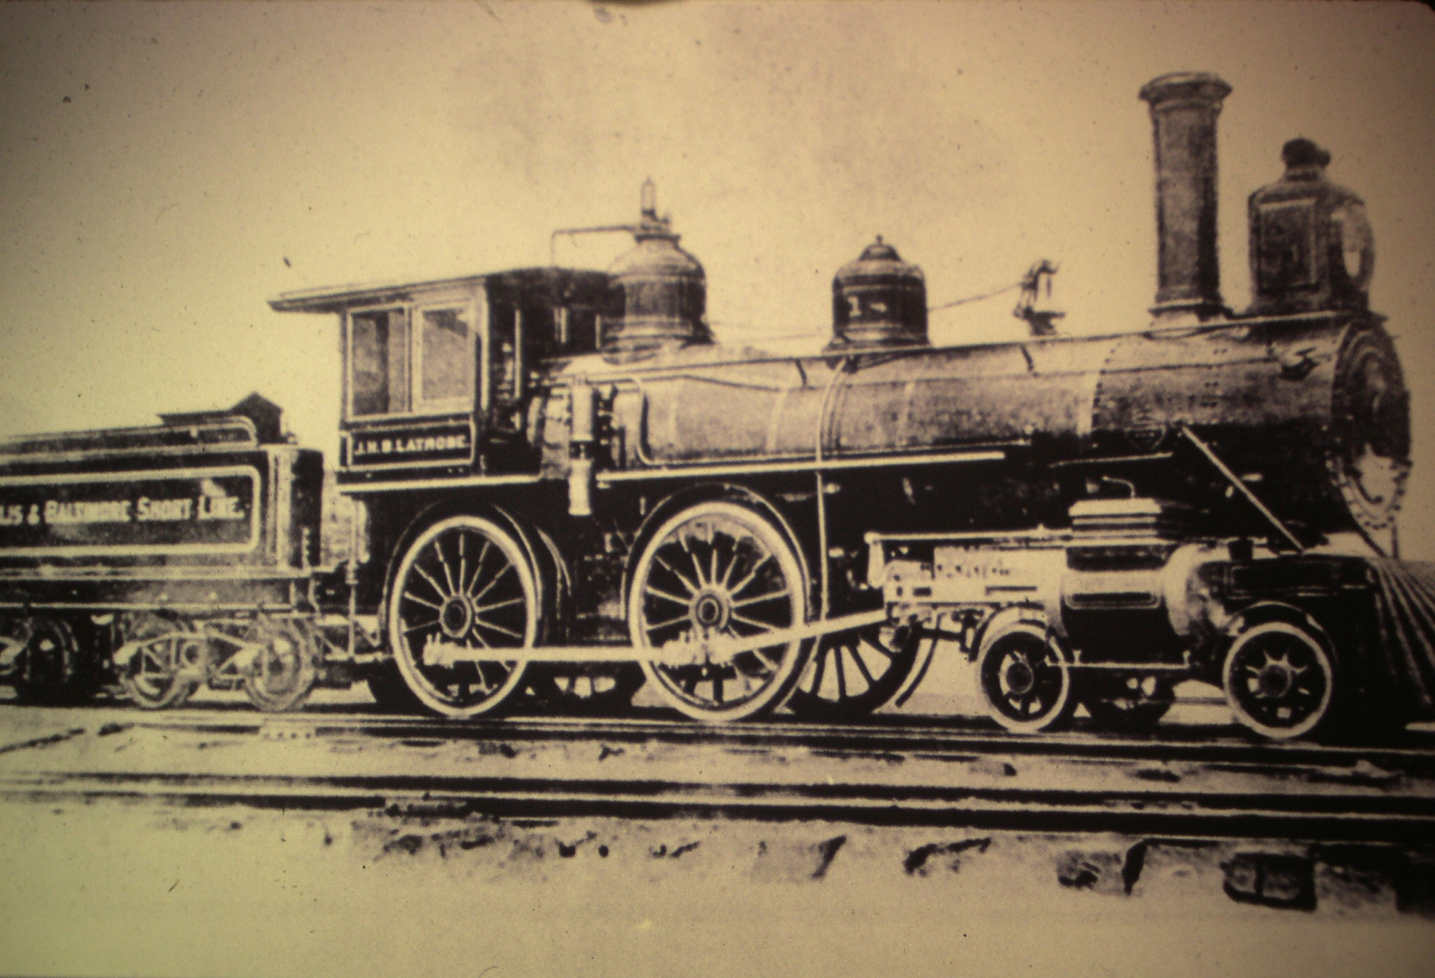
Effects of the industrial Revolution
People moved from farms to the city.
Cities became very polluted.
Inventions like the steam engine led to more transportation.

