Slide 1
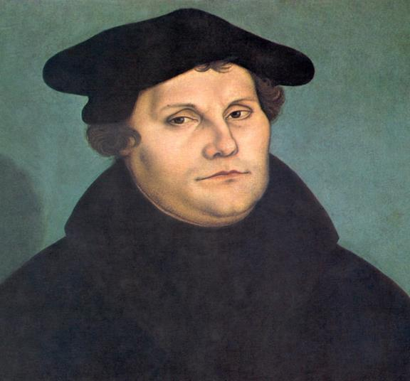
The Protestant Reformation

Slide 2
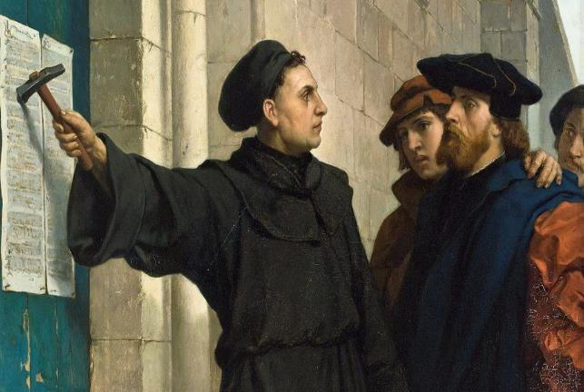
Cause: Corruption of the Catholic Church (indulgences = paying to be forgiven of sin)
Effect: Martin Luther writes
95 Thesis
Notes:
Sale of Indulgences-Leo X wants to build St. Peters Basilica so he gives Bishop Tetzel authority over the sale of indulgences
1517

Slide 3
Diet of Worms
Diet=Parliament
Worms=German City
Martin Luther is put on Trial
“I cannot and will not recant anything for it is neither safe nor right to go against conscience. God help me. Amen.”
German prince hides Martin Luther…so begins the protestant reformation
Notes:
Luther is called to recant his statement or be excommunicated
Edict of worms prevents anyone from helping Martin Luther
1521

Slide 5
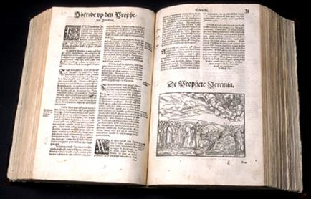
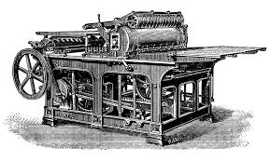
Cause: Gutenburg invents the Printing Press
Effect: The Bible is translated. Spread of Martin Luther’s work. And literacy improves
Notes:
Luther translates the bible into the vernacular. Now everyone can read it. The printing press facilitates the spread of ideas.

Slide 7
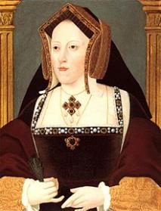
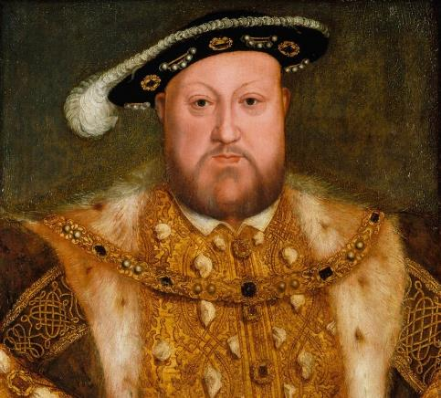
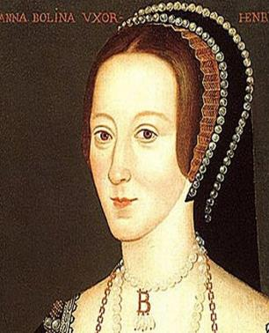
Cause: Henry VIII wants a divorce
Effect: The Church of England is created
Notes:
England joins the reformation
1529

Slide 9
