Slide 1
Roman Contributions

Slide 2
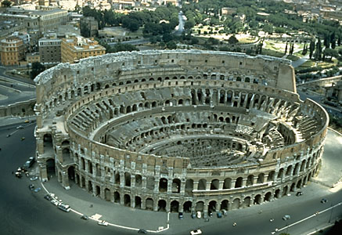
Contributions
Coliseum
Aqueducts
Arches
Roads
WHO BUILT ALL THESE THINGS?

Slide 3
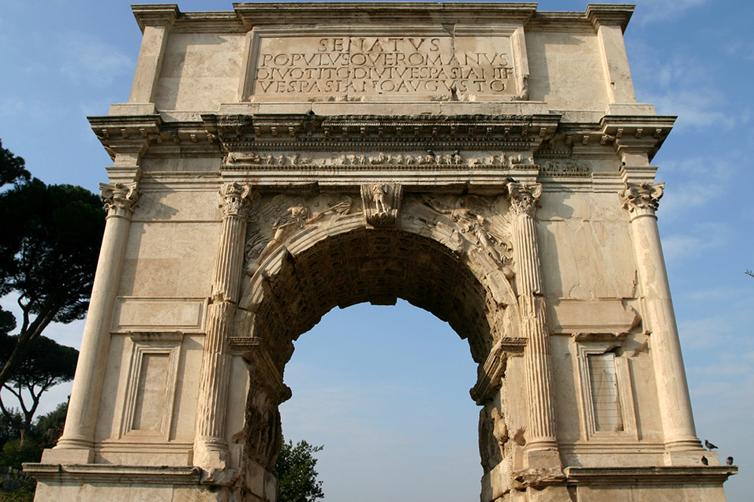
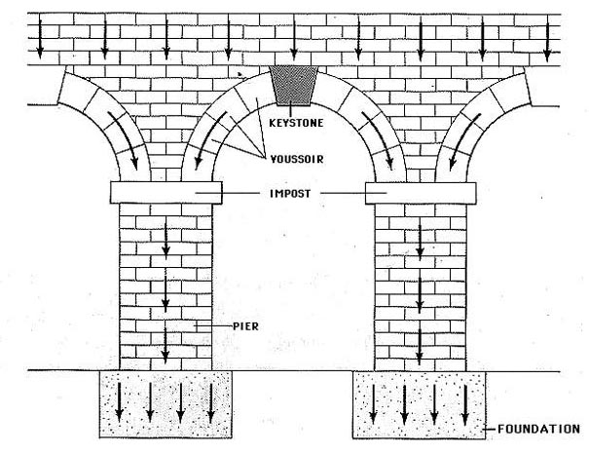
Arches
concrete

Slide 4
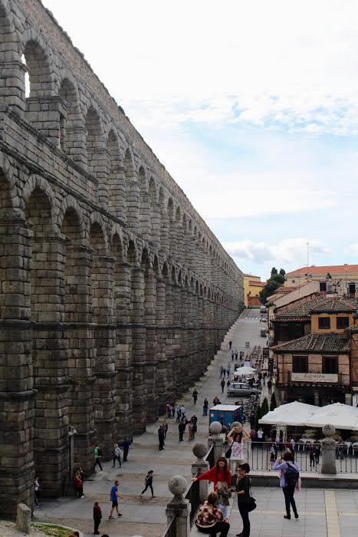
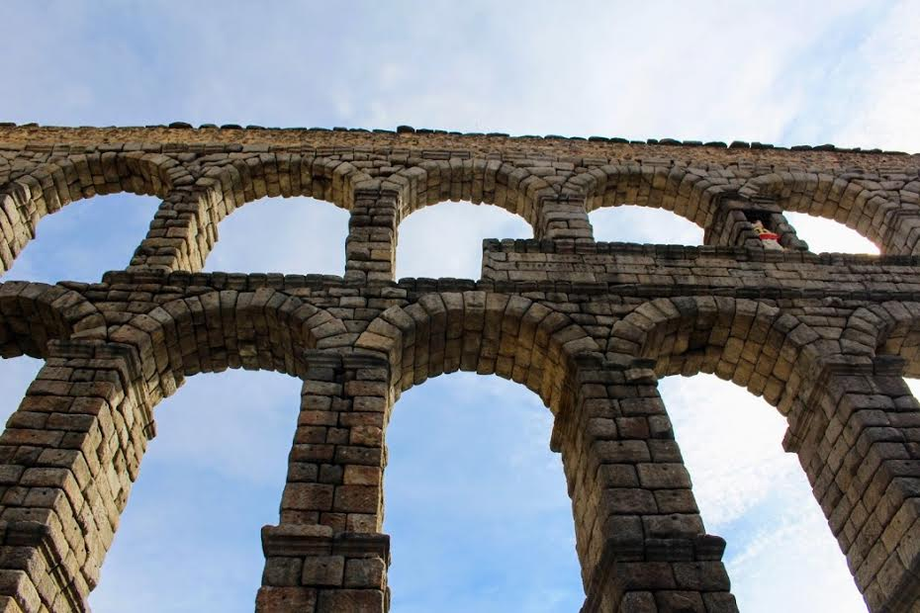
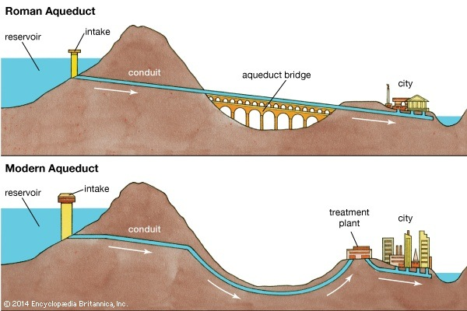
Aqueducts

Slide 5
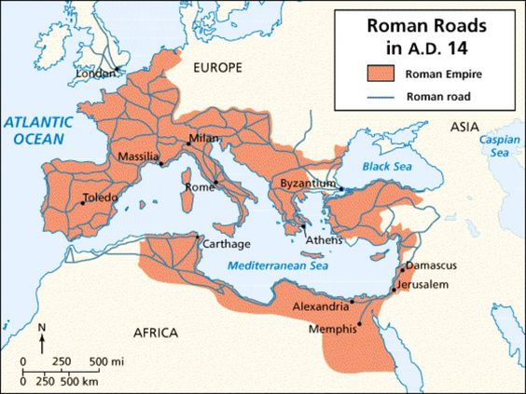
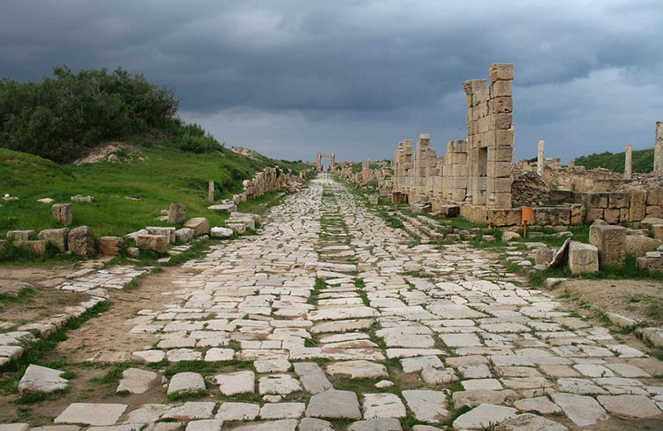
“All roads lead to Rome”

Slide 6
THE FALL OF ROME

Slide 7
Why do you think Rome fell?

Slide 8
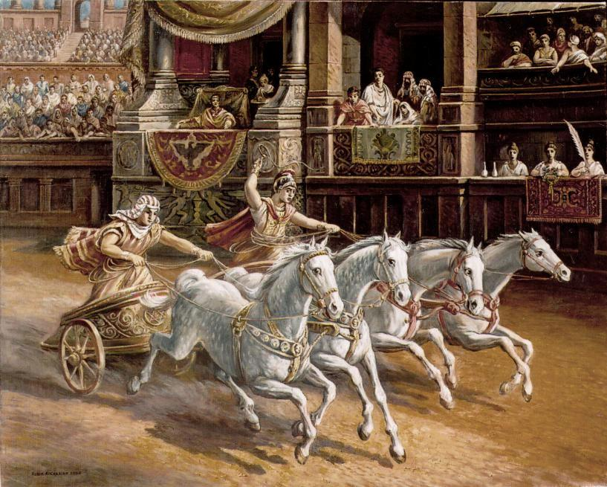
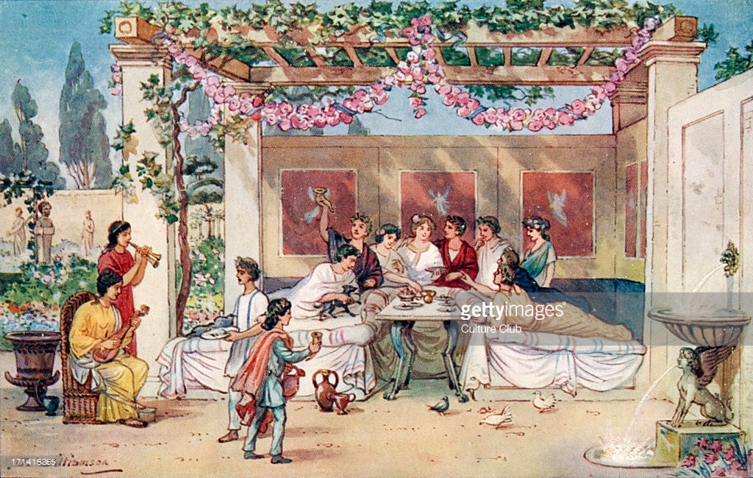
Evolution of Roman Culture
.

Slide 9
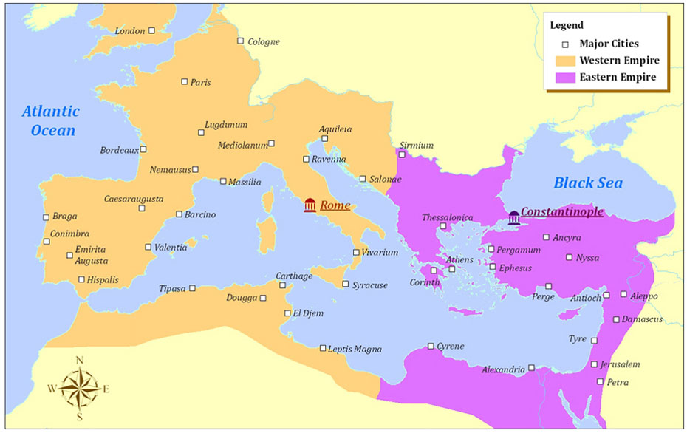
Split of the Empire

Slide 10
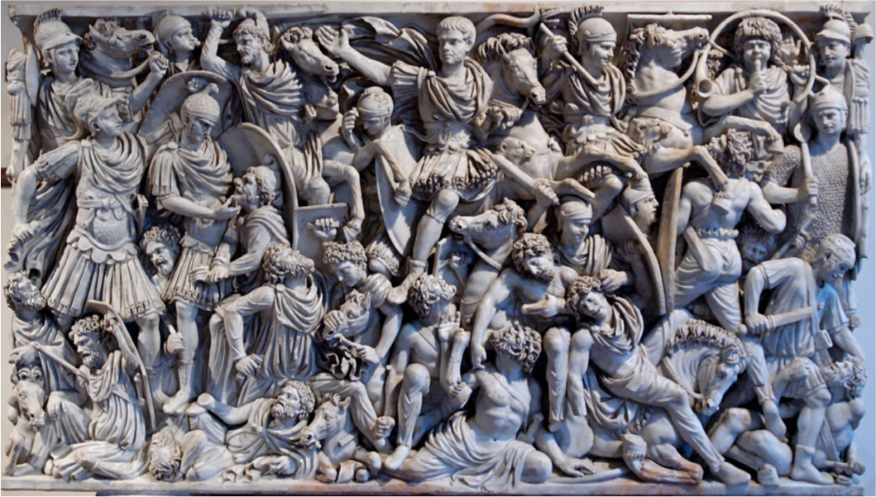
Challenges facing Rome:
Invaders
Actually had to hire barbarians to protect them from invading barbarians.
Weak economy
Civil Wars/Power struggles
Corrupt rulers
No loyalty in the army.
Lost focus on education

Slide 12
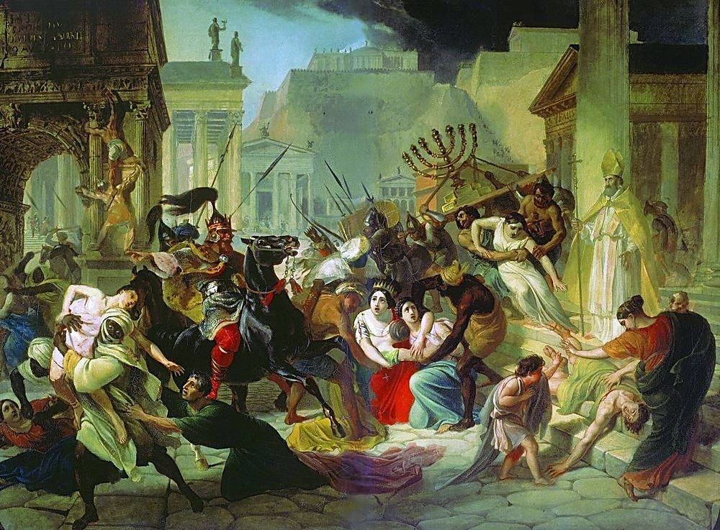
Sack of Rome
Vandals, Visigoths, Huns, Ostrogoths.
Destroyed libraries = ?
Loss of technology/inventions and information.
What did that mean for the future?
#darkages

