Slide 1
GREECE

Slide 2
https://www.youtube.com/watch?v=RRq7lLawQB4
https://www.youtube.com/watch?v=Eh3kwtjbc_M

Slide 3
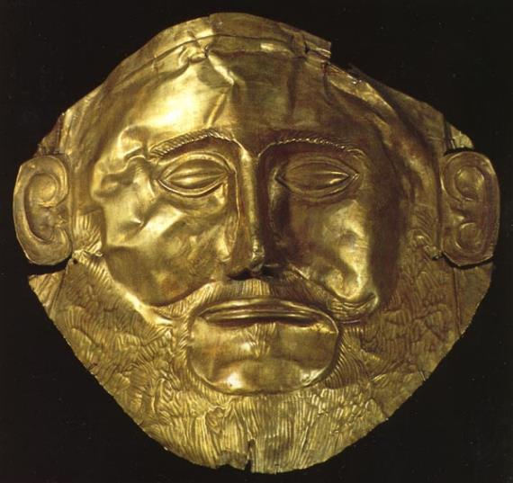
How did Greece come to be?

Slide 4
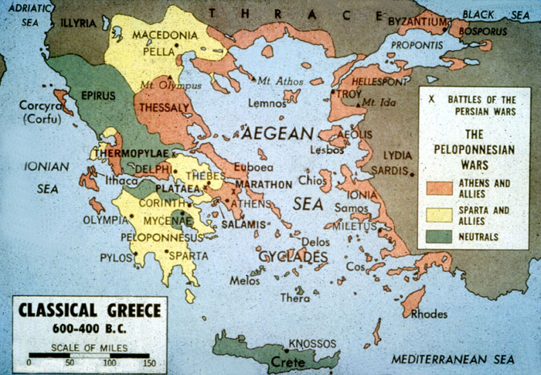
Notes:
Rocky soil
Trade
Did a lot of stuff outside because of mild climate.

Slide 5
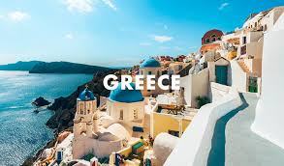
Mediterranean Climate

Slide 6
Athens
One of the first City-States in the
world. It was and is at the heart
of Greece.

Slide 7
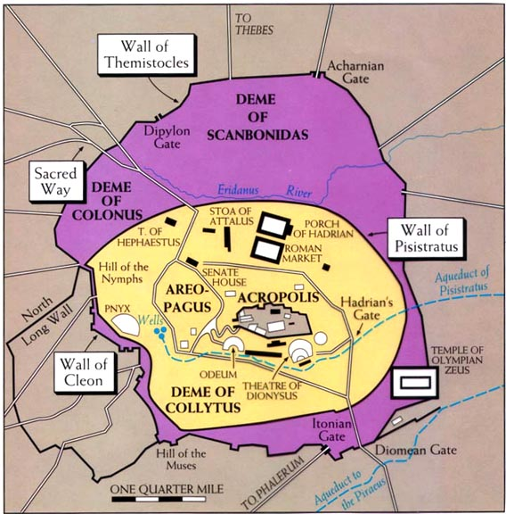

Slide 8
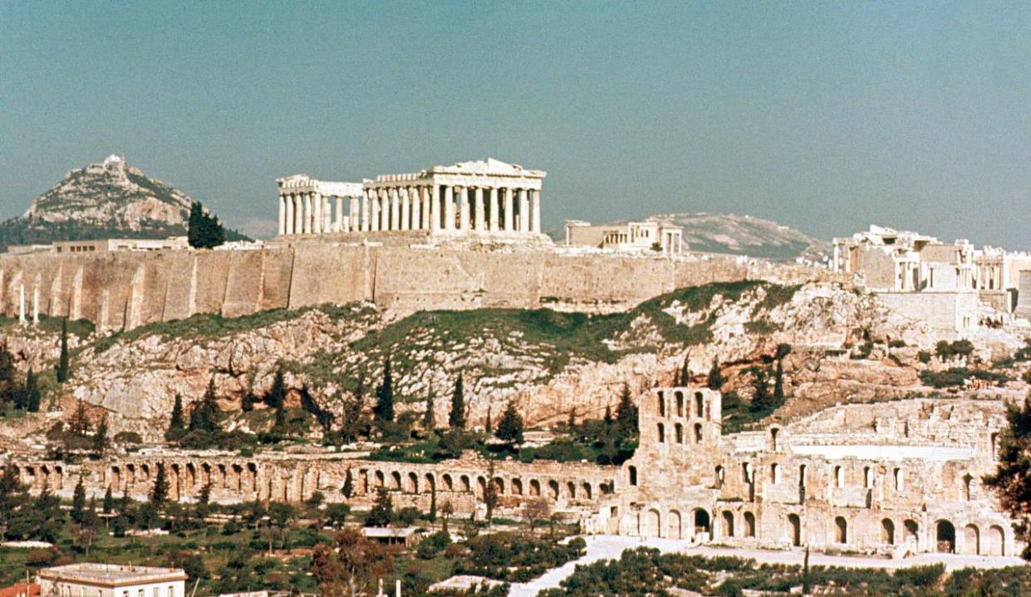

Slide 9
Athens was a place of thought, architecture,
and democracy.
Some of the greatest thinkers in
the history of the world taught there.
Only wealthy boys were educated.
They were taught arithmetic, reading,
writing, and philosophy. Any student
who misbehaved was beaten by a slave
their father hired called a paedogogus.

Slide 10
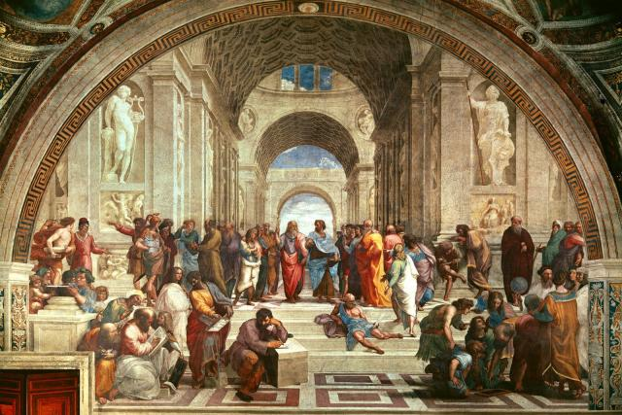
THE SCHOOL OF ATHENS

Slide 11
The Greek Philosophers created
the ideas Western Civilization
is based on.
1. Natural Laws govern the universe.
2. Man exploits those natural laws for
his own use.
3. Human life has value.

Slide 12
Man is the Measure of all things
It is usually interpreted to mean that the individual human being, rather than a god or an unchanging moral law, is the ultimate source of value.
In other words, Man creates value because he exists. This means each individual Man is what is most important in this world. Man creates what is of value on this earth through what he does.

Slide 13
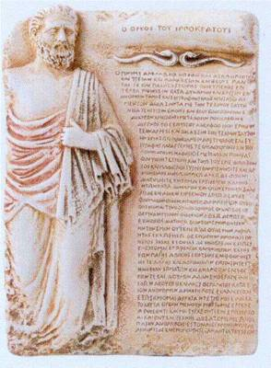
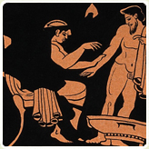
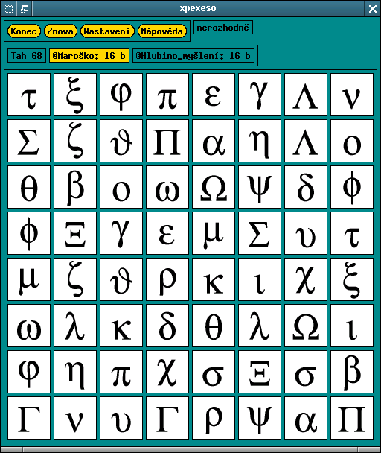
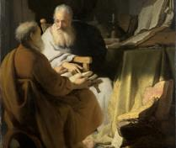
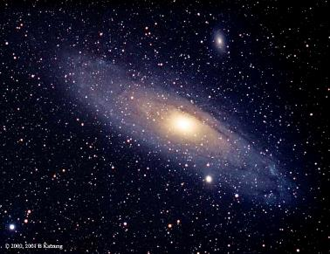
Medicine
Math
Hippocratic Oath
Astronomy
Science

Slide 14
Socrates was the first of these three thinkers.
He was sentenced to death for encouraging
young people to think for themselves.
Plato was the greatest writer of the three.
He put down on paper all that Socrates had
taught and many of his own ideas.
He established the “Academy in Athens”
Aristotle was Plato’s student. He then went on
to become the teacher of Alexander the Great.

Slide 15
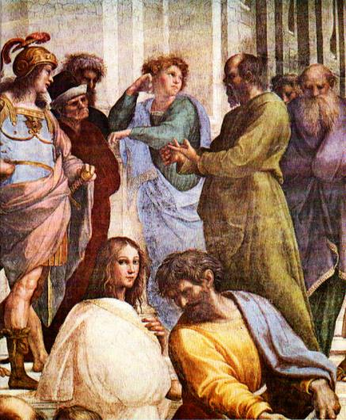
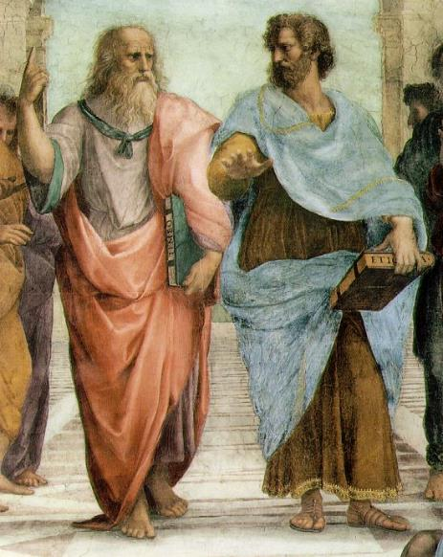
PLATO & ARISTOTLE
SOCRATES

Slide 16
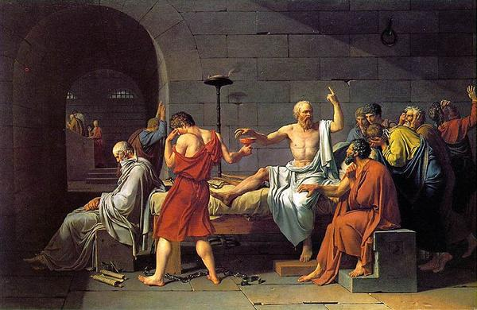

Slide 17
Athens also became the first place
on Earth to ever have a Democracy
In this government, every citizen voted for
every law. They had to vote or else they
were put in jail.
People were elected to positions in the
Government, but they were temporary
and no one styed in power for more
than a few years.

Slide 18
In this democracy, all citizens had to vote.
You had to be a male, over the age of 18,
and own land to be a
citizen of Athens.
Slaves, women, and
foreigners could not vote.

Slide 20
Sparta
The Spartan people were focused on war
and gaining more land and slaves. They
often fought against Athens and other
Greek city-states.
Due to their war-like focus, Sparta no longer exists.

Slide 21
The Spartans trained little boys (ages 4-7) to
become soldiers. No one was a coward
in battle or they were humiliated for
the rest of their life.
Only when they retired at about age 30 from
the military could they get married.
Slaves were used to run the fields
so that Spartans could train for war.

Slide 22
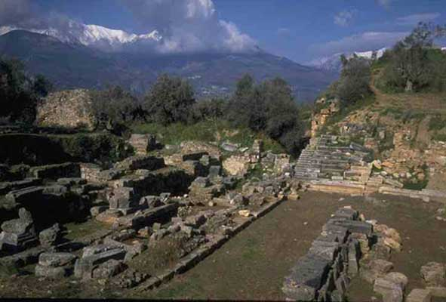

Slide 23
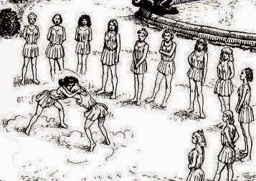
Women in Sparta
Fighting
Physically strong
Bear strong children.

Slide 24
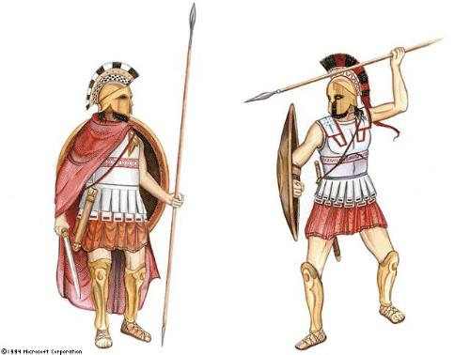
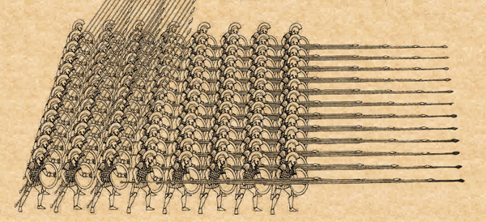
PHALANX

Slide 25
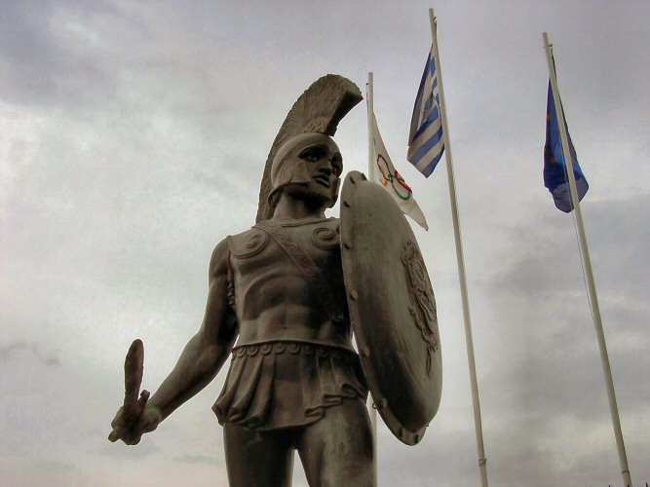

Slide 26
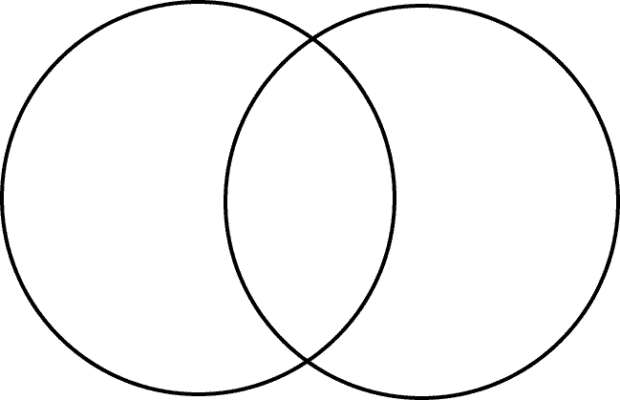
Compare Contrast Activity

Slide 27
Greek Contributions -architecture -art -mythology -theatre -Olympics

Slide 28
Athens is the beginning of fine art, and the idea of arts or arts sake. Art and architecture played a major role in Athenian society.
Architects and artists today still look at their works in wonder.

Slide 29
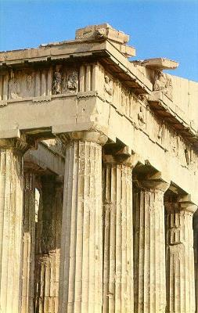
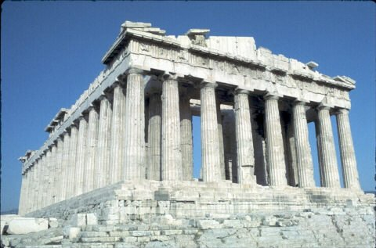
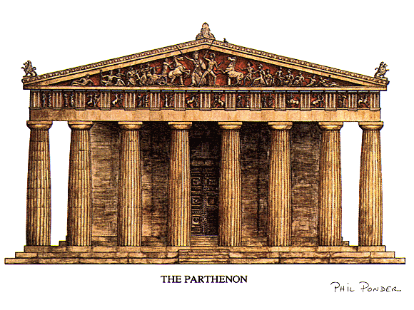
THE
PARTHENON

Slide 30
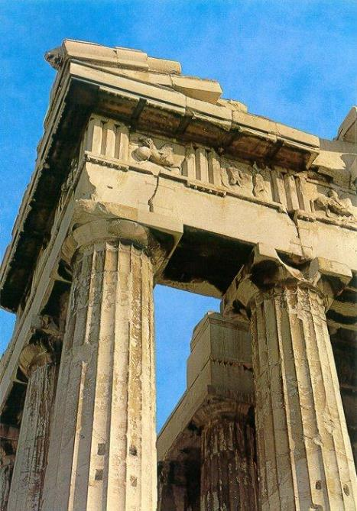
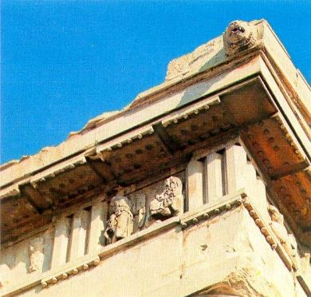
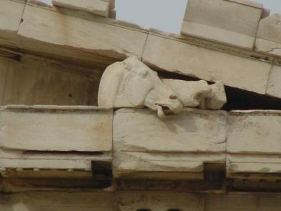

Slide 31
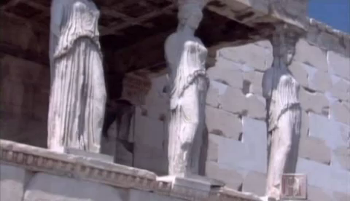

Slide 32
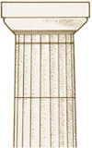
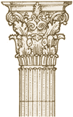
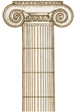
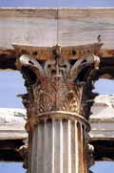
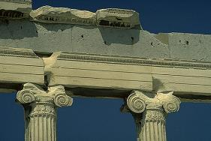
Architecture
Doric Ionic Corinthian

Slide 33
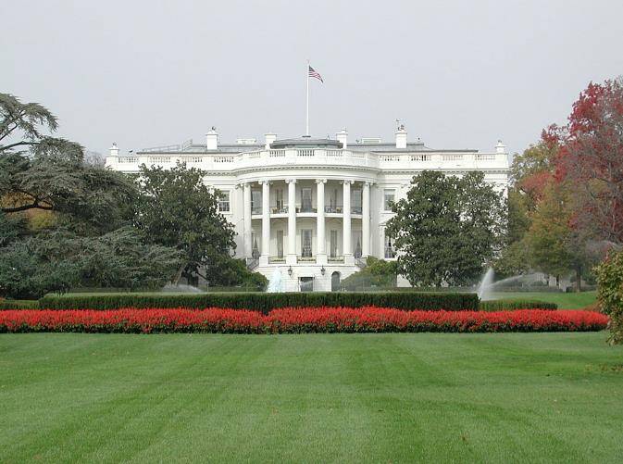
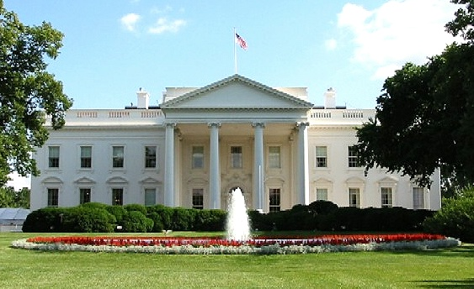
The White House

Slide 34
The Greeks were very fond of
immortalizing important people
in marble. But since the Greeks
believed in the beauty of humans,
they were almost all done in the nude.

Slide 35
Greek Contributions
Athens battles invading Persians in 490 BC
Army meets the Persians in Marathon, 26 miles from Athens
After Greek victory, soldier runs back to Athens to tell the outcome
Nikomen!
We are victorious!
Nike

Slide 36
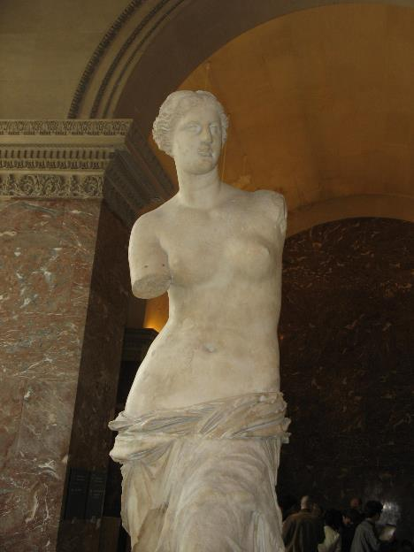
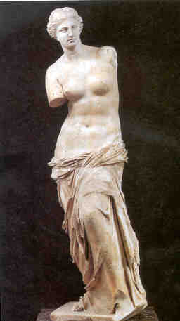
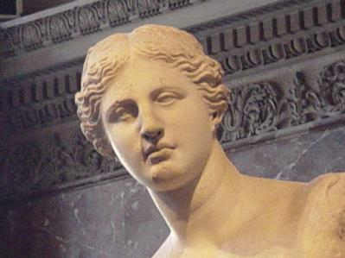
VENUS DE MILO

Slide 37
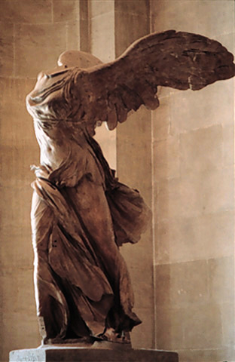
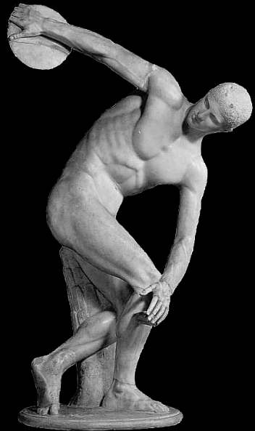
Nike of Samothrace
Discobolus (Discus Thrower)

Slide 38
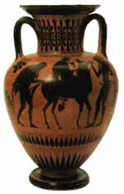
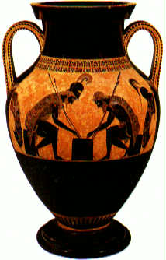
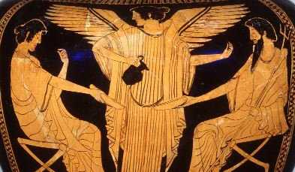
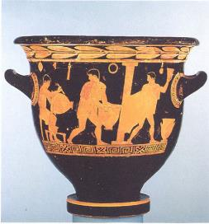
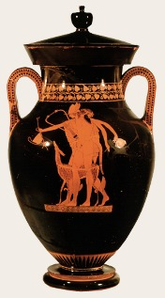
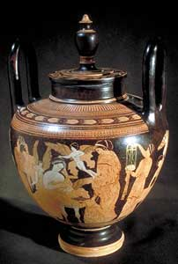
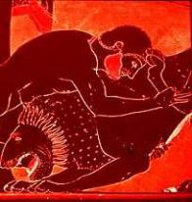
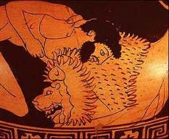
GREEK POTTERY

Slide 39
The GREEK Gods

Slide 40
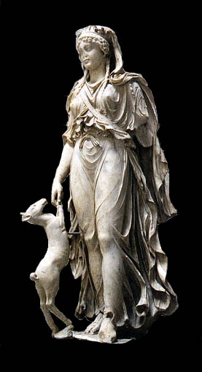
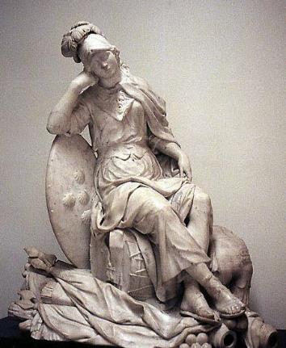
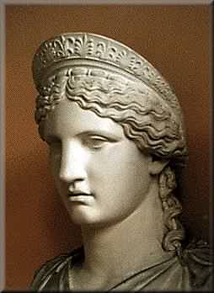
Hera
Athena
Artemis

Slide 41
Hermes
Zeus
Poseidon

Slide 42
GREEK
THEATER

Slide 43
The Olympic
Games
Boxing
Pankration

Slide 44
PAST
OLYMPICS

Slide 45
The Olympics Today

Slide 46
Peloponnesian War
Sparta (and other city-states) VS Athens--- 30 years

Slide 48
Alexander the Great
356-323 BC
Son of Phillip of Macedonia, who conquered Greece
Became King at age 16
Expands Greek territory and culture from Egypt to India
Founded 20 cities named after him including Alexandria in Egypt
Dies in Babylon

Slide 50
Alexander the Great dies
Alexander’s Kingdom divides
Rome Rises.

