Slide 1
“Beauty is in the eye of the beholder.”

Slide 2
“Beauty is pain.”

Slide 3
What things have people done to make themselves “beautiful” that are also painful? Why??

Slide 4
Maya Dental Mutilation

Slide 5
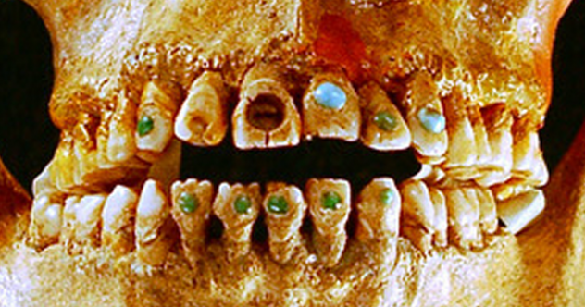
Jose C. Jimenez Lopez, Forsyth Gallery, Texas A&M. https://forsythgalleries.wordpress.com/tag/art-spotted/
Late Classic Maya (700-900 AD)

Slide 6
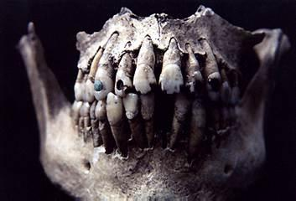
University of Minnesota Duluth
http://www.d.umn.edu/cla/faculty/troufs/anth1602/pcdentistry.html

Slide 7
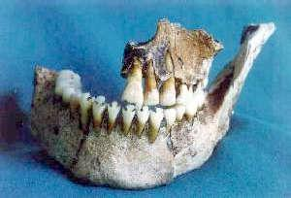
Ambergris Museum, Ambergris Caye, Belize
http://www.sanpedrosun.com/old/mayajaw.html

Slide 8
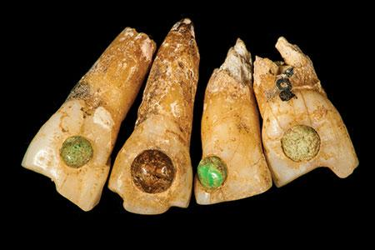
Photo © President and Fellows of Harvard College, Peabody Museum of Archaeology and Ethnology, 10-71-20/C7679, 98600128

Slide 9
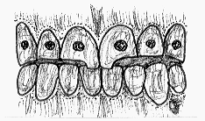
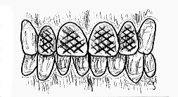
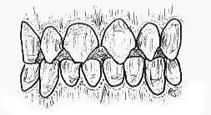
Types of Dental Mutilation
Inlaid
Crosshatched
Filed
http://www.uic.edu/classes/osci/osci590/6_1TheCulturalModificationOfTeeth.htm

Slide 10
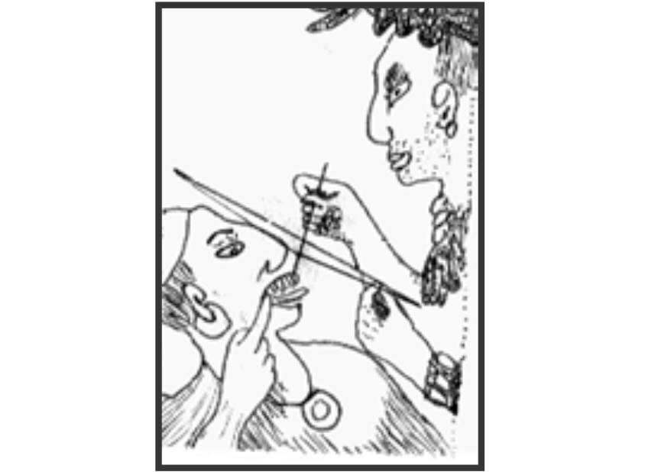
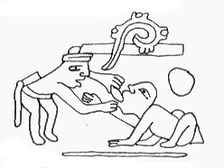
Methods of Dental Mutilation
http://www.uic.edu/classes/osci/osci590/6_1TheCulturalModificationOfTeeth.htm

Slide 11
“Clues to Mayan Prosperity” by
National Geographic
http://education.nationalgeographic.com/education/media/clues-mayan-prosperity/?ar_a=1

Slide 13
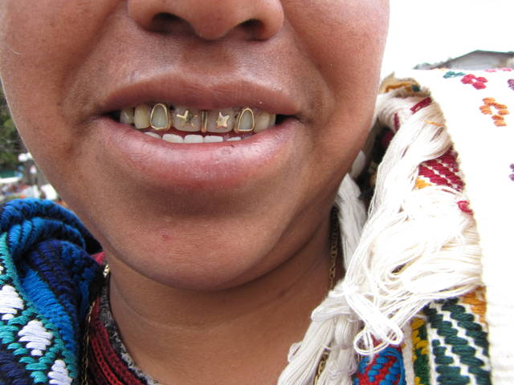

Slide 14
