Slide 1
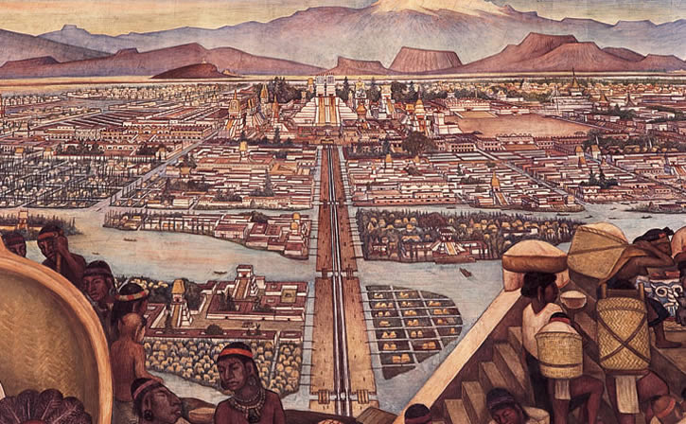
The Aztec

Slide 3
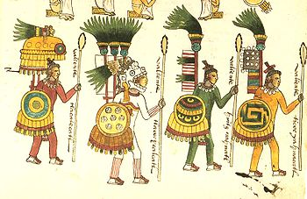
The Aztecs Rise to Power
War was the key factor in the Aztecs’ rise to power. All men at age 15 were conscripted for military service
The Aztecs built alliances, or partnerships, to build their empire.
The Aztecs made the people they conquered pay tribute, or give them cotton, gold, or food.

Slide 4
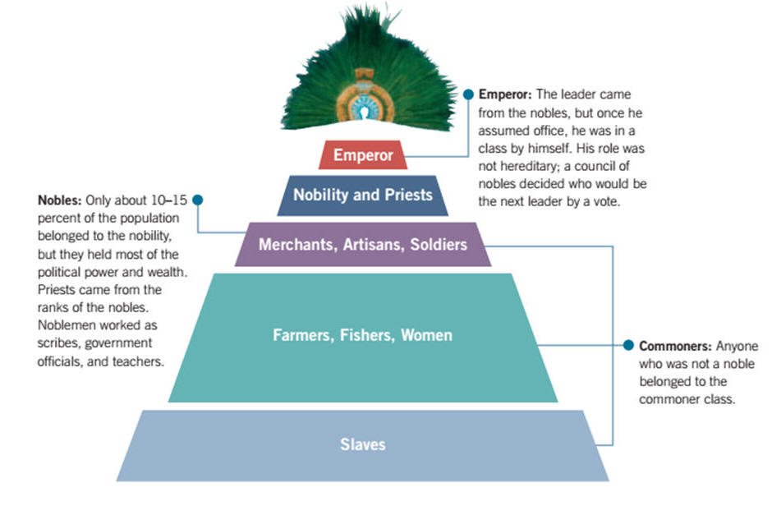
Aztec Society
People in Aztec society had clearly defined roles. These roles, along with social class, determined how Aztec men and women lived. They had four distinct social classes.
Kings and nobles
Priests and warriors
Merchants and artisans
Farmers and slaves

Slide 5
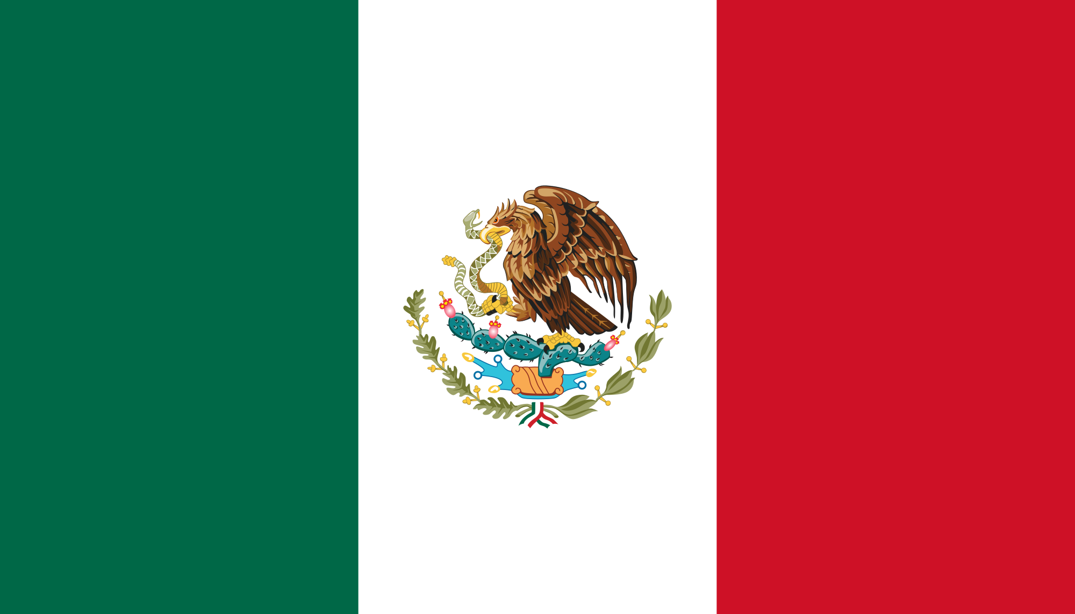

Slide 6
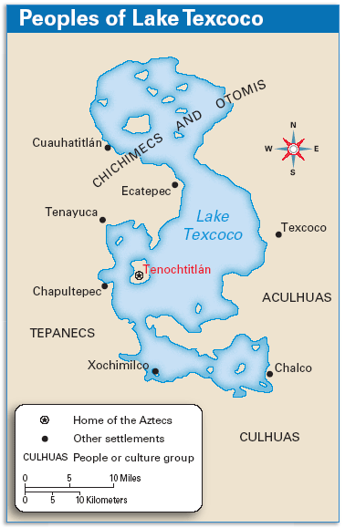
Tenochtitlán
Tenochtitlán was the capital of the Aztec Empire. It was built in the middle of a lake, on an island.
The Aztecs built causeways, or raised roads across water or wet ground, so people could access the city.
The Aztecs built stone canals to bring water to the city and floating gardens to raise food and flowers.
Tenochtitlan even had a university. Sons of nobility studied in schools from books the Spanish called codex

Slide 7
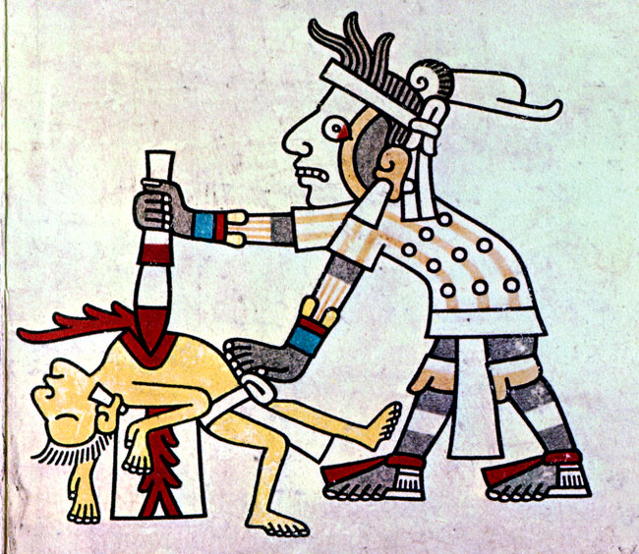
Sacrifices
The Aztecs believed that keeping the gods happy meant that their lives would be blessed.
The greatest number of sacrifices were made to the war god and the rain god.
Priests led the sacrificial rituals, which took place on top of the temples that had been built.
Humans were sacrificed because it was believed that the human hearts and blood would “feed” the gods and keep them strong. Most sacrifices were enemy warriors.
Aztec priests sacrificed as many as 10,000 victims a year in religious sacrifices.

Slide 8
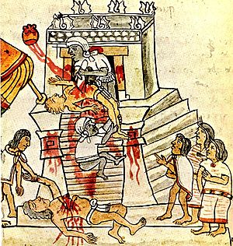

Slide 9
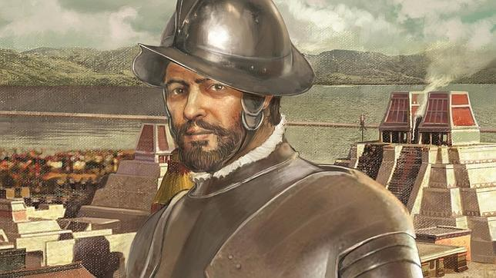
Hernan Cortez
In the late 1400s Spanish explorers and soldiers arrived in the Americas. The soldiers, or conquistadors, came to explore new lands, search for gold, and spread the Catholic religion.

Slide 10
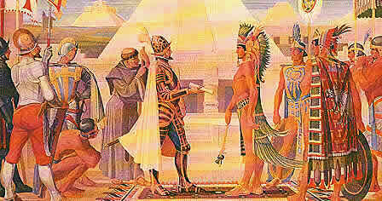
Cortés and Moctezuma
A small group of conquistadors led by Cortés reached Mexico in 1519.

Slide 11
The Fall of the Aztec Empire
Alliances The Spanish had made allies in the region who gave them supplies, information, and warriors.
Weapons The Spanish had better weapons than the Aztecs. They had cannons, armor, swords, and horses that the Aztecs did not have.
Geography The Spanish were able to cut off the capital city. The people had no food or water, so many Aztecs died of starvation.
Disease The Spanish had unknowingly brought deadly diseases such as smallpox to the Americas. These diseases killed the Aztecs, who had never been exposed to such diseases.

Slide 12
Aztec
CENTRAL mexico
Conquered by cortez
Human sacrifice
Sons of nobility studied in schools from books the Spanish called codex
Grew wealthy how?
How did the Spanish defeat the Aztec?
island in the middle of the lake city. Lake texicoco?—Tenochitlan?
Conscripted all adult males to fight.
Aztec was an empire meaning they controlled a lot of people who didn’t like the Aztec.
Spanish… we should kill them cause they do sacrifices. Or its just their culture.

