Slide 1
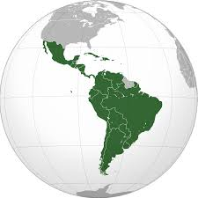
Latin America
An Overview

Slide 2
Where is Latin America?
Latin America is made of up three areas.
-Middle America. (Mexico and Central America)
-Caribbean
-South America

Slide 3
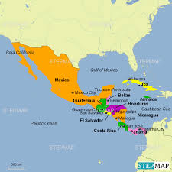
Middle America

Slide 4
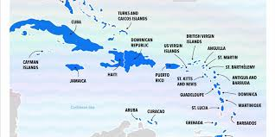
Caribbean

Slide 5
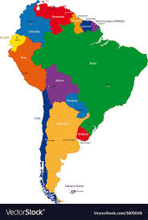
South America

Slide 6
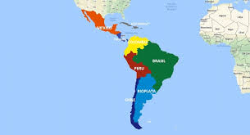
What Makes Latin America a Region?
***Remember we are looking for characteristics the areas of Latin America HAVE IN COMMON.

Slide 7
Is latin AMerica a Region because the areas have a similar Climate?
Lets see…

Slide 8
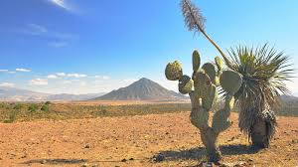
Mexico

Slide 9
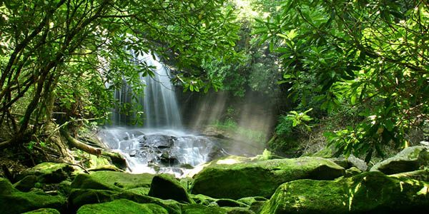
Brazil

Slide 10
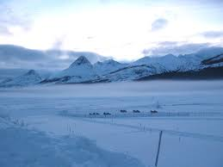
Argentina

Slide 11
No -- Latin America is Not a region because of the climate or Vegetation.
Then what makes latin America a region????

Slide 12
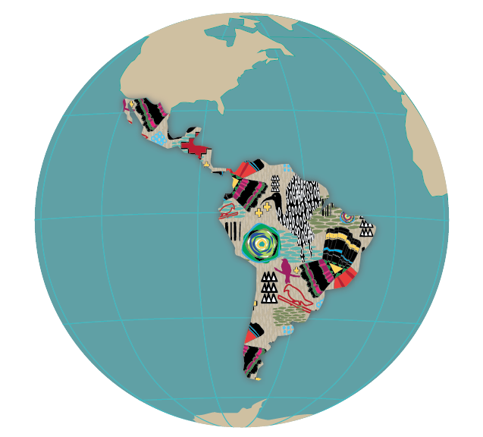
If not climate, Vegetation or Physical Features it Must Be… CULTURE!!!
Remember with such a large area these are general characteristics. There will be much variation within Latin America.

Slide 13
Latin America --- language
The region is called LATIN America because of the main Languages spoken there are based on LATIN.
-Spanish
-French
-Portuguese

Slide 14
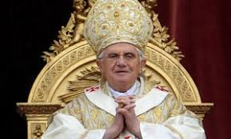
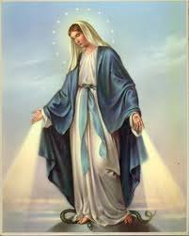
2. Religion
90% of the people in Latin America are Roman Catholic.

Slide 15
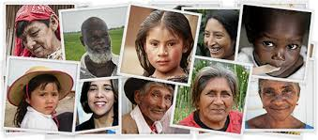
3. Similar Ethnicity
-The people of Latin America are a mixture of native, European, and African people.

Slide 16
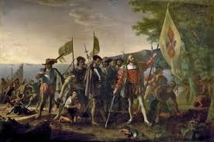
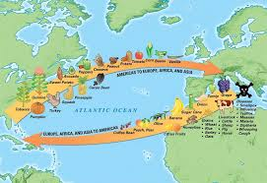
4. Latin America shares COLONIAL HISTORY
-Every place in Latin America was or is a European colony.

Slide 17
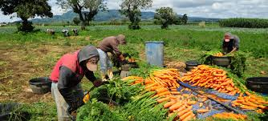
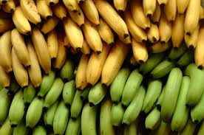
5. The EConomy
-The economy of most latin american countries is based on AGRICULTURE and/or exporting raw materials

Slide 18
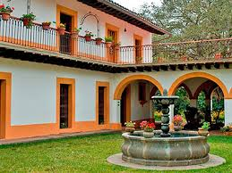
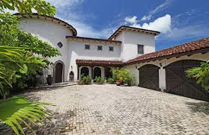
6. Land use and ownership
-Traditionally the land was owned by a few wealthy families who created large estates.

Slide 19
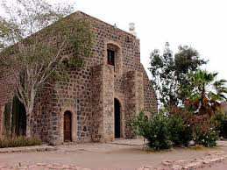
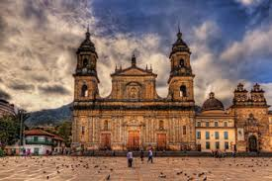
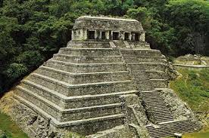
7. Art and architecture
There are 3 main styles of architechture.
1. Mission
2. Baroque
3. Native

Slide 20
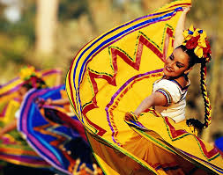
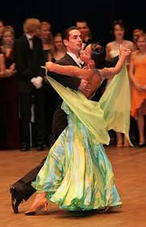
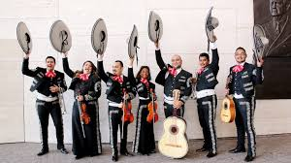
8. Latin Music and Dance!
-Tango
-Mariachi
-Rumba
-Salsa

